Slide 1
NAÏVE BAYES CLASSIFICATION
Notes:
Speaker: Myschan

Slide 2
Classification Methods
Manual: Accurate, but difficult/expensive to scale. Done at the beginning of the web by Yahoo
Rule-Based :Accurate, but requires constant rule updating/maintaining by subject matter experts. Used within Google Alerts.
Statistical: Still requires some manual classification to train, however can be done by non-experts. Used by Google to detect Spam.
Our presentation will focus on Statistical Classification

Slide 3
QUESTION
What is a drawback of Manual Classification Method?
Notes:
Speaker: Myschan

Slide 4
THINGS WE’D LIKE TO DO
Spam Classification
Given an email, predict whether it is spam or not
Medical Diagnosis
Given a list of symptoms, predict whether a patient has disease X or not
Weather
Based on temperature, humidity, etc predict if it will rain tomorrow
Notes:
Speaker: Myschan

Slide 5
BAYESIAN CLASSIFICATION
Problem statement:
Given features X1,X2,…,Xn
Predict a label Y
A good strategy is to predict:
(for example: what is the probability that the image represents a 5 given its pixels?)
Notes:
Speaker: Myschan

Slide 6
QUESTION
What kind of classification will we use for Spam classification?
Notes:
Speaker: Myschan

Slide 7
THE BAYES CLASSIFIER
Use Bayes Rule!
Likelihood-Probability of Y, given X1,...,Xn
Prior-Probability of Y
Normalization Constant-Probability of X1,...,Xn
Likelihood
Prior
Normalization Constant
Notes:
Speaker: Amal

Slide 8
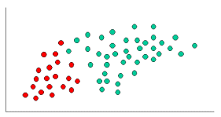
Naive Bayes Classifier
We need to find out Posterior Probability
of any random dot added in a following graph
dot being red or green. That is where the
formula would be useful.

Slide 9
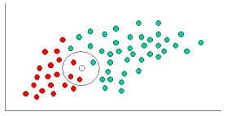
Question
Which color does the white
dot belong to according to
Bayesian Classifier?

Slide 10
THE NAÏVE BAYES MODEL
The Naïve Bayes Assumption: Assume that all features are independent given the class label Y
In effect, Naive Bayes reduces a high-dimensional density estimation task to a one-dimensional kernel density estimation.
it does simplify the classification task dramatically, since it allows the class conditional densities to be calculated separately for each variable.
Notes:
Speaker: Amal

Slide 11
QUESTION
In Naïve Bayes assumption, the feature should be dependent or independent?
Notes:
Speaker: Amal

Slide 12
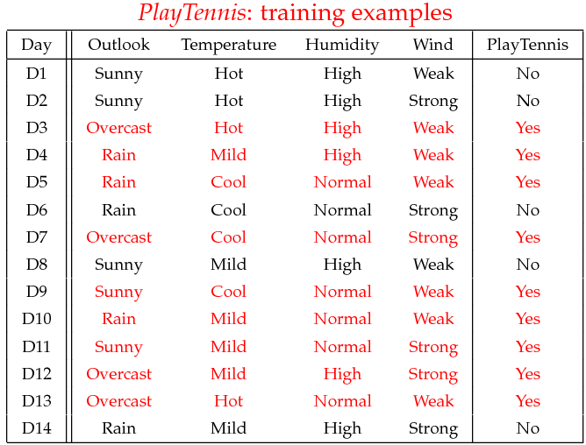
EXAMPLE
Example: Play Tennis
12
Notes:
Speaker: Shailaja

Slide 13
EXAMPLE
Learning Phase
Outlook | Play=Yes | Play=No
Sunny | 2/9 | 3/5
Overcast | 4/9 | 0/5
Rain | 3/9 | 2/5
Temperature | Play=Yes | Play=No
Hot | 2/9 | 2/5
Mild | 4/9 | 2/5
Cool | 3/9 | 1/5
Humidity | Play=Yes | Play=No
High | 3/9 | 4/5
Normal | 6/9 | 1/5
Wind | Play=Yes | Play=No
Strong | 3/9 | 3/5
Weak | 6/9 | 2/5
P(Play=Yes) = 9/14
P(Play=No) = 5/14
13

Slide 14
EXAMPLE
Test Phase
Given a new instance, predict its label
x’=(Outlook=Sunny, Temperature=Cool, Humidity=High, Wind=Strong)
Look up tables achieved in the learning phrase
P(Outlook=Sunny|Play=Yes) = 2/9
P(Temperature=Cool|Play=Yes) = 3/9
P(Huminity=High|Play=Yes) = 3/9
P(Wind=Strong|Play=Yes) = 3/9
P(Play=Yes) = 9/14
P(Outlook=Sunny|Play=No) = 3/5
P(Temperature=Cool|Play==No) = 1/5
P(Huminity=High|Play=No) = 4/5
P(Wind=Strong|Play=No) = 3/5
P(Play=No) = 5/14
P(Yes|x’) ≈ [P(Sunny|Yes)P(Cool|Yes)P(High|Yes)P(Strong|Yes)]P(Play=Yes) = 0.0053
P(No|x’) ≈ [P(Sunny|No) P(Cool|No)P(High|No)P(Strong|No)]P(Play=No) = 0.0206
Given the fact P(Yes|x’) < P(No|x’), we label x’ to be “No”.
14
Notes:
Speaker: Shailaja

Slide 15
QUESTION
What type of classification were being done in the previous example? Binary or Multiclass Classification?
Notes:
Speaker: Shailaja

Slide 16
Applications
Real time Prediction: Naive Bayes is an eager learning classifier and it is sure fast. Thus, it could be used for making predictions in real time.
Multi class Prediction: This algorithm is also well known for multi class prediction feature. Here we can predict the probability of multiple classes of target variable.
Recommendation System: Naive Bayes Classifier and Collaborative Filtering together builds a Recommendation System that uses machine learning and data mining techniques to filter unseen information and predict whether a user would like a given resource or not.

Slide 17
DEFINITION OF TEXT CLASSIFICATION: TRAINING
Given: A document space X
Documents are represented in this space – typically some type of high-dimensional space.
A fixed set of classes C = {c₁, c₂, . . . , c_{J} }
The classes are human-defined for the needs of an application (e.g., spam vs. non spam).
A training set D of labelled documents. Each labelled document (d , c) ∈ X × C
Using a learning method or learning algorithm, we then wish to learn a classifier γ that maps documents to classes:
γ : X → C

Slide 18
QUESTION
What is required to map documents to classes?

Slide 19
DEFINITION OF TC: APPLICATION/TESTING
Given: a description d ∈ X of a document
Determine: γ(d ) ∈ C, that is, the class that is most appropriate for d

Slide 20
EXAMPLES OF HOW SEARCH ENGINES USE CLASSIFICATION
Language identification (classes: English vs. French etc.)
Sentiment detection: is a movie or product review positive or negative (positive vs. negative)
The automatic detection of spam pages (spam vs. nonspam)
Topic-specific or vertical search – restrict search to a “vertical” like “related to health” (relevant to vertical vs. not)
Notes:
Speaker: Sebastian

Slide 21
QUESTION
Which is better to evaluate customer opinion of a product, topic specific search or sentiment detection?
Notes:
Speaker: Sebastian

Slide 22
EVALUATING CLASSIFICATION
Evaluation must be done on test data that are independent of the training data, i.e., training and test sets are disjoint.
It’s easy to get good performance on a test set that was available to the learner during training (e.g., just memorize the test set).
Measures: Precision, recall, F₁, classification accuracy

Slide 23
PRECISION P AND RECALL R

Slide 24
Question
When evaluating test data, the test data should be dependent or independent of the training data?

Slide 25
A COMBINED MEASURE: F
F₁ allows us to trade off precision against recall.
F1 = 2PR/(P+R)
This is the harmonic mean of P and R :
1/F = ½ (1/ P + 1/ R)

Slide 26
QUESTION
What type of Score is Harmonic mean of Precision and Recall?

