Slide 1
Jure Leskovec

Slide 2
Can we identify social communities?
Nodes: Facebook Users
Edges: Friendships

Slide 3
Social communities
High school
Summer internship
Stanford (Basketball)
Stanford (Squash)
Nodes: Facebook Users
Edges: Friendships

Slide 4
Can we identify functional modules?
Nodes: Proteins
Edges: Physical interactions

Slide 5
Functional modules
Nodes: Proteins
Edges: Physical interactions

Slide 6
Non-overlapping vs. overlapping communities
Previous lecture
Today
2/8/2016
Jure Leskovec,
C246: Mining Massive Datasets

Slide 7
Nodes
Nodes
Network
Adjacency matrix
Finding good “cuts”
2/8/2016
C246: Mining Massive Datasets

Slide 8
What if communities overlap?
Communities as “tiles”
2/8/2016

Slide 9
Communities in a network
Decomposed network
2/8/2016
C246: Mining Massive Datasets
10

Slide 10
(1) Given a model, we generate the network:
Generative model for networks
(2) Given a network, find the “best” model
Generative model for networks
2/8/2016
C246: Mining Massive Datasets

Slide 11
Goal: Define a model for generating networks
The model will have a set of “parameters” that we will later want to estimate (to detect communities)
Generative model for networks
Q: Given a set of nodes and their community memberships, how do communities “generate” edges of the network?
2/8/2016
C246: Mining Massive Datasets

Slide 12
Communities, C p_{A}
p_{B}
Model
Memberships, M
Nodes, V
Model Network
Generative model B(V, C, M, {p_{c}}) for graphs:
Nodes V, Communities C, Memberships M
Each community A has a single probability p_{A}
(Later we fit the model to networks to detect communities, that is, for each node find communities it belongs to)
2/8/2016
C246: Mining Massive Datasets

Slide 13
Communities, C p_{A}
p_{B}
Model
Memberships, M
Nodes, V
Community Affiliations
AGM generates the links:
Network
For each pair of nodes in community 𝑨
we connect them independently with prob. p
The overall edge probability is:
∏(1− p_{c} )
P(u, v) = 1−
c∈M_{u} ∩M_{v}
𝑴_{𝒖} … set of communities node 𝒖𝒖 belongs to
If u, v share no communities: P u, v
= 𝜺𝜺
Think of this as an “OR” function: If at least 1 community says “YES” we create an edge
2/8/2016
C246: Mining Massive Datasets

Slide 14
Model
Network
2/8/2016
C246: Mining Massive Datasets

Slide 15
AGM can express a variety of community structures:
Non-overlapping, Overlapping, Nested
16
2/8/2016
C246: Mining Massive Datasets

Slide 17
Detecting communities with AGM:
Given a Graph G(V, E) find the AGM
Affiliation graph M
Number of communities C
Parameters p_{c}
2/8/2016
C246: Mining Massive Datasets

Slide 18
Maximum Likelihood Principle (MLE):
Given: Data 𝑿
Assumption: Data is generated by some model f()𝚯
𝒇𝒇 … model
𝚯 … model parameters
Want to estimate 𝑷𝑷
The probability that our model 𝒇𝒇 (with parameters 𝜣) generated the data 𝑿
Now let’s find the most likely model that could have
generated the data: arg max 𝑷𝑷_{𝒇𝒇}
Θ
𝑿𝑿 𝚯𝚯)
2/8/2016
C246: Mining Massive Datasets

Slide 19
Imagine we are given a set of coin flips
Task: Figure out the bias of a coin!
▪ Data: Sequence of coin flips: 𝑿𝑿 = [𝟏𝟏, 𝟎𝟎, 𝟎𝟎, 𝟎𝟎, 𝟏𝟏, 𝟎𝟎, 𝟎𝟎, 𝟏𝟏]
Model: 𝒇𝒇 𝚯𝚯 = return 1 with prob. 𝚯𝚯, else return 0
What is 𝑷𝑷_{𝒇𝒇} 𝑿𝑿 𝚯𝚯 ? Assuming coin flips are independent
▪ So, 𝑷𝑷_{𝒇𝒇} 𝑿𝑿 𝚯𝚯 = 𝑷𝑷_{𝒇𝒇} 𝟏𝟏 𝚯𝚯 ∗ 𝑷𝑷_{𝒇𝒇} 𝟎𝟎 𝚯𝚯 ∗ 𝑷𝑷_{𝒇𝒇} 𝟎𝟎 𝚯𝚯 … ∗ 𝑷𝑷_{𝒇𝒇}
𝟏𝟏 𝚯𝚯
▪ What is 𝑷𝑷_{𝒇𝒇} 𝟏𝟏 𝚯𝚯 ? Simple, 𝑷𝑷_{𝒇𝒇} 𝟏𝟏 𝚯𝚯
▪ Then, 𝑷𝑷_{𝒇𝒇} 𝑿𝑿 𝚯𝚯 = 𝚯𝚯^{𝟑𝟑} 𝟏𝟏 − 𝚯𝚯 ^{𝟓𝟓}
For example:
= 𝚯𝚯
𝚯𝚯∗ = 𝟑𝟑/𝟖𝟖
▪ 𝑷𝑷_{𝒇𝒇} 𝑿𝑿 𝚯𝚯 = 𝟎𝟎. 𝟓𝟓
= 𝟎𝟎. 𝟎𝟎𝟎𝟎𝟑𝟑𝟎𝟎𝟎𝟎𝟎𝟎
𝑷𝑷_{𝒇𝒇} 𝑿𝑿 𝚯𝚯
▪ 𝑷𝑷_{𝒇𝒇}
𝟑𝟑
𝑿𝑿 𝚯𝚯 = = 𝟎𝟎. 𝟎𝟎𝟎𝟎𝟓𝟓𝟎𝟎𝟎𝟎𝟎𝟎
𝟖𝟖
▪ What is 𝐚𝐚𝐚𝐚𝐚𝐚 𝐦𝐦𝐚𝐚𝐱𝐱_{𝚯𝚯} 𝑷𝑷_{𝒇𝒇}(𝑿𝑿|𝚯𝚯)? 𝚯𝚯 = 𝟑𝟑/𝟖𝟖
Our data was generated by a coin with bias 3/8
𝚯
2/8/2016
C246: Mining Massive Datasets
20

Slide 20
How do we do MLE for graphs?
AGM generates a probabilistic adjacency matrix
We then flip all the entries of the probabilistic matrix to obtain the adjacency matrix of the graph G
Flip biased coins
𝑮𝑮
For every pair of nodes 𝒖𝒖, 𝒗𝒗 AGM gives the
prob. 𝒑𝒑_{𝒖𝒖𝒗𝒗} of them being linked
0 | 0.10 | 0.10 | 0.04
0.10 | 0 | 0.02 | 0.06
0.10 | 0.02 | 0 | 0.06
0.04 | 0.06 | 0.06 | 0
0 | 1 | 0 | 0
1 | 0 | 1 | 1
0 | 1 | 0 | 1
0 | 1 | 1 | 0
The likelihood of AGM generating graph G:
P(G | Θ) =
Π P(u, v) Π (1− P(u, v))
(u ,v)∉E
(u ,v)∈E
2/8/2016
C246: Mining Massive Datasets
21

Slide 21
Given graph G(V,E) and Θ, we calculate likelihood that Θ generated G: P(G|Θ)
G
0 | 0.9 | 0.9 | 0
0.9 | 0 | 0.9 | 0
0.9 | 0.9 | 0 | 0.9
0 | 0 | 0.9 | 0
0 | 1 | 1 | 0
1 | 0 | 1 | 0
1 | 1 | 0 | 1
0 | 0 | 1 | 0
A
B
Θ=B(V, C, M, {p_{c}})
G
P(G|Θ)
P(G | Θ) =
Π
(u ,v)∈E
P(u, v)
Π
(u ,v)∉E
(1− P(u, v))
2/8/2016
Stanford C246: Mining Massive Datasets
22

Slide 22
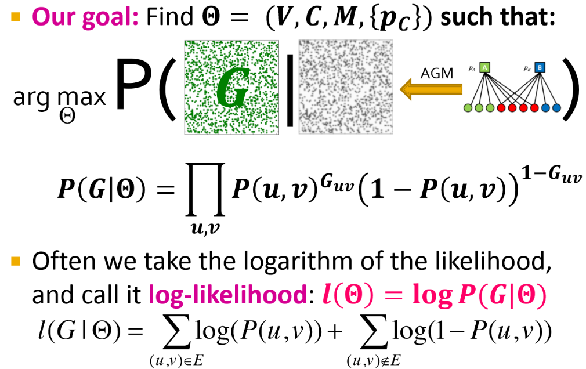
P( 𝑮𝑮 |
▪ Our goal: Find 𝚯𝚯 = (𝑽𝑽, 𝑪𝑪, 𝑴𝑴, 𝒑𝒑_{𝑪𝑪} ) such that:
)
𝟏𝟏−𝑮𝑮_{𝒖𝒖𝒗𝒗}
Θ
AGM
arg max
Θ
𝑷𝑷 𝑮𝑮 𝚯𝚯 = � 𝑷𝑷 𝒖𝒖, 𝒗𝒗 ^{𝑮𝑮𝒖𝒖𝒗𝒗}
𝒖𝒖,𝒗𝒗
𝟏𝟏 − 𝑷𝑷 𝒖𝒖, 𝒗𝒗
Often we take the logarithm of the likelihood,
and call it log-likelihood: 𝒍𝒍 𝚯𝚯
= 𝐥𝐥𝐥𝐥𝐚𝐚 𝑷𝑷(𝑮𝑮|𝚯𝚯)
l(G | Θ) = ∑log(P(u, v)) +
∑log(1− P(u, v))
(u ,v)∉E
(u ,v)∈E
2/8/2016
C246: Mining Massive Datasets

Slide 23
▪ Our goal is to find 𝑩𝑩 𝑽𝑽, 𝑪𝑪, 𝑴𝑴, 𝒑𝒑_{𝑪𝑪}
such that:
arg max
� 𝒍𝒍𝒍𝒍𝒍𝒍𝑷𝑷(𝒖𝒖, 𝒗𝒗) + � 𝒍𝒍𝒍𝒍𝒍𝒍(𝟏𝟏 − 𝑷𝑷 𝒖𝒖, 𝒗𝒗 )
𝑩𝑩(𝑽𝑽,𝑪𝑪,𝑴𝑴, 𝒑𝒑_{𝑪𝑪} ) _{𝒖𝒖,𝒗𝒗∈𝑬𝑬}
𝒖𝒖,𝒗𝒗∉𝑬𝑬
Problem: Finding B means finding the bipartite affiliation network
There is no nice way to do this
▪ Fitting 𝑩𝑩(𝑽𝑽, 𝑪𝑪, 𝑴𝑴, 𝒑𝒑_{𝑪𝑪}
) is too hard,
let’s change the model (so it is easier to fit)!
2/8/2016
C246: Mining Massive Datasets

Slide 24
▪ If 𝑩𝑩(𝑽𝑽, 𝑪𝑪, 𝑴𝑴) is given, finding {𝒑𝒑_{𝑪𝑪}} is easy:
Just write down the log-likelihood 𝒍𝒍(𝑮𝑮|𝚯𝚯) as a
function of 𝒑𝒑_{𝑪𝑪}
by computing each 𝑷𝑷 𝒖𝒖, 𝒗𝒗
Find {𝒑𝒑_{𝑪𝑪}} that maximizes the log-likelihood
l(G | Θ) = ∑log(P(u, v)) +
(u ,v)∈E
∑log(1− P(u, v))
(u ,v)∉E
2/8/2016
C246: Mining Massive Datasets

Slide 25
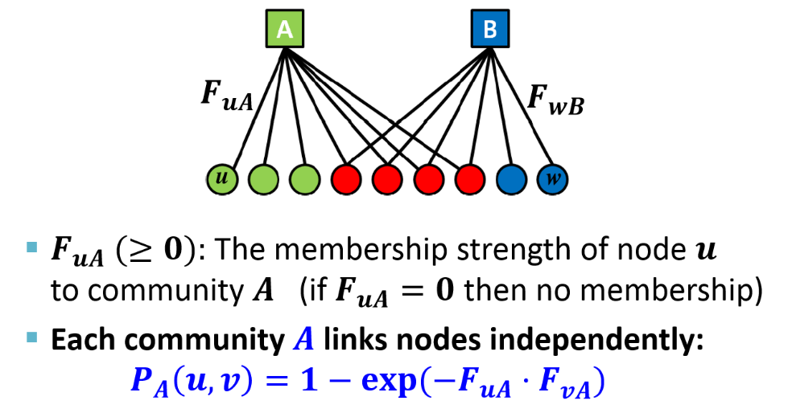
Relaxation: Memberships have strengths
^{𝑭𝑭}𝒖𝒖𝑨𝑨
^{𝑭𝑭}𝒘𝒘𝑩𝑩
u
w
𝑭𝑭_{𝒖𝒖𝑨𝑨} (≥ 𝟎𝟎): The membership strength of node 𝒖𝒖
to community 𝑨𝑨
(if 𝑭𝑭_{𝒖𝒖𝑨𝑨} = 𝟎𝟎 then no membership)
Each community 𝑨𝑨 links nodes independently:
𝑷𝑷_{𝑨𝑨} = 𝟏𝟏 − 𝐞𝐞𝐱𝐱𝐞𝐞(−𝑭𝑭_{𝒖𝒖𝑨𝑨} ⋅ 𝑭𝑭_{𝒗𝒗𝑨𝑨})
𝒖𝒖, 𝒗𝒗
2/8/2016
C246: Mining Massive Datasets

Slide 26
Community membership strength matrix 𝑭𝑭
Communities
▪ 𝑷𝑷_{𝑨𝑨} = 𝟏𝟏 − 𝐞𝐞𝐱𝐱𝐞𝐞(−𝑭𝑭_{𝒖𝒖𝑨𝑨} ⋅ 𝑭𝑭_{𝒗𝒗𝑨𝑨})
Nodes
𝒖𝒖, 𝒗𝒗
Probability of connection is proportional to the product of strengths
Notice: If one of the nodes doesn’t belong to the community 𝑨𝑨 (𝐹𝐹_{𝑢𝑢𝑢𝑢} = 0) then 𝑷𝑷_{𝑨𝑨}(𝒖𝒖, 𝒗𝒗) = 𝟎𝟎
Prob. that at least one common
community 𝑪𝑪 links the two nodes:
▪ 𝑷𝑷 𝒖𝒖, 𝒗𝒗 = 𝟏𝟏 − ∏_{𝑪𝑪} 𝟏𝟏 − 𝑷𝑷_{𝑪𝑪} 𝒖𝒖, 𝒗𝒗
𝑭𝑭 =
𝑭𝑭_{𝒖𝒖} … vector of community membership strengths of 𝒖𝒖
𝑭𝑭_{𝒗𝒗𝑨𝑨} …
strength of 𝒗𝒗’s membership to 𝑨𝑨
2/8/2016
C246: Mining Massive Datasets

Slide 27
Community 𝑨𝑨 links nodes 𝒖𝒖, 𝒗𝒗 independently:
𝑷𝑷_{𝑨𝑨}
𝒖𝒖, 𝒗𝒗
= 𝟏𝟏 − 𝐞𝐞𝐱𝐱𝐞𝐞(−𝑭𝑭_{𝒖𝒖𝑨𝑨} ⋅ 𝑭𝑭_{𝒗𝒗𝑨𝑨})
Then prob. at least one common 𝑪𝑪 links them:
𝑷𝑷 𝒖𝒖, 𝒗𝒗 = 𝟏𝟏 − ∏_{𝑪𝑪}
𝟏𝟏 − 𝑷𝑷_{𝑪𝑪}
𝒖𝒖, 𝒗𝒗
= 𝟏𝟏 − 𝐞𝐞𝐱𝐱𝐞𝐞(− ∑_{𝑪𝑪} 𝑭𝑭_{𝒖𝒖𝑪𝑪} ⋅ 𝑭𝑭_{𝒗𝒗𝑪𝑪})
𝑻𝑻
= 𝟏𝟏 − 𝐞𝐞𝐱𝐱𝐞𝐞(−𝑭𝑭_{𝒖𝒖} ⋅ 𝑭𝑭_{𝒗𝒗})
Example 𝑭𝑭 matrix:
𝑭𝑭_{𝒖𝒖}:
𝑭𝑭_{𝒗𝒗}:
𝑭𝑭_{𝒘𝒘}:
0 | 1.2 | 0 | 0.2
𝑻𝑻
Then: 𝑭𝑭_{𝒖𝒖} ⋅ 𝑭𝑭_{𝒗𝒗} = 𝟎𝟎. 𝟏𝟏𝟎𝟎
And: 𝑷𝑷 𝒖𝒖, 𝒗𝒗
But: 𝑷𝑷 𝒖𝒖, 𝒘𝒘
𝑷𝑷 𝒗𝒗, 𝒘𝒘
= 𝟏𝟏 − 𝒆𝒆𝒆𝒆𝒑𝒑 −𝟎𝟎. 𝟏𝟏𝟎𝟎
= 𝟎𝟎. 𝟏𝟏𝟏𝟏
0.5 | 0 | 0 | 0.8
= 𝟎𝟎. 𝟖𝟖𝟖𝟖
= 𝟎𝟎
0 | 1.8 | 1 | 0
Node community membership strengths
2/8/2016

Slide 28
Task: Given a network 𝑮𝑮(𝑽𝑽, 𝑬𝑬), estimate 𝑭𝑭
Find 𝑭𝑭 that maximizes the log-likelihood 𝒍𝒍(𝑭𝑭):
arg max � 𝒍𝒍𝒍𝒍𝒍𝒍𝑷𝑷(𝒖𝒖, 𝒗𝒗) + � 𝒍𝒍𝒍𝒍𝒍𝒍(𝟏𝟏 − 𝑷𝑷 𝒖𝒖, 𝒗𝒗 )
𝐹𝐹
𝒖𝒖,𝒗𝒗∈𝑬𝑬 𝒖𝒖,𝒗𝒗∉𝑬𝑬
▪ where: 𝑷𝑷 𝒖𝒖, 𝒗𝒗
𝑻𝑻
= 𝟏𝟏 − 𝐞𝐞𝐱𝐱 𝐞𝐞 −𝑭𝑭_{𝒖𝒖} ⋅ 𝑭𝑭_{𝒗𝒗}
Goal: Find 𝑭𝑭 that maximizes 𝒍𝒍(𝑭𝑭):
2/8/2016

Slide 29
𝑙𝑙(𝐹𝐹) = � 𝑙𝑙𝑙𝑙𝑙𝑙𝑙𝑙(𝑢𝑢, 𝑣𝑣) + � 𝑙𝑙𝑙𝑙𝑙𝑙(1 − 𝑙𝑙 𝑢𝑢, 𝑣𝑣 )
𝑢𝑢,𝑣𝑣∈𝐸𝐸 𝑢𝑢,𝑣𝑣∉𝐸𝐸
₌ 𝟏𝟏 ∑
Can rewrite 𝒍𝒍 𝑭𝑭
𝒍𝒍(𝑭𝑭 ) where
𝟎𝟎
𝒖𝒖∈𝑽𝑽
𝒖𝒖
𝑙𝑙 𝐹𝐹_{𝑢𝑢}
= �
𝑣𝑣∈𝒩𝒩(𝑢𝑢)
log(𝑙𝑙 𝑢𝑢, 𝑣𝑣 ) + � 𝑙𝑙𝑙𝑙𝑙𝑙(1 − 𝑙𝑙 𝑢𝑢, 𝑣𝑣 )
𝑣𝑣∉𝒩𝒩(𝑢𝑢)
Summing over all the edges is equivalent to summing over all the nodes and then over the neighbors 𝒩𝒩 of each node. ½ is since we count every edge twice.
31
𝓝𝓝(𝒖𝒖).. Set out-outgoing neighbors
2/8/2016
C246: Mining Massive Datasets

Slide 30
Compute gradient of a single row 𝑭𝑭_{𝒖𝒖} of 𝑭𝑭:
Coordinate gradient ascent:
Iterate over the rows of 𝑭𝑭:
𝓝𝓝(𝒖𝒖).. Set out outgoing neighbors
▪ Compute gradient 𝜵𝜵𝒍𝒍 𝑭𝑭_{𝒖𝒖}
of row 𝒖𝒖 (while keeping others fixed)
▪ Update the row 𝑭𝑭_{𝒖𝒖}: 𝑭𝑭_{𝒖𝒖} ← 𝑭𝑭_{𝒖𝒖} − 𝜼𝜼 𝛁𝛁𝒍𝒍(𝑭𝑭_{𝒖𝒖})
▪ Project 𝑭𝑭_{𝒖𝒖} back to a non-negative vector: If 𝑭𝑭_{𝒖𝒖𝑪𝑪} < 𝟎𝟎: 𝑭𝑭_{𝒖𝒖𝑪𝑪} = 𝟎𝟎
This is slow! Computing 𝜵𝜵𝒍𝒍 𝑭𝑭_{𝒖𝒖}
takes linear time!
2/8/2016
C246: Mining Massive Datasets

Slide 31
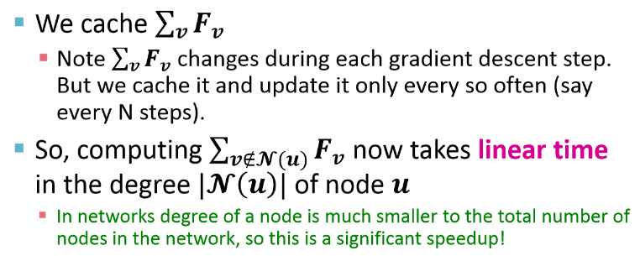
However, we notice:
▪ We cache ∑_{𝒗𝒗} 𝑭𝑭_{𝒗𝒗}
Note ∑_{𝒗𝒗} 𝑭𝑭_{𝒗𝒗} changes during each gradient descent step. But we cache it and update it only every so often (say every N steps).
So, computing ∑_{𝒗𝒗∉𝓝𝓝(𝒖𝒖)} 𝑭𝑭_{𝒗𝒗} now takes linear time
in the degree |𝓝𝓝 𝒖𝒖 | of node 𝒖𝒖
In networks degree of a node is much smaller to the total number of nodes in the network, so this is a significant speedup!
2/8/2016
C246: Mining Massive Datasets

Slide 32
BigCLAM takes 5 minutes for 300k node nets
Other methods take 10 days
Can process networks with 100M edges!
2/8/2016
C246: Mining Massive Datasets

Slide 33
How to determine the number of communities?
Use regularization to tune 𝜆𝜆
Solve:
Search for minimum number of communities (largest 𝜆𝜆) where the log-likelihood is still high:
L’(B(λ)) = log P(G|B, {p_{c}}) K(λ) = #communities detected by AGM at value λ
Details in http://cs.stanford.edu/people/jure/pubs/agmfit-icdm12.pdf
2/8/2016
C246: Mining Massive Datasets

Slide 35
Searching for small communities in the Web graph
[Kumar et al. ‘99]
What is the signature of a community / discussion in a Web graph?
Use this to define “topics”: What the same people on the left talk about on the right Remember HITS!
…
…
Dense 2-layer graph
Intuition: Many people all talking about the same things
2/8/2016
C246: Mining Massive Datasets

Slide 36
A more well-defined problem:
Enumerate complete bipartite subgraphs K_{s,t}
Where K_{s,t} : s nodes on the “left” where each links to the same t other nodes on the “right”
|X| = s = 3
|Y| = t = 4
X
Y
^{K}3,4
Fully connected
2/8/2016
C246: Mining Massive Datasets

Slide 37
Market basket analysis. Setting:
[Agrawal-Srikant ‘99]
Market: Universe U of n items
Baskets: m subsets of U: S₁, S₂, …, S_{m} ⊆ U
(S_{i} is a set of items one person bought)
Support: Frequency threshold f
Goal:
Find all subsets T s.t. T ⊆ S_{i} of at least f sets S_{i}
(items in T were bought together at least f times)
What’s the connection between the itemsets and complete bipartite graphs?
2/8/2016
C246: Mining Massive Datasets

Slide 38
Frequent itemsets = complete bipartite graphs!
[Kumar et al. ‘99]
How?
View each node i as a
set S_{i} of nodes i points to
K_{s,t} = a set Y of size t
that occurs in s sets S_{i}
Looking for K_{s,t} € set of frequency threshold to s and look at layer t – all frequent sets of size t
a
b c d
i
S_{i}={a,b,c,d}
a b c d
j i k
X
Y
s … minimum support (|X|=s)
t … itemset size (|Y|=t)
2/8/2016
C246: Mining Massive Datasets
40

Slide 39
[Kumar et al. ‘99]
View each node i as a set S_{i} of nodes i points to
a
b
Say we find a frequent itemset Y={a,b,c} of supp s So, there are s nodes that link to all of {a,b,c}:
i
c d
S_{i}={a,b,c,d}
a b c
a
b c
a b c
x
y
z
Find frequent itemsets: s … minimum support t … itemset size
a b c
We found K !
x y z
s,t
K_{s,t} = a set Y of size t
that occurs in s sets S_{i}
X
Y
2/8/2016
C246: Mining Massive Datasets

Slide 40
Support threshold s=2
a
b
{b,d}: support 3
{e,f}: support 2
And we just found 2 bipartite subgraphs:
c
d
e
f
Itemsets: a = {b,c,d} b = {d}
c = {b,d,e,f} d = {e,f}
e = {b,d} f = {}
a
b
c
d
c
d
e
f
e
2/8/2016
C246: Mining Massive Datasets

Slide 41
Example of a community from a web graph
Nodes on the right Nodes on the left
[Kumar, Raghavan, Rajagopalan, Tomkins: Trawling the Web for emerging cyber-communities 1999]
2/8/2016
C246: Mining Massive Datasets

Slide 43
2/8/2016
C246: Mining Massive Datasets

Slide 44
Extension:
Make community membership edges directed!
Outgoing membership: Nodes “sends” edges
Incoming membership: Node “receives” edges
2/8/2016
C246: Mining Massive Datasets

Slide 45
2/8/2016
C246: Mining Massive Datasets

Slide 46
Everything is almost the same except now we have 2 matrices: 𝑭𝑭 and 𝑯𝑯
𝑭𝑭… out-going community memberships
𝑯𝑯… in-coming community memberships
𝑭𝑭
𝑯𝑯
▪ Edge prob.: 𝑷𝑷 𝒖𝒖, 𝒗𝒗
𝑻𝑻
= 𝟏𝟏 − 𝒆𝒆𝒆𝒆𝒑𝒑(−𝑭𝑭_{𝒖𝒖}𝑯𝑯_{𝒗𝒗})
Network log-likelihood:
which we optimize the same way as before
2/8/2016
C246: Mining Massive Datasets

Slide 47
2/8/2016
C246: Mining Massive Datasets

Slide 48
Overlapping Community Detection at Scale: A Nonnegative Matrix Factorization Approach by J. Yang, J. Leskovec. ACM International Conference on Web Search and Data Mining (WSDM), 2013.
Detecting Cohesive and 2-mode Communities in Directed and Undirected Networks by J. Yang, J. McAuley, J. Leskovec. ACM International Conference on Web Search and Data Mining (WSDM), 2014.
Community Detection in Networks with Node Attributes by J. Yang,
J. McAuley, J. Leskovec. IEEE International Conference On Data Mining (ICDM), 2013.
2/8/2016
C246: Mining Massive Datasets
50

