Slide 1
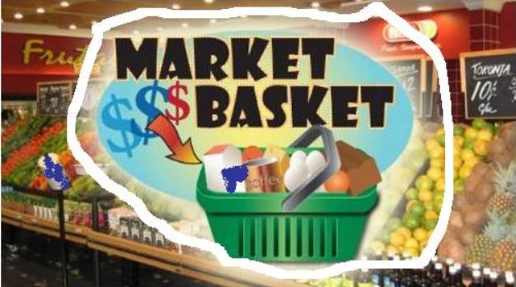
MARKET BASKET ANALYSIS, FREQUENT ITEMSETS, ASSOCIATION RULES, APRIORI ALGORITHM, OTHER ALGORITHMS

Slide 2
Market Basket Analysis and Association Rules
Market Basket Analysis studies characteristics or attributes that “go together”. Seeks to uncover associations between 2 or more attributes.
Association Rules have form:
IF antecedent THEN consequent
For example, of 1,000 customers shopping, 200 bought Milk. In addition, of 200 buying milk, 50 bought bread. Thus, the rule “If buy milk, then buy bread” has support = 50/1,000 = 5% and confidence = 50/200 = 25%
◦ Support is records with consequent over total
◦ Confidence is records with consequent over records with both

Slide 3
Market Basket Analysis(cont’d)
Applications:
Investigating proportion of subscribers to cell phone plan that respond to offer for service upgrade.
Examining the proportion of children whose parents read to them who are themselves good readers.
Finding out which items are purchased together in super market.
Challenges:
Curse of dimensionality : Number of rules grows exponentially in number of attributes. With k binary attributes, and only positive cases considered, there are k * 2^{k – 1} possible association rules.

Slide 4
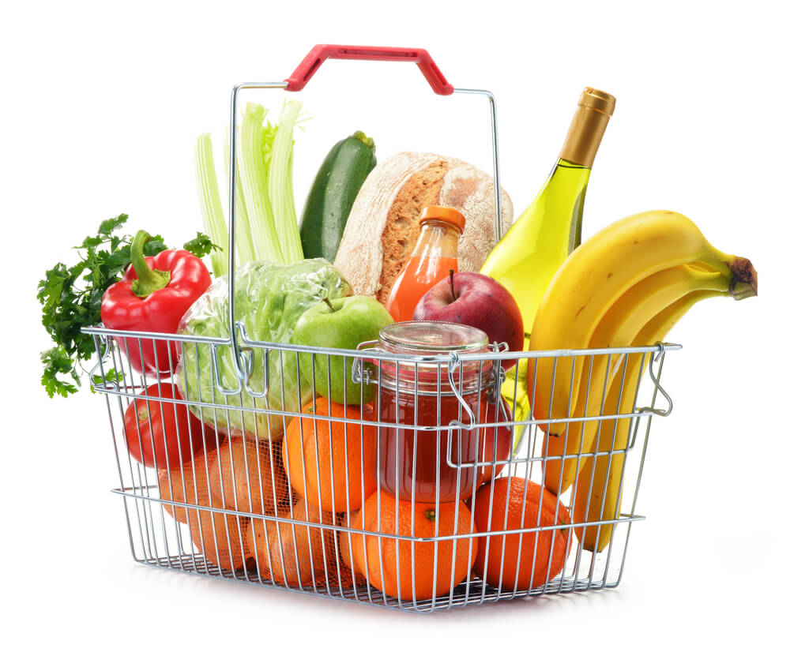
Market Basket Analysis(cont’d)
A Priori algorithm reduces search problem to manageable size. It leverages rule structure to its advantage
Example : Consider farmer selling crops at roadside stand. Seven items are available for purchase in set I = {asparagus, beans, broccoli, corn, green peppers, squash, tomatoes}. Customers purchase different subsets of I.
Transaction | Items Purchased
1 | Broccoli, green peppers, corn
2 | Asparagus, squash, corn
3 | Corn, tomatoes, beans, squash
4 | Green peppers, corn, tomatoes, beans
5 | Beans, asparagus, broccoli
6 | Squash, asparagus, beans, tomatoes

Slide 5
Support, Confidence, Frequent Itemsets, and the A Priori Property (cont’d)
Let D = set of transactions {T1, T2, ..., T14} in previous Table
Each T represents set of items contained in I
Suppose set of items A = {beans, squash} and B = {asparagus}
Association Rule has form:
IF A THEN B
A -> B
IF {beans, squash} THEN {asparagus}
A and B proper subsets of I
A and B are mutually exclusive
Therefore, by definition, rules such as IF {beans, squash} THEN {beans} excluded

Slide 6
Support, Confidence, Frequent Itemsets, and the A Priori Property
◦Support for association rule A -> B is proportion of transactions in D containing both A and B
Support = p(A∩B) = number of transactions containing both A and B
total number of transactions
Confidence for association rule A à B measures rule accuracy. Determined by percentage of transactions in D containing A, also containing B
Confidence = p(B|A) =p(A∩B) = number of transactions containing both A and B
P(A) total number of transactions containing A

Slide 7
Support, Confidence, Frequent Itemsets, and the A Priori Property
Rules often preferred having high support, high confidence, or both
Strong Rules meet specified support and/or confidence threshold
For example, an analyst may determine supermarket items purchased together with minimum support = 20% and confidence = 70%
However, fraud detection analysts may set minimum support much lower, equal to 1% or less
In this case, very few transactions are fraudulent-related

Slide 8
Support, Confidence, Frequent Itemsets, and the A Priori Property
Itemset is set of items contained in I
k-itemset contains k items
For example, {beans, squash} = 2-itemset, from roadside stand set I
Itemset Frequency is number of transactions containing specific itemset
Frequent Itemset occurrence greater than or equal to minimum threshold
Frequent Itemset has itemset frequency ≥ ϕ (where ϕ= Minimum Threshold)
We denote the set of frequent k-itemsets as F_{k}

Slide 9
Support, Confidence, Frequent Itemsets, and the A Priori Property
Mining Association Rules
Two-step process
(1) Find all frequent itemsets, where itemset frequency ≥ ϕ
(2) From list of frequent itemsets, generate association rules satisfying minimum support and confidence criteria
A Priori Property
If itemset Z not frequent, then for any item A, Z U A not frequent
In other words, no superset of Z (itemset containing Z) will be frequent
A Priori algorithm uses this property to significantly reduce the search space

Slide 10
APRIORI ALGORITHM
Apriori is a classical algorithm in data mining. It is used for mining frequent itemsets and relevant association rules.
Principle of Apriori : If an itemset is frequent, then all of its non empty subsets must also be frequent.
It is devised to operate on a database containing many transactions.

Slide 11
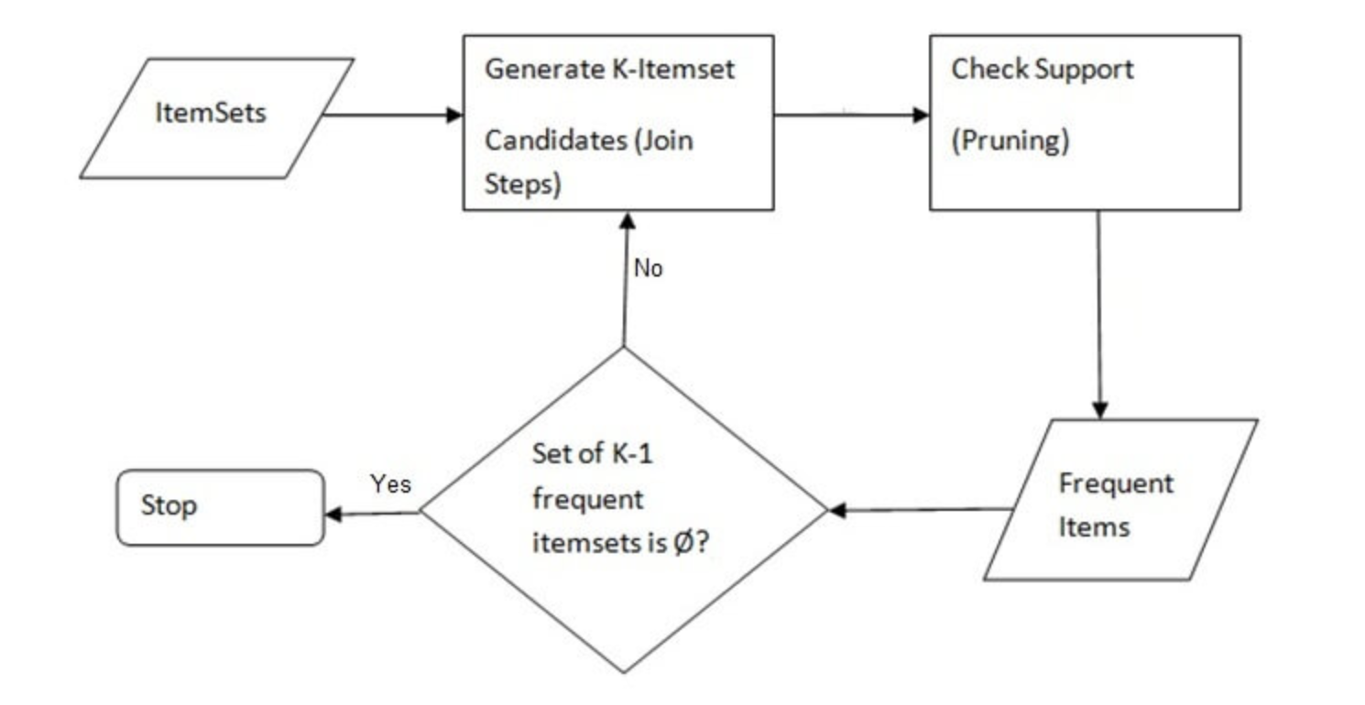
ALGORITHM

Slide 12
APPLICATIONS
Apriori algorithm is used in examining drug-drug interactions and in finding out Adverse Drug Reactions(ADR).
It is used in finding associations between diabetic conditions of people.
Mobile e commerce sites can make use of it to improve their product recommendations.

Slide 13
Pros and Cons
Pros
Apriori is an easy-to-implement and easy-to-understand algorithm.
It can be used on large itemsets.
Cons
Finding a large number of candidate rules can be computationally expensive.
Calculating support is also expensive because it has to go through the entire database.

Slide 14
Process of Rule Selection
Generate all rules that meet specified support & confidence
Find frequent item sets (those with sufficient support)
Support → The number of times an item appears in a dataset
From these item sets, generate rules with sufficient confidence
Confidence → Indicates the number of times the if/then statements have been found
to be true

Slide 15
if/then….
So if/then can be associated with two main components of association rules:
.
Antecedent → Item found in the dataset and can be viewed as the “if”
Consequent → Item found in combination with the Antecedent and can be viewed as the “ then”
e.g.
If a customer buys a bread, he/she is 80% likely to buy a butter as well..
If a customer buys a mouse, he/she is 95% likely to buy a keyboard ….

Slide 16
Generating frequent itemsets: The Apriori Algorithm
For k products….
Set minimum support criterion
Generate list of one-item sets that meet the support criterion
Use list of one-item sets to generate list of two-item sets that meet support criterion
Use list of two-item sets to generate list of three-item sets that meet support criterion
Continue up through k-item sets

Slide 17
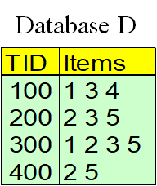
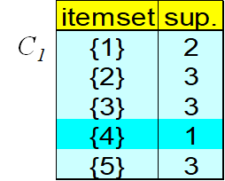
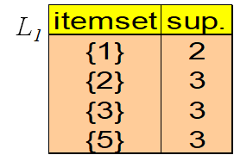
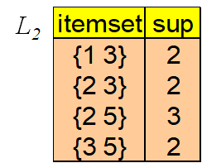
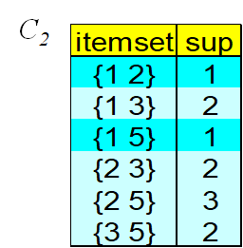
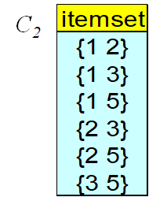
The Apriori Algorithm → Example

Slide 18
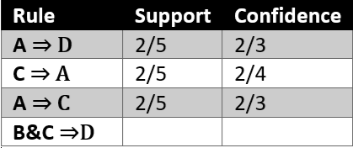
Support and Confidence
Support
→ Fraction of transactions that contain both X and Y
Confidence
→ Measure how often items in Y appears in
transactions that contain X
1/5
1/3

Slide 19
OTHER ALGORITHMS : FREQUENT PATTERN GROWTH ALGORITHM
Two step approach:
Step I: Construct a compact data structure called FP Tree.
Constructed using two pass over the data set.
Step II: Extract frequent items from directly from the FP Tree.
Traverse the tree to extract frequent item sets

Slide 20
FP TREE CONSTRUCTION
FP-Tree is constructed using 2 passes over the data-set:
Pass I:
From a set of given transactions, find support for each item.
Sort the items in decreasing order of their support. For in our example: a, b, c, d, e
Use this order when building the FP-Tree, so common prefixes can be shared.

Slide 21
EXAMPLE TRANSACTIONS AND ITEM SUPPORT
TID | Items Bought
1 | {a, b, d, e}
2 | {b, c, d}
3 | {a, b, d, e}
4 | {a, c, d, e}
5 | {b, c, d, e}
6 | {b, d, e}
7 | {c, d}
8 | {a, b, c}
9 | {a, d, e}
10 | {b, d}
Item | Support
d | 9
b | 7
e | 6
a | 5
c | 5
Support for each transaction

Slide 22
RE-ORDERING TRANSACTIONS BASED ON SUPPORT VALUE
TID | Items Bought | Reordered set
1 | {a, b, d, e} | {d, b, e, a}
2 | {b, c, d} | {d, b, c}
3 | {a, b, d, e} | {d, b, e, a}
4 | {a, c, d, e} | {d, e, a, c}
5 | {b, c, d, e} | {d, b, e, c}
6 | {b, d, e} | {d, b, e}
7 | {c, d} | {d, c}
8 | {a, b, c} | {b, a, c}
9 | {a, d, e} | {d, e, a}
10 | {b, d} | {d, b}

Slide 23
FP TREE CONSTRUCTION
insert_tree([p|P], T) {
if (T has a child n, where n.item = p increment) n.count = n.count + 1 else { create new node N n.count = 1 Link it up from the root node (null)
}

Slide 24
FP GROWTH TREE CONSTRUCTION AFTER REORDERING TRANSACTIONS
null
Each paths represent transactions
Nodes have counts to track original frequency
b
1
9
d
c
a
1
6
1
b
e
2
1
4
c
e
c
a
2
2
1
1
a
c
c
1

Slide 25
CONCEPT OF CONDITIONAL PATTERN BASE
Once the FP-tree is constructed, the next step is to traverse the FP Tree to find all frequent itemsets for each item.
For this we need to find the conditional pattern base for each pattern starting right from the 1-frequent pattern.
Conditional pattern base is defined as the prefix-paths in the FP-tree which consist of the suffix pattern.
From the conditional pattern base a conditional pattern tree is generated which is recursively mined in the algorithm.

Slide 26
FREQUENT ITEMSETS GENERATION BY MINING THE TREE
Suffix Pattern : a
(d, b, e, a, 2)
(d, e, a, 2)
(b, a, 1)
Item | Support
d | 4
e | 4
b | 3
null
4
1
d
b
4
e
2
Frequent Item sets for a: (Considering the minimum threshold to be 3)
{d, a, 4}
{d, e, a, 4}
{b, a, 3}
b
Conditional FP Tree for a

Slide 27
ADVANTAGES & DISADVANTAGES OF FP TREE GROWTH ALGORITHM
Advantages of FP-Growth
Only 2 passes over data-set than repeated database scan in Apriori
Avoids candidate set explosion by building compact tree data structure
Much faster than Apriori Algorithm
Discovering pattern of length 100 requires at least 2^100 candidates (no of subsets)
Disadvantages of FP-Growth
FP-Tree may not fit in memory
FP-Tree is expensive to build
Trade-off: takes time to build, but once it is built, frequent itemsets can be generated easily.

Slide 28
