Slide 1
Market Basket Analysis, Frequent Itemsets, Association Rules, A-priori Algorithms, Other Algorithms

Slide 2
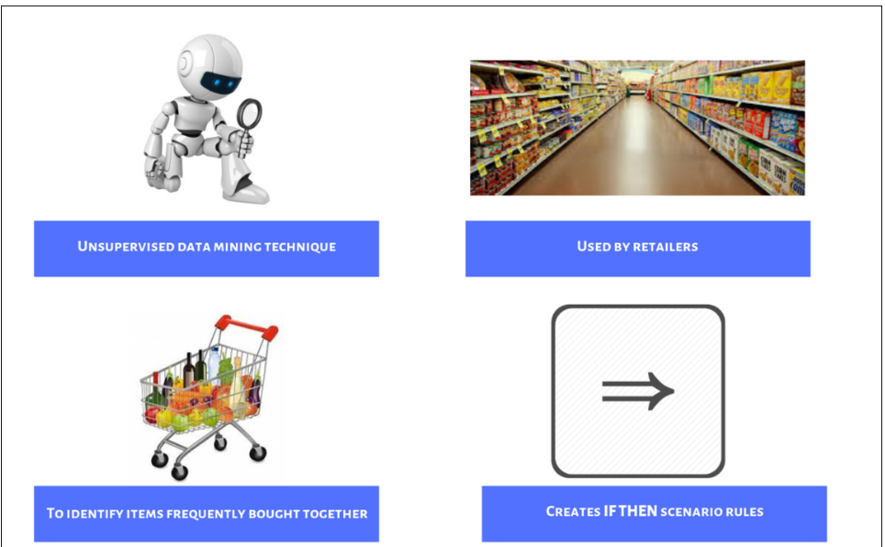
What?
Modelling technique which is traditionally used by retailers, to understand customer behaviour
It works by looking for combinations of items that occur together frequently in transactions.

Slide 3
Advantages
Cost effective as data required is readily available through electronic point of sale systems
It generates actionable insights for its various applications
Cost effective
Insightful
Notes:
Cost effective as data required is readily available through electronic point of sale systems.
It generates actionable insights for it’s various application

Slide 4
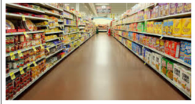
Applications
Medical
Retail - designing store layout so that consumers can more easily find items that are frequently purchased together.
Banks - Banks and financial institutions use market basket analysis to analyze credit card purchases for fraud detection.
Medical - Medical patient histories can give indications of likely complications based on certain combinations of treatments.
Retail
Banking

Slide 5
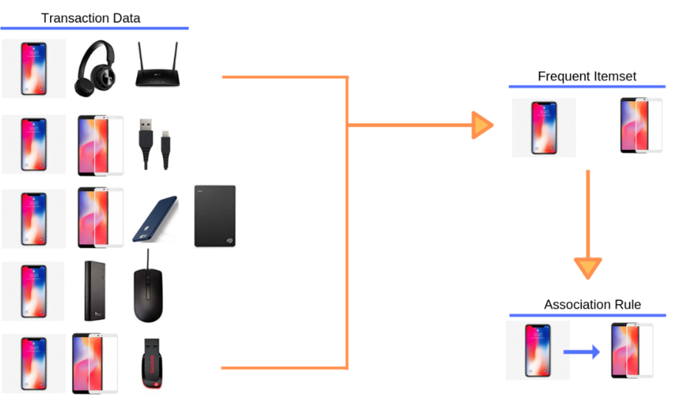
Example:

Slide 6
Frequent item sets
Itemset – A collection of one or more items
E.g. : {Phone, Case, Screen Protector}
k-itemset - An itemset that contains k items
Support count (σ) – Frequency of occurrence of an itemset
E.g. σ({Phone, Case, Screen Protector}) = 3
Support – Fraction of transactions that contain an itemset
E.g. s({Phone, Case, Screen Protector}) = 3/5
Frequent Itemset – An itemset whose support is greater
than or equal to a minsup threshold
T. ID | Items
1 | Phone, Case
2 | Screen Protector, Phone, Case, Watch, Shoes
3 | Earphones, Screen Protector, Car phone mount
4 | Phone, Case, Earphones, Screen Protector
5 | Phone, Case, Screen Protector, Car phone mount

Slide 7
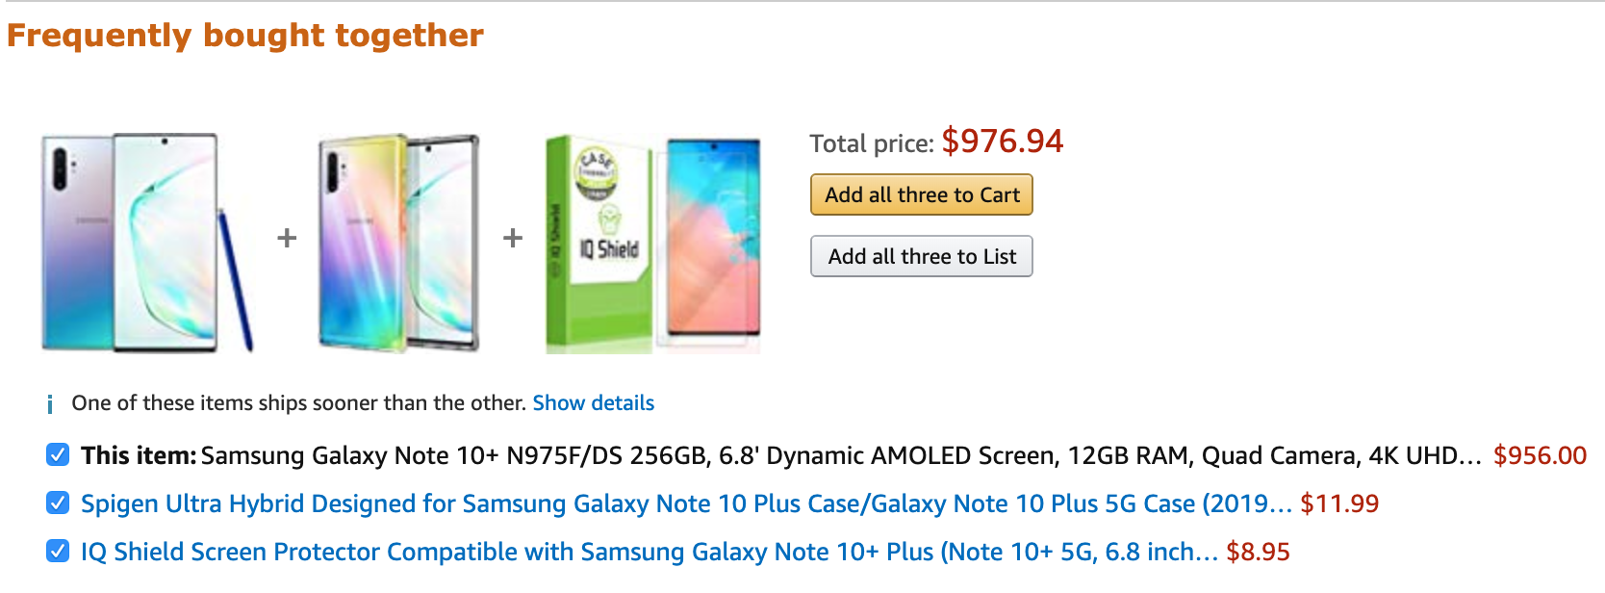

Slide 8
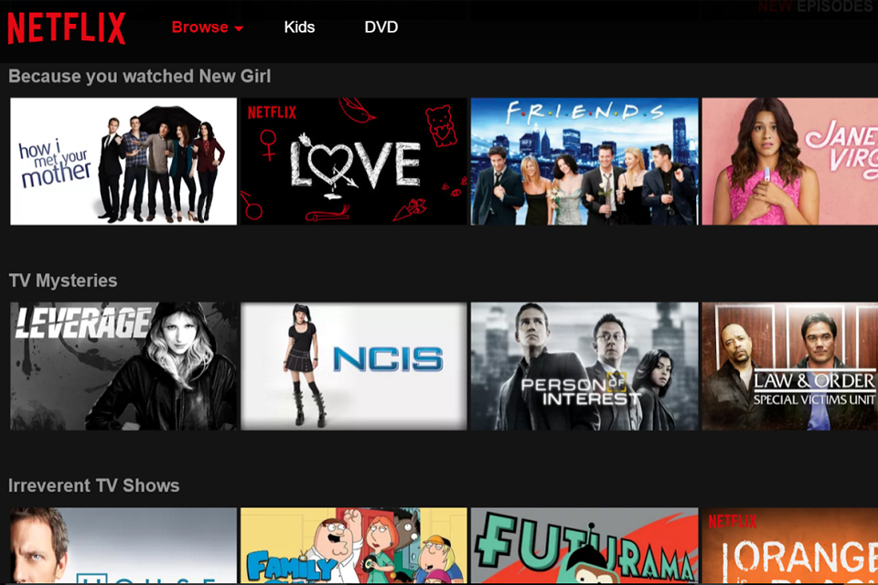
Association Rules
Rules to uncover relationship between two items
in a large dataset which are correlated or occur
together.
Useful for analysing the customer behavior
If-then statement to uncover the relationship
between unrelated data.

Slide 9
TV Shows watched | Friends | The office | Parks and Recreation
User1 | 1 | 1 | 0
User2 | 0 | 1 | 1
User3 | 1 | 1 | 0
Support - The number of times an item appear in a dataset
Confidence - Number of times if-then statements have been found to be true
Support (Friends) = 2/3
Support (Friends,The Office) = 2/3
Confidence ( Friends => The Office) = 0.3/0.3 = 1 = 100%
Watches{ friends} => Watches {The Office}

Slide 10
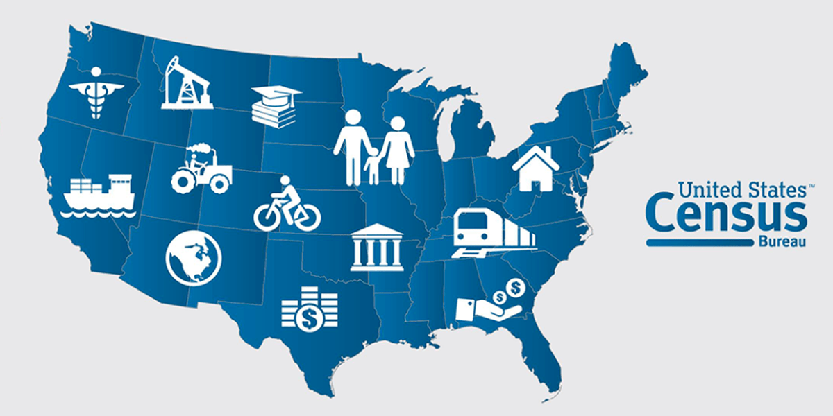
Applications of Association Rules
Medical Diagnosis
Census Data
Market Basket Analysis

Slide 11
Apriori Algorithm
Apriori is an algorithm for frequent item set mining and association rule learning over transactional databases.
It proceeds by identifying the frequent individual items in the database and extending them to larger and larger item sets as long as those item sets appear sufficiently often in the database.
The frequent item sets determined by Apriori can be used to determine association rules which highlight general trends in the database: this has applications in domains such as market basket analysis.

Slide 12
Algorithm
We have to build a candidate list for K itemset and extract a frequent list of k-elements using support count using support count
After that we use the frequent list of k itemsets in the determining the candidate and the frequent list of k+1 itemsets
We use pruning to do that
We repeat until we have an empty candidate or frequent support of k itemsets
Then return the list of k-1 itemsets

Slide 14
Pros
Easy to implement and understand
Can be used on large itemsets
Can be easily parallelized
Cons
Computationally Expensive
Calculating support requires entire database scan

Slide 15
PCY Algorithm
It was developed by three Chinese scientists Park, Chen, and Yu.
It is used in the field of big data analytics for the frequent itemset mining when the dataset is very large.
Pass 1 of PCY: In addition to item counts, maintain a hash table with as many buckets as fit in a memory
Keep a count for each bucket into which pairs of items are hashed
For each bucket just keep the count, not the actual pairs that hash to the bucket!

Slide 16
PASS 1
FOR (each basket) :
FOR (each item in the basket) :
add 1 to item’s count;
FOR (each pair of items) :
hash the pair to a bucket;
add 1 to the count for that bucket;
We are not just interested in the presence of a pair, but we need to see whether it is present at least s (support) times
If a bucket contains a frequent pair, then the bucket is surely frequent
for a bucket with total count less than s,none of its pairs can be frequent
Pairs that hash to this bucket can be eliminated as candidates (even if the pair consists of 2 frequent items)

Slide 17
PASS 2
Replace the buckets by a bit-vector:
1 means the bucket count exceeded the support s (call it a frequent bucket); 0 means it did not
Only count pairs that hash to frequent buckets.
¡Count all pairs {i, j} that meet the
conditions for being a candidate pair:
1. Both i and j are frequent items
2. The pair {i, j} hashes to a bucket whose bit in the bit vector is 1 (i.e., a frequent bucket)
¡Both conditions are necessary for the
pair to have a chance of being frequent

Slide 18
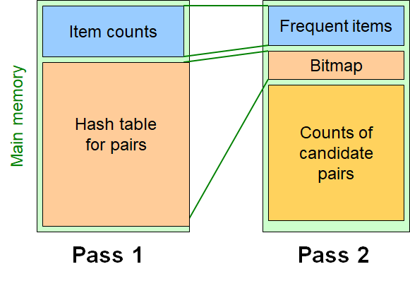
Main Memory picture for PCY

Slide 19
Savasere, Omiecinski & Navathe [SON] Algorithm
• Finding all frequent itemsets.
• Repeatedly read small subsets of the baskets into main memory and perform the simple algorithm on each subset.
• An itemset becomes a candidate if it is found to be frequent in any or more subsets of the baskets.
• On a second pass, count all the candidate itemsets and determine which are frequent in the entire set.
• Key “monotonicity” means an itemset can’t be frequent in the entire set of baskets unless it is frequent in at least one subset.

Slide 20
Savasere, Omiecinski & Navathe [SON] Algorithm
Pass 1 – Batch Processing :-
Scan data on disk
Break the data into chunks that can be processed in main memory
Repeatedly fill memory with new batch of data
Find all frequent itemsets for each chunk
Threshold = s / number of chunks
Run sampling algorithm on each batch
Generate candidate frequent itemsets
An itemset becomes a candidate if it is found to be frequent in any one or more chunks of the baskets.
reference(SON) : www.anuradhabhatia.com

Slide 21
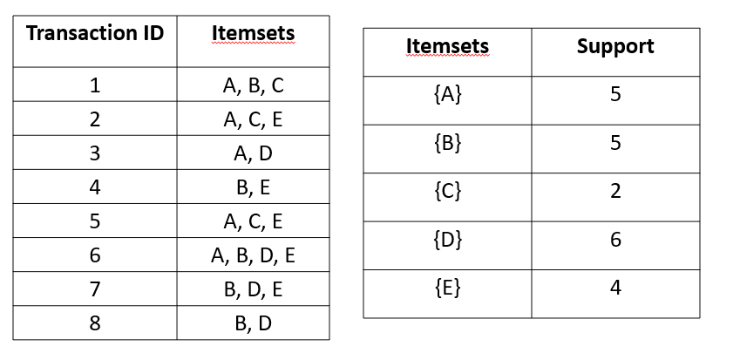
Savasere, Omiecinski & Navathe [SON] Algorithm

Slide 22
Savasere, Omiecinski & Navathe [SON] Algorithm
Pass 2 –
Validate candidate itemsets
Count all the candidate itemsets and determine which are frequent in the entire set
Monotonicity Property –
Itemset X is frequent overall -> frequent in at least one batch
False Positive –
A test result that indicates the particular attribute is present
False Negative –
A test result which wrongly indicates that a particular condition or attribute is absent. (SON works on this criteria)
reference(SON) : www.anuradhabhatia.com

Slide 23
Toivonen’s Algorithm
Toivonen's algorithm is a powerful and flexible algorithm that provides a simplistic framework for discovering frequent itemsets while also providing enough flexibility to enable performance optimizations directed towards particular data sets.
We Start as in the simple algorithm, but lower the threshold slightly for the sample. For Eg: if the sample is 1% of the baskets, use s/125 as the support threshold rather than s/100.
Our Goal is to avoid missing any itemset that is frequent in the full set of baskets.

Slide 24
Toivonen’s Algorithm
Now we add to the itemsets that are actually frequent in the sample and the negative border of these itemsets.
An itemset is in the negative border if it is not deemed frequent in the sample, but all its immediate subsets are. For Eg: {A,B,C,D} is in the negative border if and only if:
It is not frequent in the sample, but
All of {A,B,C}, {B,C,D}, {A,C,D}, and {A,B,D} are.

Slide 25
Toivonen’s Algorithm
In a second pass, count all candidate frequent itemsets from the first pass, and also count their negative border.If no itemset from the negative border turns out to be frequent, then the candidates found to be frequent in the whole data are exactly the frequent itemsets.
What if we find that something in the negative border is actually frequent? We must start over again with another sample!
Try to choose the support threshold so the probability of failure is low, while the number of itemsets checked on the second pass fits in main-memory.

Slide 26
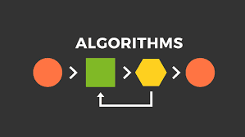
Naïve Algorithm
Naïve algorithm behaves in a very simple way , like how a child would. For example, a naive algorithm for sorting numbers scans all numbers to find the smallest one, puts it aside, and so on.
A simple way to find frequent pairs is:
Read file once, counting in main memory the occurrences of each pair.
Expand each basket of n items into its n (n -1)/2 pairs.
Fails if #items-squared exceeds main memory.

Slide 27
Details of Main-Memory Counting
There are two basic approaches:
Count all item pairs, using a triangular matrix.
Keep a table of triples [i, j, c] = the count of the pair of items {i,j } is c.
(1) requires only (say) 4 bytes/pair;
(2) requires 12 bytes, but only for those pairs with >0 counts.

Slide 28
12 per
occurring pair
4 per pair
Method (1)
Method (2)

Slide 29
Details of Approach
Number items 1,2,…
Keep pairs in the order {1,2}, {1,3},…, {1,n }, {2,3}, {2,4},…,{2,n }, {3,4},…, {3,n },…{n -1,n }.
Find pair {i, j } at the position (i –1)(n –i /2) + j – i.
Total number of pairs n (n –1)/2; total bytes about 2n ².

Slide 30
Details of Approach
You need a hash table, with i and j as the key, to locate (i, j, c) triples efficiently.
Typically, the cost of the hash structure can be neglected.
Total bytes used is about 12p, where p is the number of pairs that actually occur.
Beats triangular matrix if at most 1/3 of possible pairs actually occur.

Slide 31
Thank You!!

