Slide 1
Recommender Systems
Group 6

Slide 2
Agenda
Introduction
Why Recommendation Systems ?
Applications
Utility Matrix
Types of recommender Systems
Content-Based Systems
Collaborative Filtering
Hybrid Filtering
Algorithms
U-V Decomposition
Root Mean Square Error
Results

Slide 3
Introduction
Recommender system belongs to the class of Information Retrieval , Data Mining and Machine Learning
A recommender system or a recommendation system is a subclass of information filtering system that seeks to predict the "rating" or "preference" a user would give to an item.
Good examples of recommendation systems are:
Offering news articles to online newspaper readers, based on a prediction of reader interests.
Offering customers of an online retailer suggestions about what they might like to buy, based on their past history of purchases and/or product searches.

Slide 4
Why Recommendation Systems ?-The need
One key reason why we need a recommender system in modern society is that people have too many options to use from, due to the prevalence of Internet.
Netflix, for example, has an enormous collection of movies. Although the amount of available information increased, a new problem arose as people had a hard time selecting the items they actually want to see. This is where the recommender system comes in.
To sum up in same way, Recommender/Recommendation System is used to
To increase the items sold.
To increase the user Satisfaction.
To better understand each individual user. etc

Slide 5
Applications
Entertainment - recommendations for movies, music, and IPTV.
Content - personalized newspapers, recommendation for documents, recommendations of Web pages, e-learning applications, and e-mail filters.
E-commerce - recommendations for consumers of products to buy such as books, cameras, PCs etc.
Services - recommendations of travel services, recommendation of experts for consultation, recommendation of houses to rent, or matchmaking services.

Slide 6
Question 1:
Where do we use the Recommender System?

Slide 7
Utility Matrix
The goal is to predict the values for the empty cells based on the information available in the cells which have been filled up.
Higher the density of the matrix space, better is the recommendation.
Example : Predict whether User A would like SW2
The utility matrix we see above shows users rating for movies on a scale of 1 - 5, where in 5 being the highest rating for a movie and 1 the lowest. The values are blank if a user who has not rated. The movies names are abbreviations for Harry potter I, II, III & Twilight & Star Wars 1,2 and 3. The users are represented by capital letters A through D.
r A would like SW2

Slide 8
Question
What is the goal of an Utility Matrix?

Slide 9
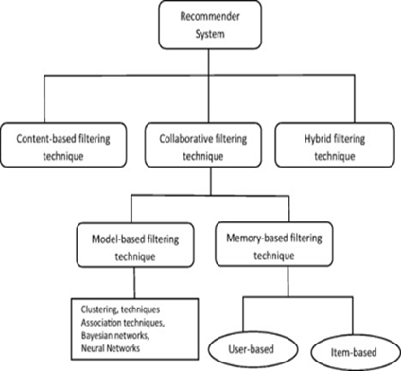
Types of Recommendation Systems
Content-Based Systems
Example:
Collaborative Filtering
Example: Netflix
Hybrid Filtering
Example: Amazon.com

Slide 10
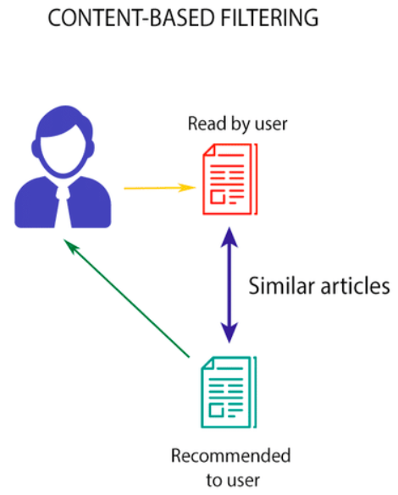
Content Based Filtering
Also known as Cognitive filtering
This system recommends items based on a comparison between the content of the items and a user profile.
The content of each item is represented as a set of descriptors or terms, typically the words that occur in a document.
The user profile is represented with the same terms and built up by analyzing the content of items which have been seen by the user.

Slide 11
How does Content Based Recommendation System works?
Step 1: Item Profiles
Construct a profile containing a record or collection of records representing important characteristics of an item
Step 2: User Profiles
●Create vectors with the same components that describe the user’s preferences. We have the utility matrix representing the connection between users and items.
Step 3: Recommending Items based on content
●With profile vectors for both users and items, we can estimate the degree to which a user would prefer an item by computing the cosine distance between the user’s and item’s vectors.
For Given User Profile x and Item Profile i,the predictions are calculated as
Thus, the highest recommendations (lowest cosine distance)

Slide 12
Item Profile Example
●Movie:
Features are actors, director, genre, year in which movie was made. Based on these feature similar movie will be recommended.
●Documents
For Documents like news articles, we use distance measure as a measure of Similarity, namely - Jaccard Distance and Cosine Distance and concepts of Term frequency and Inverse Document frequency are used.
●Images
Tag words are used in the form of words or phrases that describe the image item.

Slide 13
What is TF-IDF?
TF
Term Frequency, which measures how frequently a term occurs in a document. TF(t) = (Number of times term t appears in a document) / (Total number of terms in the document).
IDF
Inverse Document Frequency, which measures how important a term is. IDF(t) = log_e(Total number of documents / Number of documents with term t in it).
Example: Consider a document containing 100 words wherein the word cat appears 3 times. The term frequency (i.e., tf) for cat is then (3 / 100) = 0.03. Now, assume we have 10 million documents and the word cat appears in one thousand of these. Then, the inverse document frequency (i.e., idf) is calculated as log(10,000,000 / 1,000) = 4. Thus, the Tf-idf weight is the product of these quantities: 0.03 * 4 = 0.12.
Notes:
TF- Continuation Since every document is different in length, it is possible that a term would appear much more times in long documents than shorter ones. Thus, the term frequency is often divided by the document length (aka. the total number of terms in the document) as a way of normalization:
IDF- Continuation
While computing TF, all terms are considered equally important. However it is known that certain terms, such as "is", "of", and "that", may appear a lot of times but have little importance. Thus we need to weigh down the frequent terms while scale up the rare ones, by computing the following:

Slide 14
Question
What is the alternate name of Content Based Filtering?

Slide 15
Pro’s and Con’s of Content-based Filtering
Pros :
User Independence
Transparency,
Con’s :
Limited content analysis:
Over-specialization
New user

Slide 16
Examples of Content based filtering
Netflix
Amazon provide information about their product items
LinkedIn users provide their own working experiences and skills

Slide 17
Question
What are examples of Content-based filtering?

Slide 18
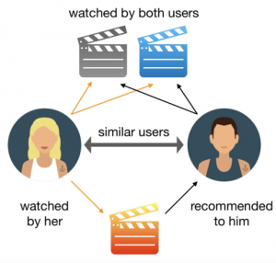
Collaborative Filtering
What is Collaborative Filtering ?
Collaborative filtering (CF) is a technique commonly used to build personalized recommendations on the Web.
The idea behind collaborative filtering is to recommend new items based on the liking of similar users.

Slide 19
Measuring Similarity
Let r_{x} be the vector user x.
Consider users x and y with
rating vectors r_{x} and r_{y}.
We need a similarity metric
sim(x,y) which should capture the
intuition that sim(A,B) > sim(A,C).
Ways of calculating similarities:
Jaccard Similarity
Cosine Similarity
Centered Cosine Similarity or Pearson correlation Coefficient

Slide 20
Jaccard Similarity
sim(A,B) = | r_{A}∩ r_{B}| / | r_{A}∪ r_{B}|
sim(A,B) = 1/5
sim(A,C) = 2/4
That is sim(A,B) < sim(A,C).
Contradicts our intuition.
Problem: It Ignores the rating values

Slide 21
Cosine Similarity
sim(A,B) = cos(r_{A}, r_{B})
sim(A,B) = 0.38 and
sim(A,C) = 0.32
In line with our intuition of
sim(A,B) > sim(A,C) but the difference is not too much
Note: Treating unknown values as 0.
Problem: Treats the missing values as Negative.
For example in this we assume user A rates HP2 as 0 (which is the least rating) although he likes HP1.

Slide 22
Centered cosine
The idea here is to Normalize the ratings by subtracting row mean or average rating of the user.
Note: Blank ratings treated as avg
The average rating for A = 10/3 (sum of the ratings/ number of rated items). B= 14/3
On normalizing A with HP1 = 4 - 10/3 = 2/3
We have thus centered the ratings around 0.
i.e. +ve rating = user liked the movie
-ve rating = user disliked the movie

Slide 23
Centered Cosine Similarity
sim(A,B) = cos(r_{A}, r_{B})
sim(A,B) = 0.09 and
sim(A,C) = -0.56
In line with our intuition of
sim(A,B) > sim(A,C)
Advantages:
Missing ratings treated as “average”.
Handles “tough raters” and “easy raters”

Slide 24
Question
What are the ways of calculating similarities between users?

Slide 25
Collaborative Filtering
In the newer, narrower sense, collaborative filtering is a method of making automatic predictions (filtering) about the interests of a user by collecting preferences or taste information from many users (collaborating). The underlying assumption of the collaborative filtering approach is that if a person A has the same opinion as a person B on an issue, A is more likely to have B's opinion on a different issue than that of a randomly chosen person.
2 Main Entities:
User:Any individual who provides ratings to a system
Items:Anything for which a human can provide a rating
Basic Assumptions:
-Users with similar interests have common preferences
-Sufficiently large number of user preference are available

Slide 26
Collaborative Filtering - Types
Collaborative filtering can be classified based on methodology and approach
Types based on methodology
1.User-based collaborative filtering
Look for users who share the same rating patterns with the active user (the user whom the prediction is for).
Use the ratings from those like-minded users found in step 1 to calculate a prediction for the active user
1.Item-based collaborative filtering
Build an item-item matrix determining relationships between pairs of items
Infer the tastes of the current user by examining the matrix and matching that user's data

Slide 27
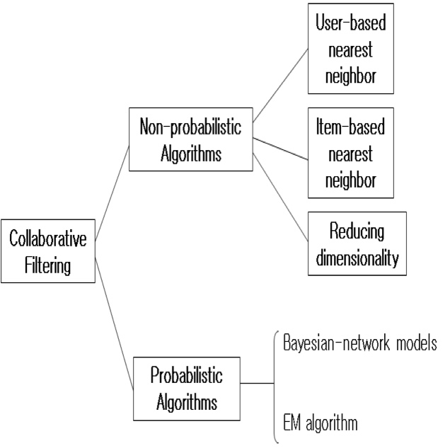
Collaborative filtering - Algorithms
Collaborative filtering - Algorithms
Memory based approach
The memory-based approach uses user rating data to compute the similarity between users or items. Typical examples of this approach are neighbourhood-based CF and item-based/user-based top-N recommendations.
Model based approach
In this approach, models are developed using different data mining, machine learning algorithms to predict users' rating of unrated items. There are many model-based CF algorithms. Bayesian networks, clustering models, latent semantic models such as singular value decomposition, probabilistic latent semantic analysis, multiple multiplicative factor, latent Dirichlet allocation and Markov decision process based models.

Slide 28
Pros/Cons of Collaborative Filtering
PROS
Works for any kind of item
CONS
No feature selection needed •
Cold Start: Need enough users in the system to find a match
Sparsity: The user/ratings matrix is sparse – Hard to find users that have rated the same items
First rater: Cannot recommend an item that has not been previously rated (New items, Esoteric items)
Popularity bias: Cannot recommend items to someone with unique taste. Tends to recommend popular items

Slide 29
Question
Types of approaches for Collaborative filtering ?
Different types of similarity measures ?

Slide 30
UV-Decomposition
It is an approach to estimating the blank entries in the utility matrix is to conjecture that the utility matrix is actually the product of two long, thin matrices
Consider movies as a case in point. Most users respond to a small number of features; they like certain genres, famous actors or actresses that they like, even a few directors.
If we start with the utility matrix M, with n rows and m columns (i.e., there are n users and m items), then we might be able to find a matrix U with n rows and d columns and a matrix V with d rows and m columns, such that UV closely approximates M in those entries where M is non-blank.
If so, then we have established that there are d dimensions that allow us to characterize both users and items closely. We can then use the entry in the product UV to estimate the corresponding blank entry in utility matrix M.

Slide 31
Root-Mean Square Error
Common Measures to evaluate how close the product UV is to M.
Calculating root-mean-square error (RMSE):
Sum, over all non blank entries in M the square of the difference between that entry and the corresponding entry in the product UV.
Take the mean of these squares by dividing by the number of terms in the sum.
Take the square root of the mean.

Slide 32
Incremental Computation of aUV-Decomposition
Finding the UV-decomposition with the least RMSE involves starting with some arbitrarily chosen U and V , and repeatedly adjusting U and V to make the RMSE smaller.
We shall consider only adjustments to a single element of U or V , although in principle, one could make more complex adjustments.
Whatever adjustments we allow, in a typical example there will be many local minima – matrices U and V such that no allowable adjustment reduces the RMSE.
Unfortunately, only one of these local minima will be the global minimum – the matrices U and V that produce the least possible RMSE.
To increase our chances of finding the global minimum, we need to pick many different starting points, that is, different choices of the initial matrices U and V.

Slide 33
Question
What measure is used to evaluate the closeness of UV to Utility matrix (M)?

Slide 34
Any Queries?

