Slide 1
Recommender Systems

Slide 2
Introduction
A recommender system, also known as a recommendation engine, is an information filtering system whose purpose is to recommend or suggest items or actions to a user
The recommendation may consist of:
Offering articles to online readers, based on a prediction of reader interests.
Offering customers an suggestion about what they might like to buy, based on their past history and/or product searches compared with the habits of similar users.
It can be said that, Recommendation engines are nothing but an automated form of “shop counter guy”. You ask him for a product. Not only will he show that product, but also the related ones which you could buy.
Notes:
Jacob

Slide 3
Why use Recommendation Systems
We are in an information society. The quantity of information increases day by day and it goes over our limited processing capabilities
For example, Netflix, It has an enormous collection of content. Because of so much information people had a hard time selecting the items they actually want to see. For this reason, they need something able to recommend or suggest us and this is where recommendation system kicks in.
Therefore Recommendation System is used to
Make search space smaller.
Increase trust and customer loyalty.
Increase sales.
Better understand each customer
Discover new things.
Notes:
Ankit

Slide 4
Part 1 A Model for Recommendation Systems
Content-Based Systems
Notes:
Ankit, Prutha, Abhilash, Snehal

Slide 5
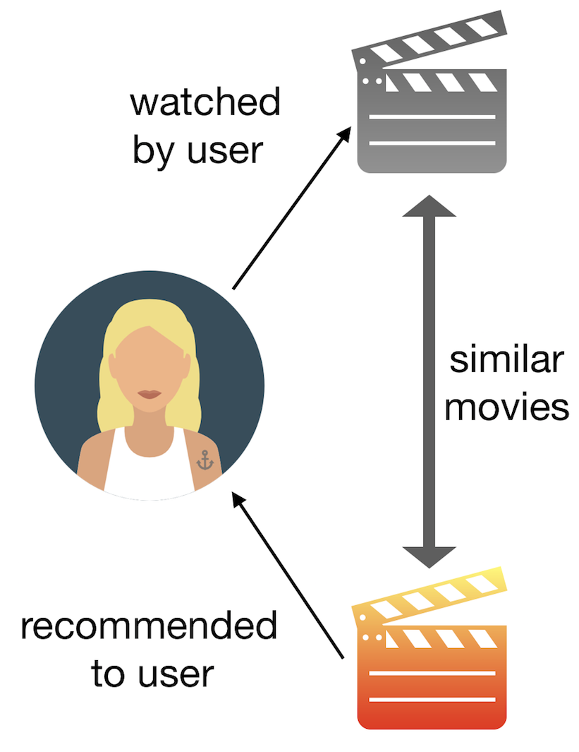
Content-Based Systems
It is a domain-dependent algorithm which emphasizes more on the analysis of the attributes of items in order to make a prediction.
The item profile is created as a set of terms that occurs in a document.
The user profile is created by analyzing the content of items which have been explored by the user.
Recommendation is made on the user profiles using features extracted from the content of the items the user has evaluated in the past.
Applications in recommendation of movies, songs, websites, books etc.
Notes:
Prutha - Uploaded the video in shared folder

Slide 6
Item Profiles
Content based systems maintain important characteristics of an item in an item profile
Each profile is a vector of features
Item profile of a book will look like:
Book: title, author, year of publication, genre
TF-IDF (Term frequency * Inverse Doc Frequency)
index can be used to extract these important features of the items.
The features with highest TF-IDF scores are selected
Notes:
Abhilash

Slide 7
Calculating TF-IDF
fij = frequency of term (feature) i in doc (item) j
Note: we normalize TF to discount for “longer” documents
n_{i} = number of docs that mention term i
N = total number of docs
TF-IDF score: w_{ij} = TF × IDF
Doc profile = set of words with highest TF-IDF
scores, together with their scores
Notes:
Abhilash

Slide 8
Advantages of Content-based approach
User Independant: Does not require the data for other users.
Different users having different taste can get the recommendation.
It can recommend completely unseen and unpopular items. That is it can recommend new items.
Transparency: It provides explanation of recommended items by listing content-features that caused an item to be recommended.
Notes:
Snehal

Slide 9
Disadvantages of Content-based approach
Extraction of important features is difficult
Insufficient content: If the information is not enough to discriminate the items precisely, the recommendation might not be precise.
Building a new user profile is difficult
It never recommends items outside a user’s content profile
Content-based method provides a limit degree of novelty, since it has to match up the features of profile and items. The recommendation might not surprise the user.
Notes:
Snehal

Slide 10
Which score can be used to evaluate how important a word is to a document?

Slide 11
TF-IDF Score

Slide 12
Part 2 Collaborative Filtering Dimensionality Reduction
Notes:
Arjun, Venkata Sai, Aishwarya, Chaitanya, Jacob

Slide 13
Collaborative Filtering
Process of recommending products to users based on the purchase activity of similar users.
Distance measure like Jaccard or cosine distance can be used to identify similar users.
Increases in sales through personalized offers inviting users to spend more time on the platform.
Used by major tech giants like YouTube, Netflix and Spotify.
2 broad categories
User-user collaborative filtering.
Item-item collaborative filtering.
Notes:
Arjun

Slide 14
Data Cleaning
When considering movie ratings, for instance,
Normalization:
If we normalize movie ratings, we get negative numbers for low ratings and positive numbers for high ratings.
Cosine distance will be opposite for users who have opposite views on similar movies watched.
Similarly, the cosine distance will be small for users who have similar ratings on common movies
Eliminate Similarity:
The similarity between movies a user rates highly to those with low ratings can be eliminated by rounding off
For instance, ratings above 3 (on a scale of 5) can be considered 1 and ratings below 3 can be considered unrated.
Notes:
Chaitanya

Slide 15
Duality Of Similarity
Collaborative filtering can be performed in two ways.
A dual approach for user-user collaborative filtering is item-item collaborative filtering.
It is similar to the traditional user-user CF. We find the neighbourhood of similar items to a given item and we see that for what user the given item can be recommended in order for the given item to get liked by the user we are going to recommend.
In theory one may tend to say both have similar performances.
In reality items tend to more classifiable into simpler terms than users. So, item-item CF shows more reliable performance.
For instance, we can have users who likes both rock and classical, but there is rarely an item that belong to both of the genres.
Notes:
Venkata Sai

Slide 16
Clustering Users and Items
As we face problems in dealing with user-item pairs because of very less information available, we prefer to cluster the users or items or both.
Clustering can be performed based on the distance measures we have learned or any other.
We prefer to cluster into small numbers initially and later follow a hierarchical approach to cluster further.
We can cluster either items or users or both and we keep on clustering until we have an intuitively reasonable number of clusters of each kind.
After that we compute a cluster-cluster utility matrix
If we were to fill the entry of user U and item I then we fill it with the entry in the cluster-cluster utility matrix looking for the clusters they belong to. If we find the cluster-cluster matrix entry as empty then we follow normal approach.
Notes:
Venkata Sai

Slide 17
Dimensionality Reduction
Dimensionality reduction is simply, the process of reducing the dimension of your feature set.
UV-Decomposition - Allows us to decompose a matrix M into the product of two matrices, U and V, to estimate blank values within M
Typically judged by Root Mean Square Error (RMSE)
Notes:
Aishwarya

Slide 18
Which method could be used to group users and items into categories to make recommendation easier?

Slide 19
Clustering

