Slide 1
Computational Advertising
and
Comparison between Mapreduce and Bulk Synchronous systems

Slide 2
Computational Advertising
Find the most relevant ads matching a particular context on the Web. The context depends on the type of advertising and could mean the content where the ad is shown, the user who is viewing the ad, or the social network of the user.
Greedy Algorithms
Competitive Algorithms
Picking the Best Advertisement
The Balance Algorithm

Slide 3
Online Algorithms
Offline Algorithms
Data can be obtained when the algorithm runs.
Decision making does not take place until all the information are obtained
Data needed is provided to algorithm initially
Data access can be of any order, algorithm provides an answer once executed

Slide 4
Greedy Algorithms
● These algorithms make their decision to an object one step at a time, at each step choosing the locally best option.
● Problem solving heuristic to optimize choice.
● In some cases, greedy algorithms construct the globally best choice by repeatedly choosing the locally best option.

Slide 5
Advantages and Disadvantages
● Pros
○ Simplicity -- greedy algorithms are easier to describe and code than others
○ Efficiency -- greedy algorithms can be implemented more efficiently than others
● Cons
○ Simplicity -- it works to construct local optimal steps and not the global optimal result (short sighted optimization)
○ Efficiency -- when its wrong its severely wrong

Slide 6
Question
Give some advantages of Greedy Algorithms

Slide 7
Competitive Algorithms
When comparing online and offline algorithms, we can expect that there will be some constant c less than 1 such that on any input, the result of an on-line algorithm is at least c times the result of the optimal offline algorithm.
Comparing the performance of online algorithm with corresponding offline algorithm for same problem instance.
Competitive ratio = min over all possible inputs sequences( | M online | / | M opt| )
where | M online | = cardinality of online algorithm
where | M opt| = cardinality of optimal offline algorithm

Slide 8
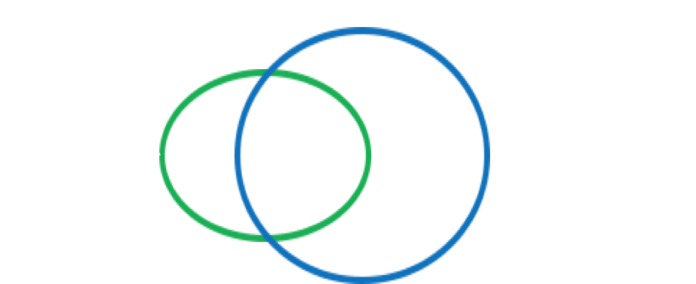
Real time example: Google Adwords
Online Advertising Service where advertisers bid for queries on the search engine.
Search engine selects and displays ads for a small subset of the bidders in a purpose of achieving the goal of maximizing search engine’s revenue
Advertisers: A and B; A bids on query x and B bids on queries x and y
Sequence of queries: xxyy
Query assigned to advertiser who has the maximum remaining budget
Competitive Ratio = ¾

Slide 9
Could you name some examples for competitive algorithms?

Slide 10
Picking the Best Ad
History
Advertisers bid on search keywords.
Advertiser pays only when ad is clicked
Adwords Problem
Many Advertisers bid on each query
Search engine must pick a subset of advertisers whose ads are shown

Slide 11
Analysing Balance
Example: two advertisers, A1 and A2, each with budget B greater than 1, an even number.
optimal solution exhausts both advertisers’ budgets. I.e, revenue to search engine =2B
Balance must exhaust at least one advertiser’s budget, If not, we can allocate more queries

Slide 12
Question
What does the Search Engine guarantee its advertisers ?

Slide 13
Balance Algorithm
This is a simple improvement to greedy algorithm
•Improved competitive ratio than greedy algorithm
•The competitive ratio is 75% for the case of two advertisers
•The competitive ratio is about 63% for a greater number of advertisers
•For each query, the advertiser with the largest remaining budget will be picked
•Break the ties arbitrarily

Slide 14
Balance Algorithm Example
•Example: Consider two advertisers A1 and A2, each bidding on query q.
•A1: bid = 1, balance = 110.
•A2: bid = 10, balance = 100.
•First 10 occurrences of query q, all go to A1, and A1 then gets 10 q’s for every one that A2 gets.
•What if there are only 10 occurrences of q?
•Optimal yields $100 whereas Balance yields only $10.

Slide 15
Question:
Which is best algorithm : Greedy Algorithm or Balanced Algorithm.

Slide 16
Comparison of MapReduce with Bulk-Synchronous Systems
Review of Bulk-Synchronous
Communication Costs
Problem of Semijoin

Slide 17
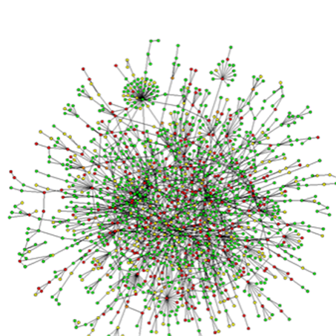
What is a Graph?
Graph is a non linear data structure
Collection of vertices and edges
Examples of Graphs
Hyperlink structure of the Web
Physical structure of computers on the Internet
Interstate highway system
Social networks

Slide 18
The Graph Model
Views all computation as a recursion on some graph.
Graph nodes send messages to one another.
Messages bunched into supersteps, where each graph node processes all data received.
Sending individual messages would result in far too much overhead.
Due to the size of graph data, graphs often require usage of parallel processing for efficient computation

Slide 19
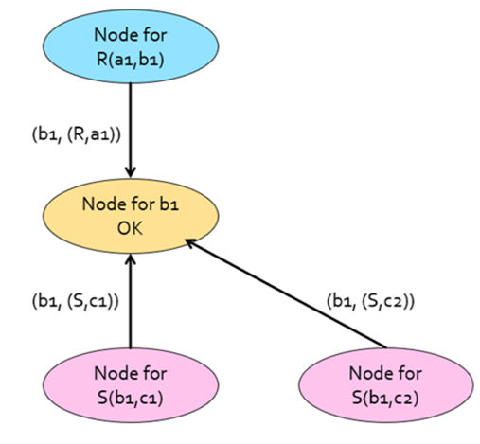
Bulk Synchronous Parallel Solution to Graph Model
Create a graph node for every tuple in R and S
Create a graph node for every B-value.
Tuples from S send a message to its corresponding
B-value
Similarly, Tuples from R send a message to its
corresponding b in B-value.
Now, the node for 'b' sends message to R, if it has
received at least a single request from S
Atlast, the traditional map-reduce operation is
performed without considering the non-dangling
tuples in S

Slide 20
Applications of Bulk-Synchronous
Some examples of Bulk-Synchronous Systems are:
Pregel - Google
Giraph - opensource Pregel build on Hadoop
GraphX - for sparks
GraphLab - is built to handle higher degree nodes

Slide 21
QUESTION??
Name one application of Bulk Synchronous technique.

Slide 22
SemiJoin
What is Semijoin?
When a dataset R is large then many records in R may not be actually referenced by any records in a said table L. Therefore semi-join can be used to avoid sending the records in R that will not join with L.
Although semi-join avoids sending the records in R that will not join with L, it does this at the cost of an extra scan of said table L.

Slide 23
Problem with Semijoin
Consider a example of Join of T(P,Q) and S(Q,R), where :
A is really large field - a video ; Q is the video ID ; S(Q,R)is small number of streaming requests, where R is the destination.
In semjoin - Find all values of Q in S and filter those (p,q) in T that are dangling -- will not join anything in S
Then Map need not move dangling tuples to any reducer.
The problem with semijoin is that it also requires that very T-tuple be sent to its mapper to some reducer.

Slide 24
QUESTION??
Mention one problem of Semijoin?

