Slide 1
Computational Advertising
And
Comparison between MapReduce and bulk-synchronous systems

Slide 2
Definition - Computational advertising
Computational advertising, popularly known as Online advertising or Web advertising, refers to finding the most relevant ads matching a particular context on the web.
It is a scientific sub-discipline at the intersection of information retrieval, statistical modeling, machine learning, optimization, large scale search and text analysis
The central challenge of computational advertising is to find the "best match" between a given user in a given context and a suitable advertisement.

Slide 3
Online- Offline Algorithms
OFFLINE
Performed on static data
See whole data set
Find optimal function for the whole dataset
ONLINE
Performed on incomplete data
Streaming data, with partial results
Future data unknown
Algorithms will always be less optimal than offline
Make irrevocable decisions on imperfect data

Slide 4
Advertising on the Web
Advertising is a form of marketing communication used to encourage, persuade, or manipulate an audience (viewers, readers or listeners; sometimes a specific group) to take or continue to take some action.
Companies like Amazon, Alibaba use ads to increase the sales
Ads may be based on the search results
Billions of opportunities daily
Open to personalization via rich context of impression
Effectiveness is measurable: can measure click-through rates as % of impressions, and conversions as % of clicks

Slide 5
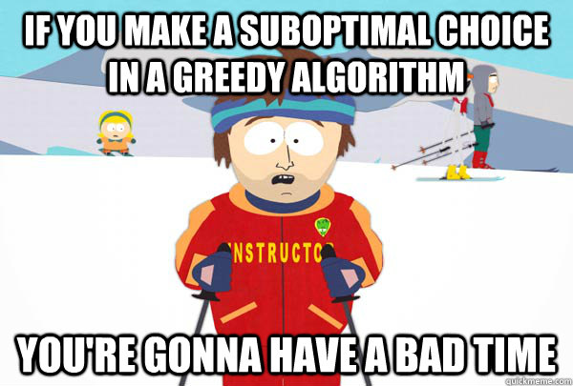
Greedy Algorithm
A greedy algorithm is a simple, intuitive algorithm that is used in optimization problems.
A greedy algorithm, as the name suggests, always makes the choice that seems to be the best at that moment i.e. it picks the best immediate output, but does not consider the big picture.
This means that it makes a locally-optimal choice in the hope that this choice will lead to a globally-optimal solution.
However, generally greedy algorithms do not provide globally optimized solutions.

Slide 6
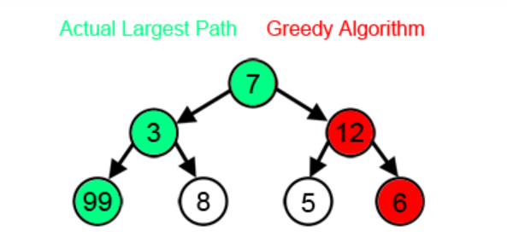
Advantages and Disadvantages
Pros:
Easy to design and implement greedy algorithms
Faster to execute
Cons:
Even with the correct algorithm, it is hard to prove why it is correct.
However, in many problems, a greedy strategy does not produce an optimal solution.

Slide 7
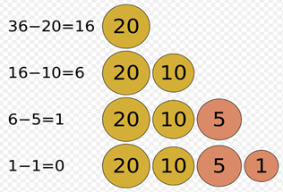
Example
The greedy algorithm is quite powerful and works well for a wide range of problems. Most networking algorithms use the greedy approach, such as:
Travelling Salesman Problem , Dijkstra's Minimal Spanning Tree Algorithm
Example : Counting coins : $36 = $20+$10+$5+$1 = 4 coins

Slide 8
Competitive Ratio
A comparison of an online algorithm with the best possible offline algorithm
There will be some constant c < 1 such that for any input, the result of online algorithm is at least c times the result of optimum offline algorithm
Competitive ratio = min _{all possible inputs I} ( | M _{online} | / | M _{opt}| )
where | M _{online} | = cardinality of online algorithm
where | M _{opt}| = cardinality of optimal offline algorithm

Slide 9
Adwords Problem
Google's advertising system in which advertisers bid on certain keywords in order for their clickable ads to appear in Google's search results.
Since advertisers have to pay for these clicks, this is how Google makes money from search.
The price advertisers willing to pay for each click is called cost-per-click (CPC).
Search engine selects and displays ads for a small subset of the bidders in a purpose of achieving the goal of maximizing search engine’s revenue.
The decision regarding which ads to show must be made on-line.

Slide 10
Adwords Problem
Metric used:
AD RANK = CPC BID X QUALITY SCORE
The Quality Score is typically the relationship between ad group, keywords, ad and landing page and what a user is looking for and the likelihood that someone will click the ad.
Advertisers: A and B;
A bids on query x and B bids on queries x and y
Sequence of queries: xxyy
Query assigned to advertiser who has the maximum ad rank

Slide 11
Performance - based Advertising.
Performance-based advertising is the business model by which referrers of the product or service are paid commissions for referring it.
Crucial Elements:
First is ads that will catch the attention of the public.
Then, a second key point is placing ads on relevant topics or locations. Marketers call this targeting.
A third key point is making user-friendly landing pages for click ads.
Last, but not least is monitoring and adjustment to increase click responses.

Slide 12
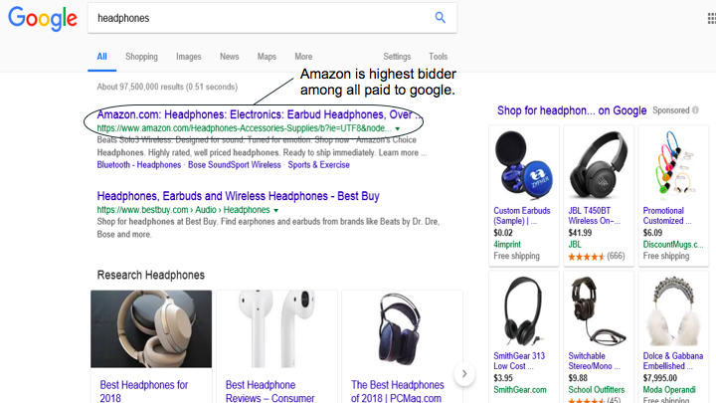
Example:

Slide 13
A more balanced Approach:
Balance Algorithm
Improvement to the Greedy Algorithm
Queries are assigned to the advertisers that bid on the query with the largest remaining budget.
Uses some of each advertisers budget

Slide 14
Generalized Balanced Algorithm
Why generalization?:
If we train the system with certain values of bids, then it will be able to identify the relevant data but when we apply different values of bids it produces terrible BALANCE and this is where generalization comes into the picture.
It was designed to solve the problems of greedy algorithm, however, there are certain limitations in balanced algorithm.
For the different values of bid(untrained data) it does not result expected balanced output.
The competitive ratio for Generalized balanced algorithm is (1-1/e)

Slide 15
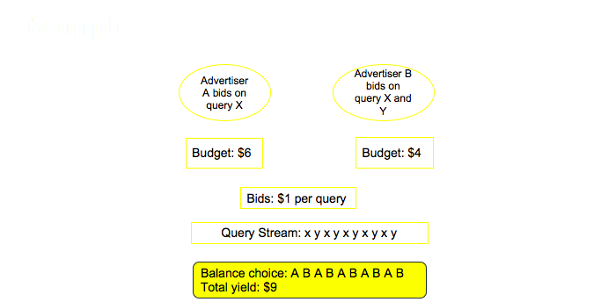

Slide 16
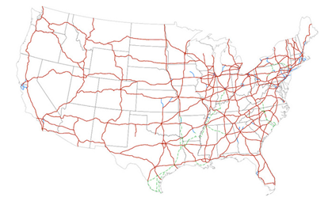
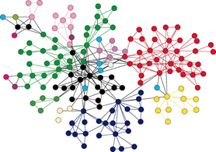
Graph
Graph is a non-linear data structure.
It is a pictorial representation of a set of objects where some pairs of objects are connected by links. The inter-connected objects are called vertices, and the links that connect the vertices are called edges.
Examples of Graphs
Social networks
Physical Structure of the computers on the Internet
Interstate Highway system
Recommendations on e-commerce websites
Used to study molecules in Chemistry and Physics

Slide 17
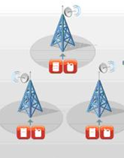
Graph Problem
●Finding Shortest Path
Routing Internet Traffic and Logistics
●Finding Minimum Spanning Trees
Telephone Network Design
●Maximum Flow Problem
Airline Scheduling
●Bipartite Matching
Monster.com, Match.com
●PageRank
Processing Graph Data
●As the size of the graph data is very large, parallel processing has to be used for efficient computation.
●Techniques Used : MapReduce, Bulk-Synchronous Systems

Slide 18
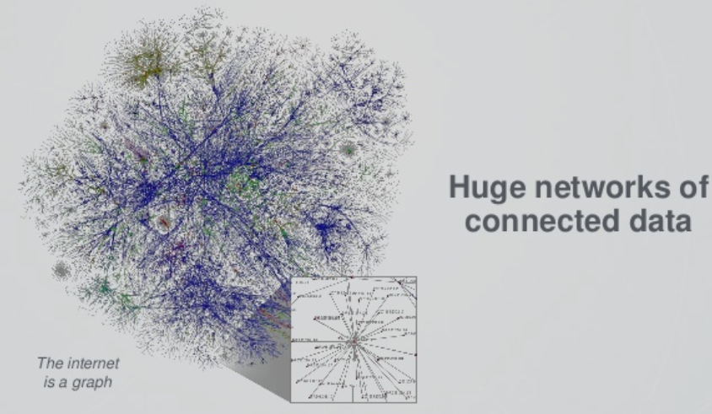
Map Reduce Programming Model for Graph Problem
Why Map Reduce?
Can process big set of data, large clusters in a reliable manner.
Computing/Grouping
Independent blocks
Parallel processing - performs aggregation

Slide 19
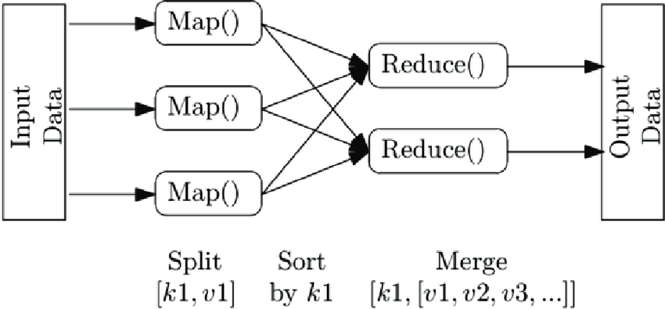
How does Map Reduce work?
Map - The input data is first split into smaller blocks. Each block is then assigned to a mapper for processing.
Combine - Runs individually on each mapper server. It reduces the data on each mapper further to a simplified form before passing it downstream.
Partition - the process that translates the <key, value> pairs resulting from mappers to another set of <key, value> pairs to feed into the reducer.
Reduce - All the map output values that have the same key are assigned to a single reducer, which then aggregates the values for that key.
34

Slide 20
Bulk Synchronous Systems
The bulk synchronous parallel (BSP) is a bridging model for designing parallel algorithms.
The components of BSP are :
Processors
Network
Hardware Facility
The components of supersteps are:
Concurrent Computation
Communication
Barrier Synchronization

Slide 21
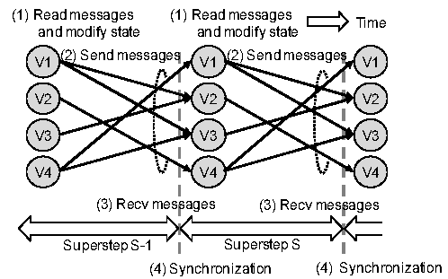
BSP model for Graph Processing
Processing occurs in a series of supersteps.
In every super step, a user defined function is executed in parallel on every active vertex.
All graph vertices are partitioned and loaded into local memories of machines (hosts).
Graph processing is organized by means of messages sent across machines with individual graph nodes.
At every super step, each host receives messages from other hosts that are related to nodes preserved by this host.
Program terminates when there are no more messages to send b/w hosts or maximum iterations reached.

Slide 22
THANK YOU

