Slide 1



Distributed Computing with Spark
Reza Zadeh
Thanks to Matei Zaharia.
Tweet with #fearthespark

Slide 2

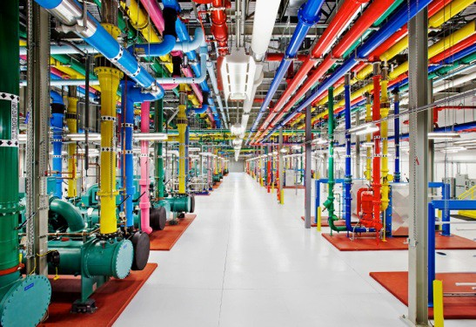
Problem
Data growing faster than processing speeds Only solution is to parallelize on large clusters
» Wide use in both enterprises and web industry
How do we program these things?

Slide 3
Outline
Data flow vs. traditional network programming Limitations of MapReduce
Spark computing engine Machine Learning Example
Current State of Spark Ecosystem
Built-in Libraries

Slide 4
Data flow vs. traditional network programming

Slide 5
Traditional Network Programming
Message-passing between nodes (e.g. MPI) Very difficult to do at scale:
» How to split problem across nodes?
Must consider network & data locality
» How to deal with failures? (inevitable at scale)
» Even worse: stragglers (node not failed, but slow)
» Ethernet networking not fast
» Have to write programs for each machine
Rarely used in commodity datacenters

Slide 6













Data Flow Models
Restrict the programming interface so that the system can do more automatically
Express jobs as graphs of high-level operators
» System picks how to split each operator into tasks and where to run each task
» Run parts twice fault recovery
Map
Reduce
Map
Biggest example: MapReduce
Reduce
Map

Slide 7
Example MapReduce Algorithms
Matrix-vector multiplication Power iteration (e.g. PageRank) Gradient descent methods Stochastic SVD
Tall skinny QR
Many others!

Slide 8
Why Use a Data Flow Engine?
Ease of programming
» High-level functions instead of message passing
Wide deployment
» More common than MPI, especially “near” data
Scalability to very largest clusters
» Even HPC world is now concerned about resilience
Examples: Pig, Hive, Scalding, Storm

Slide 9
Limitations of MapReduce

Slide 10
Limitations of MapReduce
MapReduce is great at one-pass computation, but inefficient for multi-pass algorithms
No efficient primitives for data sharing
» State between steps goes to distributed file system
» Slow due to replication & disk storage

Slide 11






























Example: Iterative Apps
file system read
file system write
file system read
file system write
iter. 1
iter. 2
. . .
Input
file system read
query 1
result 1
query 2
result 2
query 3
result 3
Input
. . .
Commonly spend 90% of time doing I/O

Slide 12




































Example: PageRank
Repeatedly multiply sparse matrix and vector Requires repeatedly hashing together page
adjacency lists and rank vector
Same file grouped over and over
Neighbors (id, edges)
Ranks (id, rank)
…
iteration 1
iteration 2
iteration 3

Slide 13
Result
While MapReduce is simple, it can require
asymptotically more communication or I/O

Slide 14
Spark computing engine

Slide 15
Spark Computing Engine
Extends a programming language with a distributed collection data-structure
» “Resilient distributed datasets” (RDD)
Open source at Apache
» Most active community in big data, with 50+ companies contributing
Clean APIs in Java, Scala, Python, R

Slide 16
Resilient Distributed Datasets (RDDs)
Main idea: Resilient Distributed Datasets
» Immutable collections of objects, spread across cluster
» Statically typed: RDD[T] has objects of type T
val sc = new SparkContext()
val lines = sc.textFile("log.txt")
// RDD[String]
// Transform val errors = val messages
using standard collection operations
lines.filter(_.startsWith("ERROR"))
= errors.map(_.split(‘\t’)(2))
lazily evaluated
messages.saveAsTextFile("errors.txt")
kicks off a computation

Slide 17
Key Idea
Resilient Distributed Datasets (RDDs)
» Collections of objects across a cluster with user controlled partitioning & storage (memory, disk, ...)
» Built via parallel transformations (map, filter, …)
» The world only lets you make make RDDs such that they can be:
Automatically rebuilt on failure

Slide 18
Python, Java, Scala, R
// Scala:
val lines = sc.textFile(...)
lines.filter(x => x.contains(“ERROR”)).count()
// Java (better in java8!):
JavaRDD<String> lines = sc.textFile(...); lines.filter(new Function<String, Boolean>() {
Boolean call(String s) { return s.contains(“error”);
}
}).count();

Slide 19

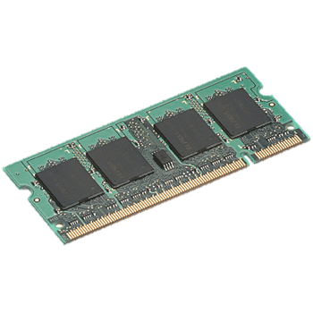






Fault Tolerance
RDDs track lineage info to rebuild lost data
file.map(lambda rec: (rec.type, 1))
.reduceByKey(lambda x, y: x + y)
.filter(lambda (type, count): count > 10)
map reduce
filter
Input file

Slide 20










Fault Tolerance
RDDs track lineage info to rebuild lost data
file.map(lambda rec: (rec.type, 1))
.reduceByKey(lambda x, y: x + y)
.filter(lambda (type, count): count > 10)
map reduce
filter
Input file

Slide 21
Partitioning
RDDs know their partitioning functions
file.map(lambda rec: (rec.type, 1))
.reduceByKey(lambda x, y: x + y)
.filter(lambda (type, count): count > 10)
map reduce
Known to be hash-partitioned
Also known
filter
Input file

Slide 22
Machine Learning example

Slide 23
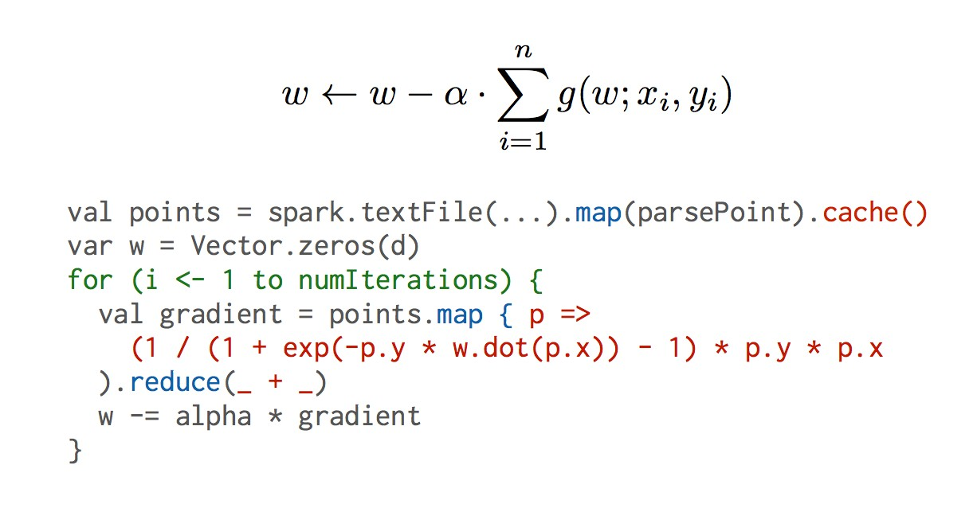
Logistic Regression
data = spark.textFile(...).map(readPoint).cache() w = numpy.random.rand(D)
for i in range(iterations): gradient = data.map(lambda p:
(1 / (1 + exp(-­‐p.y * w.dot(p.x)))) * p.y * p.x
).reduce(lambda a, b: a + b) w -­‐= gradient
print “Final w: %s” % w

Slide 24








Logistic Regression Results
4000
3500
3000
2500
2000
1500
1000
500
0
110 s / iteration
Running Time (s)
Hadoop Spark
first iteration 80 s further iterations 1 s
1
5 10 20
Number of Iterations
30
100 GB of data on 50 m1.xlarge EC2 machines

Slide 25










Behavior with Less RAM
100
80
60
40
20
0
68.8
Iteration time (s)
58.1
40.7
29.7
11.5
0%
25% 50% 75%
% of working set in memory
100%

Slide 26



Benefit for Users
Same engine performs data extraction, model training and interactive queries
Separate engines
DFS read | parse | DFS write
DFS read | train | DFS write
DFS read | query | DFS write
…
Spark
DFS read | parse | train | query
DFS

Slide 27
State of the Spark ecosystem

Slide 28

















Spark Community
Most active open source community in big data 200+ developers, 50+ companies contributing
Contributors in past year
150
100
50
Giraph
Storm
0

Slide 29
Project Activity
1600
Spark
350000
Spark
1400
300000
1200
250000
1000
200000
800
150000
600
MapReduce
YARN
HDFS
Storm
MapReduce
YARN
HDFS
Storm
400
100000
200
50000
0
0
Commits
Lines of Code Changed
Activity in past 6 months

Slide 30
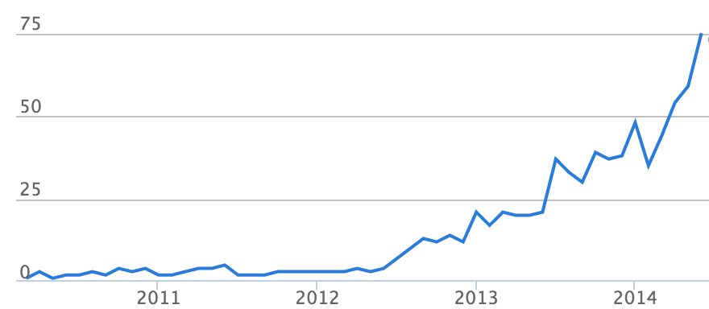
Continuing Growth
Contributors per month to Spark
source: ohloh.net

Slide 31
Built-in libraries

Slide 32


Standard Library for Big Data
Python Scala Java R
Big data apps lack libraries of common algorithms
Spark’s generality + support for multiple languages make suitable to offer this
SQL ML graph
…
Core
it
Much of future activity will be in these libraries

Slide 33
A General Platform
Standard libraries included with Spark
Spark Streaming real-time
MLlib machine learning
Spark SQL
structured
GraphX
graph
…
Spark Core

Slide 34
Machine Learning Library (MLlib)
points = context.sql(“select model = KMeans.train(points,
latitude,
10)
longitude from tweets”)
40 contributors in past year

Slide 35
MLlib algorithms
classification: logistic regression, linear SVM, naïve Bayes, classification tree
regression: generalized linear models (GLMs), regression tree
collaborative filtering: alternating least squares (ALS), non-negative matrix factorization (NMF)
clustering: k-means|| decomposition: SVD, PCA
optimization: stochastic gradient descent, L-BFGS

Slide 36
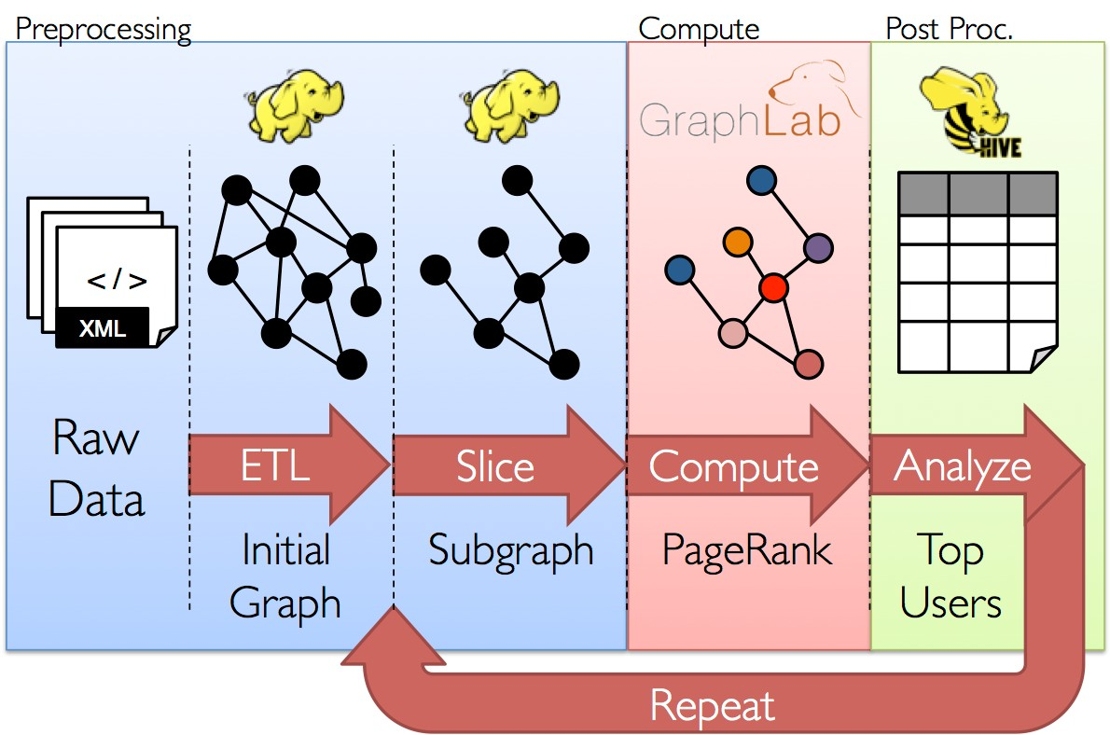
GraphX

Slide 37
GraphX
General graph processing library
Build graph using RDDs of nodes and edges
Large library of graph algorithms with composable steps

Slide 38
GraphX Algorithms
Collaborative Filtering
» Alternating Least Squares
» Stochastic Gradient Descent
» Tensor Factorization
Community Detection
» Triangle-Counting
» K-core Decomposition
» K-Truss
Structured Prediction
» Loopy Belief Propagation
» Max-Product Linear Programs
» Gibbs Sampling
Graph Analytics
» PageRank
» Personalized PageRank
» Shortest Path
» Graph Coloring
Classification
» Neural Networks
Semi-supervised ML
» Graph SSL
» CoEM

Slide 39















Spark Streaming
Run a streaming computation as a series of very small, deterministic batch jobs
live data stream
Spark Streaming
Chop up the live stream into batches of
X seconds
Spark treats each batch of data as RDDs and processes them using RDD opera;ons
Finally, the processed results of the RDD opera;ons are returned in batches
batches of X seconds
Spark
processed results

Slide 40
Spark Streaming
Run a streaming computation as a series of very small, deterministic batch jobs
live data stream
Spark Streaming
Batch sizes as low as ½ second, latency
~ 1 second
Poten;al for combining batch processing and streaming processing in the same system
batches of X seconds
Spark
processed
results

Slide 41
Spark SQL
// Run SQL statements
val teenagers = context.sql(
"SELECT name FROM people WHERE
age >= 13 AND age <= 19")
// The results of SQL queries are RDDs of Row objects
val names = teenagers.map(t => "Name: " + t(0)).collect()

Slide 42
Spark SQL
Enables loading & querying structured data in Spark
From Hive:
c = HiveContext(sc)
rows = c.sql(“select text, year from hivetable”) rows.filter(lambda r: r.year > 2013).collect()
From JSON: c.jsonFile(“tweets.json”).registerAsTable(“tweets”) c.sql(“select text, user.name from tweets”)
tweets.json
{“text”: “hi”, “user”: {
“name”: “matei”, “id”: 123
}}

Slide 43
Conclusions

Slide 44
Spark has all its roots in research, so we hope to keep incorporating new ideas!
Spark and Research

Slide 45
Conclusion
Data flow engines are becoming an important platform for numerical algorithms
While early models like MapReduce were inefficient, new ones like Spark close this gap
More info: spark.apache.org

