Slide 1


Intro to Apache Spark
Paco Nathan
http://databricks.com/

Slide 2
00: Getting Started
Introduction
installs + intros

Slide 3
Intro: Online Course Materials
In addition to these slides, all of the code samples are available on GitHub gists:
•
•
•
gist.github.com/ceteri/f2c3486062c9610eac1d gist.github.com/ceteri/8ae5b9509a08c08a1132 gist.github.com/ceteri/11381941

Slide 4
Intro: Success Criteria
Objectives:
open a Spark Shell
use of some ML algorithms
explore data sets loaded from HDFS, etc.
review Spark SQL, Spark Streaming, Shark
review advanced topics and BDAS projects
follow-up courses and certification
developer community resources, events, etc.
return to workplace and demo use of Spark!

Slide 5
Intro: Preliminaries
intros – what is your background?
who needs to use AWS instead of laptops?
PEM key, if needed? See tutorial:
Connect to Your Amazon EC2 Instance from Windows Using PuTTY

Slide 6
01: Getting Started
Installation
hands-on lab

Slide 7
Installation:
Let’s get started using Apache Spark, in just four easy steps…
http://spark.apache.org/docs/latest/

Slide 8
Step 1: Install Java JDK 6/7 on MacOSX or Windows
http://oracle.com/technetwork/java/javase/downloads/ jdk7-downloads-1880260.html
follow the license agreement instructions
then click the download for your OS
need JDK instead of JRE (for Maven, etc.)

Slide 9
Step 1: Install Java JDK 6/7 on Linux
this is much simpler on Linux…
sudo apt-get -y install openjdk-7-jdk

Slide 10
Step 2: Download Spark
we’ll be using Spark 1.0.0
see http://park.apache.org/downloads.html
download this URL with a browser
double click the archive file to open it
connect into the newly created directory

Slide 11
Step 3: Run Spark Shell
we’ll run Spark’s interactive shell…
./bin/spark-shell
then from the “scala>” REPL prompt, let’s create some data…
val data = 1 to 10000

Slide 12
Step 4: Create an RDD
create an RDD based on that data…
val distData = sc.parallelize(data)
then use a filter to select values less than 10…
distData.filter(_ < 10).collect()

Slide 13
Step 4: Create an RDD
create an
val distData = sc.parallelize(data)
then use a filter to select values less than 10…
d
Checkpoint:
what do you get for results?
gist.github.com/ceteri/ f2c3486062c9610eac1d#file-01-repl-txt

Slide 14


Installation: Optional Downloads: Python
For Python 2.7, check out Anaconda by Continuum Analytics for a full-featured platform:
store.continuum.io/cshop/anaconda/

Slide 15

Installation: Optional Downloads: Maven
Java builds later also require Maven, which you can download at:
maven.apache.org/download.cgi

Slide 16
03: Getting Started
Spark Deconstructed

Slide 17

Spark Deconstructed:
Let’s spend a few minutes on this Scala thing…
scala-lang.org/

Slide 18
Spark Deconstructed: Log Mining Example
// load error messages from a log into memory
// then interactively search for various patterns
// https://gist.github.com/ceteri/8ae5b9509a08c08a1132
// base RDD
val lines = sc.textFile("hdfs://...")
// transformed RDDs
val errors = lines.filter(_.startsWith("ERROR")) val messages = errors.map(_.split("\t")).map(r => messages.cache()
r(1))
// action 1
messages.filter(_.contains("mysql")).count()
// action 2
messages.filter(_.contains("php")).count()

Slide 19



Spark Deconstructed: Log Mining Example
We start with Spark running on a cluster… submitting code to be evaluated on it:
Worker
Worker Driver
Worker

Slide 20

Spark Deconstructed: Log Mining Example
// base RDD
val lines = sc.textFile("hdfs://...")
// transformed RDDs
val errors = lines.filter(_.startsWith("ERROR"))
val messages = errors.map(_.split("\t")).map(r => r(1)) messages.cache()
// action 1
messages.filter(_.contains("mysql")).count()
//dacitsiocn u2 ssing the other part
messages.filter(_.contains("php")).count()

Slide 21
Spark Deconstructed: Log Mining Example
At this point, take a look at the transformed RDD operator graph:
scala> messages.toDebugString res5: String =
MappedRDD[4] at map at <console>:16 (3 partitions)
MappedRDD[3] at map
at <console>:16 (3 partitions) filter at <console>:14 (3 partitions)
textFile at <console>:12 (3 partitions)
FilteredRDD[2] at
MappedRDD[1] at
HadoopRDD[0] at textFile at <console>:12 (3 partitions)

Slide 22

Spark Deconstructed: Log Mining Example
// base RDD
val lines = sc.textFile("hdfs://...")
// transformed RDDs
val errors = lines.filter(_.startsWith("ERROR"))
val messages = errors.map(_.split("\t")).map(r => r(1)) messages.cache()
// action 1
messages.filter(_.contains("mysql")).count()
Worker
// action 2
me_{d}ssa_{i}g_{s}es_{c}.f_{u}il_{s}te_{s}r(_{i}__{n}.co_{g}nta_{t}in_{h}s(_{e}"php_{o}")_{t})._{h}co_{e}unt_{r}() _{part}
Worker Driver
Worker

Slide 23
Spark Deconstructed: Log Mining Example
// base RDD
val lines = sc.textFile("hdfs://...")
// transformed RDDs
val errors = lines.filter(_.startsWith("ERROR"))
val messages = errors.map(_.split("\t")).map(r => r(1)) messages.cache()
// action 1
messages.filter(_.contains("mysql")).count()
Worker
// action 2
me_{d}ssa_{i}g_{s}es_{c}.f_{u}il_{s}te_{s}r(_{i}__{n}.co_{g}nta_{t}in_{h}s(_{e}"php_{o}")_{t})._{h}co_{e}unt_{r}() _{part}
block 1
Worker
Driver
block 2
Worker
block 3

Slide 24
Spark Deconstructed: Log Mining Example
// base RDD
val lines = sc.textFile("hdfs://...")
// transformed RDDs
val errors = lines.filter(_.startsWith("ERROR"))
val messages = errors.map(_.split("\t")).map(r => r(1)) messages.cache()
// action 1
messages.filter(_.contains("mysql")).count()
Worker
// action 2
me_{d}ssa_{i}g_{s}es_{c}.f_{u}il_{s}te_{s}r(_{i}__{n}.co_{g}nta_{t}in_{h}s(_{e}"php_{o}")_{t})._{h}co_{e}unt_{r}() _{part}
block 1
Worker
Driver
block 2
Worker
block 3

Slide 25
Spark Deconstructed: Log Mining Example
// base RDD
val lines = sc.textFile("hdfs://...")
// transformed RDDs
val errors = lines.filter(_.startsWith("ERROR"))
val messages = errors.map(_.split("\t")).map(r => r(1)) messages.cache()
// action 1
messages.filter(_.contains("mysql")).count()
Worker
read HDFS
block
// action 2
me_{d}ssa_{i}g_{s}es_{c}.f_{u}il_{s}te_{s}r(_{i}__{n}.co_{g}nta_{t}in_{h}s(_{e}"php_{o}")_{t})._{h}co_{e}unt_{r}() _{part}
block 1
Worker
read HDFS
block
Driver
block 2
Worker
read HDFS
block
block 3

Slide 26
Spark Deconstructed: Log Mining Example
// base RDD
val lines = sc.textFile("hdfs://...")
// transformed RDDs
val errors = lines.filter(_.startsWith("ERROR")) val messages = errors.map(_.split("\t")).map(r => messages.cache()
r(1))
// action 1
messages.filter(_.contains("mysql")).count()
cache 1
process, cache data
Worker
// action 2
me_{d}ssa_{i}g_{s}es_{c}.f_{u}il_{s}te_{s}r(_{i}__{n}.co_{g}nta_{t}in_{h}s(_{e}"php_{o}")_{t})._{h}co_{e}unt_{r}() _{part}
block 1
cache 2
process, cache data
Worker
Driver
block 2
cache 3
process, cache data
Worker
block 3

Slide 27
Spark Deconstructed: Log Mining Example
// base RDD
val lines = sc.textFile("hdfs://...")
// transformed RDDs
val errors = lines.filter(_.startsWith("ERROR")) val messages = errors.map(_.split("\t")).map(r => messages.cache()
r(1))
// action 1
messages.filter(_.contains("mysql")).count()
cache 1
Worker
// action 2
me_{d}ssa_{i}g_{s}es_{c}.f_{u}il_{s}te_{s}r(_{i}__{n}.co_{g}nta_{t}in_{h}s(_{e}"php_{o}")_{t})._{h}co_{e}unt_{r}() _{part}
block 1
cache 2
Worker
Driver
block 2
cache 3
Worker
block 3

Slide 28

Spark Deconstructed: Log Mining Example
// base RDD
val lines = sc.textFile("hdfs://...")
// transformed RDDs
va_{d}l e_{i}r_{s}ro_{c}rs_{u}=_{s}l_{s}in_{i}e_{n}s.f_{g}ilt_{t}er_{h}(__{e}.sta_{o}rt_{t}sW_{h}it_{e}h("_{r}ERR_{p}OR_{a}")_{r}) _{t}
val messages = errors.map(_.split("\t")).map(r => r(1))
messages.cache()
// action 1
messages.filter(_.contains("mysql")).count()
cache 1
Worker
// action 2
messages.filter(_.contains("php")).count()
block 1
cache 2
Worker
Driver
block 2
cache 3
Worker
block 3

Slide 29
Spark Deconstructed: Log Mining Example
// base RDD
val lines = sc.textFile("hdfs://...")
// transformed RDDs
va_{d}l e_{i}r_{s}ro_{c}rs_{u}=_{s}l_{s}in_{i}e_{n}s.f_{g}ilt_{t}er_{h}(__{e}.sta_{o}rt_{t}sW_{h}it_{e}h("_{r}ERR_{p}OR_{a}")_{r}) _{t}
val messages = errors.map(_.split("\t")).map(r => r(1))
messages.cache()
// action 1
messages.filter(_.contains(“mysql")).count()
cache 1
process from cache
Worker
// action 2
messages.filter(_.contains("php")).count()
block 1
cache 2
process from cache
Worker
Driver
block 2
cache 3
process from cache
Worker
block 3

Slide 30
Spark Deconstructed: Log Mining Example
// base RDD
val lines = sc.textFile("hdfs://...")
// transformed RDDs
va_{d}l e_{i}r_{s}ro_{c}rs_{u}=_{s}l_{s}in_{i}e_{n}s.f_{g}ilt_{t}er_{h}(__{e}.sta_{o}rt_{t}sW_{h}it_{e}h("_{r}ERR_{p}OR_{a}")_{r}) _{t}
val messages = errors.map(_.split("\t")).map(r => r(1))
messages.cache()
// action 1
messages.filter(_.contains(“mysql")).count()
cache 1
Worker
// action 2
messages.filter(_.contains("php")).count()
block 1
cache 2
Worker
Driver
block 2
cache 3
Worker
block 3

Slide 31
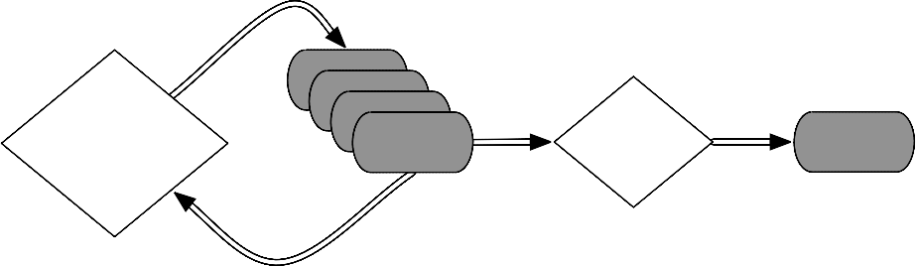




Spark Deconstructed:
Looking at the RDD transformations and actions from another perspective…
// load error messages from a log into memory
// then interactively search for various patterns
// https://gist.github.com/ceteri/8ae5b9509a08c08a1132
// base RDD
val lines = sc.textFile("hdfs://...")
RDD
RDD
RDD
RDD
transformations
action
value
// transformed RDDs
val errors = lines.filter(_.startsWith("ERROR"))
val messages = errors.map(_.split("\t")).map(r => r(1)) messages.cache()
// action 1
messages.filter(_.contains("mysql")).count()
// action 2
messages.filter(_.contains("php")).count()

Slide 32
Spark Deconstructed:
RDD
// base RDD
val lines = sc.textFile("hdfs://...")

Slide 33
Spark Deconstructed:
RDD
RDD
RDD
transformations
RDD
// transformed RDDs
val errors = lines.filter(_.startsWith("ERROR")) val messages = errors.map(_.split("\t")).map(r => messages.cache()
r(1))

Slide 34
Spark Deconstructed:
RDD
RDD
RDD
transformations
RDD
action
value
// action 1
messages.filter(_.contains("mysql")).count()

Slide 35
04: Getting Started
Simple Spark Apps

Slide 36
Simple Spark Apps: WordCount
Definition:
count how often each word appears in a collection of text documents
void map (String doc_id, String text): for each word w in segment(text):
emit(w, "1");
count how often each word appears in a collection of text documents
This simple program provides a good test case for parallel processing, since it:
•
•
requires a minimal amount of code demonstrates use of both symbolic and
numeric values
isn’t many steps away from search indexing serves as a “Hello World” for Big Data apps
void reduce (String word, Iterator group): int count = 0;
for each pc in group: count += Int(pc);
•
•
emit(word, String(count));
A distributed computing framework that can run WordCount efficiently in parallel at scale can likely handle much larger and more interesting compute problems

Slide 37
Simple Spark Apps: WordCount
Scala:
val f = sc.textFile("README.md") val wc = f.flatMap(l => l.split(" wc.saveAsTextFile("wc_out.txt") | ")).map(word | => | (word, | 1)).reduceByKey(_ | + | _)
Python:
from operator import add f = sc.textFile("README.md") wc = f.flatMap(lambda x: x.split(' wc.saveAsTextFile("wc_out.txt") | ')).map(lambda | x: (x, | 1)).reduceByKey(add)

Slide 38
Simple Spark Apps: WordCount
Scala:
val f = sc.textFile( val wc wc.saveAsTextFile(
Checkpoint:
Python how many “Spark” keywords?
:
from operator
f = sc wc = f
wc.saveAsTextFile(

Slide 39


Simple Spark Apps: Code + Data
The code + data for the following example of a join is available in:
gist.github.com/ceteri/11381941
stage 1
cached partition
A:
B:
RDD
map()
map()
E:
stage 2
C:
D:
join()
map()
map()
stage 3

Slide 40
Simple Spark Apps: Source Code
val format = new java.text.SimpleDateFormat("yyyy-MM-dd")
case lng: case
class Register (d: java.util.Date, uuid: String, cust_id: String, lat: Float, Float)
class Click (d: java.util.Date, uuid: String, landing_page: Int)
val reg = sc.textFile("reg.tsv").map(_.split("\t")).map(
r => (r(1), Register(format.parse(r(0)), r(1), r(2), r(3).toFloat, r(4).toFloat))
)
val clk = sc.textFile("clk.tsv").map(_.split("\t")).map(
c => (c(1), Click(format.parse(c(0)), c(1), c(2).trim.toInt))
)
reg.join(clk).take(2)

Slide 41

Simple Spark Apps: Operator Graph
scala> reg.join(clk).toDebugString res5: String =
FlatMappedValuesRDD[46] at join at <console>:23 (1 partitions) MappedValuesRDD[45] at join at <console>:23 (1 partitions)
CoGroupedRDD[44] at join at <console>:23 (1 partitions) MappedRDD[36] at map at <console>:16 (1 partitions)
MappedRDD[35] at map at <console>:16 (1 partitions) MappedRDD[34] at textFile at <console>:16 (1 partitions)
HadoopRDD[33] at textFile at <console>:16 (1 partitions) MappedRDD[40] at map at <console>:16 (1 partitions)
MappedRDD[39] at map at <console>:16 (1 partitions) MappedRDD[38] at textFile at <console>:16 (1 partitions)
HadoopRDD[37] at textFile at <console>:16 (1 partitions)
stage 1
cached partition
A:
B:
RDD
map()
map()
E:
stage 2
C:
D:
join()
map()
map()
stage 3

Slide 42
Simple Spark Apps: Operator Graph
stage 1
cached partition
A:
 | B:
RDD
E:
map()
map()
stage 2
C:
 | D:
join()
map()
map()
stage 3

Slide 43
Simple Spark Apps: Assignment
Using the README.md and CHANGES.txt files in the Spark directory:
create RDDs to filter each line for the keyword “Spark”
perform a WordCount on each, i.e., so the results are (K,V) pairs of (word, count)
join the two RDDs

Slide 44
Simple Spark Apps: Assignment
Using the
the Spark directory:
1. create RDDs to filter each file for the keyword
“S
2. pe
park”
rform a WordCount on each, i.e., so the lts are (K,V) pairs of (word, count)
Checkpoint:
how many “Spark” keywords?
resu
3. join the two RDDs

Slide 45
05: Getting Started
A Brief History

Slide 46

A Brief History:
2004
MapReduce paper
2010
Spark paper
2002
2004
2006
2008
2010
2012
2014
2002
2008
Hadoop Summit
2014
MapReduce @ Google
Apache Spark top-level
2006
Hadoop @ Yahoo!

Slide 47
A Brief History: MapReduce
circa 1979 – Stanford, MIT, CMU, etc.
set/list operations in LISP, Prolog, etc., for parallel processing
www-formal.stanford.edu/jmc/history/lisp/lisp.htm
circa 2004 – Google
MapReduce: Simplified Data Processing on Large Clusters Jeffrey Dean and Sanjay Ghemawat research.google.com/archive/mapreduce.html
circa 2006 – Apache
Hadoop, originating from the Nutch Project Doug Cutting research.yahoo.com/files/cutting.pdf
circa 2008 – Yahoo
web scale search indexing Hadoop Summit, HUG, etc. developer.yahoo.com/hadoop/
circa 2009 – Amazon AWS
Elastic MapReduce
Hadoop modified for EC2/S3, plus support for Hive, Pig, Cascading, etc.
aws.amazon.com/elasticmapreduce/

Slide 48
A Brief History: MapReduce
Open Discussion:
Enumerate several changes in data center technologies since 2002…

Slide 49
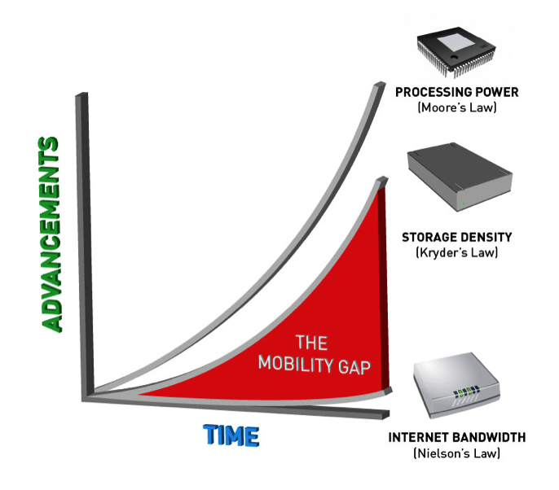
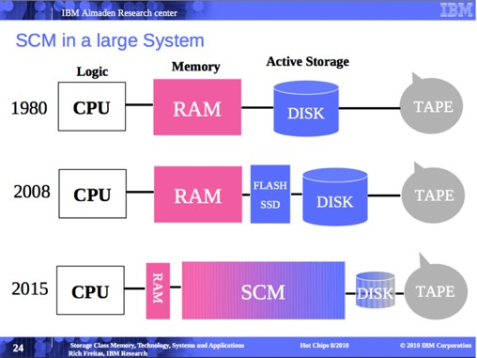
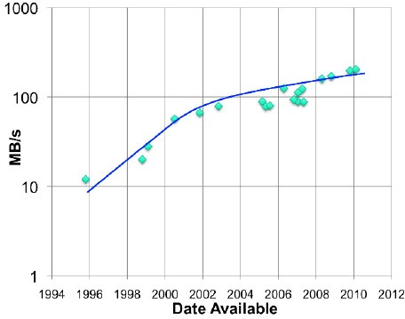
A Brief History: MapReduce
Rich Freitas, IBM Research
pistoncloud.com/2013/04/storage- and-the-mobility-gap/
meanwhile, spinny disks haven’t changed all that much…
storagenewsletter.com/rubriques/hard- disk-drives/hdd-technology-trends-ibm/

Slide 50
A Brief History: MapReduce
MapReduce use cases showed two major limitations:
difficultly of programming directly in MR
performance bottlenecks, or batch not fitting the use cases
In short, MR doesn’t compose well for large applications
Therefore, people built specialized systems as workarounds…

Slide 51


A Brief History: MapReduce
Pregel
Giraph
Dremel
Drill
Tez
MapReduce
Impala
GraphLab
Storm
S4
General Batch Processing
Specialized Systems:
iterative, interactive, streaming, graph, etc.
The State of Spark, and Where We're Going Next
Matei Zaharia
Spark Summit (2013)
youtu.be/nU6vO2EJAb4

Slide 52
A Brief History: Spark
2004
MapReduce paper
2010
Spark paper
2002
2004
2006
2008
2010
2012
2014
2002
2008
Hadoop Summit
2014
MapReduce @ Google
Apache Spark top-level
2006
Hadoop @ Yahoo!
Spark: Cluster Computing with Working Sets Matei Zaharia, Mosharaf Chowdhury, Michael J. Franklin, Scott Shenker, Ion Stoica USENIX HotCloud (2010)
people.csail.mit.edu/matei/papers/2010/hotcloud_spark.pdf
Resilient Distributed Datasets: A Fault-Tolerant Abstraction for In-Memory Cluster Computing
Matei Zaharia, Mosharaf Chowdhury,Tathagata Das,Ankur Dave,
Justin Ma, Murphy McCauley, Michael J. Franklin, Scott Shenker, Ion Stoica NSDI (2012)
usenix.org/system/files/conference/nsdi12/nsdi12-final138.pdf

Slide 53
A Brief History: Spark
Unlike the various specialized systems, Spark’s
goal was to generalize MapReduce to support new apps within same engine
Two reasonably small additions are enough to express the previous models:
fast data sharing
general DAGs
This allows for an approach which is more efficient for the engine, and much simpler for the end users

Slide 54

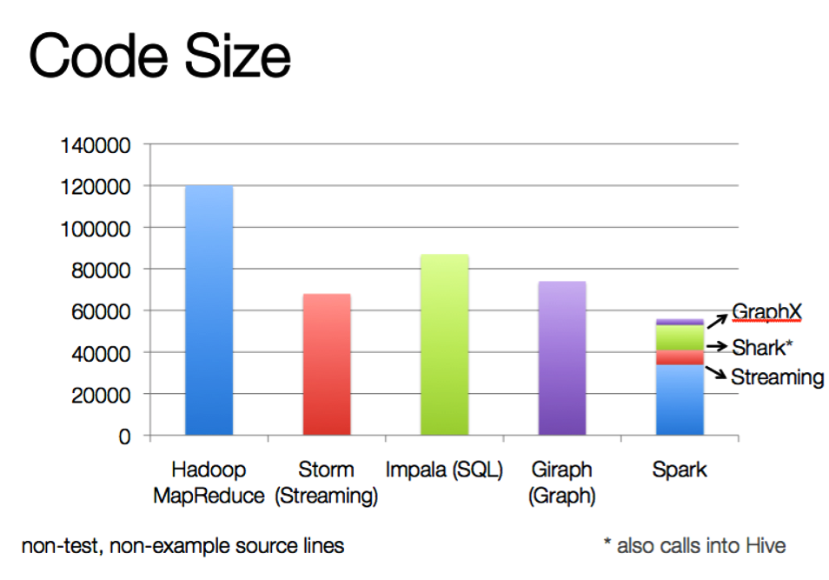
A Brief History: Spark
The State of Spark, and Where We're Going Next
Matei Zaharia
Spark Summit (2013)
youtu.be/nU6vO2EJAb4
used as libs, instead of specialized systems

Slide 55
A Brief History: Spark
Some key points about Spark:
handles batch, interactive, and real-time within a single framework
native integration with Java, Python, Scala
programming at a higher level of abstraction
more general: map/reduce is just one set
of supported constructs

Slide 56

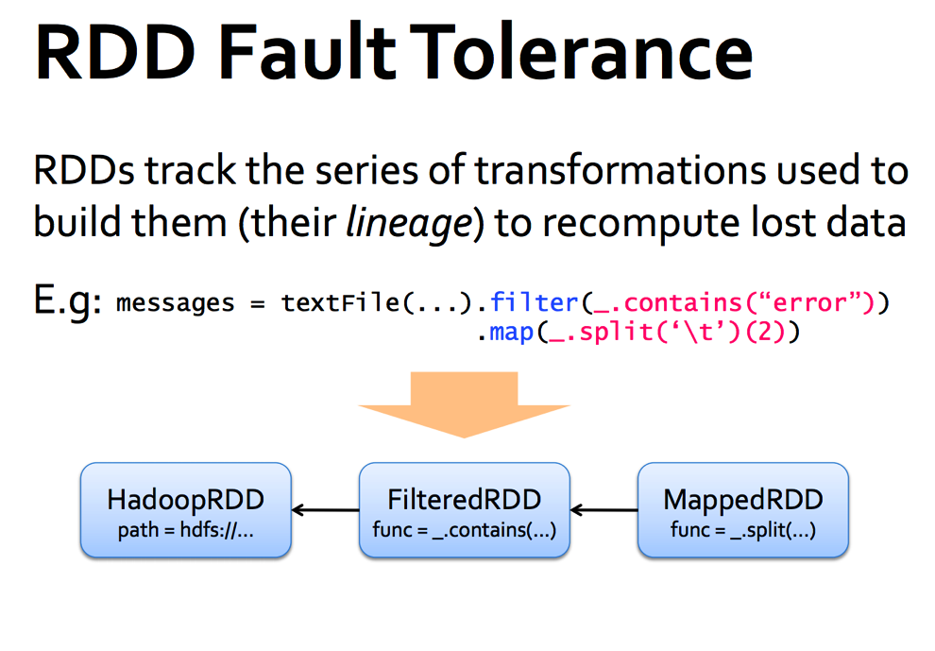
A Brief History: Spark
The State of Spark, and Where We're Going Next
Matei Zaharia
Spark Summit (2013)
youtu.be/nU6vO2EJAb4

Slide 57

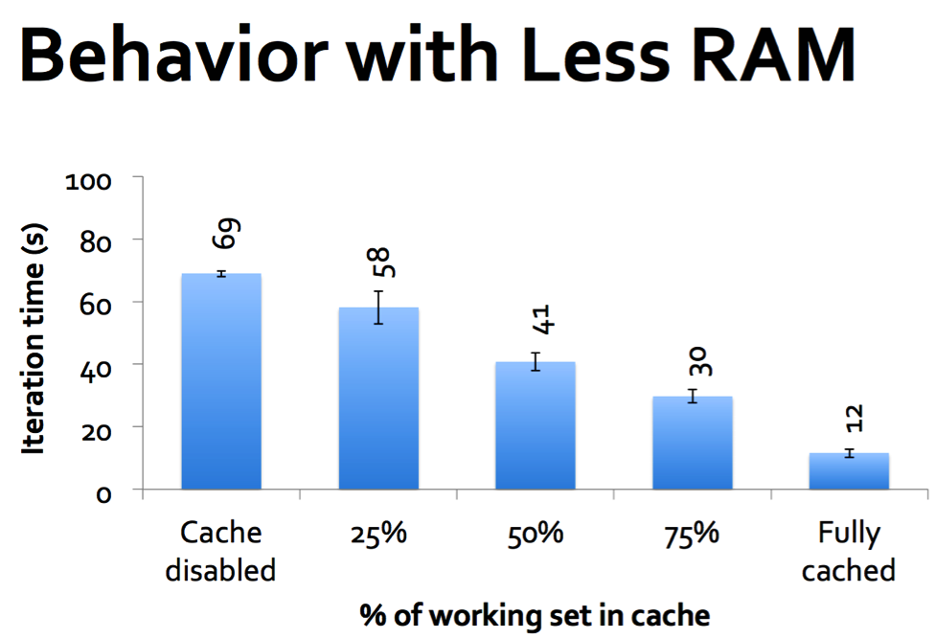
A Brief History: Spark
The State of Spark, and Where We're Going Next
Matei Zaharia
Spark Summit (2013)
youtu.be/nU6vO2EJAb4

Slide 58
03: Intro Spark Apps
Spark Essentials

Slide 59
Spark Essentials:
Intro apps, showing examples in both Scala and Python…
Let’s start with the basic concepts in:
spark.apache.org/docs/latest/scala- programming-guide.html
using, respectively:
./bin/spark-shell
./bin/pyspark
alternatively, with IPython Notebook:
IPYTHON_OPTS="notebook --pylab inline" ./bin/pyspark

Slide 60
Spark Essentials: SparkContext
First thing that a Spark program does is create a SparkContext object, which tells Spark how to access a cluster
In the shell for either Scala or Python, this is the sc variable, which is created automatically
Other programs must use a constructor to instantiate a new SparkContext
Then in turn SparkContext gets used to create other variables

Slide 61
Spark Essentials: SparkContext
Scala:
scala> sc
res: spark.SparkContext
= spark.SparkContext@470d1f30
Python:
>>> sc
<pyspark.context.SparkContext object at 0x7f7570783350>

Slide 62
Spark Essentials: Master
The master parameter for a SparkContext
determines which cluster to use
master | description
local | run Spark locally with one worker thread (no parallelism)
local[K] | run Spark locally with K worker threads (ideally set to # cores)
spark://HOST:PORT | connect to a Spark standalone cluster; PORT depends on config (7077 by default)
mesos://HOST:PORT | connect to a Mesos cluster; PORT depends on config (5050 by default)

Slide 63


Spark Essentials: Master
spark.apache.org/docs/latest/cluster- overview.html
Worker Node
Exectuor
cache
task
task
Driver Program SparkContext |  | Cluster Manager
Worker Node
Exectuor
cache
task
task

Slide 64
Spark Essentials: Master
connects to a cluster manager which allocate resources across applications
acquires executors on cluster nodes – worker processes to run computations and store data
sends app code to the executors
sends tasks for the executors to run
Worker Node
Exectuor
cache
task
task
Driver Program SparkContext |  | Cluster Manager
Worker Node
Exectuor
cache
task
task

Slide 65
Spark Essentials: RDD
Resilient Distributed Datasets (RDD) are the
primary abstraction in Spark – a fault-tolerant collection of elements that can be operated on in parallel
There are currently two types:
parallelized collections – take an existing Scala collection and run functions on it in parallel
Hadoop datasets – run functions on each record
of a file in Hadoop distributed file system or any
other storage system supported by Hadoop

Slide 66
Spark Essentials: RDD
two types of operations on RDDs:
transformations and actions
transformations are lazy (not computed immediately)
the transformed RDD gets recomputed when an action is run on it (default)
however, an RDD can be persisted into storage in memory or disk

Slide 67
Spark Essentials: RDD
Scala:
scala> val data = Array(1, 2, 3, 4, 5)
data: Array[Int] = Array(1, 2, 3, 4, 5)
scala> val distData = sc.parallelize(data)
distData: spark.RDD[Int] = spark.ParallelCollection@10d13e3e
Python:
>>> data = [1, 2, 3, 4, 5]
>>> data
[1, 2, 3, 4, 5]
>>> distData = sc.parallelize(data)
>>> distData
ParallelCollectionRDD[0] at parallelize at PythonRDD.scala:229

Slide 68
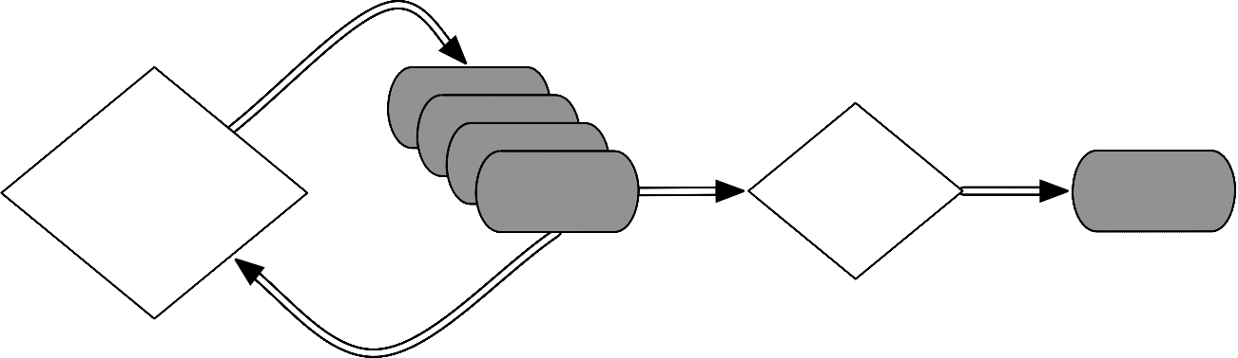
Spark Essentials: RDD
Spark can create RDDs from any file stored in HDFS or other storage systems supported by Hadoop, e.g., local file system,Amazon S3, Hypertable, HBase, etc.
Spark supports text files, SequenceFiles, and any other Hadoop InputFormat, and can also take a directory or a glob (e.g. /data/201404*)
RDD
RDD
RDD
RDD
transformations
action
value

Slide 69
Spark Essentials: RDD
Scala:
scala> val distFile = sc.textFile("README.md") distFile: spark.RDD[String] = spark.HadoopRDD@1d4cee08
Python:
>>> distFile = sc.textFile("README.md")
14/04/19 23:42:40 INFO storage.MemoryStore: ensureFreeSpace(36827) with curMem=0, maxMem=318111744
called
14/04/19 23:42:40 INFO storage.MemoryStore: Block broadcast_0 stored as values to memory (estimated size 36.0 KB, free 303.3 MB)
>>> distFile
MappedRDD[2] at textFile at NativeMethodAccessorImpl.java:-2

Slide 70
Spark Essentials: Transformations
Transformations create a new dataset from
an existing one
All transformations in Spark are lazy: they do not compute their results right away – instead they remember the transformations applied to some base dataset
optimize the required calculations
recover from lost data partitions

Slide 71
Spark Essentials: Transformations
transformation | description
map(func) | return a new distributed dataset formed by passing each element of the source through a function func
filter(func) | return a new dataset formed by selecting those elements of the source on which func returns true
flatMap(func) | similar to map, but each input item can be mapped to 0 or more output items (so func should return a Seq rather than a single item)
sample(withReplacement, fraction, seed) | sample a fraction fraction of the data, with or without replacement, using a given random number generator seed
union(otherDataset) | return a new dataset that contains the union of the elements in the source dataset and the argument
distinct([numTasks])) | return a new dataset that contains the distinct elements of the source dataset

Slide 72
Spark Essentials: Transformations
transformation | description
groupByKey([numTasks]) | when called on a dataset of (K, V) pairs, returns a dataset of (K, Seq[V]) pairs
reduceByKey(func, [numTasks]) | when called on a dataset of (K, V) pairs, returns a dataset of (K, V) pairs where the values for each key are aggregated using the given reduce function
sortByKey([ascending], [numTasks]) | when called on a dataset of (K, V) pairs where K implements Ordered, returns a dataset of (K, V) pairs sorted by keys in ascending or descending order, as specified in the boolean ascending argument
join(otherDataset, [numTasks]) | when called on datasets of type (K, V) and (K, W), returns a dataset of (K, (V, W)) pairs with all pairs of elements for each key
cogroup(otherDataset, [numTasks]) | when called on datasets of type (K, V) and (K, W), returns a dataset of (K, Seq[V], Seq[W]) tuples – also called groupWith
cartesian(otherDataset) | when called on datasets of types T and U, returns a dataset of (T, U) pairs (all pairs of elements)

Slide 73
Spark Essentials: Transformations
Scala:
val distFile = sc.textFile("README.md") distFile.map(l => l.split(" ")).collect()
distFile is a collection of lines
distFile.flatMap(l => l.split(" ")).collect()
Python:
distFile = sc.textFile("README.md") distFile.map(lambda x: x.split(' ')).collect() distFile.flatMap(lambda x: x.split(' ')).collect()

Slide 74
Spark Essentials: Transformations
Scala:
val distFile = sc.textFile("README.md") distFile.map(l => l.split(" ")).collect() distFile.flatMap(l => l.split(" ")).collect()
closures
Python:
distFile = sc.textFile("README.md") distFile.map(lambda x: x.split(' ')).collect() distFile.flatMap(lambda x: x.split(' ')).collect()

Slide 75
Spark Essentials: Transformations
Scala:
val distFile = sc.textFile("README.md") distFile.map(l => l.split(" ")).collect() distFile.flatMap(l => l.split(" ")).collect()
closures
Python:
distFile = sc.textFile("README.md") distFile.map(lambda x: x.split(' ')).collect() distFile.flatMap(lambda x: x.split(' ')).collect()
looking at the output, how would you compare results for map() vs. flatMap() ?

Slide 76
Spark Essentials: Transformations
Using closures is now possible in Java 8 with
lambda expressions support, see the tutorial:
databricks.com/blog/2014/04/14/Spark-with- Java-8.html
RDD
RDD
RDD
RDD
transformations
action
value

Slide 77
Spark Essentials: Transformations
Java 7:
JavaRDD<String> distFile = sc.textFile("README.md");
// Map each line to multiple words JavaRDD<String> words = distFile.flatMap(
new FlatMapFunction<String, String>() | {
public Iterable<String> call(String | line) | {
return Arrays.asList(line.split(" | "));
}
});
Java 8:
JavaRDD<String> JavaRDD<String>
distFile = sc.textFile("README.md"); words =
distFile.flatMap(line -> Arrays.asList(line.split("
")));

Slide 78
Spark Essentials: Actions
action | description
reduce(func) | aggregate the elements of the dataset using a function func (which takes two arguments and returns one), and should also be commutative and associative so that it can be computed correctly in parallel
collect() | return all the elements of the dataset as an array at the driver program – usually useful after a filter or other operation that returns a sufficiently small subset of the data
count() | return the number of elements in the dataset
first() | return the first element of the dataset – similar to take(1)
take(n) | return an array with the first n elements of the dataset – currently not executed in parallel, instead the driver program computes all the elements
takeSample(withReplacement, fraction, seed) | return an array with a random sample of num elements of the dataset, with or without replacement, using the given random number generator seed

Slide 79
Spark Essentials: Actions
action | description
saveAsTextFile(path) | write the elements of the dataset as a text file (or set of text files) in a given directory in the local filesystem, HDFS or any other Hadoop-supported file system. Spark will call toString on each element to convert it to a line of text in the file
saveAsSequenceFile(path) | write the elements of the dataset as a Hadoop SequenceFile in a given path in the local filesystem, HDFS or any other Hadoop-supported file system. Only available on RDDs of key-value pairs that either implement Hadoop's Writable interface or are implicitly convertible to Writable (Spark includes conversions for basic types like Int, Double, String, etc).
countByKey() | only available on RDDs of type (K, V). Returns a `Map` of (K, Int) pairs with the count of each key
foreach(func) | run a function func on each element of the dataset – usually done for side effects such as updating an accumulator variable or interacting with external storage systems

Slide 80
Spark Essentials: Actions
Scala:
val f = sc.textFile("README.md") val words = f.flatMap(l => l.split(" ")).map(word | => | (word, | 1))
words.reduceByKey(_ + _).collect.foreach(println)
Python:
from operator import add f = sc.textFile("README.md") words = f.flatMap(lambda x: x.split(' ')).map(lambda | x: (x, | 1))
words.reduceByKey(add).collect()

Slide 81
Spark Essentials: Persistence
Spark can persist (or cache) a dataset in memory across operations
Each node stores in memory any slices of it that it computes and reuses them in other actions on that dataset – often making future actions more than 10x faster
The cache is fault-tolerant: if any partition of an RDD is lost, it will automatically be recomputed using the transformations that originally created it

Slide 82
Spark Essentials: Persistence
transformation | description
MEMORY_ONLY | Store RDD as deserialized Java objects in the JVM. If the RDD does not fit in memory, some partitions will not be cached and will be recomputed on the fly each time they're needed.This is the default level.
MEMORY_AND_DISK | Store RDD as deserialized Java objects in the JVM. If the RDD does not fit in memory, store the partitions that don't fit on disk, and read them from there when they're needed.
MEMORY_ONLY_SER | Store RDD as serialized Java objects (one byte array per partition).This is generally more space-efficient than deserialized objects, especially when using a fast serializer, but more CPU-intensive to read.
MEMORY_AND_DISK_SER | Similar to MEMORY_ONLY_SER, but spill partitions that don't fit in memory to disk instead of recomputing them on the fly each time they're needed.
DISK_ONLY | Store the RDD partitions only on disk.
MEMORY_ONLY_2, MEMORY_AND_DISK_2, etc | Same as the levels above, but replicate each partition on two cluster nodes.

Slide 83
Spark Essentials: Persistence
Scala:
val f = sc.textFile("README.md") val w = f.flatMap(l => l.split(" ")).map(word w.reduceByKey(_ + _).collect.foreach(println) | => | (word, | 1)).cache()
Python:
from operator import add f = sc.textFile("README.md") w = f.flatMap(lambda x: x.split(' ')).map(lambda w.reduceByKey(add).collect() | x: (x, | 1)).cache()

Slide 84
Spark Essentials: Broadcast Variables
Broadcast variables let programmer keep a read-only variable cached on each machine rather than shipping a copy of it with tasks
For example, to give every node a copy of a large input dataset efficiently
Spark also attempts to distribute broadcast variables using efficient broadcast algorithms to reduce communication cost

Slide 85
Spark Essentials: Broadcast Variables
Scala:
val broadcastVar = sc.broadcast(Array(1, broadcastVar.value
2, 3))
Python:
broadcastVar = sc.broadcast(list(range(1, broadcastVar.value
4)))

Slide 86
Spark Essentials: Accumulators
Accumulators are variables that can only be “added” to through an associative operation
Used to implement counters and sums, efficiently in parallel
Spark natively supports accumulators of numeric value types and standard mutable collections, and programmers can extend for new types
Only the driver program can read an accumulator’s value, not the tasks

Slide 87
Spark Essentials: Accumulators
Scala:
val accum = sc.accumulator(0) sc.parallelize(Array(1, 2, 3, | 4)).foreach(x | => | accum | += | x)
accum.value
Python:
accum = sc.accumulator(0)
rdd = sc.parallelize([1, 2, 3, 4])
def f(x):
global accum accum += x
rdd.foreach(f) accum.value

Slide 88
Spark Essentials: Accumulators
Scala:
val accum = sc.accumulator(0) sc.parallelize(Array(1, 2, 3,
accum.value
4)).foreach(x
=> accum += x)
driver-side
Python:
accum = sc.accum rdd = sc.paralle def f(x):
global accum accum += x
ulator(0)
lize([1, 2, 3, 4])
rdd.foreach(f)
accum.value

Slide 89
Spark Essentials: (K,V) pairs
Scala:
val pair = (a, | b)
pair._1 // pair._2 // | => => | a b
Python:
pair = (a, b)
pair[0] pair[1]
# => a
# => b
Java:
Tuple2 pair
= new Tuple2(a, b);
pair._1 | // => | a
pair._2 | // => | b

Slide 90
Spark Essentials: API Details
For more details about the Scala/Java API:
spark.apache.org/docs/latest/api/scala/ index.html#org.apache.spark.package
For more details about the Python API:
spark.apache.org/docs/latest/api/python/

Slide 91
03: Intro Spark Apps
Spark Examples

Slide 92
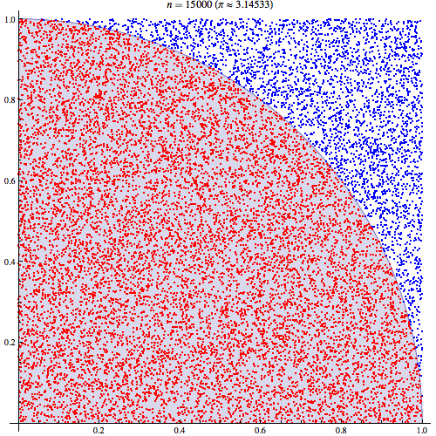
Spark Examples: Estimate Pi
Next, try using a Monte Carlo method to estimate the value of Pi
./bin/run-example SparkPi 2 local
wikipedia.org/wiki/Monte_Carlo_method

Slide 93
Spark Examples: Estimate Pi
import scala.math.random
import org.apache.spark._
/** Computes an approximation to pi */
object SparkPi {
def main(args: Array[String]) {
val conf = new SparkConf().setAppName("Spark Pi") val spark = new SparkContext(conf)
val slices = if (args.length > 0) args(0).toInt else 2
val n = 100000 * slices
val count = spark.parallelize(1 to n, slices).map { i =>
val x = | random * 2 | - | 1
val y = | random * 2 | - | 1
if (x*x | + y*y < 1) | 1 | else 0
}.reduce(_ + _)
println("Pi is roughly " + 4.0 * count / n) spark.stop()
}
}

Slide 94

Spark Examples: Estimate Pi
val count = sc.parallelize(1 to
n, slices)
base RDD
.map | { | i | =>
val | x | = | random * 2 | - 1
val | y | = | random * 2 | - 1
transformed RDD
if (x*x + y*y
}
.reduce(_ + _)
< 1) 1 else 0
action
RDD
RDD
RDD
RDD
transformations
action
value

Slide 95
Spark Examples: Estimate Pi
val count
base RDD
.map val val if
}
transformed RDD
.redu
^{ce} action
Checkpoint:
what estimate do you get for Pi?
RDD
RDD
RDD
RDD
transformations
action
value

Slide 96
Spark Examples: K-Means
Next, try using K-Means to cluster a set of vector values:
cp ../data/examples-data/kmeans_data.txt .
./bin/run-example SparkKMeans kmeans_data.txt 3
Based on the data set:
0.01
local
0.0 | 0.0 | 0.0
0.1 | 0.1 | 0.1
0.2 | 0.2 | 0.2
9.0 | 9.0 | 9.0
9.1 | 9.1 | 9.1
9.2 | 9.2 | 9.2
Please refer to the source code in:
examples/src/main/scala/org/apache/spark/examples/SparkKMeans.scala

Slide 97
Spark Examples: PageRank
Next, try using PageRank to rank the relationships in a graph:
cp ../data/examples-data/pagerank_data.txt .
./bin/run-example SparkPageRank pagerank_data.txt 10 local
Based on the data set:
1 | 2
1 | 3
1 | 4
2 | 1
3 | 1
4 | 1
Please refer to the source code in:
examples/src/main/scala/org/apache/spark/examples/SparkPageRank.scala

Slide 98
04: Data Workflows
Unifying the Pieces

Slide 99
Data Workflows:
Again, unlike the various specialized systems,
Spark’s goal was to generalize MapReduce to support new apps within same engine
Two reasonably small additions allowed the previous specialized models to be expressed within Spark:
fast data sharing
general DAGs
Pregel
Giraph
Dremel
Drill
Tez
MapReduce
Impala
GraphLab
Storm
S4
General Batch Processing
Specialized Systems:
iterative, interactive, streaming, graph, etc.

Slide 100
Data Workflows:
Unifying the pieces into a single app:
Spark SQL, Streaming, Shark, MLlib, etc.
discuss how the same business logic can be deployed across multiple topologies
demo Spark SQL
demo Spark Streaming
discuss features/benefits for Shark
discuss features/benefits for MLlib

Slide 101
Data Workflows: Spark SQL
blurs the lines between RDDs and relational tables
spark.apache.org/docs/latest/sql-programming- guide.html
intermix SQL commands to query external data, along with complex analytics, in a single app:
allows SQL extensions based on MLlib
Shark is being migrated to Spark SQL
Spark SQL: Manipulating Structured Data Using Spark Michael Armbrust, Reynold Xin (2014-03-24) databricks.com/blog/2014/03/26/Spark-SQL- manipulating-structured-data-using-Spark.html

Slide 102
Data Workflows: Spark SQL
val sqlContext = new org.apache.spark.sql.SQLContext(sc) import sqlContext._
// Define the schema using a case class.
case class Person(name: String, age: Int)
// Create an RDD of Person objects and register it as a table.
val people = sc.textFile("examples/src/main/resources/ people.txt").map(_.split(",")).map(p => Person(p(0), p(1).trim.toInt))
people.registerAsTable("people")
// SQL statements can be run by using the sql methods provided by sqlContext.
val teenagers = sql("SELECT name FROM people WHERE age >= 13 AND age <= 19")
// | The results of SQL queries are SchemaRDDs | and support all the
// | normal RDD operations.
// | The columns of a row in the result can be | accessed by ordinal.
teenagers.map(t => "Name: " + t(0)).collect().foreach(println)

Slide 103
Data Workflows: Spark SQL
val sqlContext
import
// Define the schema using a case class.
case class
// Create an
RDD of Person objects and register it as a table.
val people
people.txt"
Checkpoint:
what name do you get?
people
// SQL sta
tements can be run by using the sql methods pr
ovided by
sqlContext.
val teenagers
// The results of SQL queries are SchemaRDDs and support all the
// normal RDD operations.
// The columns of a row in the result can be accessed by ordinal.
teenagers

Slide 104
Data Workflows: Spark SQL
Source files, commands, and expected output are shown in this gist:
gist.github.com/ceteri/ f2c3486062c9610eac1d#file-05-spark-sql-txt

Slide 105
Data Workflows: Spark SQL: queries in HiveQL
//val sc: SparkContext // An existing SparkContext.
//NB: example on laptop lacks a Hive MetaStore
val hiveContext = new org.apache.spark.sql.hive.HiveContext(sc)
// Importing the SQL context gives access to all the
// public SQL functions and implicit conversions.
import hiveContext._
hql("CREATE TABLE IF NOT EXISTS src (key INT, value STRING)")
hql("LOAD DATA LOCAL INPATH 'examples/src/main/resources/kv1.txt'
INTO TABLE src")
// Queries are expressed in HiveQL
hql("FROM src SELECT key, value").collect().foreach(println)

Slide 106

Data Workflows: Spark SQL: Parquet
Parquet is a columnar format, supported by many different Big Data frameworks
http://parquet.io/
Spark SQL supports read/write of parquet files, automatically preserving the schema of the original data (HUGE benefits)
Modifying the previous example…

Slide 107
Data Workflows: Spark SQL: Parquet
val sqlContext = new org.apache.spark.sql.SQLContext(sc) import sqlContext._
// Define the schema using a case class.
case class Person(name: String, age: Int)
// Create an RDD of Person objects and register it as a table.
val people = sc.textFile("examples/src/main/resources/people.txt"). map(_.split(",")).map(p => Person(p(0), p(1).trim.toInt)) people.registerAsTable("people")
// The RDD is implicitly converted to a SchemaRDD
## allowing it to be stored using parquet.
people.saveAsParquetFile("people.parquet")
// Read in the parquet file created above. Parquet files are
// self-describing so the schema is preserved.
// The result of loading a parquet file is also a JavaSchemaRDD.
val parquetFile = sqlContext.parquetFile("people.parquet")
//Parquet files can also be registered as tables and then used in
// SQL statements. parquetFile.registerAsTable("parquetFile") val teenagers =
sql("SELECT name FROM parquetFile WHERE age >= 13 AND age <= 19")
teenagers.collect().foreach(println)

Slide 108
Data Workflows: Spark SQL: Parquet
In particular, check out the query plan in the console output:
== Query Plan == Project [name#4:0]
Filter ((age#5:1 >= 13) && (age#5:1 <= 19))
ParquetTableScan [name#4,age#5], (ParquetRelation people.parquet),
None
generated from the SQL query:
SELECT name FROM parquetFile WHERE age >= 13 AND age <= 19

Slide 109
Data Workflows: Spark SQL: Parquet
An output directory get created for each Parquet “file”:
$ ls people.parquet/
._SUCCESS.crc | .part-r-1.parquet.crc | _SUCCESS | part-r-1.parquet
._metadata.crc | .part-r-2.parquet.crc | _metadata | part-r-2.parquet
$ file people.parquet/part-r-1.parquet people.parquet/part-r-1.parquet: Par archive
data
gist.github.com/ceteri/
f2c3486062c9610eac1d#file-05-spark-sql-parquet-txt

Slide 110
Data Workflows: Spark SQL: DSL
Spark SQL also provides a DSL for queries
Scala symbols represent columns in the underlying table, which are identifiers prefixed with a tick (')
For a full list of the functions supported, see:
spark.apache.org/docs/latest/api/scala/ index.html#org.apache.spark.sql.SchemaRDD
…again, modifying the previous example
For a comparison, check out LINQ:
linqpad.net/WhyLINQBeatsSQL.aspx

Slide 111
Data Workflows: Spark SQL: DSL
val sqlContext = new org.apache.spark.sql.SQLContext(sc) import sqlContext._
// Define the schema using a case class.
case class Person(name: String, age: Int)
// Create an RDD of Person objects and register it as a table.
val people = sc.textFile("examples/src/main/resources/ people.txt").map(_.split(",")).map(p => Person(p(0), p(1).trim.toInt))
people.registerAsTable("people")
// The following is the same as
// 'SELECT name FROM people WHERE
val teenagers = people.where('age
age >= 13 AND age <= 19'
>= 13).where('age <= 19).select('name)
// The results of SQL queries are SchemaRDDs and support all the
// normal RDD operations.
// The columns of a row in the result can be accessed by ordinal.
teenagers.map(t => "Name: " + t(0)).collect().foreach(println)

Slide 112

Data Workflows: Spark SQL: PySpark
Let’s also take a look at Spark SQL in PySpark, using IPython Notebook…
spark.apache.org/docs/latest/api/scala/ index.html#org.apache.spark.sql.SchemaRDD
To launch:
IPYTHON_OPTS="notebook --pylab inline" ./bin/pyspark

Slide 113
Data Workflows: Spark SQL: PySpark
from pyspark.sql import SQLContext from pyspark import SparkContext sc = SparkContext()
sqlCtx = SQLContext(sc)
# Load a text file and convert each line to a dictionary lines = sc.textFile("examples/src/main/resources/people.txt") parts = lines.map(lambda l: l.split(","))
people = parts.map(lambda p: {"name": p[0], "age": int(p[1])})
# Infer the schema, and register the SchemaRDD as a table.
# In future versions of PySpark we would like to add support
# for registering RDDs with other datatypes as tables peopleTable = sqlCtx.inferSchema(people) peopleTable.registerAsTable("people")
# SQL can | be run over SchemaRDDs that have been registered as a | table
teenagers teenNames | = sqlCtx.sql("SELECT name FROM people WHERE age >= 13 = teenagers.map(lambda p: "Name: " + p.name) | AND age <= 19")
teenNames.collect()

Slide 114
Data Workflows: Spark SQL: PySpark
Source files, commands, and expected output are shown in this gist:
gist.github.com/ceteri/ f2c3486062c9610eac1d#file-05-pyspark-sql-txt

Slide 115
Data Workflows: Spark Streaming
Spark Streaming extends the core API to allow high-throughput, fault-tolerant stream processing of live data streams
spark.apache.org/docs/latest/streaming- programming-guide.html
Discretized Streams: A Fault-Tolerant Model for Scalable Stream Processing
Matei Zaharia,Tathagata Das, Haoyuan Li, Timothy Hunter, Scott Shenker, Ion Stoica Berkeley EECS (2012-12-14)
www.eecs.berkeley.edu/Pubs/TechRpts/2012/EECS-2012-259.pdf

Slide 116
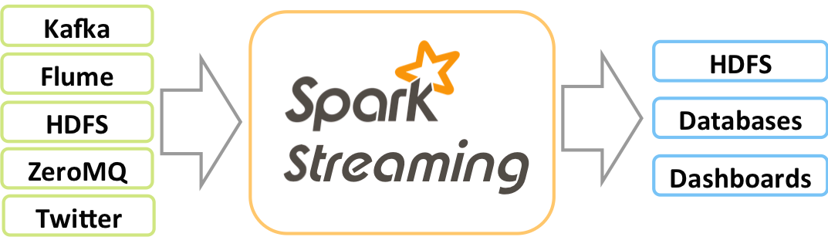
Data Workflows: Spark Streaming
Data can be ingested from many sources:
Kafka, Flume, Twitter, ZeroMQ,TCP sockets, etc.
Results can be pushed out to filesystems, databases, live dashboards, etc.
Spark’s built-in machine learning algorithms and graph processing algorithms can be applied to data streams

Slide 117
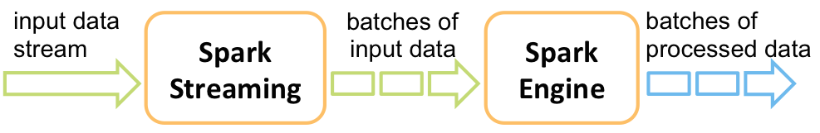
Data Workflows: Spark Streaming
Comparisons:
Twitter Storm
Yahoo! S4
Google MillWheel

Slide 118
Data Workflows: Spark Streaming
# in one terminal run the NetworkWordCount example in Spark Streaming
# expecting a data stream on the localhost:9999 TCP socket
./bin/run-example org.apache.spark.examples.streaming.NetworkWordCount localhost 9999
# | in | another terminal use Netcat http://nc110.sourceforge.net/
# | to | generate a data stream on the localhost:9999 TCP socket
$ | nc | -lk 9999
hello world hi there fred
what a nice world there

Slide 119
Data Workflows: Spark Streaming
import org.apache.spark.streaming._
import org.apache.spark.streaming.StreamingContext._
// Create
val ssc =
a StreamingContext with a SparkConf configuration
new StreamingContext(sparkConf, Seconds(10))
// Create
val lines
a DStream that will connect to serverIP:serverPort
= ssc.socketTextStream(serverIP, serverPort)
// Split each line into words
val words = lines.flatMap(_.split(" "))
// Count each word in each batch
val pairs = words.map(word => (word, 1)) val wordCounts = pairs.reduceByKey(_ + _)
// Print a few of the counts to the console
wordCounts.print()
ssc.start() | // Start the computation
ssc.awaitTermination() | // Wait for the computation to | terminate

Slide 120
Data Workflows: Spark Streaming
What the stream analysis produced:
14/04/19 13:41:28 INFO scheduler.TaskSetManager: Finished TID 3 in 17 ms on localhost (progress: 1/1)
14/04/19
have all 14/04/19
14/04/19
finished 14/04/19
13:41:28 INFO scheduler.TaskSchedulerImpl: Removed TaskSet 3.0, whose tasks completed, from pool
13:41:28
13:41:28
in 0.019
13:41:28
INFO scheduler.DAGScheduler: INFO scheduler.DAGScheduler: s
INFO
Completed ResultTask(3, 1)
Stage 3 (take at DStream.scala:583)
finished: take at DStream.scala:583,
spark.SparkContext: Job
took 0.034258 s
------------------------------------------- Time: 1397940088000 ms
-------------------------------------------
(hello,1)
(what,1)
(world,2)
(there,2)
(fred,1)
(hi,1)
(a,1)
(nice,1)

Slide 121
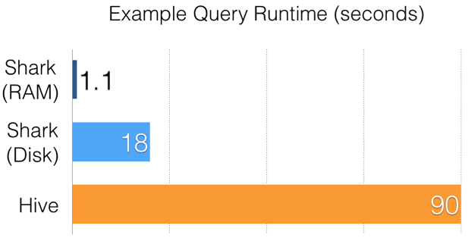
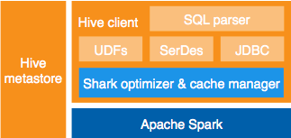
Data Workflows: Shark
An open source distributed SQL query engine for Hadoop data, based on Spark
http://shark.cs.berkeley.edu/
Runs unmodified Hive queries on existing warehouses
Up to 100x faster in memory, 10x faster on disk

Slide 122
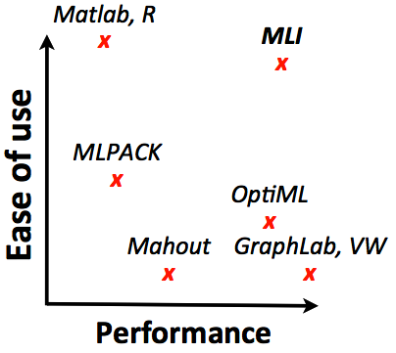
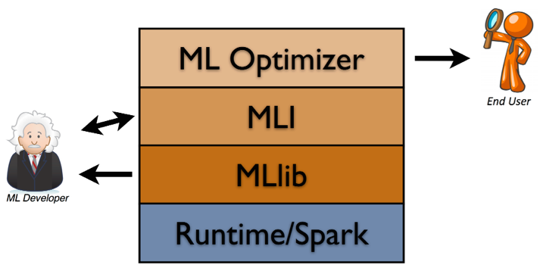
Data Workflows: MLlib
spark.apache.org/docs/latest/mllib-guide.html
val data = // RDD of Vector
val model = KMeans.train(data, k=10)
MLI: An API for Distributed Machine Learning Evan Sparks, Ameet Talwalkar, et al. International Conference on Data Mining (2013) http://arxiv.org/abs/1310.5426

Slide 123
05: Data Workflows
Advanced Topics

Slide 124
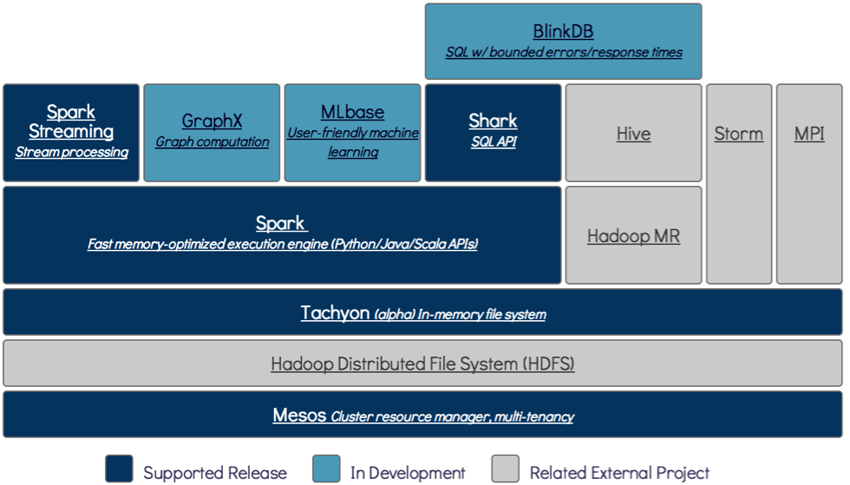
Advanced Topics:
Other BDAS projects running atop Spark for
graphs, sampling, and memory sharing:
BlinkDB
GraphX
Tachyon

Slide 125

Advanced Topics: BlinkDB
BlinkDB
blinkdb.org/
massively parallel, approximate query engine for running interactive SQL queries on large volumes of data
allows users to trade-off query accuracy for response time
enables interactive queries over massive
data by running queries on data samples
presents results annotated with meaningful
error bars

Slide 126
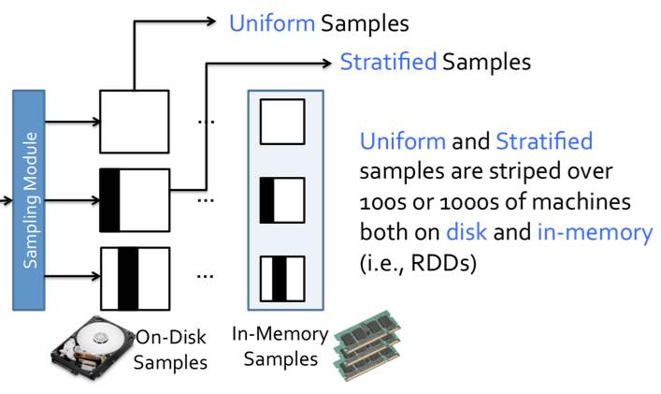
Advanced Topics: BlinkDB
“Our experiments on a 100 node cluster show that BlinkDB can answer queries on up to 17 TBs of data in less than 2 seconds (over 200 x faster than Hive), within an error of 2-10%.”
BlinkDB: Queries with Bounded Errors and Bounded Response Times on Very Large Data Sameer Agarwal, Barzan Mozafari,Aurojit Panda, Henry Milner, Samuel Madden, Ion Stoica EuroSys (2013) dl.acm.org/citation.cfm?id=2465355

Slide 127

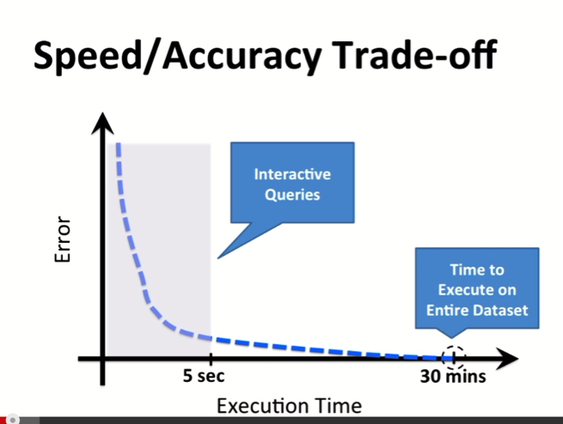

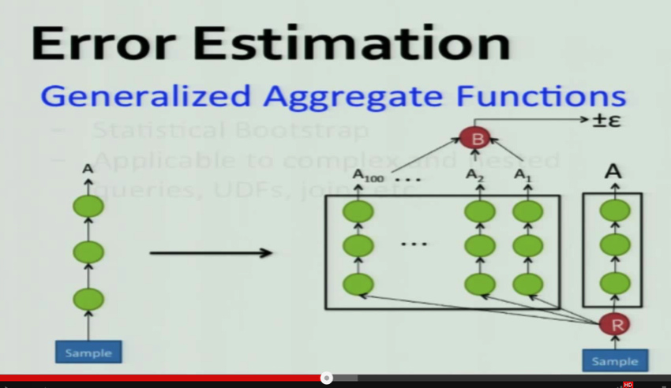
Advanced Topics: BlinkDB
Deep Dive into BlinkDB Sameer Agarwal youtu.be/WoTTbdk0kCA
Introduction to using BlinkDB Sameer Agarwal youtu.be/Pc8_EM9PKqY

Slide 128
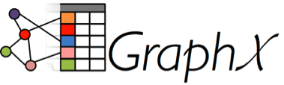
Advanced Topics: GraphX
GraphX
amplab.github.io/graphx/
extends the distributed fault-tolerant collections API and interactive console of Spark with a new graph API which leverages recent advances in graph systems (e.g., GraphLab) to enable users to easily and interactively build, transform, and reason about graph structured data at scale

Slide 129
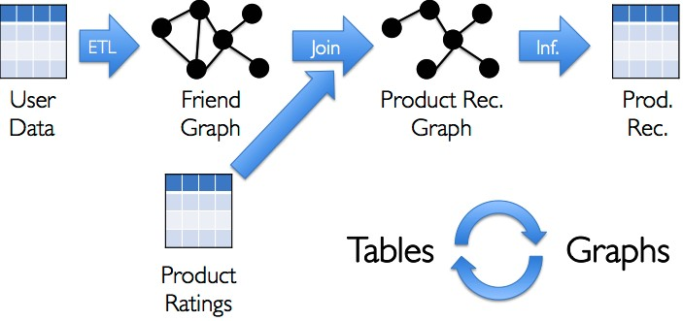
Advanced Topics: GraphX
unifying graphs and tables
spark.apache.org/docs/latest/graphx-programming- guide.html
ampcamp.berkeley.edu/big-data-mini-course/graph- analytics-with-graphx.html

Slide 130

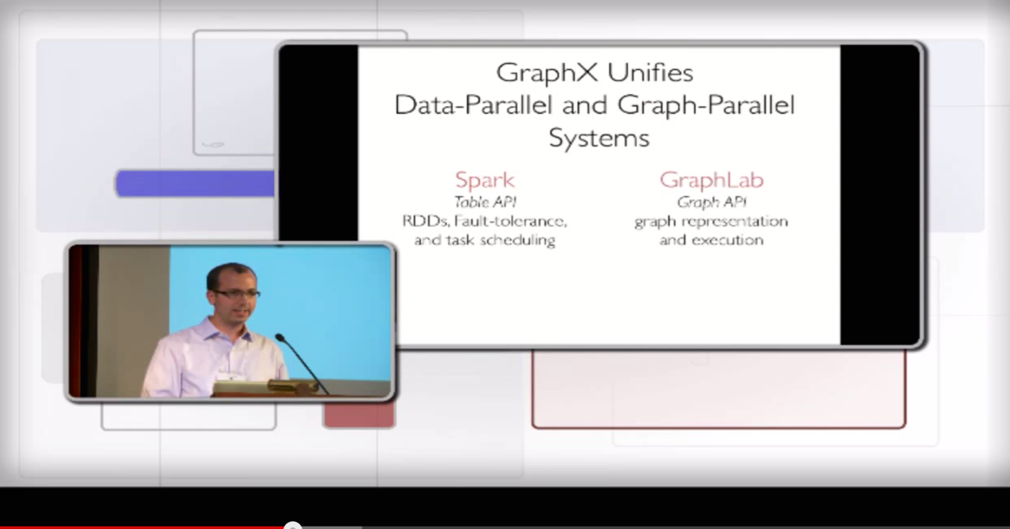
Advanced Topics: GraphX
Introduction to GraphX
Joseph Gonzalez, Reynold Xin
youtu.be/mKEn9C5bRck

Slide 131

Advanced Topics: Tachyon
Tachyon
tachyon-project.org/
fault tolerant distributed file system enabling reliable file sharing at memory-speed across cluster frameworks
achieves high performance by leveraging lineage
information and using memory aggressively
caches working set files in memory thereby
avoiding going to disk to load datasets that are
frequently read
enables different jobs/queries and frameworks
to access cached files at memory speed

Slide 132
Advanced Topics: Tachyon
More details:
tachyon-project.org/Command-Line-Interface.html ampcamp.berkeley.edu/big-data-mini-course/
tachyon.html
timothysc.github.io/blog/2014/02/17/bdas-tachyon/

Slide 133

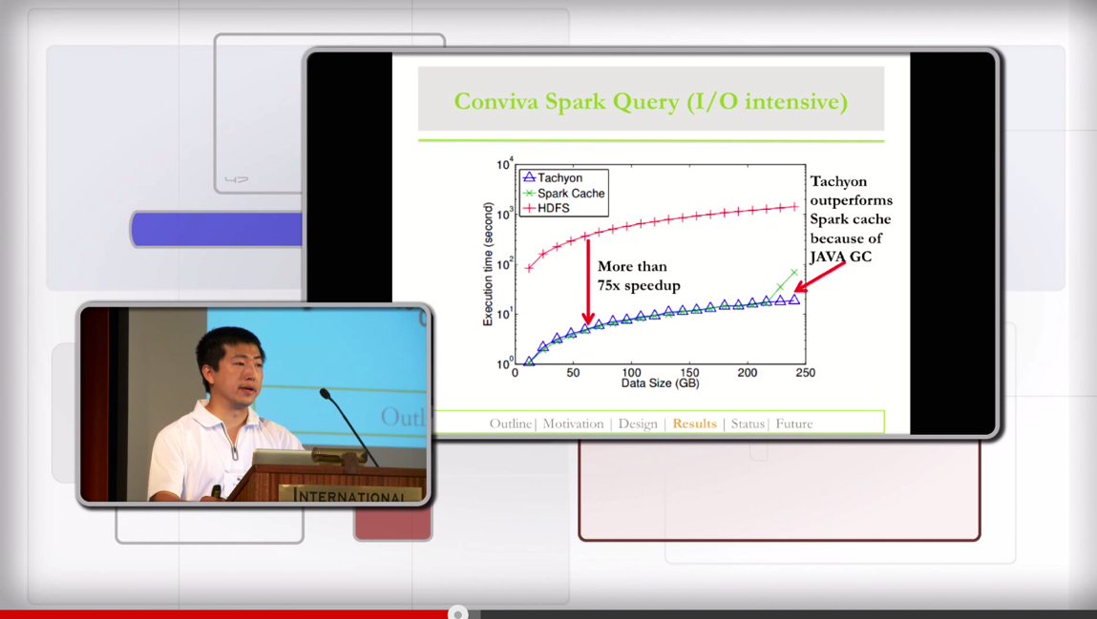
Advanced Topics: Tachyon
Introduction to Tachyon Haoyuan Li youtu.be/4lMAsd2LNEE

Slide 134
06: Spark in Production
The Full SDLC

Slide 135
Spark in Production:
In the following, let’s consider the progression through a full software development lifecycle, step by step:
build
deploy
monitor

Slide 136
Spark in Production: Build
builds:
build/run a JAR using Java + Maven
SBT primer
build/run a JAR using Scala + SBT

Slide 137
Spark in Production: Build: Java
The following sequence shows how to build
a JAR file from a Java app, using Maven
maven.apache.org/guides/introduction/ introduction-to-the-pom.html
First, connect into a different directory where you have space to create several files
Then run the following commands…

Slide 138
Spark in Production: Build: Java
# Java source (cut&paste 1st following
slide)
mkdir
-p src/main/java src/main/java/SimpleApp.java
cat >
# project model (cut&paste 2nd cat > pom.xml | following | slide)
# copy a file to use for data cp $SPARK_HOME/README.md .
# build the JAR mvn clean package
# run the JAR
mvn exec:java -Dexec.mainClass="SimpleApp"

Slide 139
Spark in Production: Build: Java
/*** SimpleApp.java ***/
import import
org.apache.spark.api.java.*; org.apache.spark.api.java.function.Function;
public
class SimpleApp {
public static void | main(String[] args) {
String logFile = | "README.md";
JavaSparkContext | sc = new JavaSparkContext("local", | "Simple App",
"$SPARK_HOME", new String[]{"target/simple-project-1.0.jar"}); JavaRDD<String> logData = sc.textFile(logFile).cache();
long numAs = logData.filter(new | Function<String, Boolean>() | {
public Boolean call(String s) | { return s.contains("a"); }
}).count();
long numBs = logData.filter(new | Function<String, Boolean>() | {
public Boolean call(String s) | { return s.contains("b"); }
}).count();
System.out.println("Lines
with a: " + numAs + ", lines with
b: " + numBs);
}
}

Slide 140
Spark in Production: Build: Java
<project>
<groupId>edu.berkeley</groupId>
<artifactId>simple-project</artifactId>
<modelVersion>4.0.0</modelVersion>
<name>Simple Project</name>
<packaging>jar</packaging>
<version>1.0</version>
<repositories>
<repository>
<id>Akka repository</id>
<url>http://repo.akka.io/releases</url>
</repository>
</repositories>
<dependencies>
<dependency> <!-- Spark dependency -->
<groupId>org.apache.spark</groupId>
<artifactId>spark-core_2.10</artifactId>
<version>0.9.1</version>
</dependency>
<dependency>
<groupId>org.apache.hadoop</groupId>
<artifactId>hadoop-client</artifactId>
<version>2.2.0</version>
</dependency>
</dependencies>
</project>

Slide 141
Spark in Production: Build: Java
Source files, commands, and expected output are shown in this gist:
gist.github.com/ceteri/ f2c3486062c9610eac1d#file-04-java-maven-txt
…and the JAR file that we just used:
ls target/simple-project-1.0.jar

Slide 142
Spark in Production: Build: SBT
builds:
build/run a JAR using Java + Maven
SBT primer
build/run a JAR using Scala + SBT

Slide 143
Spark in Production: Build: SBT
SBT is the Simple Build Tool for Scala:
www.scala-sbt.org/
This is included with the Spark download, and does not need to be installed separately.
Similar to Maven, however it provides for incremental compilation and an interactive shell, among other innovations.
SBT project uses StackOverflow for Q&A, that’s a good resource to study further:
stackoverflow.com/tags/sbt

Slide 144
Spark in Production: Build: SBT
command | description
clean | delete all generated files (in the target directory)
package | create a JAR file
run | run the JAR (or main class, if named)
compile | compile the main sources (in src/main/scala and src/main/java directories)
test | compile and run all tests
console | launch a Scala interpreter
help | display detailed help for specified commands

Slide 145
Spark in Production: Build: Scala
builds:
build/run a JAR using Java + Maven
SBT primer
build/run a JAR using Scala + SBT

Slide 146
Spark in Production: Build: Scala
The following sequence shows how to build
a JAR file from a Scala app, using SBT
First, this requires the “source” download, not the “binary”
Connect into the SPARK_HOME directory
Then run the following commands…

Slide 147
Spark in Production: Build: Scala
# Scala source + SBT build script on following slides
cd simple-app
../sbt/sbt -Dsbt.ivy.home=../sbt/ivy package
../spark/bin/spark-submit \
--class "SimpleApp" \
--master local[*] \
target/scala-2.10/simple-project_2.10-1.0.jar

Slide 148
Spark in Production: Build: Scala
/*** SimpleApp.scala ***/
import import
org.apache.spark.SparkContext org.apache.spark.SparkContext._
object SimpleApp {
def main(args: Array[String]) {
val logFile = "README.md" // Should be some file on your system
val sc = new SparkContext("local", "Simple App", "SPARK_HOME",
List("target/scala-2.10/simple-project_2.10-1.0.jar"))
val | logData | = sc.textFile(logFile, | 2).cache()
val val | numAs = numBs = | logData.filter(line => logData.filter(line => | line.contains("a")).count() line.contains("b")).count()
println("Lines with a: %s, Lines with b: %s".format(numAs, numBs))
}
}

Slide 149
Spark in Production: Build: Scala
name := "Simple Project"
version := "1.0"
scalaVersion := "2.10.4"
libraryDependencies += "org.apache.spark" % "spark-core_2.10" % "1.0.0"
resolvers += "Akka Repository" at "http://repo.akka.io/releases/"

Slide 150
Spark in Production: Build: Scala
Source files, commands, and expected output are shown in this gist:
gist.github.com/ceteri/ f2c3486062c9610eac1d#file-04-scala-sbt-txt

Slide 151
Spark in Production: Build: Scala
The expected output from running the JAR is shown in this gist:
gist.github.com/ceteri/ f2c3486062c9610eac1d#file-04-run-jar-txt
Note that console lines which begin with “[error]” are not errors – that’s simply the console output being written to stderr

Slide 152
Spark in Production: Deploy
deploy JAR to Hadoop cluster, using these
alternatives:
discuss how to run atop Apache Mesos
discuss how to install on CM
discuss how to run on HDP
discuss how to run on MapR
discuss how to run on EC2
discuss using SIMR (run shell within MR job)
…or, simply run the JAR on YARN

Slide 153
Spark in Production: Deploy: Mesos
deploy JAR to Hadoop cluster, using these
alternatives:
discuss how to run atop Apache Mesos
discuss how to install on CM
discuss how to run on HDP
discuss how to run on MapR
discuss how to run on EC2
discuss using SIMR (run shell within MR job)
…or, simply run the JAR on YARN

Slide 154

Spark in Production: Deploy: Mesos
Apache Mesos, from which Apache Spark originated…
Running Spark on Mesos
spark.apache.org/docs/latest/running-on-mesos.html
Run Apache Spark on Apache Mesos Mesosphere tutorial based on AWS mesosphere.io/learn/run-spark-on-mesos/
Getting Started Running Apache Spark on Apache Mesos
O’Reilly Media webcast
oreilly.com/pub/e/2986

Slide 155
Spark in Production: Deploy: CM
deploy JAR to Hadoop cluster, using these
alternatives:
discuss how to run atop Apache Mesos
discuss how to install on CM
discuss how to run on HDP
discuss how to run on MapR
discuss how to run on EC2
discuss using SIMR (run shell within MR job)
…or, simply run the JAR on YARN

Slide 156
Spark in Production: Deploy: CM
Cloudera Manager 4.8.x:
cloudera.com/content/cloudera-content/cloudera- docs/CM4Ent/latest/Cloudera-Manager-Installation- Guide/cmig_spark_installation_standalone.html
5 steps to install the Spark parcel
5 steps to configure and start the Spark service
Also check out Cloudera Live:
cloudera.com/content/cloudera/en/products-and- services/cloudera-live.html

Slide 157
Spark in Production: Deploy: HDP
deploy JAR to Hadoop cluster, using these
alternatives:
discuss how to run atop Apache Mesos
discuss how to install on CM
discuss how to run on HDP
discuss how to run on MapR
discuss how to run on EC2
discuss using SIMR (run shell within MR job)
…or, simply run the JAR on YARN

Slide 158

Spark in Production: Deploy: HDP
Hortonworks provides support for running Spark on HDP:
spark.apache.org/docs/latest/hadoop-third-party- distributions.html
hortonworks.com/blog/announcing-hdp-2-1-tech- preview-component-apache-spark/

Slide 159
Spark in Production: Deploy: MapR
deploy JAR to Hadoop cluster, using these
alternatives:
discuss how to run atop Apache Mesos
discuss how to install on CM
discuss how to run on HDP
discuss how to run on MapR
discuss how to run on EC2
discuss using SIMR (run shell within MR job)
…or, simply run the JAR on YARN

Slide 160

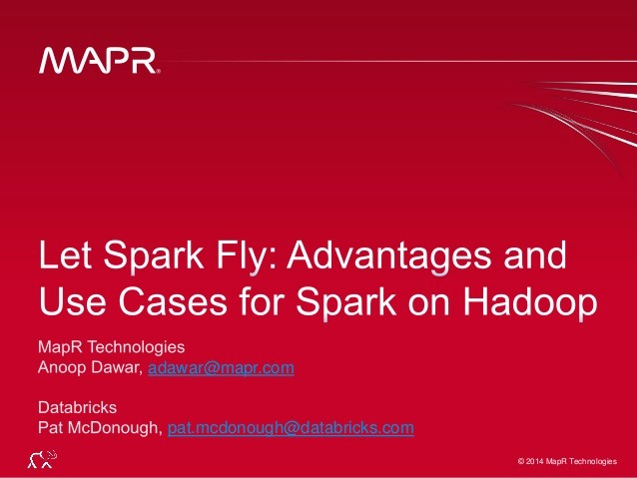
Spark in Production: Deploy: MapR
MapR Technologies provides support for running Spark on the MapR distros:
mapr.com/products/apache-spark slideshare.net/MapRTechnologies/map-r-
databricks-webinar-4x3

Slide 161
Spark in Production: Deploy: EC2
deploy JAR to Hadoop cluster, using these
alternatives:
discuss how to run atop Apache Mesos
discuss how to install on CM
discuss how to run on HDP
discuss how to run on MapR
discuss how to run on EC2
discuss using SIMR (run shell within MR job)
…or, simply run the JAR on YARN

Slide 162

Spark in Production: Deploy: EC2
Running Spark on Amazon AWS EC2:
spark.apache.org/docs/latest/ec2-scripts.html

Slide 163
Spark in Production: Deploy: SIMR
deploy JAR to Hadoop cluster, using these
alternatives:
discuss how to run atop Apache Mesos
discuss how to install on CM
discuss how to run on HDP
discuss how to run on MapR
discuss how to run on EC2
discuss using SIMR (run shell within MR job)
…or, simply run the JAR on YARN

Slide 164
Spark in Production: Deploy: SIMR
Spark in MapReduce (SIMR) – quick way
for Hadoop MR1 users to deploy Spark:
databricks.github.io/simr/
spark-summit.org/talk/reddy-simr-let-your- spark-jobs-simmer-inside-hadoop-clusters/
Sparks run on Hadoop clusters without any install or required admin rights
SIMR launches a Hadoop job that only
contains mappers, includes Scala+Spark
./simr jar_file main_class parameters [—outdir=] [—slots=N] [—unique]

Slide 165
Spark in Production: Deploy:YARN
deploy JAR to Hadoop cluster, using these
alternatives:
discuss how to run atop Apache Mesos
discuss how to install on CM
discuss how to run on HDP
discuss how to run on MapR
discuss how to rum on EMR
discuss using SIMR (run shell within MR job)
…or, simply run the JAR on YARN

Slide 166

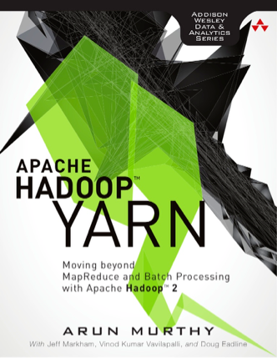
Spark in Production: Deploy:YARN
spark.apache.org/docs/latest/running-on-yarn.html
Simplest way to deploy Spark apps in production
Does not require admin, just deploy apps to your
Hadoop cluster
Apache Hadoop YARN
Arun Murthy, et al.
amazon.com/dp/0321934504

Slide 167
Spark in Production: Deploy: HDFS examples
Exploring data sets loaded from HDFS…
launch a Spark cluster using EC2 script
load data files into HDFS
run Spark shell to perform WordCount
NB: be sure to use internal IP addresses on AWS for the “hdfs://…” URLs

Slide 168
Spark in Production: Deploy: HDFS examples
# http://spark.apache.org/docs/latest/ec2-scripts.html
cd $SPARK_HOME/ec2
export AWS_ACCESS_KEY_ID=$AWS_ACCESS_KEY
export AWS_SECRET_ACCESS_KEY=$AWS_SECRET_KEY
./spark-ec2 -k spark -i ~/spark.pem -s 2 -z us-east-1b launch foo
# can review EC2 instances and their security groups to identify master
# ssh into master
./spark-ec2 -k spark -i ~/spark.pem -s 2 -z us-east-1b login foo
# use ./ephemeral-hdfs/bin/hadoop to access HDFS
/root/ephemeral-hdfs/bin/hadoop fs /root/ephemeral-hdfs/bin/hadoop fs | -mkdir /tmp -put CHANGES.txt | /tmp
# now is the time when we Spark cd /root/spark export SPARK_HOME=$(pwd)
SPARK_HADOOP_VERSION=1.0.4 sbt/sbt | assembly
/root/ephemeral-hdfs/bin/hadoop fs ./bin/spark-shell | -put CHANGES.txt | /tmp

Slide 169
Spark in Production: Deploy: HDFS examples
/** NB: replace host IP with EC2 internal IP address **/
val f = sc.textFile("hdfs://10.72.61.192:9000/foo/CHANGES.txt") val counts =
f.flatMap(line => line.split(" ")).map(word => (word, 1)).reduceByKey(_ + _)
counts.collect().foreach(println) counts.saveAsTextFile("hdfs://10.72.61.192:9000/foo/wc")

Slide 170
Spark in Production: Deploy: HDFS examples
Let’s check the results in HDFS…
root/ephemeral-hdfs/bin/hadoop fs
(Adds,1)
(alpha,2)
(ssh,1) (graphite,1) (canonical,2) (ASF,3)
(display,4) (synchronization,2) (instead,7) (javadoc,1)
(hsaputra/update-pom-asf,1)
-cat
/tmp/wc/part-*
…

Slide 171
Spark in Production: Monitor
review UI features
spark.apache.org/docs/latest/monitoring.html http://<master>:8080/
http://<master>:50070/
verify: is my job still running?
drill-down into workers and stages
examine stdout and stderr
discuss how to diagnose / troubleshoot

Slide 172
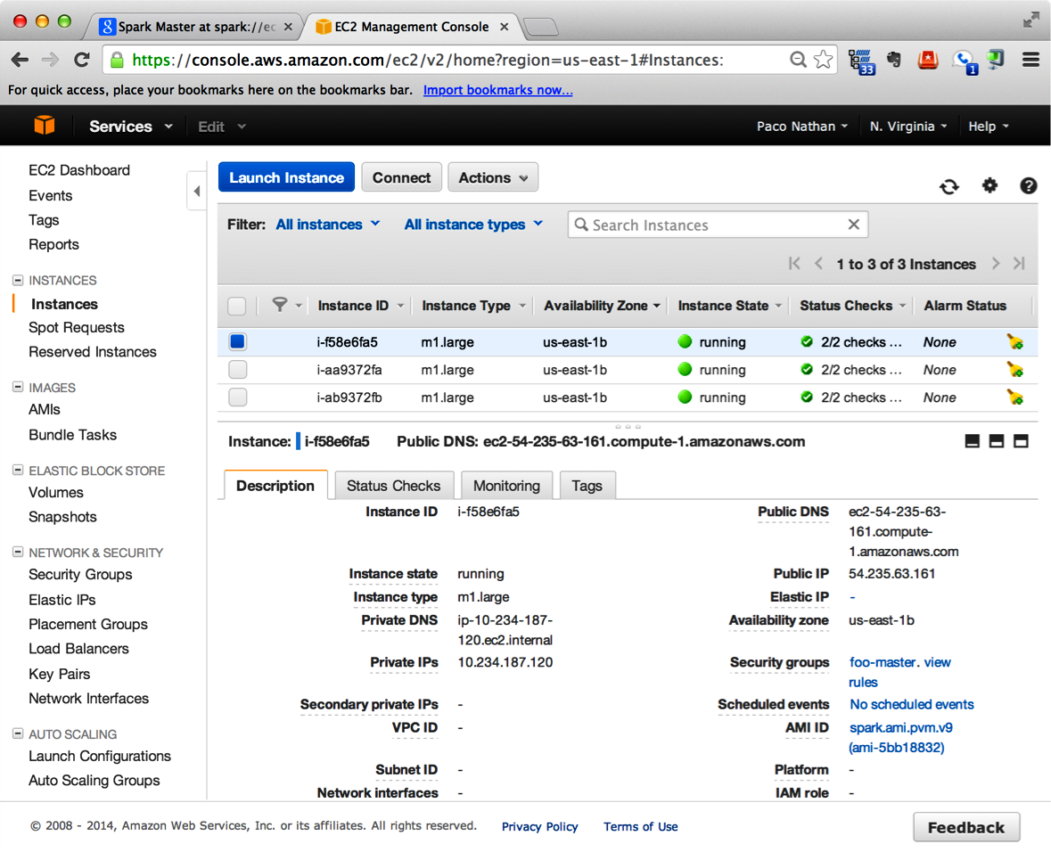
Spark in Production: Monitor: AWS Console

Slide 173
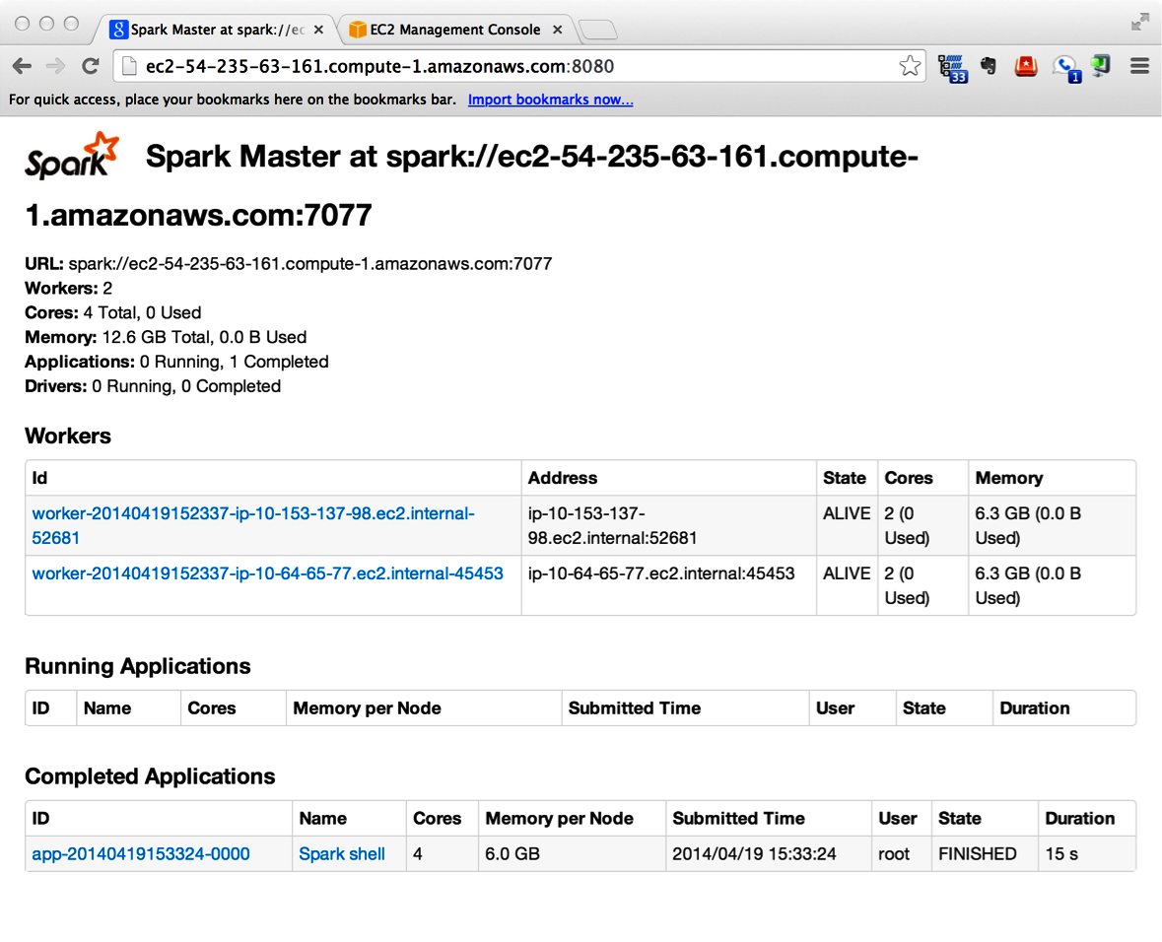
Spark in Production: Monitor: Spark Console

Slide 174
07: Summary
Case Studies

Slide 175
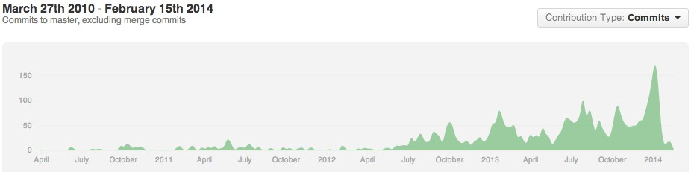



























Summary: Spark has lots of activity!
2nd Apache project ohloh.net/orgs/apache
most active in the Big Data stack

Slide 176

Summary: Case Studies
Spark at Twitter: Evaluation & Lessons Learnt
Sriram Krishnan slideshare.net/krishflix/seattle-spark-meetup- spark-at-twitter
Spark can be more interactive, efficient than MR
  Support for iterative algorithms and caching
  More generic than traditional MapReduce
Why is Spark faster than Hadoop MapReduce?
  Fewer I/O synchronization barriers
  Less expensive shuffle
  More complex the DAG, greater the
performance improvement

Slide 177

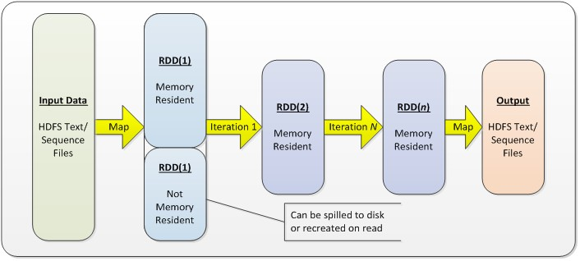
Summary: Case Studies
Using Spark to Ignite Data Analytics
ebaytechblog.com/2014/05/28/using-spark-to- ignite-data-analytics/

Slide 178


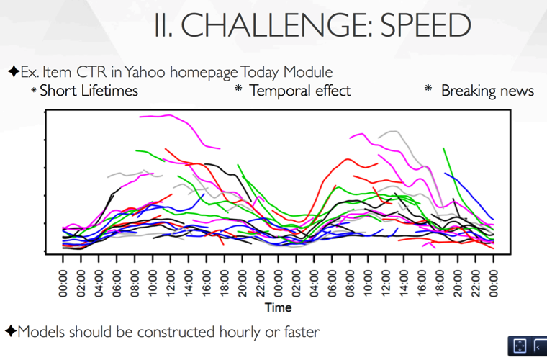
Hadoop and Spark Join Forces in Yahoo
Andy Feng
Summary: Case Studies
spark-summit.org/talk/feng-hadoop-and-spark- join-forces-at-yahoo/

Slide 179

Summary: Case Studies
Collaborative Filtering with Spark
Chris Johnson slideshare.net/MrChrisJohnson/collaborative- filtering-with-spark
collab filter (ALS) for music recommendation
Hadoop suffers from I/O overhead
show a progression of code rewrites, converting
a Hadoop-based app into efficient use of Spark

Slide 180

Summary: Case Studies
Why Spark is the Next Top (Compute) Model
Dean Wampler slideshare.net/deanwampler/spark-the-next- top-compute-model
Hadoop: most algorithms are much harder to implement in this restrictive map-then-reduce model
Spark: fine-grained “combinators” for
composing algorithms
slide #67, any questions?

Slide 181

Summary: Case Studies
Open Sourcing Our Spark Job Server
Evan Chan
engineering.ooyala.com/blog/open-sourcing-our- spark-job-server
•
github.com/ooyala/spark-jobserver
REST server for submitting, running, managing Spark jobs and contexts
company vision for Spark is as a multi-team big
data service
shares Spark RDDs in one SparkContext among
multiple jobs

Slide 182

Summary: Case Studies
Beyond Word Count:
Productionalizing Spark Streaming
Ryan Weald
spark-summit.org/talk/weald-beyond-word- count-productionalizing-spark-streaming/
blog.cloudera.com/blog/2014/03/letting-it-flow- with-spark-streaming/
overcoming 3 major challenges encountered while developing production streaming jobs
write streaming applications the same way
you write batch jobs, reusing code
•
stateful, exactly-once semantics out of the box
integration of Algebird

Slide 183

Summary: Case Studies
Installing the Cassandra / Spark OSS Stack
Al Tobey
tobert.github.io/post/2014-07-15-installing- cassandra-spark-stack.html
install+config for Cassandra and Spark together
spark-cassandra-connector integration
•
examples show a Spark shell that can access tables in Cassandra as RDDs with types pre- mapped and ready to go

Slide 184


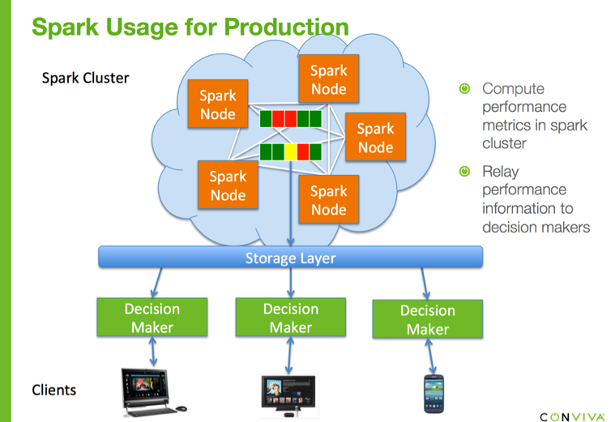
Summary: Case Studies
One platform for all: real-time, near-real-time, and offline video analytics on Spark
Davis Shepherd, Xi Liu
spark-summit.org/talk/one-platform-for-all- real-time-near-real-time-and-offline-video- analytics-on-spark

Slide 185
08: Summary
Follow-Up

Slide 186
Summary:
discuss follow-up courses, certification, etc.
links to videos, books, additional material for self-paced deep dives
check out the archives:
http://spark-summit.org

Slide 187
Summary: Community + Events
Community and events:
•
•
•
Spark Meetups Worldwide
http://strataconf.com/ http://spark.apache.org/community.html

Slide 188
Summary: Email Lists
Contribute to Spark and related OSS projects
via the email lists:
•
user@spark.apache.org
usage questions, help, announcements
dev@spark.apache.org
for people who want to contribute code
•

Slide 189




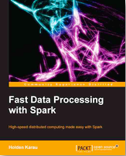

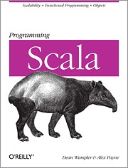
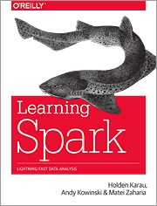
Summary: Suggested Books + Videos
Programming Scala Dean Wampler, Alex Payne O’Reilly (2009)
shop.oreilly.com/product/ 9780596155964.do
Learning Spark Holden Karau, Andy Kowinski, Matei Zaharia O’Reilly (2015*)
shop.oreilly.com/product/ 0636920028512.do
Fast Data Processing with Spark Holden Karau Packt (2013)
shop.oreilly.com/product/ 9781782167068.do
Spark in Action Chris Fregly Manning (2015*) sparkinaction.com/

Slide 190


slides by:
Paco Nathan @pacoid liber118.com/pxn/

