Slide 1
Decision Rules
Action Rule Discovery
Cloud Computing 6190
Aaroh Mathur
Naga Vamsi Abhivarsh Peddireddy
Akhila Penmetsa
Gayathri Prabhanandan
Kowshik Prasad Navilur
Sanyasi Naidu Pyla
Srisanmathi Ramachandran
Piper Ramirez-Espitia

Slide 2
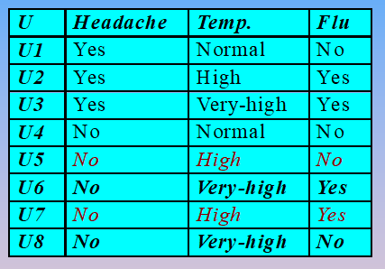
What is LERS ?
Stands for Learning from Examples based on Rough Sets.
It allows us to generate rules, which have a specific attribute on the right hand side of the rule, called as decision attribute.
Using other attributes(Headache and Temperature) we will come to know whether Flu is there or not.
LERS works based on the concept called as covering.

Slide 3
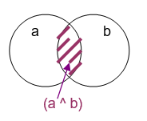
COVERING
P is a covering of R in S if P* ≤ R* ⌐ ( ∃Q⊆ P) [P* ≤ R*] .
In other words, P is a covering of R if P is a subset of R , and we do not have a smaller set, which is a subset of R which implies P is the smallest.
For Example, {a} is bigger than {a, b} (and {a, b} is smaller than {a}) because {a} is more general than {a, b}, in other words, {a} includes {a, b}

Slide 4
Question for LERS
LERS stands for ?

Slide 5
Steps to Generate LERS Rules
X | A | B | C
X1 | 0 | 0 | 0
X2 | 0 | 1 | 1
X3 | 0 | 0 | 0
X4 | 0 | 1 | 1
X5 | 1 | 1 | 2
X6 | 1 | 1 | 2
X7 | 2 | 2 | 3
X8 | 2 | 2 | 3
X = {x1,x2,x3,x4,x5,x6,x7,x8}
Classification attribute: {A,B} Decision Attribute :{C}
Step1: Find coverings of {A,B,C} and check if coverings of the classification attribute are
the subset of coverings of decision attribute and mark them.
{C,0}* = { x1,x3}; {C,1}* = {x2,x4 }; {C,2}* = {x5,x6 }; {C,3}* = {x7,x8 };
{A,0}* = { x1,x2,x3,x4}; {B,0}* = { x1,x3} ⊆ {C,0} ✓
{A,1}* = { x5,x6} ⊆ {C,2} ✓ {B,1}* = { x2,x4,X5,X6};
{A,2}* = { x7,x8} ⊆{C,3} ✓ {C,2}* = { x7,x8} ⊆ {C,3} ✓

Slide 6
Steps to Generate LERS Rules
Step2: Generate rules from the sets in the first loop. Certain rules are generated from marked sets and possible rules are generated from unmarked sets.
Certain rules have confidence of 100%, but possible rules have different confidence which is less than 100%
Certain Rules: Possible Rules:
(a,1) → (c,2) (a,0) → (c,0) with confidence = 1/2
(a,2) → (c,3) (a,0) → (c,1) with confidence = 1/2
(b,0) →(c,0) (b,1) → (c,1) with confidence = 1/2
(b,2) → (c,3) (b,1) → (c,2) with confidence = 1/2
(a,0) & (b,1) → (c,1)
Step 3. Next, if there are unmarked sets in the First Loop, then we go to a Second Loop, by combining the unmarked sets together. Continue the process until there are no unmarked sets.

Slide 7
Question for LERS rules
What is the confidence of certain rules?

Slide 8
Practical Examples
LERS (Learning from Examples based on Rough sets) :
LERS was developed at the University of Kansas and it is a family of data mining systems. This system is universal and it helps to compute rules for any kind of data.
In LERS the set of rules that was induced previously is apted to find new rules. Furthermore, it compute rules from imperfect data, like datas with missing values or inconsistent cases.
The benefit of using LERS is, it handles inconsistencies and does not require any preliminary or additional information about the data. In this method, the inconsistencies are not removed entirely, instead lower and upper boundary approximations of the concept are computed.

Slide 9
Practical Examples
Some practical examples are:
Finance industry -- to decide whether to give a loan.
Medical industry -- decision support for diagnosing.
Military --- evaluation of job performance.
NASA --a tool to be used in medical decision making on board the International Space System.

Slide 10
Question on Practical Examples
Question
LERs systems can only compute rules for perfect data (true or false)?

Slide 11
Action rules
Constructed from classification rules to suggest a way to re-classify objects to a desired state
Set of attributes in decision table is partitioned into conditions & decisions
Set of attributes is classified into stable and flexible.
Example of an action rule
[ (b₁, v₁-> w₁) ^ (b₂, v₂ -> w₂) ^ … ^ (b_{p}, v_{p} -> w_{p})](x) => [(d, k₁ ->k₂)](x)

Slide 12
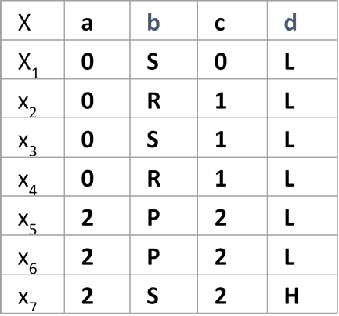
Action rules cont.
Decision Table
{a,c} - Stable attributes
{b,d} - Flexible attributes
Rules discovered:
r₁ = [(b, P) ->(d, L)]
r₂ = [(a, 2) ^ (b, S) -> (d, H)]
action rule:
[(b, P-> S)](x) => [(d, L-> H)](x)
Rules discovered:
r1 = [(b, P) (d, L)]
r2 = [(a, 2) ^ (b, S) (d, H)]
action rule:
[(b, P S)](x) [(d, L H)](x)

Slide 13
Question on Action Rules
Can you give an example of a stable attribute?

Slide 14
Cost Of an Action Rule
Every action is associated with a specific cost.
Types of Costs:
Monetary cost
Moral cost
Example:
Relocating an employee from one city to another (re-classifying the employee from one division to another) may cost us the moving expense(Monetary Cost), in addition to a moral cost – some negative emotions of the employee about it may influence his/her future performance or perception of our organization

Slide 15
Cost Of an Action Rule
Cost is denoted by ‘ρ’
The range of ‘ρ’ is (0 to +∞]
The cost(ρ) will be close to zero if the action is trivial(if the action is easily accomplished)
The cost(ρ) will be close to +∞ if the action is very difficult to accomplish.

Slide 16
Question on action rules
What is the cost of an almost impossible action?

Slide 17
Practical Examples
In the Action Rules Method the attributes in the database must be split into two groups: stable and flexible.
Binding to Thrombin (Key receptor in blood clotting)
Classify active and inactive compound receptors to design new drugs
Benchmarking in Insurance Companies for certain policies
Reclassifying attributes in a car policy from 5 to 6
Allows to better market different policies to certain customers

Slide 18
Practical Examples
Breast Cancer Diagnosis
Classifying a tumor as benign or malignant
Ability to provide suggestions or actionable rules to be made in order to changes the class from malignant to benign
Better classification of when a tumor should be immediately removed because it could be life threatening.

Slide 19
Question
What are the two groups the data attributes must be split into?
Notes:
Stable and Flexible

Slide 20
Implementation and demo
LERS algorithm in Hadoop MapReduce
Action Rules

