Slide 1
ITCS 6190: Cloud Computing for Data Analysis
Clustering

Slide 2
Introduction
A way of grouping together data samples that are similar in some way - according to some criteria that you pick
A form of unsupervised learning – you generally don’t have examples demonstrating how the data should be grouped together
So, it’s a method of data exploration – a way of looking for patterns or structure in the data that are of interest

Slide 3
Introduction to Clustering Techniques
Points, Spaces, and Distances: The dataset for clustering is a collection of points, where objects belongs to some space. I.e. a space is just a universal set of points, from which the points in the dataset are drawn.
The requirements for a function on pairs of points to be a distance measure are that:
Distances are always nonnegative, and only the distance between a point and itself is 0.
Distance is symmetric; it doesn’t matter in which order you consider the points when computing their distance.
Distance measures obey the triangle inequality; the distance from x to y to z is never less than the distance going from x to z directly.

Slide 4
Question
What are the requirements for pairs of points to be a distance measure?

Slide 5
Clustering Strategies

Slide 6
Clustering Strategies
There are mainly two types of clustering strategies
Hierarchical (or) agglomerative algorithms
Starts with each point in its own cluster
Clusters are combined based on closeness
Combination step is stopped when something undesirable happens.
Point assignment involved algorithms
First initial clusters are estimated
Each point is assigned to each cluster it best fits
Variations sometimes that allows splitting of clusters
It might also un assign the point if it is outlier

Slide 7
Clustering Strategies
Algorithms for clustering can be distinguished by
Whether the algorithms assumes Euclidean space or works for an arbitrary distance measure
Whether the algorithms assumes that the data fits in main memory or it must reside in secondary memory

Slide 8
Question
What is the difference between main memory and secondary memory?

Slide 9
Hierarchical Clustering

Slide 10
Hierarchical Clustering Methods
Hierarchical clustering is characterized by the development of a hierarchy or tree-like structure.
Agglomerative clustering starts with each object in a separate cluster. Clusters are formed by grouping objects into bigger and bigger clusters.
Divisive clustering starts with all the objects grouped in a single cluster. Clusters are divided or split until each object is in a separate cluster.
Agglomerative methods are commonly used in marketing research. They consist of linkage methods, variance methods, and centroid methods.

Slide 11
Hierarchical Clustering Advantages
Advantages:
Hierarchical clustering is a powerful technique which is easy to implement and allows you to build tree structures from data similarities.
You can see how different sub-clusters relate to each other, and how far apart data points are.
Disadvantages:
It is not possible to undo the previous step: once the instances have been assigned to a cluster, they can no longer be moved around.
Time complexity: not suitable for large datasets

Slide 12
Question
What parameter does the algorithm in Hierarchical Clustering use to merge or split the two data points?

Slide 13
Hierarchical Clustering Examples

Slide 14
Dendrogram
A binary tree that shows how clusters are merged/split hierarchically
Each node on the tree is a cluster; each leaf node is a singleton cluster

Slide 15
How to merge Clusters?
How to measure the distance between the clusters?
Single – Link
Complete – Link
Average – Link
Centroid Distance
Distance between clusters is usually defined on the basis of distance between objects.

Slide 16
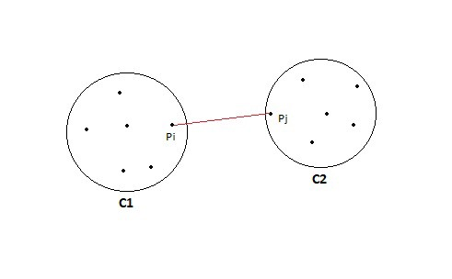
Single - Link
Single linkage algorithm can be defined as the similarity of two clusters C1 and C2 is equal to the minimum of the similarity between points Pi and Pj such that Pi belongs to C1 and Pj belongs to C2.
Mathematically this can be written as,
Sim(C1,C2) = Min Sim(Pi,Pj) such that Pi ∈ C1 & Pj ∈ C2

Slide 17
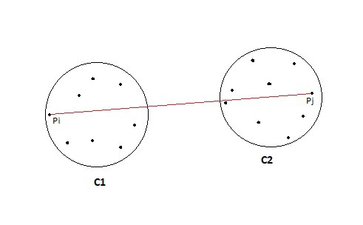
Complete - Link
Complete linkage algorithm, this is exactly opposite to the MIN approach. The similarity of two clusters C1 and C2 is equal to the maximum of the similarity between points Pi and Pj such that Pi belongs to C1 and Pj belongs to C2.
Mathematically this can be written as,
Sim(C1,C2) = Max Sim(Pi,Pj) such that Pi ∈ C1 & Pj ∈ C2

Slide 18
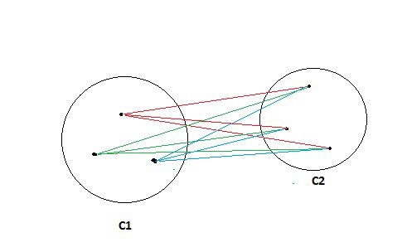
Average - Link
Take all the pairs of points and compute their similarities and calculate the average of the similarities.
Mathematically this can be written as,
sim(C1,C2) = ∑ sim(Pi, Pj)/|C1|*|C2| where, Pi ∈ C1 & Pj ∈ C2

Slide 19
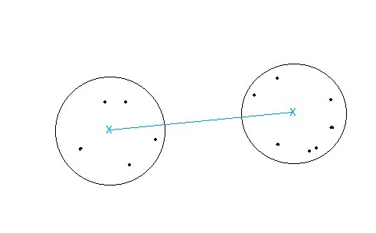
Centroid Distance
Compute the centroids of two clusters C1 & C2 and take the similarity between the two centroids as the similarity between two clusters. This is a less popular technique in the real world.

Slide 20
Question
What are the types for measuring distance between the clusters?

Slide 21
K – Means Clustering

Slide 22
K – Means Clustering
So what exactly is K-means? Well, it is an unsupervised learning algorithm (meaning there are no target labels) that allows you to identify similar groups or clusters of data points within your data.
Again the problem of K means can be thought of as grouping the data into K clusters where assignment to the clusters is based on some similarity or distance measure to a centroid (more on this later). So how do we do this? Well, let’s first outline the steps involved.
We randomly initialize the K starting centroids. Each data point is assigned to its nearest centroid.
The centroids are recomputed as the mean of the data points assigned to the respective cluster.
Repeat steps 1 and 2 until we trigger our stopping criteria.

Slide 23
K – Means Clustering
Advantages:
Fast, robust and easier to understand
Relatively efficient
Gives best result when data set are distinct or well separated from each other.
Disadvantages:
Randomly choosing of the cluster center cannot lead us to the fruitful result
Applicable only when mean is defined i.e. fails for categorical data.
Unable to handle noisy data and outliers.
Algorithm fails for non-linear data set.

Slide 24
Question
What does k represent in k- means clustering?

Slide 25
K – Means Clustering Examples

Slide 26
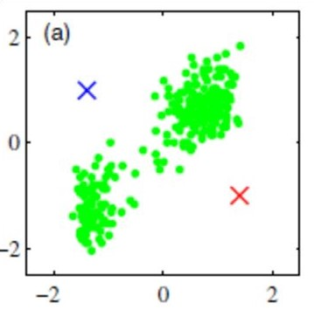
K – Means Clustering Examples
As you can see the figure above shows K means at work. We have defined k = 2 so we are assigning data to one of two clusters at each iteration. Figure (a) corresponds to the randomly initializing the centroids.

Slide 27
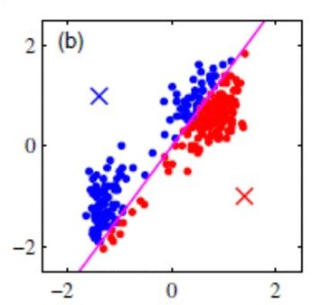
K – Means Clustering Examples
In (b) we assign the data points to their closest cluster

Slide 28
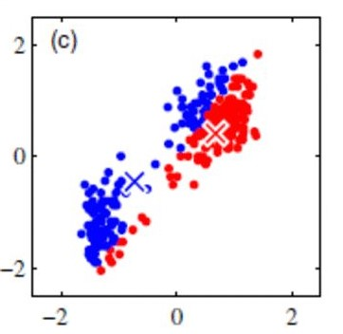
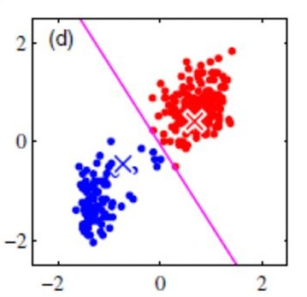
K – Means Clustering Examples
and in Figure c we assign new centroids as the average of the data in each cluster.

Slide 29
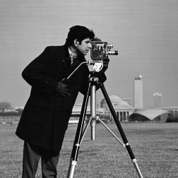
K – Means Clustering Image Segmentation
One example where 2, 3, and 10 colors are chosen to encode a color image
Original Image
K = 2
K = 3
K = 10

Slide 30
Question
What type of algorithm is K-means Clustering ?

Slide 31
Cure Clustering

Slide 32
Cure Clustering
Attempts to eliminate the disadvantages of the centroid approach and all-points approaches by presenting a hybrid of the two.
1) Identifies a set of well scattered points, representative of a potential cluster’s shape.
2) Scales/shrinks the set by a factor α to form (semi-centroids).
3) Merges semi-centroids at each iteration

Slide 33
Cure Clustering Approach
Pick a random sample of points that fit in main memory.
Cluster these points hierarchically – group nearest points/clusters.
For each cluster, pick a sample of points, as dispersed as possible.
From the sample, pick representatives by moving them (say) 20% toward the centroid of the cluster.

Slide 34
Question
Cure clustering eliminates the disadvantages of which approach?

Slide 35
Cure Clustering Examples

Slide 36
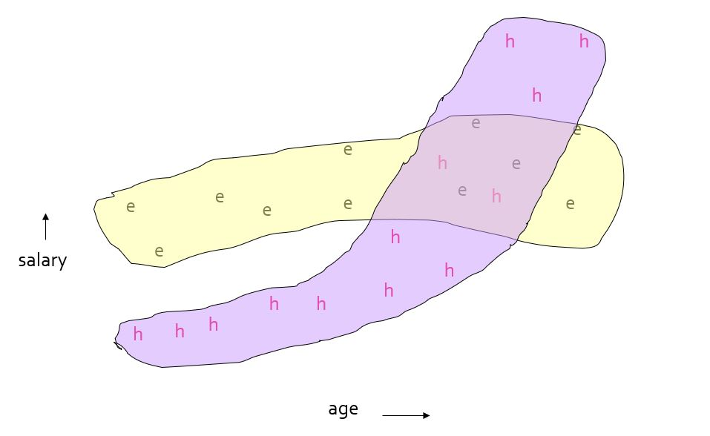
Cure Clustering Examples
Stanford Faculty Salaries

Slide 37
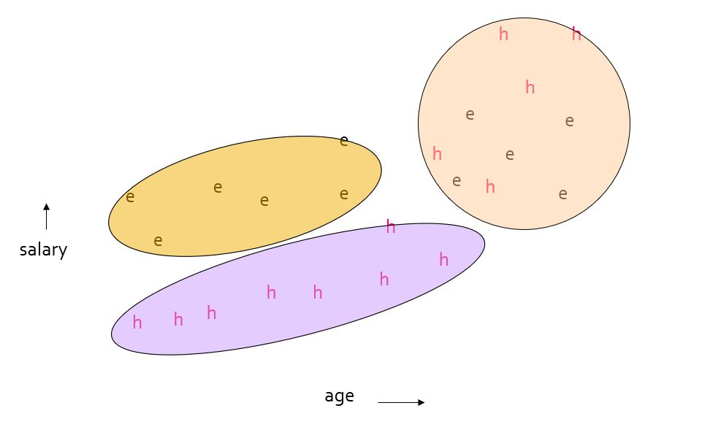
Cure Clustering Examples
Initial Clusters

Slide 38
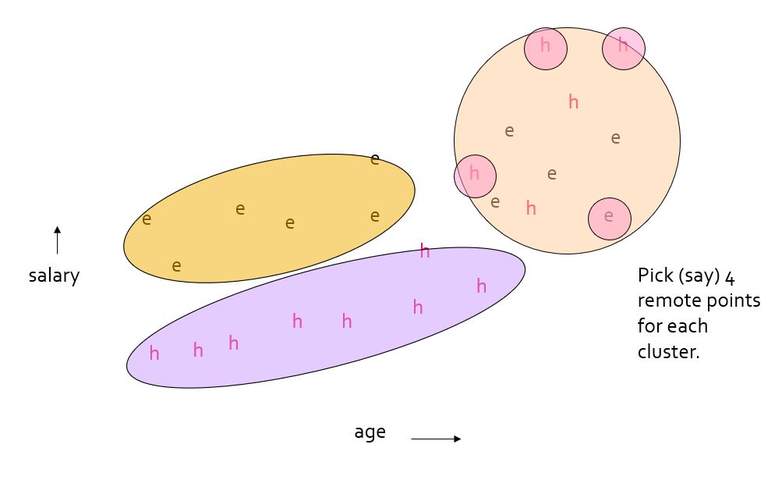
Cure Clustering Examples
Pick Dispersed Points

Slide 39
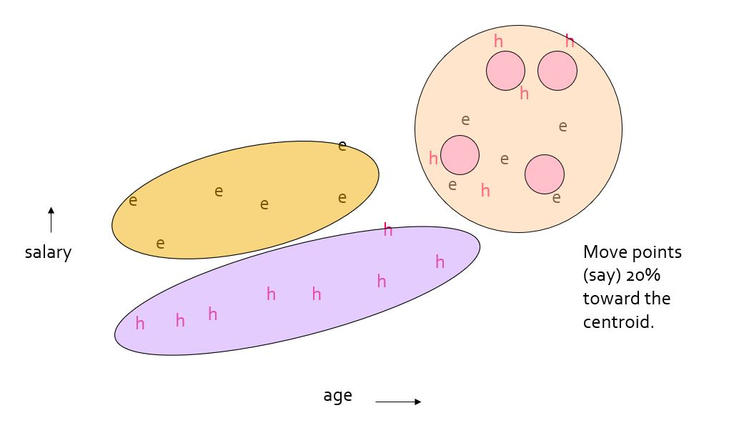
Cure Clustering Examples
Pick Dispersed Points by moving 20%

Slide 40
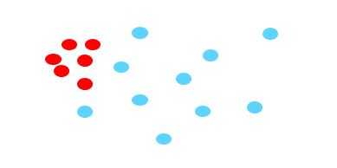
Cure Clustering Examples
Why the 20% move Inward?
A large, dispersed cluster will have large moves from its boundary.
A small, dense cluster will have little move.
Favors a small, dense cluster that is near a larger dispersed cluster.

Slide 41
Question
What does the Cure Cluster do with outliers?

Slide 42
References
https://webpages.uncc.edu/aatzache/ITCS6190.html
https://towardsdatascience.com/k-means-clustering-8e1e64c1561c
https://www.mathworks.com/help/images/ref/imsegkmeans.html
http://santini.se/teaching/ml/2016/Lect_10/10c_UnsupervisedMethods.pdf

Slide 43
Thank You ☺

Slide 44
Any Questions?

