Slide 1
Suzaku Pattern Programming Framework (a) Structure and low level patterns
© 2015 B. Wilkinson Suzaku.pptx Modification date February 22, 2016

Slide 2
Suzaku program structure
Similar to OpenMP but using processes instead of threads.
Computation begins with a single master process
(after initialization of the environment).
One or more parallel sections created that will use all the processes including the master process.
Outside parallel sections only executed by the master process.

Slide 3
Suzaku program structure
int main (int argc, char **argv ) {
int P, ... // variables declaration and initialization
SZ_Init(P); // initialize message-passing environment
// sets P to number of processes
...
SZ_Parallel_begin // parallel section
…
SZ_Parallel_end;
...
SZ_Finalize();
return(0);
}
All the variables declared here are duplicated in each process. All initializations here will apply to all copies of the variables.
After call to SZ_Init() only master process executes code, until a parallel section.
After SZ_Parallel_begin, all processes execute code, until a SZ_Parallel_end
Only master process executed code here.

Slide 4
Routines available in Suzaku divided into:
Low-level message passing patterns or routines
and
Routines that implement high-level patterns

Slide 6
Implementation
Low level Suzaku routines implemented using macros and exposed in suzaku.h.
Macros perform in-line text substitution and are more efficient to replace short simple routines.
Macros used here because do not require parameters of a specific data type or size, whereas routines/functions would require parameters of a specific type and size in C.
Low-level Suzaku routines do not require programmer to specify data type or size and in some cases accept different data types.
Point to point routine accepts characters, integers, doubles, one-dimensional arrays of characters, integers, and doubles, and multi-dimensional arrays of doubles without specification.

Slide 7
Point-to-point pattern with various data types
#include "suzaku.h" // Suzaku macros
int main(int argc, char *argv[]) {
char m[20], n[20];
int p, x, y, xx[5], yy[5];
double a, b, aa[10], bb[10], aaa[2][3], bbb[2][3];
...
SZ_Init(p); // initialize environment,
SZ_Parallel_begin // parallel section - from proc 0 to proc 1:
SZ_Point_to_point(0, 1, m, n); // send a string
SZ_Point_to_point(0, 1, &x, &y); // send an int
SZ_Point_to_point(0, 1, &a, &b); // send a double
SZ_Point_to_point(0, 1, xx, yy); // send 1-D array of ints
SZ_Point_to_point(0, 1, aa, bb); // send 1-D array of doubles
SZ_Point_to_point(0, 1, aaa, bbb); // send 2-D array of doubles
SZ_Parallel_end; // end of parallel section
...
SZ_Finalize();
return 0;
}
Address of an individual variable specified by prefixing argument with & address operator.

Slide 8
Compilation/execution
As a regular MPI program.
Compile pt-to-pt.c:
mpicc -o pt-to-pt pt-to-pt.c
where suzaku.h is present in the same directory.
Execute pt-to-pt.c:
mpiexec -n <no_of processes> pt-to-pt
where <no_of processes> is number of processes you wish to use.

Slide 9
Master-slave pattern
Implemented using broadcast, scatter, and gather patterns.
For efficient mapping to collective MPI routines, master also acts as one slave.
Slaves
Master
SZ_Parallel_begin
SZ_Scatter(a,c); // Scatter data
SZ_Broadcast(b); // Broadcast data
Compute(); // All slaves do this
SZ_Gather(b,a); // Gather results
SZ_Parallel_end;

Slide 10
Matrix multiplication with Suzaku routines
SZ_Parallel_begin
SZ_Scatter(A,A1); // Scatter A array into A1
SZ_Broadcast(B); // broadcast B array
blksz = N/P; // note: must be executed by all processes
for (i = 0 ; i < blksz; i++) {
for (j = 0 ; j < N ; j++) {
sum = 0;
for(k = 0 ; k < N ; k++) {
sum += A1[i][k] * B[k][j];
}
C1[i][j] = sum;
}
}
SZ_Gather(C1,C); // gather results
SZ_Parallel_end;

Slide 11
Higher Level Patterns
Workpool (three versions)
Iterative synchronous pipeline pattern
Generalized patterns (to implement any pattern, stencil. etc.)
Higher level patterns implemented as routines in suzaku.c, which needs to be compiled.

Slide 12
Workpool Pattern
Very widely applicable pattern
Master gives slaves tasks
Once a slave return the result for a task, it is given another task from task queue, until empty
Creates load-balancing quality.
Slaves/Workers
Another task if task queue not empty
Result
Task from task queue
Aggregate answers
Task queue
Master
Need to differentiate from master-slave pattern, which does not imply a task queue.

Slide 13
Programming
Modeled on the Seeds framework (see later).
Workpool
Three phases:
1. Master sends data to slaves
(in Seeds terminology “diffuses”)
2. Slaves performs computations
3. Master gathers results for slaves
Slaves
Workpool
Master
Slaves
Compute
Diffuse
Gather
Master
Message passing done by framework

Slide 14
Suzaku Interface
In first implementation of the workpool, data sent between processes limited to 1-D arrays of doubles.
Programmer must implement four routines:
init() -- sets values for number of tasks (T), number of data elements in each task (D), and number of data elements in results (R).
diffuse() -- generates the next task – a 1-D array of D doubles with an associated task ID - when called by the master.
compute() -- takes a task generated by diffuse and generate the corresponding result - a 1-D array of R doubles with an associated task ID. Executed by slaves.
gather() -- accepts a slave result and use it to develop the final answer. Executed by master.

Slide 15
Workpool code
Implemented by the provided routine SZ_Workpool() placed within a parallel section:
SZ_Parallel_begin
SZ_Workpool(init, diffuse, compute, gather);
SZ_Parallel_end;
Input function parameters:
init(), diffuse(), compute(), and gather()
Can be re-named to accommodate for example multiple workpools in a single program. (Not possible in Seeds)

Slide 16
Program structure
#include "suzaku.h"
void init(int *T, int *D, int *R) {
...
}
void diffuse(int *taskID,double output[D]) {
...
}
void compute(int taskID, double input[D], double output[R]) {
...
}
void gather(int taskID, double input[R]) {
...
}
int main(int argc, char *argv[]) {
int P;
SZ_Init(P); ...
SZ_Parallel_begin
SZ_Workpool(init, diffuse, compute, gather);
SZ_Parallel_end;
... // final results
SZ_Finalize();
return 0;
}

Slide 17
Compilation/Execution
SZ_Workpool() is in the file suzaku.c. Could be separately compiled into suzaku.o with
mpicc –c –o suzaku.o suzuku.c
Then compile prog1 with:
mpicc –o prog1 prog1.c suzaku.o
with suzaku.h and suzaku.o in the same directory. suzaku.c does not use suzaku.h but since SZ_Workpool() needs to be within a parallel section, application code must include suzaku.h.
Execute as a regular MPI program:
mpiexec –n <no_of processes> prog1
Add to create object file
Add

Slide 18
Sample workpool programs
1. Adding and multiplying numbers
// Suzaku Workpool : Adding and multiplying numbers. B. Wilkinson April 3, 2015
#include <stdio.h>
#include <string.h>
#include "suzaku.h"
#define T 6 // number of tasks, max = INT_MAX - 1
#define D 10 // number of data items in each task, doubles only
#define R 2 // number of data items in result of each task, doubles only
double workpool_result[T][R]; // Final results computed by workpool, in gather()
double task[T][D]; // Initial data, created by initialize() for testing
void init(int *tasks, int *data_items, int *result_items) {
*tasks = T;
*data_items = D;
*result_items = R;
return;
}
void diffuse(int *taskID,double output[D]) {
int j; // taskID not used
static int temp = 0; // only initialized first time function called
for (j = 0; j < D; j++)
output[j] = ++temp; // set elements to consecutive data values
}

Slide 19
void compute(int taskID, double input[D], double output[R]) { // function done by slaves
// adding numbers together, and multiply them
output[0] = 0;
output[1] = 1;
int i;
for (i = 0; i < D; i++) {
output[0] += input[i];
output[1] *= input[i];
}
return;
}
void gather(int taskID, double input[R]) { // function by master collecting slave results,
//uses taskID
int j;
for (j = 0; j < R; j++) {
workpool_result[taskID][j] = input[j];
}
}
// additional routines used in this application
void initialize() { // create initial data for sequential testing, not used by workpool
...
}
void compute_seq() { // Compute results sequentially and print out
...
}

Slide 20
int main(int argc, char *argv[]) {
int i; // All variables declared here are in every process
int P; // number of processes, set by SZ_Init(P)
SZ_Init(P); // initialize MPI message-passing, sets P to # of processes
printf("number of tasks = %d\n",T);
printf("number of data items in each task = %d\n",D);
printf("number of data items in each result = %d\n",R);
initialize(); // create initial data for sequential testing, not used by workpool
compute_seq(); // compute results sequentially and print out
SZ_Parallel_begin
SZ_Workpool(init,diffuse,compute,gather);
SZ_Parallel_end; // end of parallel
printf("\nWorkpool results\n"); // print out workpool results
for (i = 0; i < T; i++) {
printf("%5.2f ", workpool_result[i][0]); // result
printf("%5.2e", workpool_result[i][1]); // result
printf("\n");
}
SZ_Finalize();
return 0;
}

Slide 21
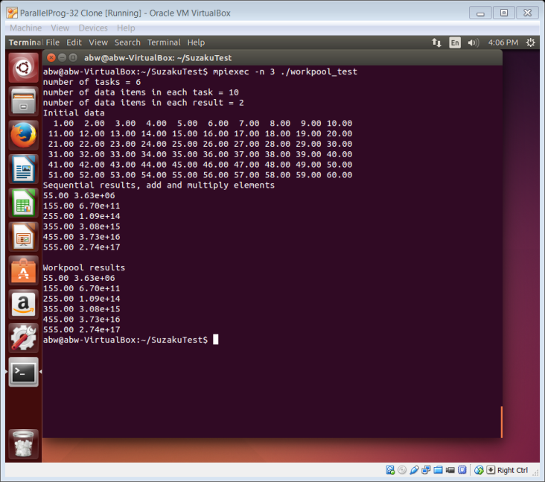
Sample output

Slide 22
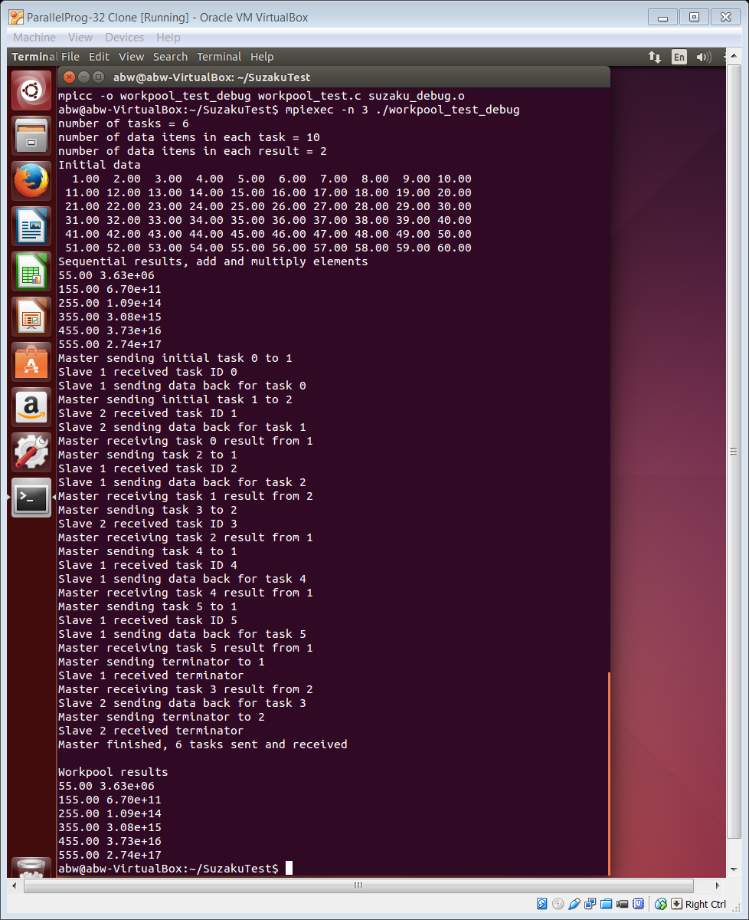
Sample output with debug messages There is version of SZ_Workpool that will print out debug messages.

Slide 23
2. Calculate π using the Monte Carlo method
Circle formed within a 2 x 2 square.
Ratio of area of circle to square:
y = $\sqrt{1 − x^{2}}$
1
Area = π
y
2
x
Points within square chosen randomly. Count how many points lie within circle.
Fraction of points within circle will be π/4, given sufficient number of randomly selected samples.
2
Typically only one quadrant used. Random pairs of numbers, (xr,yr) generated, each between 0 and 1. Counted as in circle if

Slide 24
Workpool implementation
Slaves
Compute
Return number of random points inside arc of circle
inside
seed
DiffuseData
GatherData
Starting seed for random sequence to each slave
Aggregate answers
Master

Slide 25
Suzaku Monte Carlo Pi program
// Suzaku Workpool: Monte Carlo Pi. B. Wilkinson April 4, 2015
#include <stdio.h>
#include <string.h>
#include <stdlib.h>
#include <time.h>
#include "suzaku.h"
// required Suzaku constants
#define T 100 // number of tasks, max = INT_MAX - 1
#define D 1 // number of data items in each task, doubles only
#define R 1 // number of data items in result of each task, doubles only
#define S 1000000 // constant used in computation, sample pts done in a slave
double total = 0; // // gobal variable, final result
void init(int *tasks, int *data_items, int *result_items) {
*tasks = T;
*data_items = D;
*result_items = R;
return;
}
void diffuse(int *taskID,double output[D]) {// taskID not used in computation
static int temp = 0; // only initialized first time function called
output[0] = ++temp; // set seed to consecutive data value
}

Slide 26
void compute(int taskID, double input[D], double output[R]) {
int i;
double x, y;
double inside = 0;
srand(input[0]); // initialize random number generator
for (i = 0; i < S; i++) {
x = rand() / (double) RAND_MAX;
y = rand() / (double) RAND_MAX;
if ( (x * x + y * y) <= 1.0 ) inside++;
}
output[0] = inside;
return;
}
void gather(int taskID, double input[R]) {
total += input[0]; // aggregate answer
}
double get_pi() { // additional routines used in this application
double pi;
pi = 4 * total / (S*T);
printf("\nWorkpool results, Pi = %f\n",pi); // results
}

Slide 27
int main(int argc, char *argv[]) {
int i; // All variables declared here are in every process
int P; // number of processes, set by SZ_Init(P)
double time1, time2; // use clock for timing
SZ_Init(P); // initialize MPI environment, sets P to number of procs
printf("number of tasks = %d\n",T);
printf("number of samples done in slave per task = %d\n",S);
time1 = SZ_Wtime(); // record time stamp
SZ_Parallel_begin // start of parallel section
SZ_Workpool(init,diffuse,compute,gather);
SZ_Parallel_end; // end of parallel
time2 = SZ_Wtime(); // record time stamp
get_pi(); // calculate final result
printf(“Exec. time =\t%lf (secs)\n",time2- time1);
SZ_Finalize();
return 0;
}

Slide 28
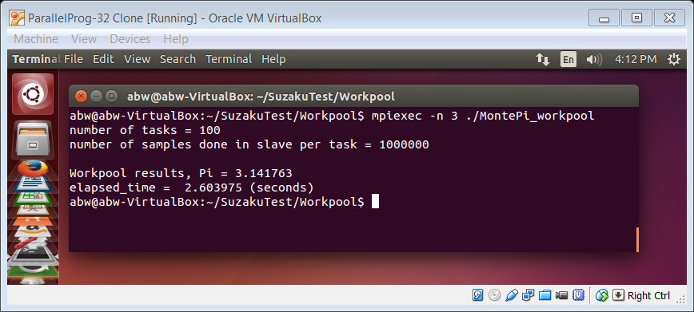
Sample output

Slide 29
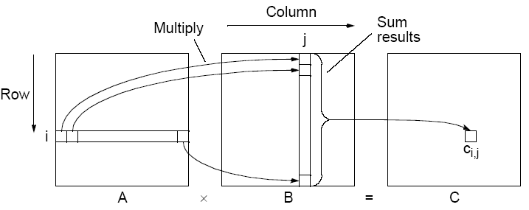
Matrix Multiplication
Workpool implementation
Slaves
Return one element of C
C
With one slave computing one element of result.
Send one row of A and one column of B to slave
A
B
Master

Slide 30
3 Suzaku matrix multiplication workpool program
// Suzaku Workpool: Matrix Multiplication. B. Wilkinson April 5, 2015
#include ... // usual C includes
#include "suzaku.h"
#define T 100 // req. Suzaku constants, T (tasks), D (data in task), R (result elements
#define D 6
#define R 1
#define N 3 // size of arrays
double A[N][N], B[N][N], C[N][N], Cseq[N][N];
void init(int *tasks, int *data_items, int *result_items) {
*tasks = T;
*data_items = D;
*result_items = R;
return;
}
void diffuse(int taskID,double output[D]) { // same as Seeds sample but inefficient int i, a, b; // copying of arrays, taskID used
a = taskID / N;
b = taskID % N;
for (i = 0; i < N; i++) { //Copy one row of A and one col of B into output
output[i] = A[a][i];
output[i+N] = B[i][b];
}
return;
}

Slide 31
void compute(int taskID, double input[D], double output[R]) {
int i;
output[0] = 0;
for (i = 0; i < N; i++) {
output[0] += input[i] * input[i+N];
}
return;
}
void gather(int taskID, double input[R]) {
int a, b;
a = taskID / 3;
b = taskID % 3;
C[a][b]= input[0];
return;
}
// additional routines used in this application
void initialize() { // initialize arrays
...
return;
}
void seq_matrix_mult(double A[N][N], double B[N][N], double C[N][N]) {
...
return;
}
void print_array(double array[N][N]) { // print out an array
...
return;
}

Slide 32
int main(int argc, char *argv[]) {
int i; // All variables declared here are in every process
int P; // number of processes, set by SZ_Init(P)
double time1, time2; // use clock for timing
SZ_Init(P); // initialize MPI environment, sets P
initialize(); // initialize input arrays
... // print out arrays
.. // compute sequentially to check results
time1 = SZ_Wtime(); // record time stamp
SZ_Parallel_begin // start of parallel section
SZ_Workpool(init,diffuse,compute,gather);
SZ_Parallel_end; // end of parallel
time2 = SZ_Wtime(); // record time stamp
printf("Workpool results"); ... // print final result
printf(“Time =\t%lf (seconds)\n", time2 - time1);
SZ_Finalize();
return 0;
}

Slide 33
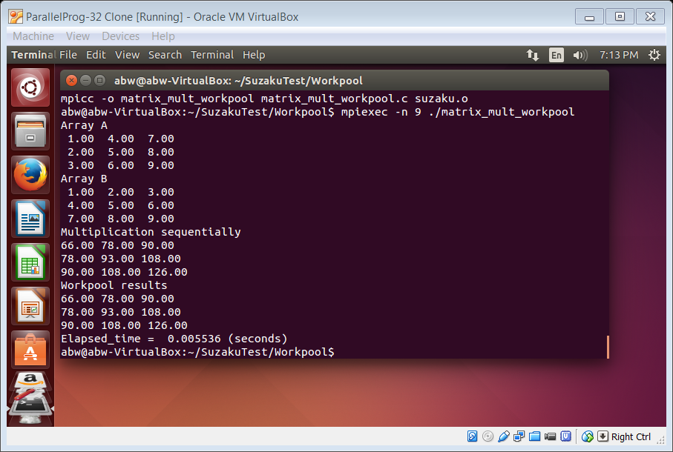
Sample output

Slide 34
Questions

