Slide 1
Suzaku Pattern Programming Framework Workpool pattern (Version 2)
© 2016 B. Wilkinson SuzakuWorkpool.pptx Modification date: February 25, 2016

Slide 2
Suzaku Workpool version 2
Mirrors the Java-based Seeds framework interface (see later) but using C but without objects.
In Seeds, a Java hashmap used that associates a key (a string) with each data item. Programmer refers to data by the key and uses put method to add data to the task and get method to extract data.
Now not limited to just 1-D arrays of doubles.
May incur a greater overhead that version 1 but more elegant to use and will be basis of the dynamic workpool (Workpool version 3) and other patterns.

Slide 3
Suzaku Put and Get
SZ_Put(char[8] key, void *x)
Purpose: Places data into the send message and associates a user-defined name to it.
SZ_Get(char[8] key, void *x)
Purpose: Extract data from the received message that is associated with a user-defined name.
x can be an individual character, integer, double, or 1-D array of characters, integers, or doubles, or a multi-dimensional array of doubles. Type does not have to be specified. Multi-dimensional arrays of other types not supported. Implemented with macros calling routines.

Slide 4
Test Program using Suzaku workpool version 2
#include <stdio.h>
#include "suzaku.h"
#define T 4 // number of tasks, max = INT_MAX - 1
void init(int *tasks) { // sets number of tasks
*tasks = T;
return;
}
void diffuse(int taskID) {
int j;
char w[] = "Hello World";
static int x = 1234; // only initialized first time function called
static double y = 5678;
double z[2][3]; z[0][0] = 357; z[1][1] = 246;
SZ_Put("w",w);
SZ_Put("x",&x);
SZ_Put("y",&y);
SZ_Put("z",z);
printf("Diffuse Task sent: taskID = %2d, w = %s, x = %5d, y = %8.2f, z[0][0] = %8.2f, z[1][1] = %8.2f\n",taskID, w, x, y,z[0][0],z[1][1]);
x++;
y++;
return;
}

Slide 5
void compute(int taskID) { // simply passing data x 10 in different order
char w[12] = "-----------";
int x = 0;
double y = 0;
double z[2][3]; z[0][0] = 0; z[1][1] = 0;
SZ_Get("z",z);
SZ_Get("x",&x);
SZ_Get("w",w);
SZ_Get("y",&y);
printf("Compute Task received: taskID = %2d, w = %s, x = %5d, y = %8.2f, z[0][0] = %8.2f, z[1][1] = %8.2f\n",taskID, w, x, y,z[0][0],z[1][1]);
x = x * 10;
y = y * 10;
z[0][0] = z[0][0] * 10;
z[1][1] = z[1][1] * 10;
printf("Compute Result: taskID = %2d, w = %s, x = %5d, y = %8.2f, z[0][0] = %8.2f, z[1][1] = %8.2f\n",taskID, w, x, y,z[0][0],z[1][1]);
SZ_Put("xx",&x); // use different names for test, could have been same names
SZ_Put("yy",&y);
SZ_Put("zz",z);
SZ_Put("ww",w)
return;
}

Slide 6
void gather(int taskID) { // function done by master collecting slave results.
char w[12] = "-----------";
int x = 0;
double y = 0;
double z[2][3];
z[0][0] = 0;
z[1][1] = 0;
SZ_Get("ww",w);
SZ_Get("zz",z);
SZ_Get("xx",&x);
SZ_Get("yy",&y);
printf("Gather Task received: taskID = %2d, w = %s, x = %5d, y = %8.2f, z[0][0] = %8.2f, z[1][1] = %8.2f\n",taskID, w, x, y,z[0][0],z[1][1]);
return;
}
Note order of put and get are not the same although they could be. Names used to identify variables chosen by programmer. (They are limited to eight characters in the current implementation for simplicity.)

Slide 7
int main(int argc, char *argv[]) {
int i; // All variables declared here are in every process
int P; // number of processes, set by SZ_Init(P)
SZ_Init(P); // initialize MPI message-passing environment
// sets P to be number of processes
printf("number of tasks = %d\n",T);
SZ_Parallel_begin
SZ_Workpool2(init,diffuse,compute,gather);
SZ_Parallel_end; // end of parallel
SZ_Finalize();
return 0;
}

Slide 8
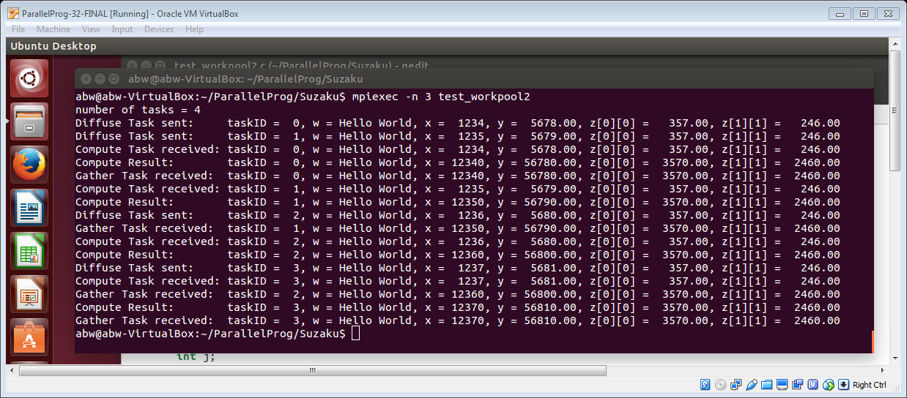
Sample output

Slide 9
Matrix multiplication Here each task consists of multiplying one row of A with one column of B to create one element of the answer

Slide 10
Mapping rows and columns to tasks
Assuming 3 x 3 arrays:
Arow Bcol
task 0 0 0
task 1 0 1
task 2 0 2
task 3 1 0
task 4 1 1
task 5 1 2
task 6 2 0
task 7 2 1
task 8 2 2
int Arow = taskID/3;
Int Bcol = taskID%3;

Slide 11
#include <stdio.h>
#include "suzaku.h"
#define T 9 // required Suzaku constant, number of tasks, max = INT_MAX - 1
#define N 3 // size of matrices
double A[N][N], B[N][N], C[N][N], Cseq[N][N];
void init(int *tasks) {
*tasks = T;
return;
}
void diffuse(int taskID) { // as Seeds sample but inefficient copying arrays
int i;
int a, b;
double rowA[3],colB[3];
a = taskID / N; // taskID used in computation
b = taskID % N;
for (i = 0; i < N; i++) { //Copy one column of B into output colB[i] = B[i][b]; // do not need to copy row of A
}
SZ_Put("rowA",A[a]);
SZ_Put("colB",colB);
return;
}

Slide 12
void compute(int taskID) {
int i;
double out;
double rowA[3],colB[3];
SZ_Get("rowA",rowA);
SZ_Get("colB",colB);
out = 0;
for (i = 0; i < N; i++) {
out += rowA[i] * colB[i];
}
SZ_Put("out",&out);
return;
}

Slide 13
void gather(int taskID) {
int a,b;
double answer;
SZ_Get("out",&answer);
a = taskID / 3;
b = taskID % 3;
C[a][b]= answer;
return;
}

Slide 14
int main(int argc, char *argv[]) {
int i; // All variables declared here are in every process
int P; // number of processes, set by SZ_Init(P)
double time1, time2; // for timing
SZ_Init(P); // initialize MPI environment, sets P to number of processes
initialize(); // initialize input arrays
… // print arrays
… // compute matrix multiplication sequentially for testing
time1 = SZ_Wtime(); // record time stamp
SZ_Parallel_begin // start of parallel section
SZ_Workpool2(init,diffuse,compute,gather);
SZ_Parallel_end; // end of parallel
time2 = SZ_Wtime(); // record time stamp
… // print results
printf("Elapsed_time = %f (seconds)\n", time2 - time1);
SZ_Finalize();
return 0;
}

Slide 15
Questions

