Slide 1
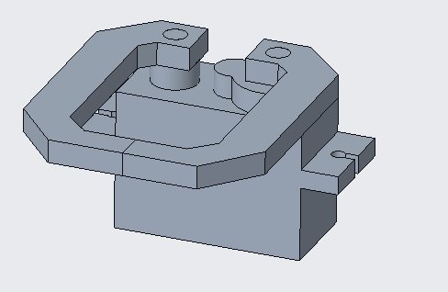
Bag Clasping Claw
For Self replacing trash can
Purpose: The Purpose of this design is to be integrated on an extending and retracting component within a trash can. This assembly will latch onto an empty trash bag and retain clamping force while it is retracted to replace the bag.
Major Decisions: During the component phase of this design a major revision had to be made to the claw components to allow for the motor to attach without complication. I opted for symmetrically identical claw components instead which could be mounted to a singular motor. This configuration and design was much easier to manufacture and implement.
Major Calculations: The most significant calculation made during this design process was the clamping force required to ensure slippage does not occur. It was determined a clamping force of ~10lbs was sufficient. Stress calculations were also performed to make sure that the claws could handle this, and the motor could provide the required output.
Major Lessons: The biggest lesson I learned was that the saying “we’ll cross that bridge when we get there”, is a horrible saying and should be avoided at all costs. In the long run it is much better to think about the future meticulously. You WILL cross that bridge, but it is always better to know what to expect than to walk blindly into an inferno.
Be proactive!

