Slide 1
On A Winter’s Night
By Kadee Blakely

Slide 2
Mode/Reference-Value Settings
Camera Example
Microwave Exmaple

Slide 3
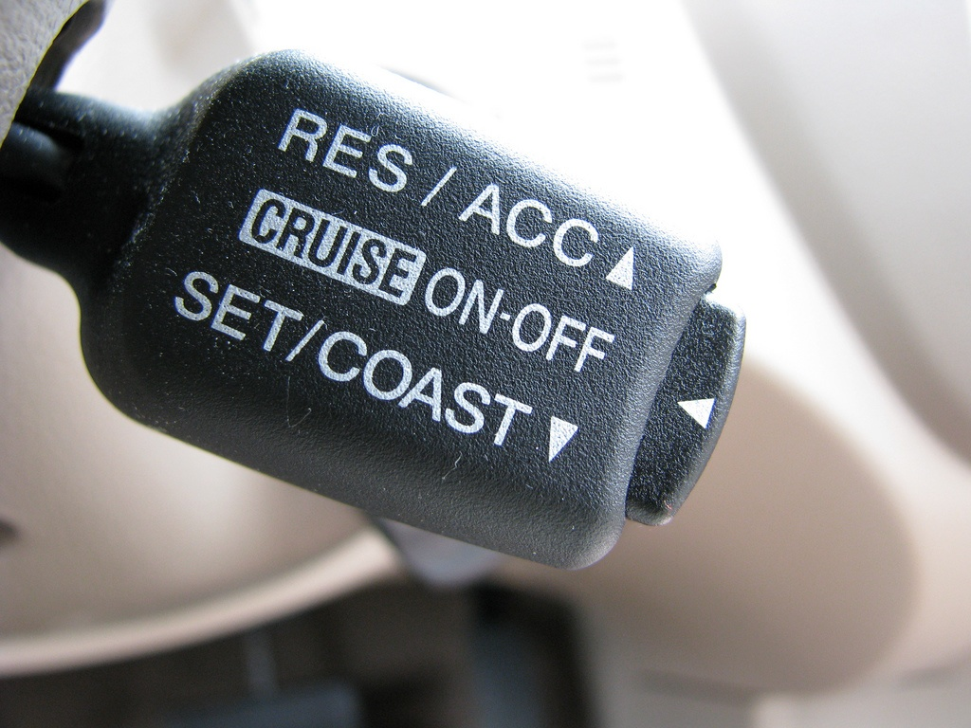
Cruise Control

Slide 4
What’s Involved?
On the left: a switch that will arm the cruise control
On the other side: set/coast button and on top of that there is the resume/accelerate rocker buttons

Slide 5
What’s Happening When We Use It?
By Squeezing the set/coast button the cruise control engages with a slight surge
A device pneumatic device is now holding the pedal at the set speed of 40mph
But what happens when there’s no visual indication to remind you that the car is in cruise control?

Slide 6
Continued…
If you push on the set/coast button, it will decrease by 1 mile. Hold it down? It keeps decreasing
Pressing the “off” button will disengage the entire operation and you’ll need your foot again
Taping the brakes will transition from cruise to engage

Slide 7
The Scenario
Imagine you’re at you’re exit, which is at the top of a hill and you assume that taking your foot off the break will naturally slow the car. So you do. Somehow, though, the car starts climbing in speed as if it were on a flat road.

Slide 8
What Should Have Happened?
1. Identify the current mode of the machine
2. Know the behavior of the machine- how and when it moves from one mode to another
3. Sense the vents that trigger the transition between modes

Slide 9
What We Can Assume
We can assume that the driver knew that the cruise control was not in active mode.
1. Override
2. Canceled
3. Armed

Slide 10
How can you tell?
If we are in override and lift our foot from the pedal, the speed will decrease until we end up at 40 mph and return to active mode
If we are in canceled and release the gas pedal, the speed will go down to 0, just as if we are driving manually
In armed the speed will also go down to0

Slide 11
So what happened at the intersection?
There was no indication of what mode the cruise control was in. Non-deterministic

