Slide 1
Would you know if you are having a heart attack?
Photonovella
Jeanette Egerer
April 27th, 2007

Slide 2
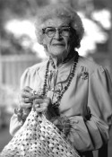
Featuring:
Elroy and Martha Smith

Slide 3
Martha and Elroy are enjoying a nice Sunday evening when Elroy starts to feel bad.
Honey I am not feeling so well
Well…what’s wrong?

Slide 4
I will take you to the hospital ..that is what happened to Lucy and she had a heart attack!!
I am sweating , I feel pressure in my chest, and my left arm is really painful.

Slide 5
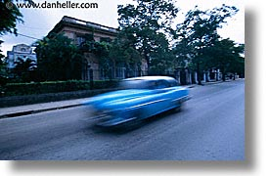
Martha and Elroy rush to the Hospital
Come on honey, let’s go!! I’ve got the keys!!

Slide 6
Elroy checks in to the hospital and waits for the doctor to see him
I would like to see a doctor. I am having chest pains
Okay Sir, Have a seat and we will get you back in a few moments

Slide 7
Elroy and Martha wait to see the Doctor

Slide 8
Elroy meets with the doctor
Hello Mr. Smith, I am Dr. Carson, I hear you are having chest pains , can you tell me what else is going on?

Slide 9
Well Doc, I just haven’t been feeling well today. It all started with a headache, and I couldn’t breathe well, and then my chest was hurting and my left arm too. I just haven’t felt right today, not myself.

Slide 10
Well Mr. Smith, you did the right thing by coming to the hospital. Sounds like you could be experiencing symptoms of a heart attack.
Too often patients attribute heart attack symptoms to indigestion, fatigue, or stress and consequently delay seeking prompt medical attention.
Chest pain, pain in he left arm, feelings of heart burn, shortness of breath, feeling ill, and even nausea and vomiting.

Slide 11
A heart attack results when a blood clot completely obstructs a coronary artery supplying blood to the heart muscle and heart muscle dies.
Not ignoring and being aware of your symptoms is what has saved your life today, Mr.Smith.

Slide 12
Well I am so glad my wife made me come here today
We are too Mr. Smith

Slide 13
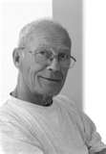
I am going to admit you into our hospital today, Sir, so that we can run a few test and find out what is going on…
Thanks Doc, that’s sounds great

Slide 14
I love you so much honey. Thanks for taking me to the hospital. The doctor says if I would have waited any longer things could have been really bad or even fatal!!
I love you too! I am glad that I was aware of the symptoms of a heart attack.

Slide 15
The doctor comes back with results and discusses how these important factors can prevent Mr. Smith from having another heart attack.
Okay Mr. Smith..we are going to let you go home but there are some things we want you to start doing
Whatever you say Doc!!

Slide 16
There is no cure for coronary heart disease, but it is important for you to quit smoking, watch your cholesterol levels, lose weight, follow an exercise plan I am giving to you today and try to control your stress level.
Alright Doc, you got it!

Slide 17
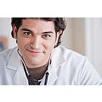
We will make an appointment with you for a check up in 4-6 weeks!!
Thank you so much for saving my husband Doctor Carson!
Mrs. Smith you saved your husbands life, thank you for being aware.

Slide 18
Elroy and Martha go home

Slide 19
The End

