Slide 1
Knowing Your Body…
The Importance Of Seeing Your Doctor: For All Ages

Slide 2
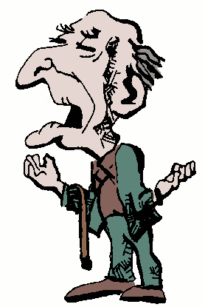
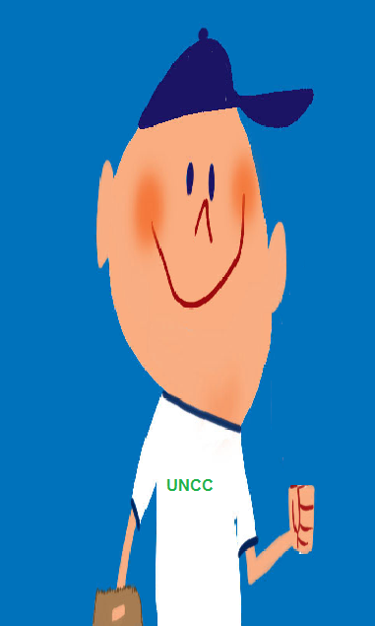
Bill
Joe
Hey! I’m only 21! I’m in college! I’m as healthy as an ox! I don’t need check ups!
That’s ridiculous! I’ve been healthy my entire life. I don’t need a Doctor!

Slide 3
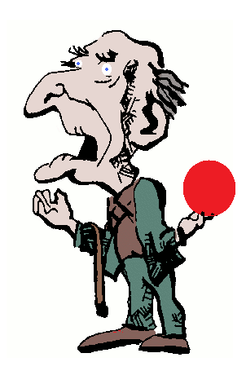
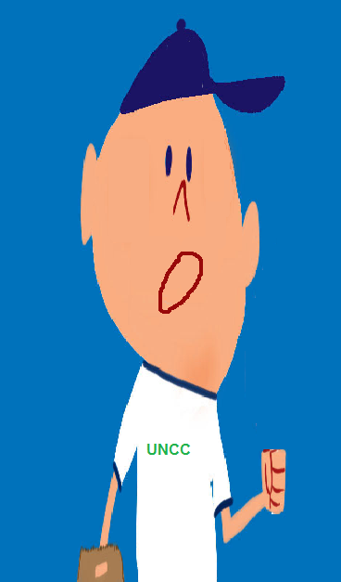
COUGH! COUGH!
OW MY WRIST!

Slide 4
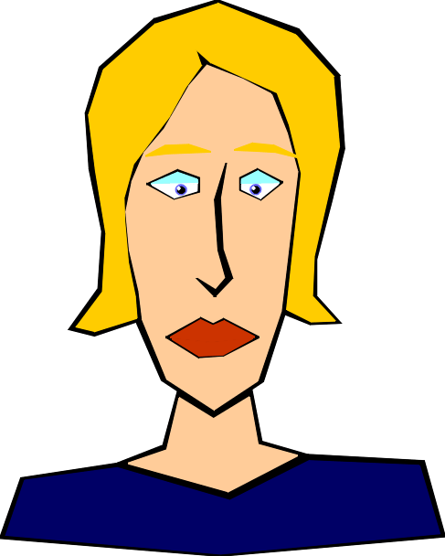
I think you two need to go see a doctor.
I just need to bowl through the pain. I’ll be fine.
I just have a cold. I’ll be fine.

Slide 5
One Month Later….
My team is going to kill me! My average is a 22!
Man! This cough just won’t go away!

Slide 6

Joe, it looks like you have allergies. Take this and you’ll feel better.
Bill, that’s definitely arthritis. Just wear this over your wrist and you’ll be fine.

Slide 7
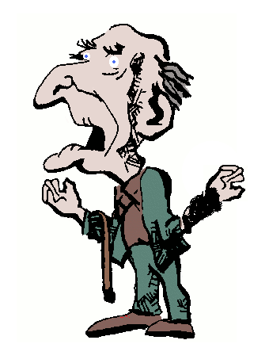
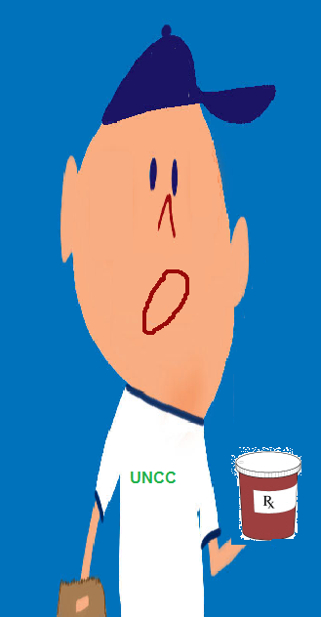
One Month Later…
I would have thought this cough would have gone away by now.
This stupid wrist thing does nothing!

Slide 8
You two need to go back to the doctor. What he gave you is not working.
We tried that, and he couldn’t do anything! Besides, it’s not that bad. It will go away on its own

Slide 9
One month later…
Grandpa, this isn’t going away. Maybe we should go see the doctor like mom said.
Alright, fine. Let’s try one more time.

Slide 10
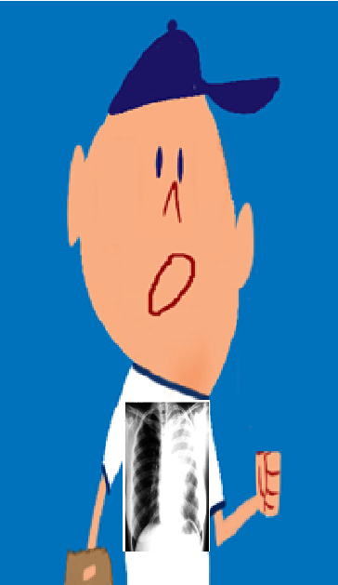
Well, Bill it looks like your arthritis is worse than I thought. We will have to start you on physical therapy immediately. And Joe, it looks like that wasn’t allergies at all. After taking an x-ray of your chest, I can see that you have Lymphoma and a large tumor has grown in your lungs. We’ll have to start you on chemotherapy fast.

Slide 11
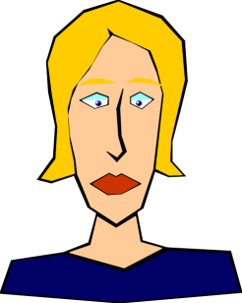
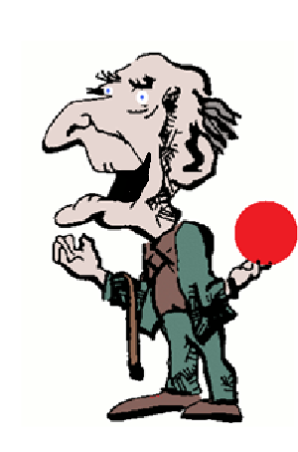
One Year Later….
See…
Man! I feel great! I can finally go back to living a normal life!
Your not going to believe this! I bowled a perfect game!

Slide 12
It is important to understand and listen to your body. Anything can happen at any stage in your life and at any age. By keeping up on Dr. visits you can be sure to stay healthy and enjoy the things you love.
If Joe had only gone to the Dr. sooner, he could have avoided the growth of the tumor in his lung and gotten rid of it more quickly.
Bill could have gotten the therapy he needed faster and had much more time to do the things he loves to do, like bowling.

