Slide 1





Knowledge-Graph Construction
CCI, UNC-Charlotte
CS Dept., PJAIT, Warsaw, Poland
Zbigniew W. Ras
University of North Carolina at Charlotte
&
Polish-Japanese Academy of Information Technology
Sponsored by

Slide 2
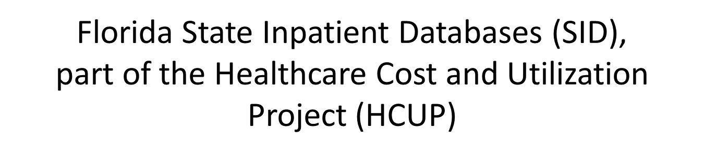
Recommendations/interventions leading to
readmission reduction

Slide 3
HCUP Dataset
Part of the Healthcare Cost and Utilization Project (HCUP).
A total of over 7.8 million visit discharges for over 3.6 million
patients in Florida..
Each patient can exhibit up to 31 diagnoses and up to 31 procedures.
(The first procedure is considered the main procedure).
Diagnoses/Procedures codes:
  International Classification of Diseases, Ninth Revision, Clinical Modification (ICD-9-CM)
  Clinical Classifications Software (CCS)
Diagnoses: ~15k (ICD-9-CM), ~300 (CCS)
Procedure codes: ~4k (ICD-9-CM), 231 (CCS)

Slide 4
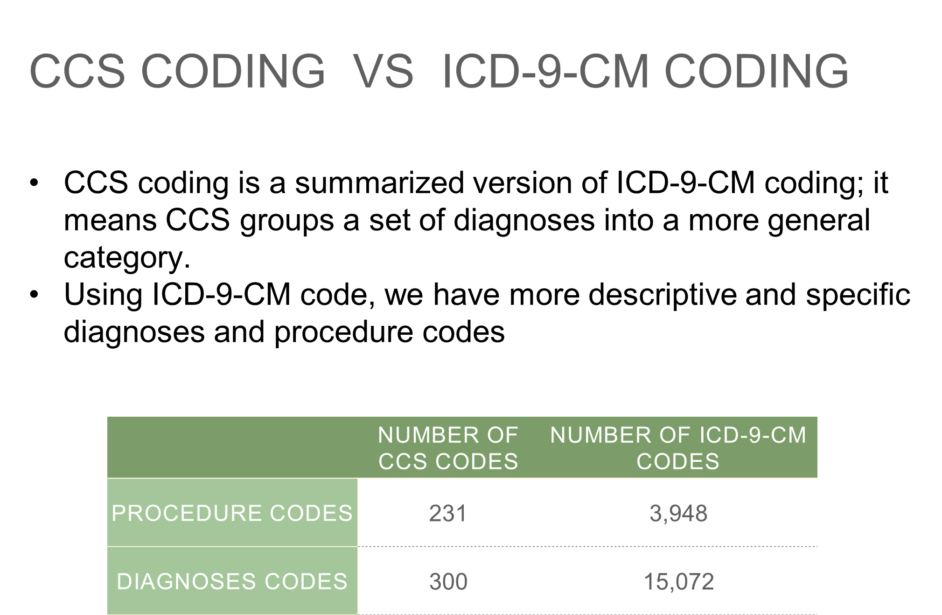

Slide 5
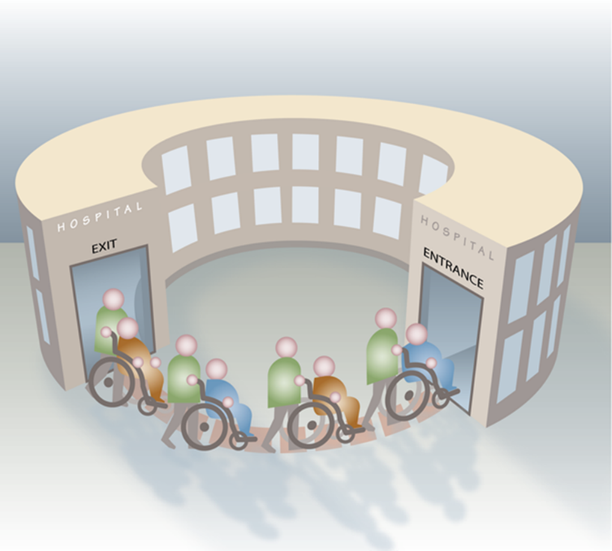
Hospital Readmissions
Hospital Readmission is defined as a re-hospitalization of a patient after being discharged from a hospital within a short period of time. The period in average is 30 days

Slide 6
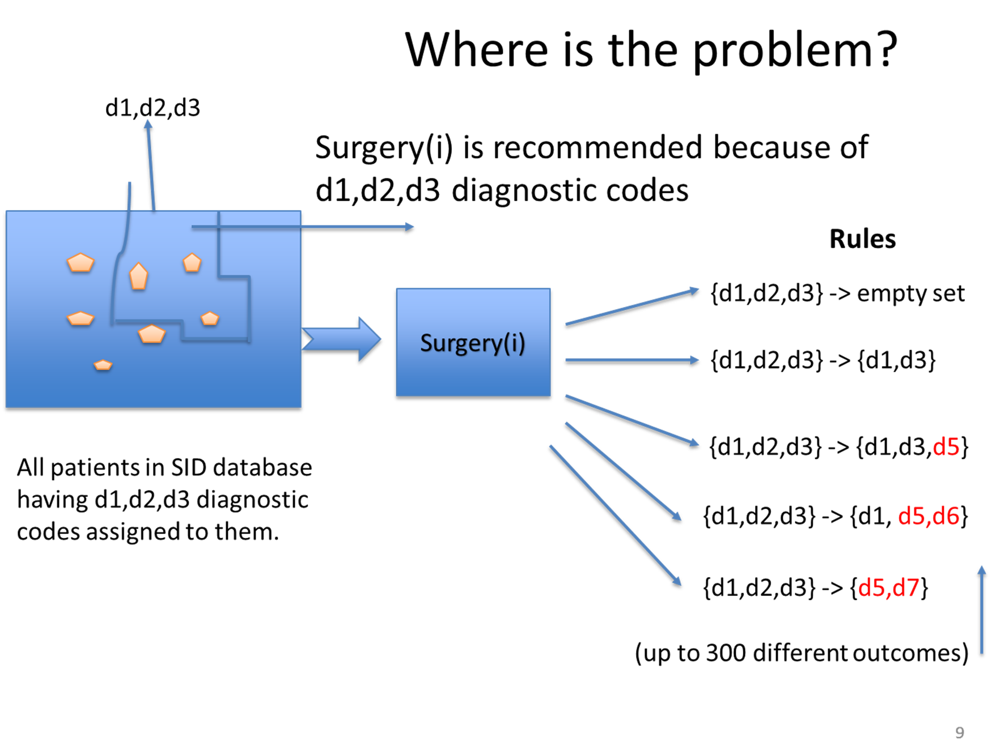
Hospital Readmissions

Slide 7
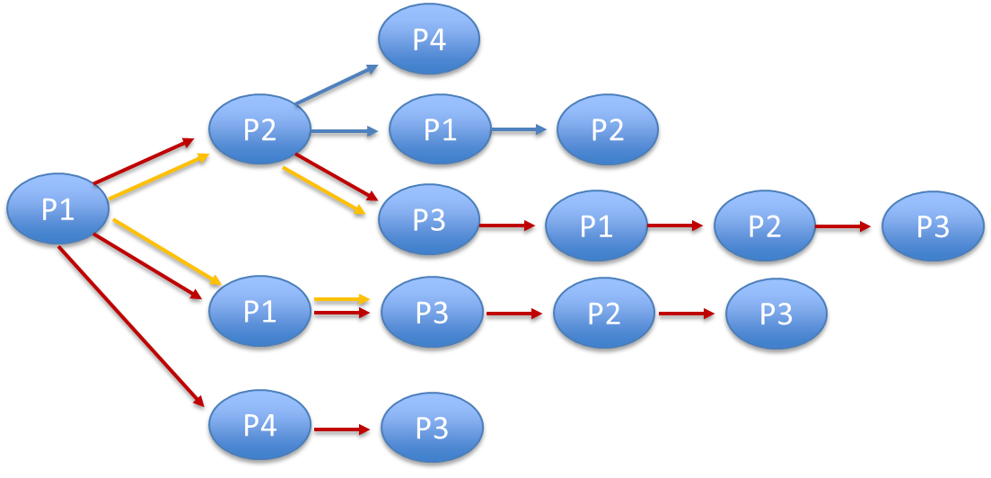
Procedure paths: sequence of procedures that a given patient undertakes to reach a desired treatment.
We study the problem of predicting procedure paths and providing a foundation for transitioning from one procedure path to another

Slide 8
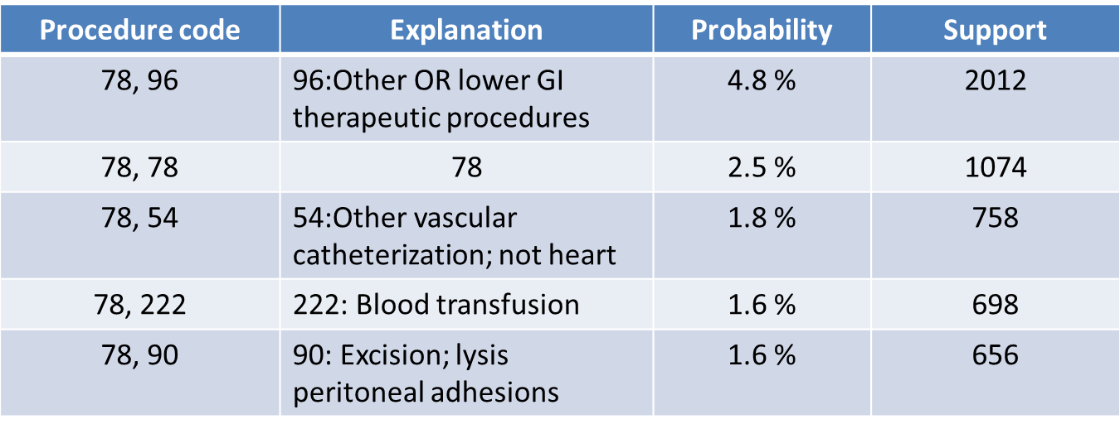
Example: Procedure Code 78 (Colorectal Resection)
41,753 patients started with this procedure.
6,774 unique procedure paths.
Most probable 2-element paths

Slide 9
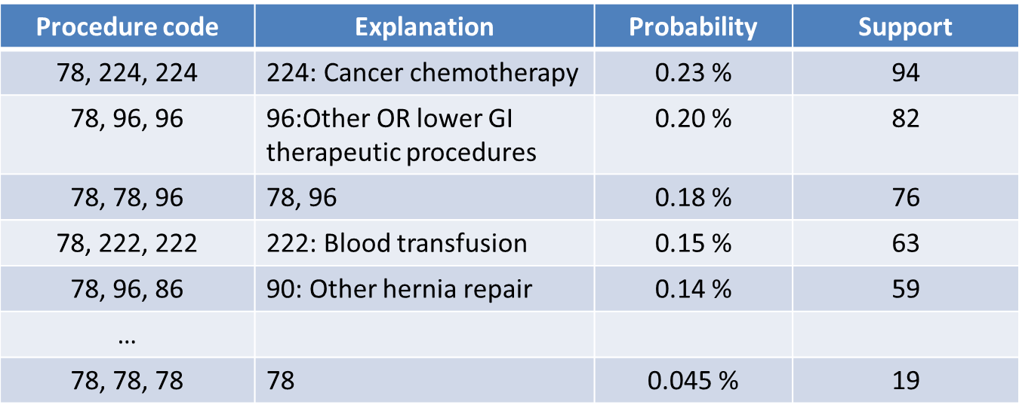
Example: Procedure Code 78 (Colorectal Resection)
41,753 patients started with this procedure.
6,774 unique procedure paths.
Most probable 3-element paths

Slide 10
Procedure 78: Longest Path
Length 22 (1 path):
78(Colorectal resection), 223(Enteral and parenteral nutrition), 223(Enteral and parenteral nutrition), 70(Upper gastrointestinal endoscopy; biopsy), 75(Small bowel resection), 223(Enteral and parenteral nutrition), 172(Skin graft), 223(Enteral and parenteral nutrition), 223(Enteral and parenteral nutrition), 223(Enteral and parenteral nutrition), 223(Enteral and parenteral nutrition), 223(Enteral and parenteral nutrition),
54(Other vascular catheterization; not heart), 223(Enteral and parenteral nutrition),
54(Other vascular catheterization; not heart), 70(Upper gastrointestinal endoscopy; biopsy), 54(Other vascular catheterization; not heart), 223(Enteral and parenteral nutrition), 54(Other vascular catheterization; not heart), 54(Other vascular catheterization; not heart), 34(Tracheostomy; temporary and permanent), 54(Other vascular catheterization; not heart),
Probability is 2.396070198582124E37, Support: 1

Slide 11
Procedure 78: Length 21 (2 paths):
78(Colorectal resection), 221(Nasogastric tube), 96(Other OR lower GI therapeutic procedures), 231(Other therapeutic procedures), 231(Other therapeutic procedures), 221(Nasogastric tube), 221(Nasogastric tube), 78(Colorectal resection), 78(Colorectal resection), 223(Enteral and parenteral nutrition), 223(Enteral and parenteral nutrition), 221(Nasogastric tube), 222(Blood transfusion), 54(Other vascular catheterization; not heart), 223(Enteral and parenteral nutrition), 223(Enteral and parenteral nutrition),
223(Enteral and parenteral nutrition), 174(Other non-OR therapeutic procedures on skin and breast), 174(Other non-OR therapeutic procedures on skin and breast), 223(Enteral and parenteral nutrition), 223(Enteral and parenteral nutrition),
Probability is 2.3960703494154103E35, Support: 1
------------------------------------
78(Colorectal resection), 222(Blood transfusion), 58(Hemodialysis), 88(Abdominal paracentesis), 58(Hemodialysis), 58(Hemodialysis), 88(Abdominal paracentesis), 58(Hemodialysis), 58(Hemodialysis), 58(Hemodialysis), 58(Hemodialysis), 58(Hemodialysis), 88(Abdominal paracentesis),
58(Hemodialysis), 47(Diagnostic cardiac catheterization; coronary arteriography),
34(Tracheostomy; temporary and permanent), 216(Respiratory intubation and mechanical ventilation), 58(Hemodialysis), 40(Other diagnostic procedures of respiratory tract and mediastinum), 58(Hemodialysis), 222(Blood transfusion),
Probability is 2.3960705057112934E35, Support: 1

Slide 12
Knowledge Graph

Slide 13
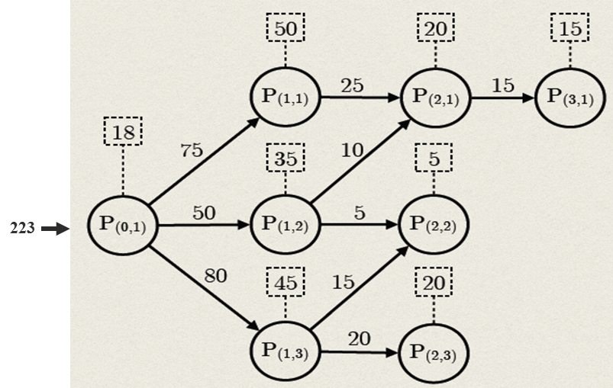
Knowledge Graph
Knowledge graph for some procedure p is defined as a graph representing all possible procedure paths extracted from our dataset for patients who underwent procedure p as their first procedure
Notes:
This is the first step of the research, which is to find all possible paths that a new patient may undertake during the course of treatment.
Here I am showing a hypothetical example for all possible paths after performing P(0,1) as the first procedure. These paths form a tree that we call procedure graph.
Explain the Nodes, Length and numbers:
Nodes: The nodes in the graph represent the procedures. These procedures could be major like a surgery or minor such as x-ray
Length: The length of any given procedure path is an indicator of the number of readmissions that occurred or will occur throughout the course of treatment.
Numbers: Explain the numbers in the graph.

Slide 14
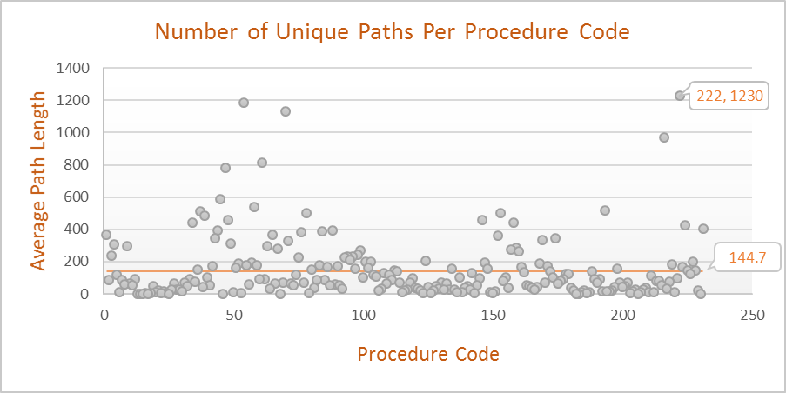
Information Extracted from Knowledge Graph
The number of all procedure paths is extremely high.
It does not exist a single universal course of treatment that patients typically follow to reach the desired state.
222 : Blood Transfusion

Slide 15
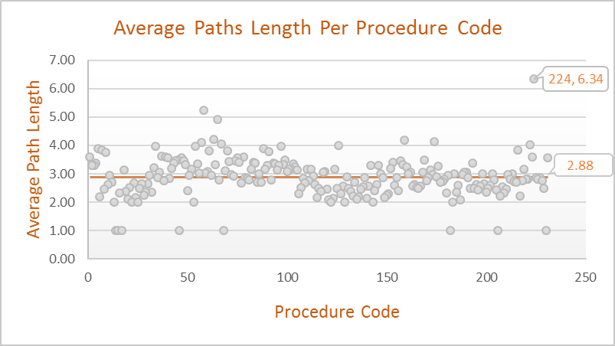
Information Extracted from Knowledge Graph
The length of the procedure path is an indicator of the number of readmissions during the course of treatment.
Path length (Number of readmission) = Number of nodes (procedures)-1
224 : Cancer chemotherapy
Notes:
Note that these numbers may include outliers, for example, there could be only one patient who had the maximum path length of 56. In Chapter 6, we will
provide a more robust mechanism that provides a score for each procedure, which represents the average number of hospital readmissions

Slide 16
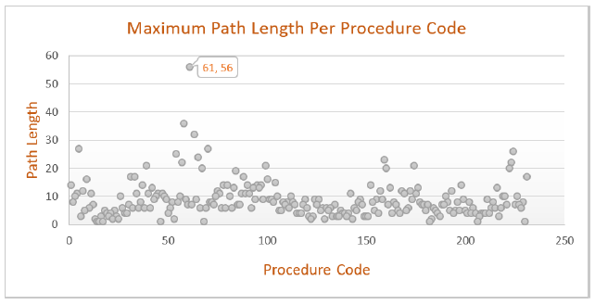
Information Extracted from Knowledge Graph
Knowing that patient will undergo procedure 58 (Hemodialysis) as the initial procedure allows us to anticipate what could be the maximum and the average number of possible readmissions in general, which are 36 and 4.2 respectively.
61 : procedures on vessels other than head and neck

Slide 17
Knowledge Graph
Personalization

Slide 18
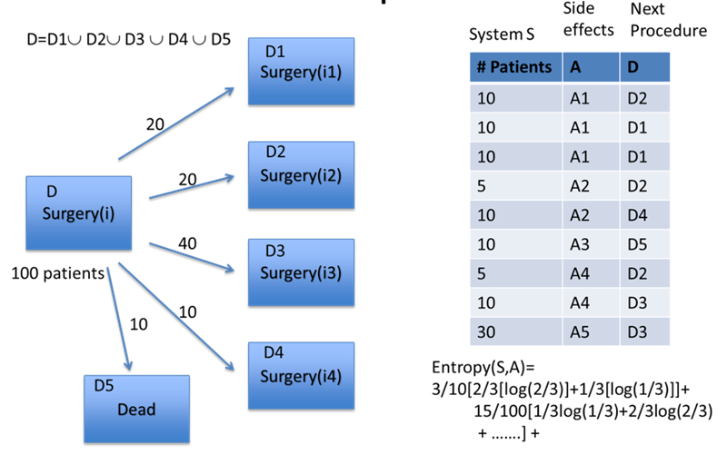

Slide 19

Patients’ Clustering
Clustering criteria:
Race
Gender
Age
Diagnoses
Procedures
Stable
Flexible
. . .

Slide 20
Stable Features Clusters
Race | Code
White | 1
Black | 2
Hispanic | 3
Asian or Pacific Islander | 4
Native American | 5
Other | 6
Age | Range
Child | [0 – 17]
Young | [18 – 44]
Mature | [45 – 65]
Old | [65 – ]
.
.
.
White, Child | Black, Child | Hispanic, Child | Asian, Child | Native, Child | Other, Child
White, Young | Black, Young | Hispanic, Young | Asian, Young | Native, Young | Other, Young
White, Mature | Black, Mature | Hispanic, Mature | Asian, Mature | Native, Mature | Other, Mature
White, Old | Black, Old | Hispanic, Old | Asian, Old | Native, Old | Other, Old

Slide 21
Personalization Using Stable Features
Procedure Code | Number of Patients | Entropy
 |  | No Clustering | Clustering based on
 |  |  | Race only | Age only | Race and Age
48 | 15139 | 5.657 | 5.608 | 5.595 | 5.518
44 | 7705 | 5.684 | 5.604 | 5.615 | 5.495
58 | 9187 | 3.914 | 3.855 | 3.853 | 3.748
158 | 17129 | 5.29 | 5.249 | 5.181 | 5.103
39 | 8717 | 4.993 | 4.927 | 4.866 | 4.753
Slight decrease in entropy
48: Insertion; revision; replacement; removal of cardiac pacemaker or cardioverter/defibrillator,
44: Coronary artery bypass graft (CABG)
58: Hemodialysis, 158: Spinal fusion, 39: Incision of pleura; thoracentesis; chest drainage

Slide 22
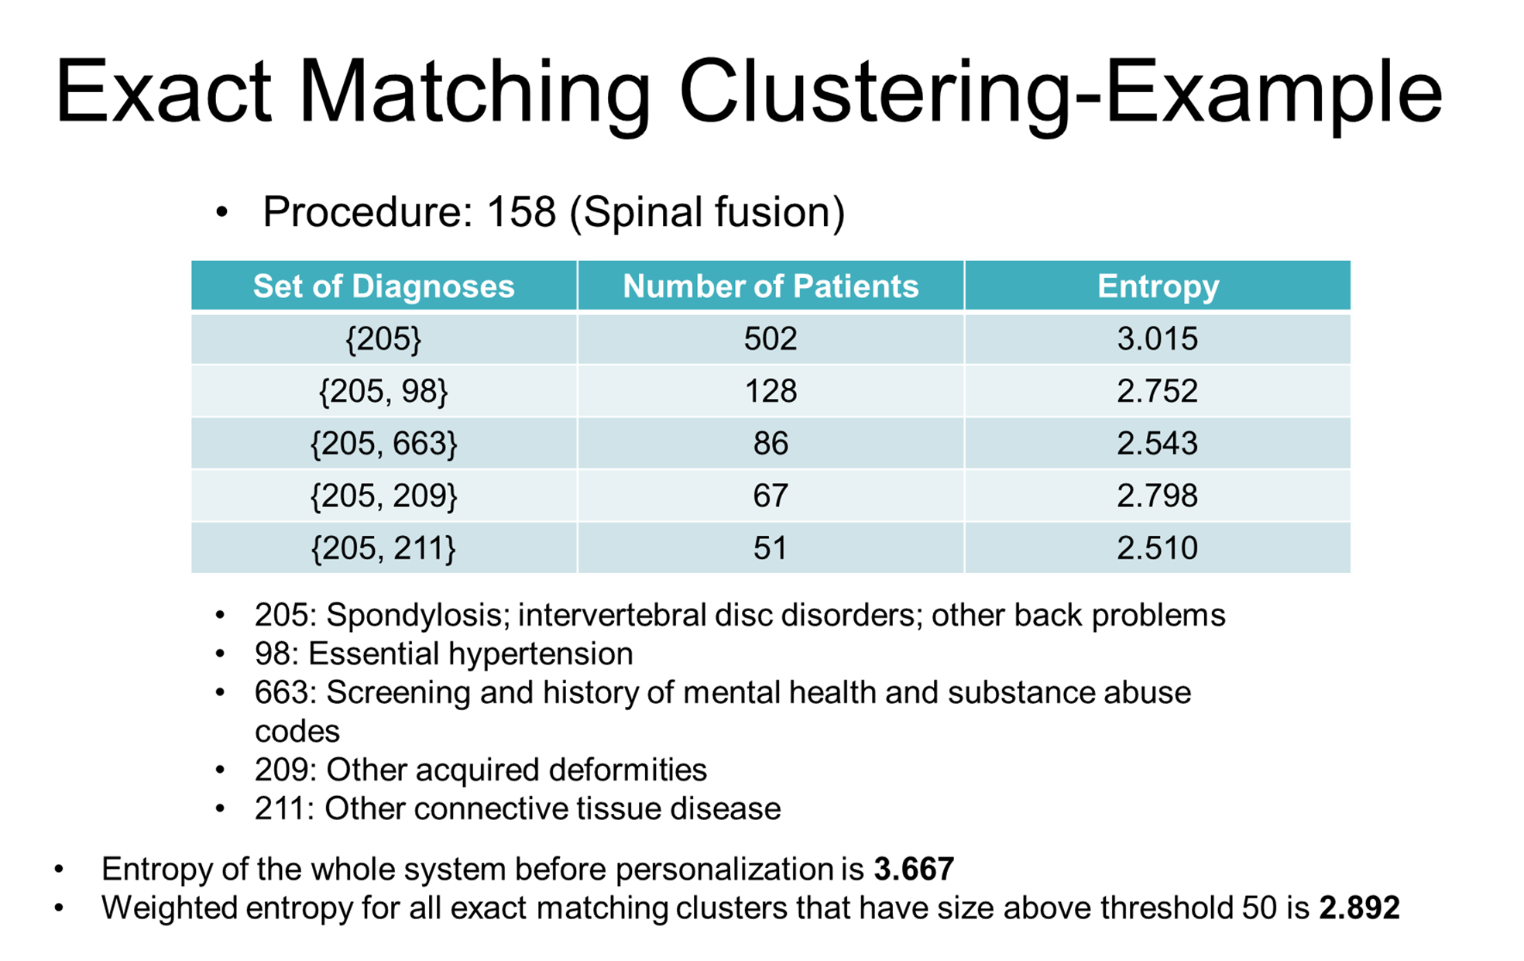

Slide 23

Rough Clustering of Patients
Patients are clustered based on diagnoses.
We define two sets of diagnoses that will determine whether a patient belongs to a particular cluster or not:
  Included set: describes the set of diagnoses that a patient has to exhibit to belong to a given cluster.
  Excluded set: describes the set of diagnoses that a patient cannot exhibit to belong to a given cluster.
Notes:
We proposed an algorithm to cluster the patients based on the diagnoses that they have and they don’t have. So, we defined two sets: the included and excluded sets.

Slide 24

Rough Clustering - Example
{2391, 2749}
{-2859}
{2749}
{-2859, -3723}
{2391, 2749}
{-2859, -3723}
{}
{-2859, -3723,
-2749}
Notes:
So we proposed an algorithm to cluster the patients based on the diagnoses that they have and they don’t have. So we defined two sets: the included and excluded sets. The best way

Slide 25

Rough Clustering - Example
{2391, 2749}
{-2859}
Level 3
{2749}
{-2859, -3723}
{2391, 2749}
{-2859, -3723}
{}
{-2859, -3723,
-2749}
Notes:
So we proposed an algorithm to cluster the patients based on the diagnoses that they have and they don’t have. So we defined two sets: the included and excluded sets. The best way

Slide 26
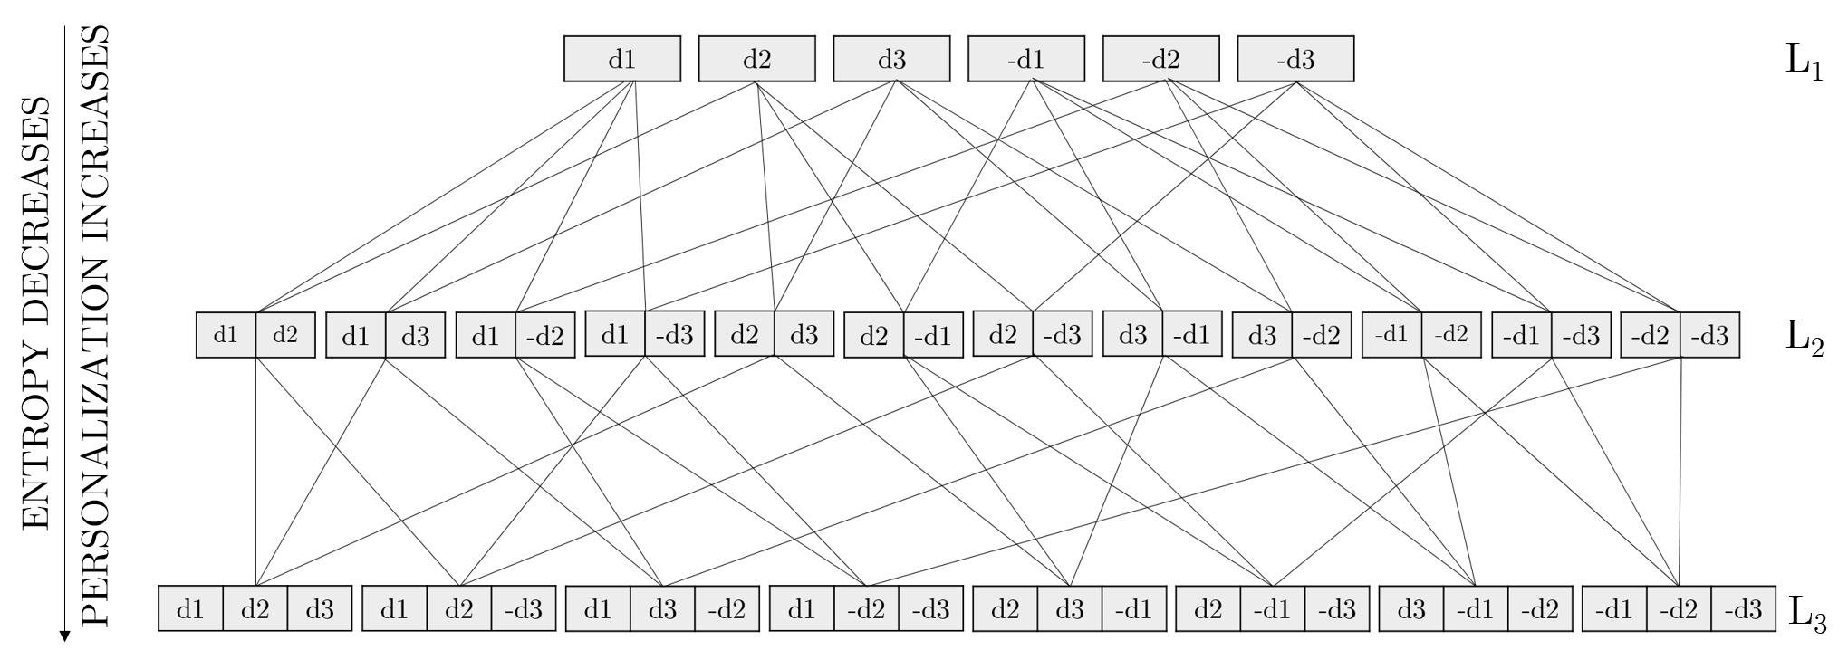
Rough Clustering - Implementation
.
.
.
Notes:
Constructing more combinations of the diagnostic codes enforces more personalization on the patients and as a result improves the predictability of the next procedure (the entropy decreases).

Slide 27

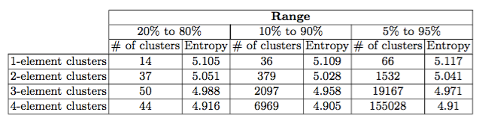
Rough Clustering - Filtering
If all patients have a common diagnosis, then this diagnosis will not play any role in determining the state for which patients end up in.
We only considered diagnostic codes that lie within a specific range. For example, when we choose the allowed range to be between 20% and 80%, this means that we only consider diagnoses for which the number of patients that exhibit that diagnosis is between 20% and 80%. It means only these diagnoses are considered in clusters construction.
This procedure is also applied to the excluded set, meaning that we only consider diagnoses that were missing from 20% to 80% of the total number of patients.
Procedure 158
Spinal Fusion
Number of clusters increases
ENTROPY INCREASES
NUMBER OF CLUSTERS
INCREASES

Slide 28
Rough Clustering - Filtering
Rough clustering generates a large number of clusters
  Number of diagnoses = 283
  Number of 1-element sets = 566
  Number of 2-element sets = 159,612
  Number of 3-element sets = 29,980,454
Table 1. Number of clusters and entropy for different element sets and different ranges for procedure 158 (spinal fusion)
Number of clusters increases
ENTROPY INCREASES
ENTROPY INCREASES
ENTROPY INCREASES
NUMBER OF CLUSTERS
INCREASES
NUMBER OF CLUSTERS
INCREASES
Notes:
In our approach of selecting t diagnostic codes candidates, we started by discarding the diagnostic codes that were either always or never evident in the set of diagnoses. Although this may seem counterintuitive at first, the reasoning behind doing so is rather logical.
if all patients have a common diagnosis, then this diagnosis will not play any role in
determining the state for which patients end up in.

Slide 29
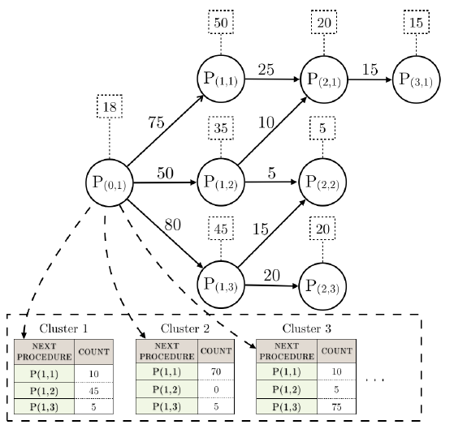
Rough Clustering – Knowledge Graph Personalization
223
Notes:
The distribution of procedures in cluster 1 implies that if a new patient were to belong this cluster, then most likely he or she will undergo procedure P(1,2)

