Slide 1
The Pitfalls of
Next-Token Prediction
Gregor Bachmann and Vaishnavh Nagarajan
ICML 2024 - Proceedings of Machine Learning Research
Presented by: Fatemeh Rajabi and Mehjabeen T Shaikh | ITCS 6101/8101 - Natural Language Processing

Slide 2
Motivation: Why Question Next-Token Prediction?
Can a mere next-token predictor faithfully model human intelligence?
How Humans Reason
How LLMs Are Trained
Plan and evaluate outcomes before acting
Backtrack when a path fails
Think ahead (System 2 thinking)
Revise earlier decisions based on future context
Language models generate text one token at a time
No built-in backtracking or lookahead
Common concern: Errors accumulate during generation
Does the model learn correct reasoning during training?
2

Slide 3
What is Next-Token Prediction?
A language model generates text one token at a time
At each step, it predicts: the next token given previous tokens
P(next token | previous tokens)
Autoregressive Inference
Input: "The cat"
Output: "sat" → "on" → "the" → "mat"
The full sequence is built step-by-step
3

Slide 4
Background: Two Modes of Next-Token Prediction
Teacher-Forcing (Training)
Autoregressive Inference
• Uses correct previous tokens only • Never sees its own mistakes
Key issue: • Does not learn to recover from errors Main finding:
• Fails to learn proper reasoning during training • Cannot be fixed later (e.g., CoT)
• Uses its own previous predictions • Does not see the correct answers Problem (snowball effect): • Errors accumulate over time • Small mistakes grow into large errors • Long sequences can become completely wrong
The problem starts during training, not at inference.
4

Slide 5
Prior Work: Focus on Inference, Not Training
Prior Work
Limitation
Optimistic view
Any sequence can be modeled using the chain rule
Common criticism
Errors accumulate during inference
The probability of a correct sequence decreases exponentially
Focuses only on inference errors
Assumes training is correct
Ignores how the model learns
Shannon (1948, 1951); Shlegeris et al. (2022);
LeCun (2024); Dziri et al. (2024); Ross & Bagnell (2010)
5

Slide 6
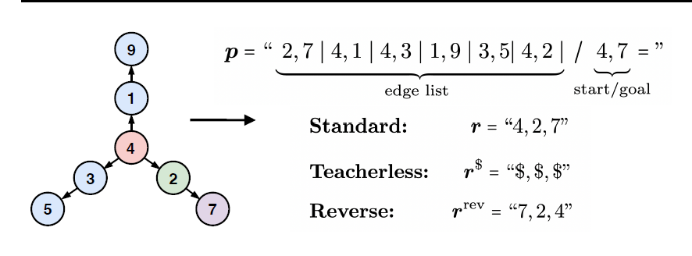
Minimal Lookahead Task: Path-Star Graphs
Task Setup
Start from a node (Start)
There are multiple possible paths
Only one path reaches the Goal
Input:
Graph connections (shuffled)
Start node + Goal node
Output
Correct path from Start → Goal
Figure adapted from Bachmann & Nagarajan, ICML 2024
6

Slide 7
Where Teacher-Forcing Fails
Method 1 (Hard / logical way)
Method 2 (Easy trick / shortcut)
The model Looks at all paths from Start
Checks which one reaches Goal
Like exploring a maze
Instead of starting from the start node:
The model starts from the goal
Goes backward (reverse direction)
Finds the path to Start
Then reverses it
So it’s easy to trace backward
Teacher-Forcing
During training: • The model sees input p and the correct previous steps Instead of learning the full solution: • p → full path It learns a shortcut: • (p + correct previous steps) → next step
❌ Problem 1: It cheats
❌ Problem 2: It avoids the real challenge
7

Slide 8
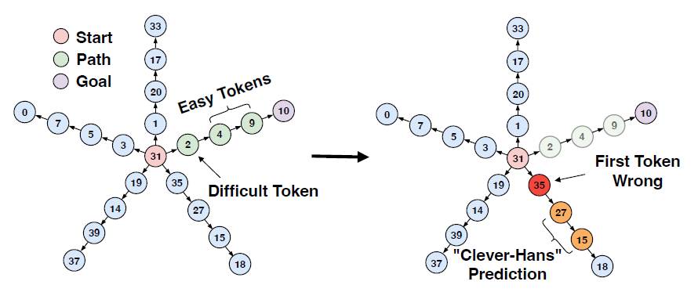
The Clever Hans Cheat
What does “cheating” mean?
During training, the model receives:
The graph (p)
Part of the correct path (r<i)
Instead of solving the full problem, the model does not ask: “What is the correct path?”
Instead, it learns a shortcut: “Given previous steps, what is the next obvious step?”
This behavior is called Clever Hans cheating.
EAY - CHEAT WORKS
Figure adapted from Bachmann & Nagarajan, ICML 2024
When the model cheats on easy tokens, the first token loses its learning signal and becomes difficult to learn.
8

Slide 9
Failure 2: The Indecipherable Token (Loss of Supervision)
Step 1:
Early steps (e.g., v₁) are still hard → maybe the model can learn
Step 2:
After shortcut learning → the model ignores most of the path
• Learns from limited signals (mainly v₁)
Step 3:
Loss of supervision
• Before: full path → Start → … → Goal
• After: only Start → v₁
→ Most information is lost
Result:
• The first step (v₁) becomes an indecipherable token
EAY - CHEAT WORKS
9

Slide 10
Experiments: Setup
Dataset
Models
Training Conditions
Path-star graphs G(d, l, N)
d = degree (# of paths)
l = path length
N = node vocabulary size
200k training samples
Train and test from same
distribution (in-distribution!)
GPT-Mini (from scratch)
12 layers, dim=384, heads=6
GPT-2 Large (pretrained)
36 layers, dim=1280, heads=20
Mamba (from scratch)
12 layers, dim=784 (SSM)
Optimizer: AdamW
Trained to 100% training accuracy
(up to 500 epochs)
3 conditions compared:
1. Standard (teacher-forced)
2. Teacherless ($ tokens)
3. Reversed targets
Key metric: Acc_ag = exact-match accuracy on auto-regressively generated paths vs. ground truth
10

Slide 11
Results: Standard Teacher-Forcing Fails In-Distribution
All models achieve accuracy ~1/d -- equivalent to random guessing -- despite perfect training accuracy.
Graph (d, l) | GPT-Mini | GPT-2 Large | Mamba | Random (1/d)
G(2,5) | 49.8% | 48.9% | 48.5% | 50%
G(2,20) | 49.1% | 49.2% | 48.7% | 50%
G(5,5) | 19.1% | 19.4% | 20.2% | 20%
G(10,5) | 8.1% | 10.3% | 9.3% | 10%
G(20,5) | 0% | 3.5% | 0% | 5%
Key observation: Accuracy tracks 1/d across ALL architectures. Training accuracy was 100%. This is an in-distribution failure — caused by the training objective, not the model architecture or generalization gap.
Reversal training: ~99-100% on all graphs. Teacherless (GPT-2 Large): ~99% on most graphs.
Table adapted from Bachmann & Nagarajan, ICML 2024
11

Slide 12
Proposed Solutions
Solution 1 - Teacherless Training
Solution 2 - Path Reversal
Monea et al. (2023) - repurposed here
Lee et al. 2023; Shen et al. 2023
How it works:
Replace ground-truth prefix r<i with uninformative $ tokens. The model must learn from p alone.
Objective: J_tless = E[sum log P(r_i | p, $...$)]
Results:
GPT-2 Large: ~99% on G(2,5), G(5,5), G(10,5) From-scratch: only works on simplest graphs
Key insight:
Without the cheat, model voluntarily learns right-to-left (later tokens achieve high accuracy first).
How it works:
Train model to predict reversed path r_rev = v_goal, ..., v_start. Now v_goal is predicted first — it's always unique.
Why it eliminates the problem:
Every token is now an 'easy' token! Each next node is just the node inwardly adjacent to the previous. No planning needed.
Results:
Near-perfect (99%+) across ALL graph types for ALL architectures (GPT-Mini, GPT-2 Large, Mamba).
Lesson:
Problem framing matters enormously for what teacher-forcing can learn.
12

Slide 13
Critical Discussion
Strengths
Limitations
Precise, testable distinction
Separates autoregressive vs. training-time failures — clarity missing in prior work
Architecture-agnostic
Shown on both Transformer (GPT-Mini, GPT-2) and Mamba SSM
Minimal, auditable benchmark
Path-star graphs are verifiable by hand; failure is demonstrably surprising
Positive results included
Reversal and teacherless training clearly fix the failure, validating the theory
No formal proofs
Arguments are conceptual and empirical; Proposition 3 is informal
Not tested on large models
No Llama-2, Mistral, or GPT-4 experiments; pretraining may help
Narrow benchmark domain
Range of affected tasks is uncharacterized; natural language speculation only
Teacherless training is limited
Only works for some topologies; fails for from-scratch models on harder graphs
13

Slide 14
Conclusion & Key Takeaways
01
Conflating the two modes is a mistake
Autoregressive inference != teacher-forcing. They fail differently and need different solutions.
02
Teacher-forcing has a training-time failure on lookahead tasks
The Clever Hans cheat and Indecipherable Token together cause complete in-distribution failure. No post-hoc fix works.
03
Failure is architecture-independent
Both Transformer and Mamba fail identically — the training objective is the root cause, not the model.
04
Teacherless training and reversal show a path forward
Forcing multi-token lookahead or reversing the output order resolves the identified failures and opens new research directions.
"Can a model trained on thousands of novels learn to write plot twists?" -- an open question this paper leaves us with

Slide 15
References
[1] Bachmann, G. & Nagarajan, V. (2024). The Pitfalls of Next-Token Prediction. ICML 2024, PMLR 235.
[2] Vaswani, A. et al. (2017). Attention is All You Need. NeurIPS 2017.
[3] Gu, A. & Dao, T. (2023). Mamba: Linear-Time Sequence Modeling with Selective State Spaces. arXiv:2312.00752.
[4] Radford, A. et al. (2019). Language Models are Unsupervised Multitask Learners. OpenAI Blog.
[5] Monea, G., Joulin, A. & Grave, E. (2023). PaSS: Parallel Speculative Sampling. NeurIPS 2023 Workshop.
[6] Lee, N. et al. (2023). Teaching Arithmetic to Small Transformers. arXiv:2307.03381.
[7] Malach, E. (2023). Auto-Regressive Next-Token Predictors are Universal Learners. arXiv:2309.06979.
[8] Wies, N., Levine, Y. & Shashua, A. (2023). Sub-Task Decomposition Enables Learning in Seq2Seq Tasks. ICLR 2023.
[9] LeCun, Y. (2024). Do Large Language Models Need Sensory Grounding? University Lecture.
[10] Wei, J. et al. (2022). Chain-of-Thought Prompting Elicits Reasoning in Large Language Models. NeurIPS 2022.
15

Slide 16
Preemptive Q: Does this apply to real language tasks?
Story-Writing as a Lookahead Task (from Section 4.5 & Appendix C)
Event 1 (Setup):
Alex and Bob are friends trying to defeat the Evil King.
Event 2 (Conflict):
Bob turns against Alex, but deliberately fails.
<-- must be planned ahead
Event 4 (Backstory):
Bob reveals he was a double-agent.
Event 5 (Resolution):
Bob deliberately failed on orders, then relays intel.
<-- planned BEFORE Events 1 & 2
Event 6:
Alex uses Bob's intel to defeat the King.
Paper's conjecture: A teacher-forced model fits Event 5 (resolution) via Clever Hans cheat from Events 2 & 4. Earlier narrative events then become Indecipherable — the model generates arbitrary twists instead of planning.
Note: speculative — not empirically tested in the paper.
16

Slide 17
Preemptive Q: Can't Chain-of-Thought solve this?
CoT helps, but doesn't fully solve the problem
CoT works when supervision is available before the target
Wies et al. (2023) and Malach (2023) show complex tasks become learnable if intermediate steps are provided before the final answer. The paper's reversal experiment is consistent with this.
CoT annotations may not be available for creative/unstructured tasks
For story-writing, poem generation, or novel reasoning, the correct chain-of-thought supervision is unknown. The paper shows teacherless training can use hindsight supervision instead.
Inference-time CoT (ToT, Self-Refine) doesn't fix training-time failures
These techniques still use a backbone trained with teacher-forcing. If the backbone never learned planning, clever inference wrappers cannot recover it.
17

