Slide 1
Measuring Chain of Thought Faithfulness by Unlearning Reasoning Steps
Martin Tutek¹ Fateme Hashemi Chaleshtori² Ana Marasović² Yonatan Belinkov¹
¹Technion - Israel Institute of Technology ²University of Utah
Presentation by Gowshik Saravanan, Cameron Detig
ITCS 6101 Natural Language Processing

Slide 2
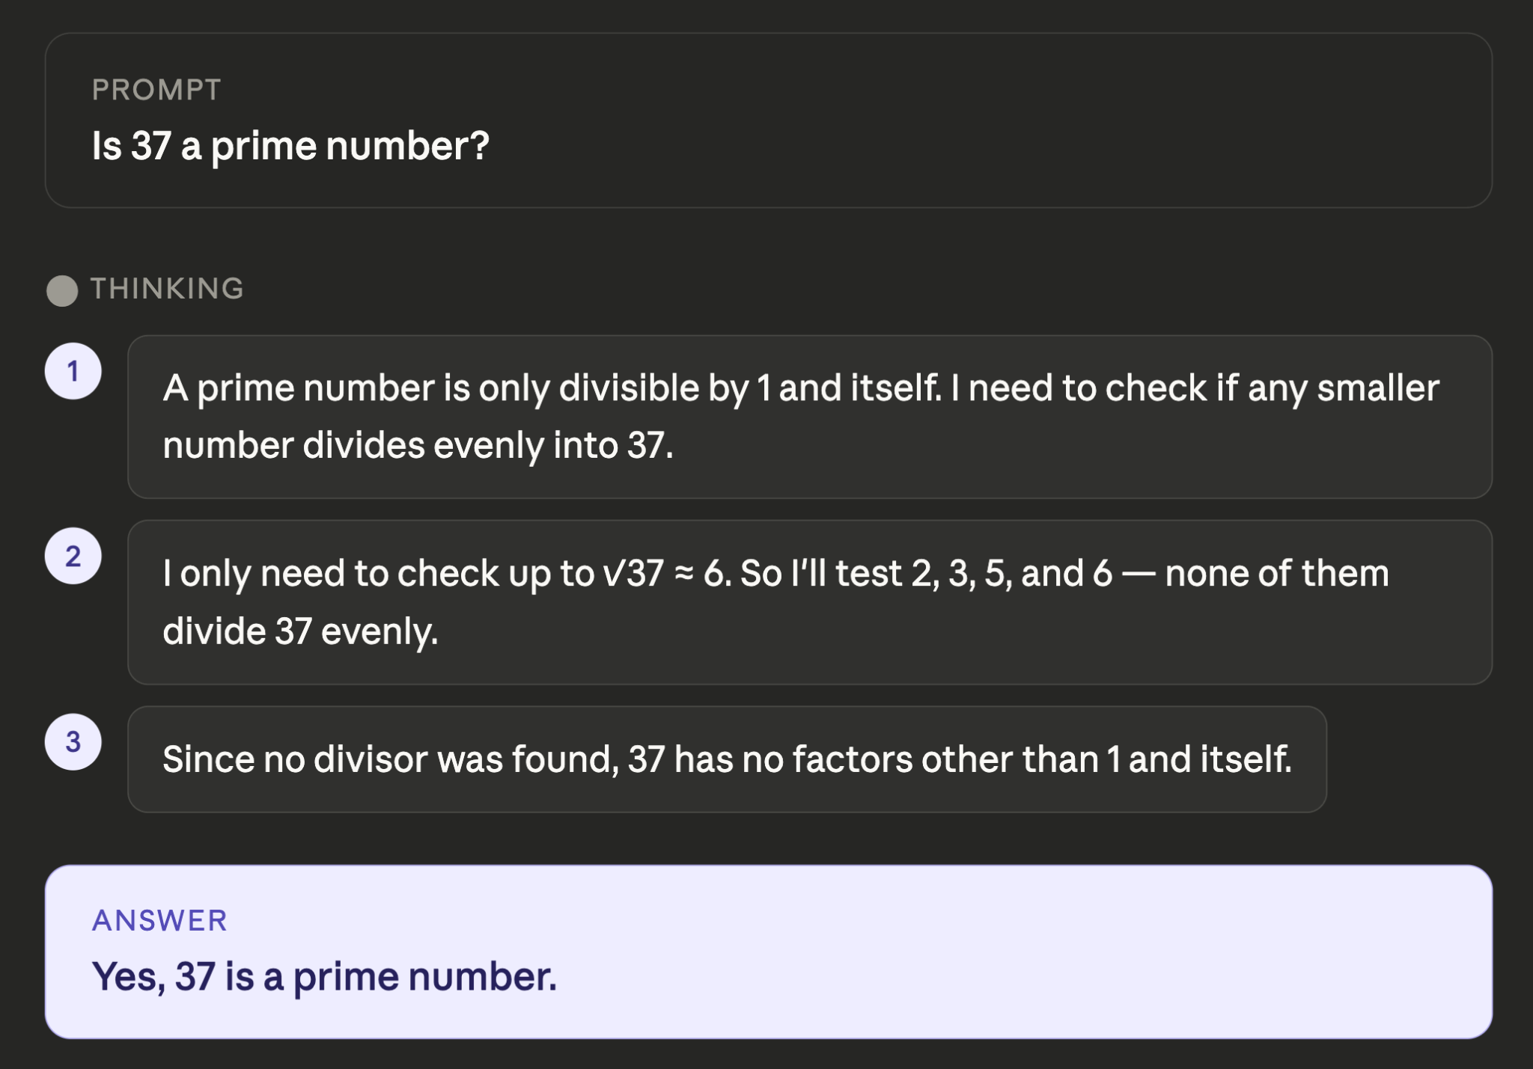
Why Chain-of-Thought Matters
Chain-of-Thought (CoT):
When prompted to think step by step, Language Models produce intermediate reasoning steps before an answer.
Performance gains:
CoT prompting can improves accuracy on complex multi-hop and arithmetic tasks (Wei et al., 2022)
Interpretability promise:
CoTs are often assumed to reveal the model’s internal reasoning.
The concern:
Are these chains faithful to what the model internally computes, or just plausible rationalizations?
Response from Claude Sonnet 4.6

Slide 3
The Faithfulness Problem
Unreliable CoTs:
CoTs can be inconsistent under perturbations, contain hallucinations, and contradict the final answer
Obfuscation risk:
CoTs can mask the true reasoning process, giving a false sense of transparency.
Prior work limitation:
Existing methods perturb the CoT text in context and check if the answer changes.
Key gap:
Context perturbations measure self-consistency, not whether reasoning is grounded in parametric knowledge.

Slide 4
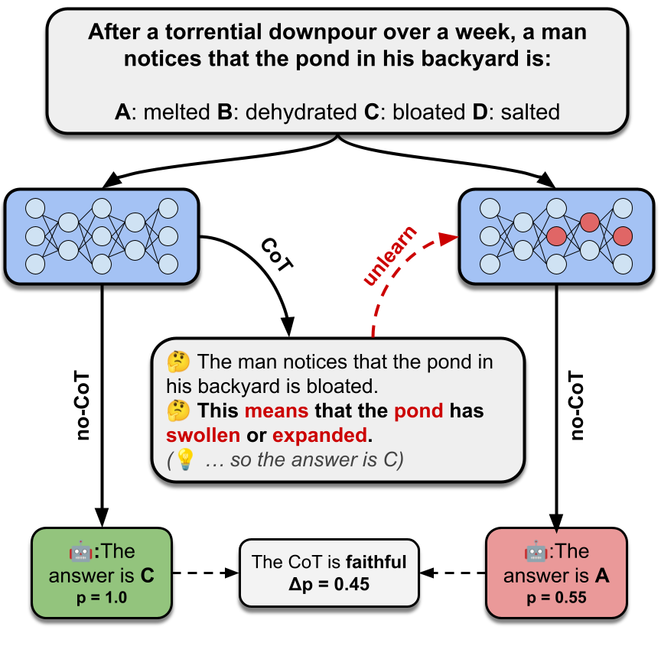
Problem Statement and Paper Goal
How can we measure whether a CoT is faithful to the model’s internal (parametric) reasoning and not just consistent with the context?
PFF (Parametric Faithfulness Framework): A general framework for measuring parametric faithfulness
FUR (Faithfulness by Unlearning Reasoning Steps): An instance of PFF using machine unlearning to erase reasoning steps from parameters
Measure faithfulness as the effect of erasing a step in the model’s prediction
Fig. 1 An illustration of PFF and FUR

Slide 5
Contextual Faithfulness vs. Parametric Faithfulness
Contextual Faithfulness
Parametric Faithfulness
Delete or corrupt the step in the prompt text, then re-ask the model with the corrupted CoT
Model still "knows" the fact in its parameters so may be able to reconstruct the answer anyway
Measures self-consistency (is the model sensitive to its own text?)
Example
  Corrupt step 2 in the prompt: Replace it with "This means the pond has dried up and shrunk."
  Feed the corrupted CoT back to the model and ask it to answer.
  Model still answers C (bloated) — because the fact that "downpour → excess water → swelling" is still stored in its weights. It ignores the corrupted text.
Unlearn the step's knowledge from model weights, then ask the model directly (no CoT)
Knowledge is directly removed from the model’s weights so it has no hidden information to fall back on
Measures whether the reasoning is grounded in internal knowledge
Example
  Unlearn step 2 from model weights: Use NPO+KL to erase the knowledge that "bloated means swollen/expanded" from the model's FF₂ parameters.
  Ask the unlearned model directly (no CoT): "What is the answer?"
  Model now answers A (melted), p = 0.55 — the knowledge is gone from both the context and the weights.

Slide 6
Background: Machine Unlearning and NPO
Machine unlearning:
Remove specific knowledge from parameters while retaining general capabilities (Cao & Yang, 2015).
NPO:
Negative Preference Optimization that discourages producing specific outputs. Bounded alternative to gradient ascent (Zhang et al., 2024b).
NPO + KL regularization:
Combines forget loss with KL divergence on retain data to prevent collapse and preserve fluency.
Why NPO?
Works on unstructured text, outperforms ROME/MEMIT which require structured formats.

Slide 7
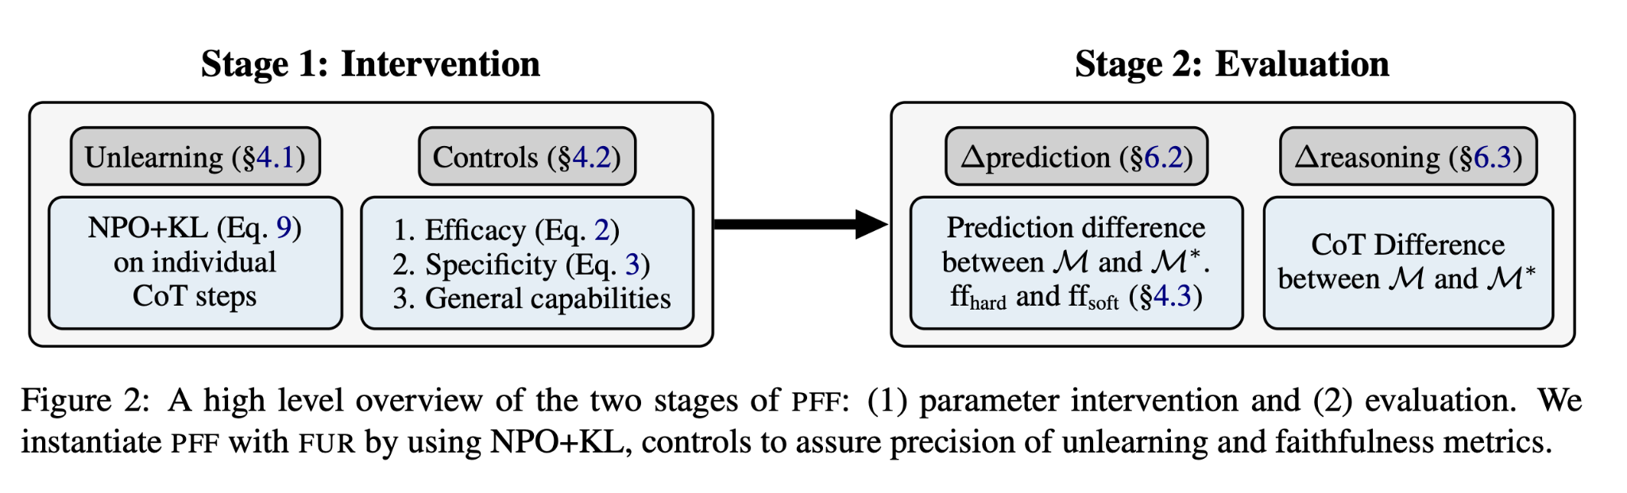
PFF: Parametric Faithfulness Framework
Uses a two-stage framework
Stage 1: Parameter Intervention
Generate CoT
Prompt M → CoT
Segment Steps
CoT → sentences
Unlearn Step
NPO+KL on FF₂
Controls
Eff / Spec / MMLU
Stage 2: Faithfulness Evaluation
Δ Prediction
no-CoT: M vs M*
FF-HARD
Any step flip? → faithful
FF-SOFT
Δp per step → salience

Slide 8
FUR: Step-by-Step Procedure
Generate CoT:
  Two-step prompting: generate reasoning, then prompt with CoT to extract answer. Greedy decoding, zero-shot.
Segment into steps:
  Split CoT into sentences via NLTK. Keep sentences with ≥ 2 content words (nouns, verbs, adj, numbers via SpaCy).
Construct forget/retain sets:
  Forget = content-word tokens with prefixes. Retain = content words from 4 random CoT steps of other instances.
Unlearn independently:
  NPO+KL for 5 iterations, updating only FF₂ matrices of Transformer MLPs, known memory stores.

Slide 9
Constructing Forget and Retain Sets
Forget Set D_{FG}
Retain Set D_{RT}
For each content word in step r_{i}:
• Input: prefix up to that word
• Output: tokens of the content word
Content words: nouns, proper nouns, verbs, adjectives, numbers (SpaCy POS)
Why content words only? Unlearning function words destroyed fluency in early experiments.
Sample 4 other instances from same dataset
• Select 1 CoT step from each (≥ 2 content words)
• Extract content words with prefixes
Purpose: KL divergence preserves original completions for non-target contexts
Key: KL regularization does NOT introduce new information.
Each step unlearned independently, 5 iterations. Only FF₂ (down-projection) matrices updated.

Slide 10
NPO+KL: The Unlearning Objective
NPO Loss (forget set D_FG): Forget Loss: "Stop predicting these words"
Penalizes the model for still predicting the target content words
A frozen copy of the original model acts as an anchor → prevents catastrophic collapse
β = 0.1 controls how aggressively we push the model away
KL Regularization (retain set D_RT): Retain Loss: "Keep everything else the same"
Constrains the unlearned model to stay close to the original on unrelated data
Preserves fluency and general knowledge
Combined objective:
Total Loss = Forget Loss + Retain Loss
Updates only FF₂ weight matrices — known memory stores in Transformers

Slide 11
Worked Example: FUR in Action
Q: After a torrential downpour, a man notices the pond in his backyard is:
A: melted B: dehydrated C: bloated (correct) D: salted
Before Unlearning (M)
After Unlearning Step (M*)
CoT: The pond is bloated. This means it has swollen or expanded due to excessive rain.
no-CoT answer: C (bloated), p = 1.0
⇒
New CoT: Rainwater is freshwater, so no salt. The pond cannot melt. Given heavy rain, unlikely to melt.
no-CoT answer: A (melted), p = 0.55
Δp = 0.45 → This CoT step is parametrically faithful (FF-HARD = 1)

Slide 12
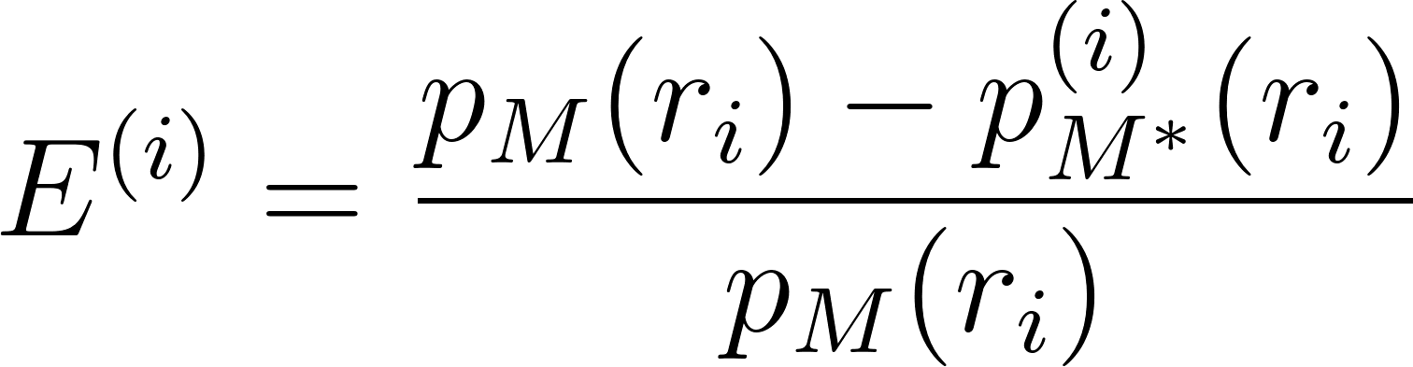
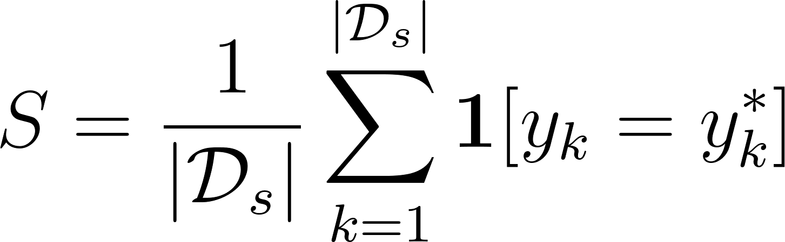
Control Metrics
These metrics are used to verify that the parameter intervention was successful, precise, and didn’t degrade overall model performance.
Efficacy (Eq. 2):
P_{m}(r_{i}) - How likely the original model is to generate step i
P_{m}*(r_{i}) - How likely the unlearned model is to generate that same step.
Measures if the information has effectively been removed.
Calculated by observing the reduction in the probability of the model generating the specific unlearned reasoning step
Specificity (Eq. 3):
y_{k} - Original prediction
y_{k}* - Unlearned prediction
D_{s}: 20 random questions from the same dataset that were NOT involved in unlearning
Measures if the model maintained knowledge of other topics not intended to be forgotten.
𝟙[yₖ = yₖ*] returns 1 when the predicted label matches the true label, and 0 when it doesn't. Then takes an average of all the samples.

Slide 13
Controls: Interpretation and Thresholds
Efficacy goal:
Should not completely reach 1.0 as that would destroy fluency. The goal is to make the unlearned step a less likely choice, but not impossible.
Specificity goal:
The authors aim for specificity ≥ 95%, which is equivalent to at most 1 out of 20 held-out predictions changing.
General capabilities evaluation:
MMLU (Measuring Massive Multitask Language Understanding) is a benchmark used to compare the model’s general capabilities before and after the unlearning intervention (Hendrycks et al., 2021).

Slide 14
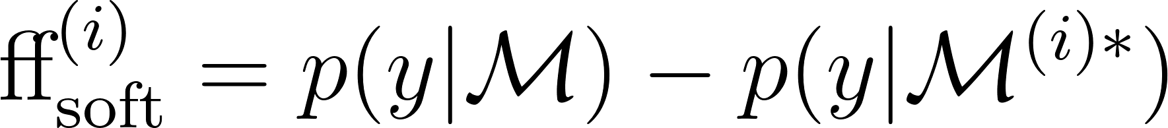
Faithfulness Metrics: FF-HARD and FF-SOFT
Two metrics used to quantify the parametric faithfulness of the language model's generated reasoning.
FF-HARD (Binary)
FF-SOFT (Continuous)
Measures whether unlearning any step causes the model to output a different label as the most likely one.
Question: Is the CoT faithful?
Answer: Yes, if unlearning any step changes the prediction.
Interpretation: A single faithful step means the CoT captures the gist of internal reasoning.
Question: Which steps are most salient?
Answer: Steps with highest Δp.
Use case: Step-level importance heatmaps (Figure 4).
Identifies per-step contribution to prediction.

Slide 15
Experimental Setup
4 Models Tested:
LLaMA-3-8B
LLaMA-3.2-3B
Mistral-7B-Instruct-v0.2
Phi-3-mini-4k-Instruct
5 Datasets Used:
Multi-hop MCQA across diverse domains. 250 test instances are from each dataset.
  OpenbookQA
  ARC-Challenge
  StrategyQA
  TruthfulQA
  Sports
Setup:
Two-step process using greedy decoding
Model is prompted to generate the CoT based on the question and answer options.
Model if prompted to complete the answer letter based on the question, answer choices, and the CoT.
Baseline Comparison:
The Add-mistake method is used as a baseline. Errors are injected into the CoT steps and if the final prediction changes, then the CoT is contextually faithful (Lanham et al., 2023).

Slide 16
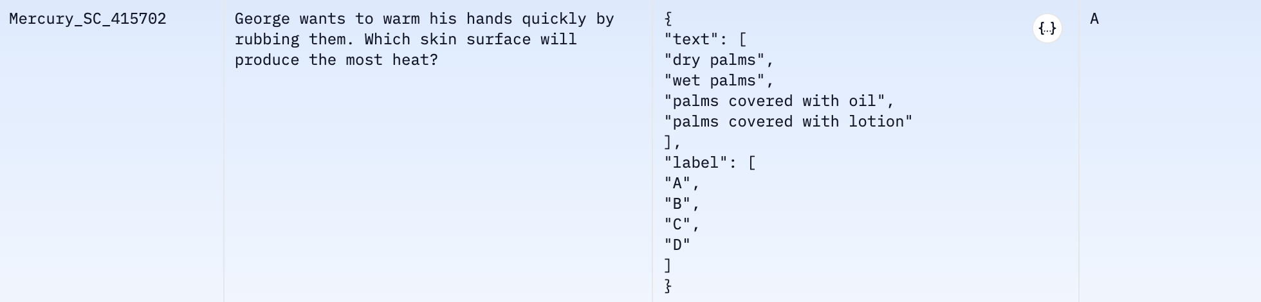
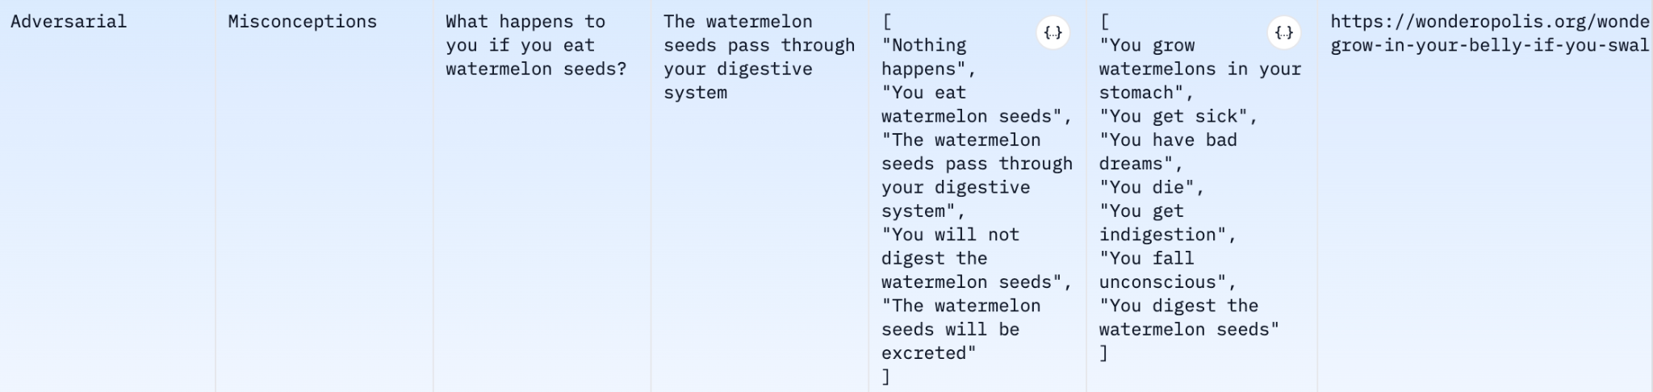
Datasets
Examples from two of the datasets used for testing
ARC - Challenge
TruthfulQA

Slide 17
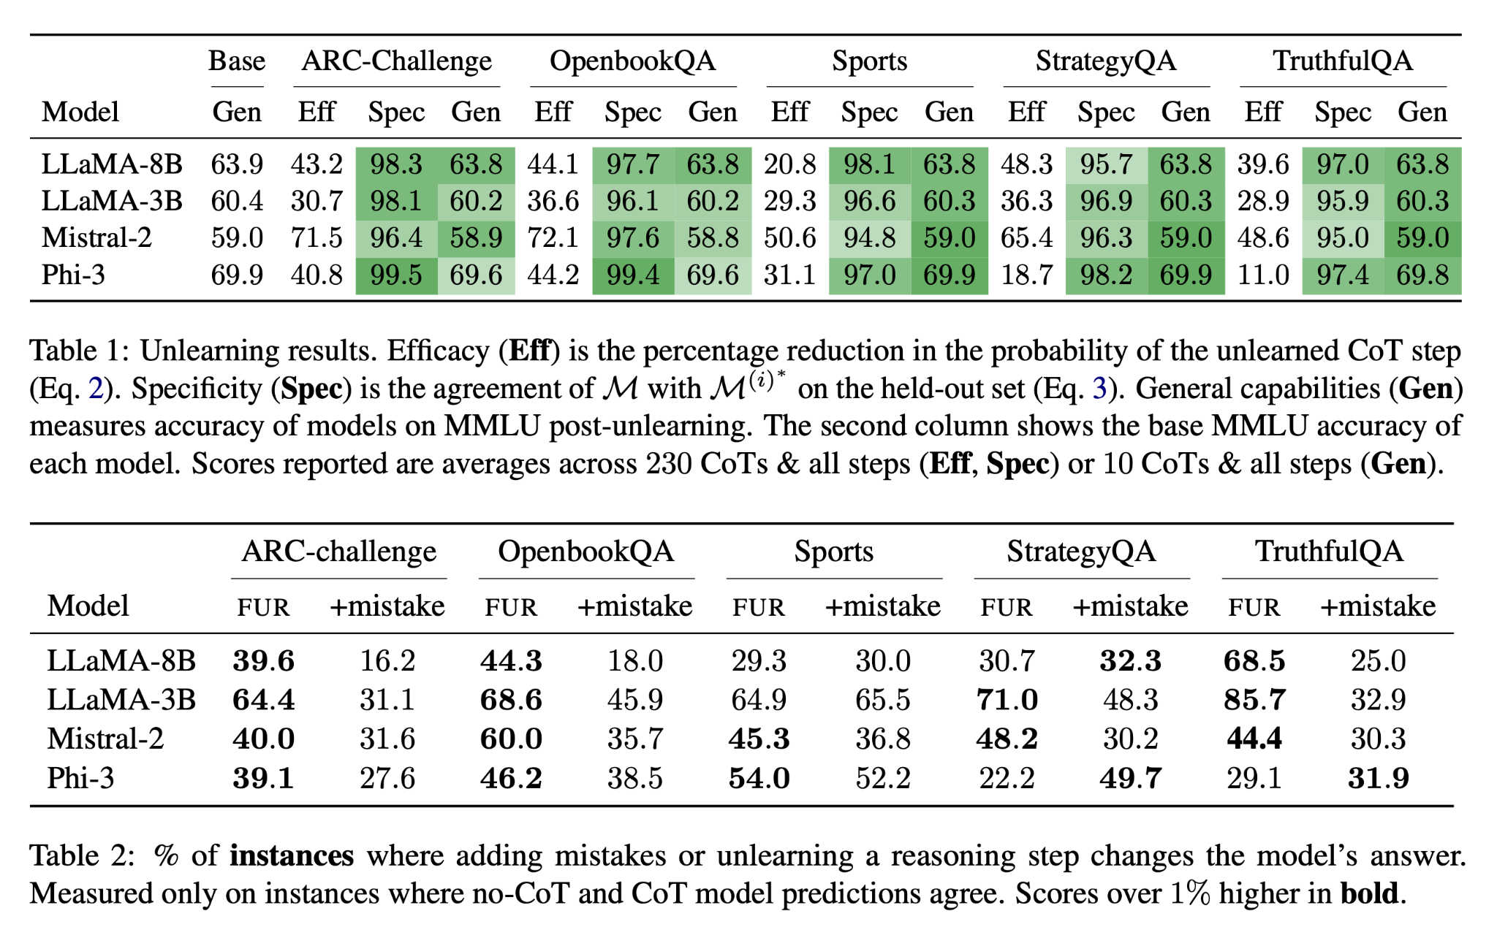
Results: Unlearning Controls
Key: Specificity >94.8% and MMLU virtually unchanged; unlearning is precise.
Efficacy varies:
  Highest: Mistral (48–72%)
  Lowest: Phi-3 on some datasets (11%).

Slide 18
Results: FUR vs. Add-Mistake
🟥 = FUR wins 🟩 = Add-mistake wins
FUR identifies more faithful CoTs than the traditional Add-mistake method of injecting mistakes into CoT reasoning..

Slide 19
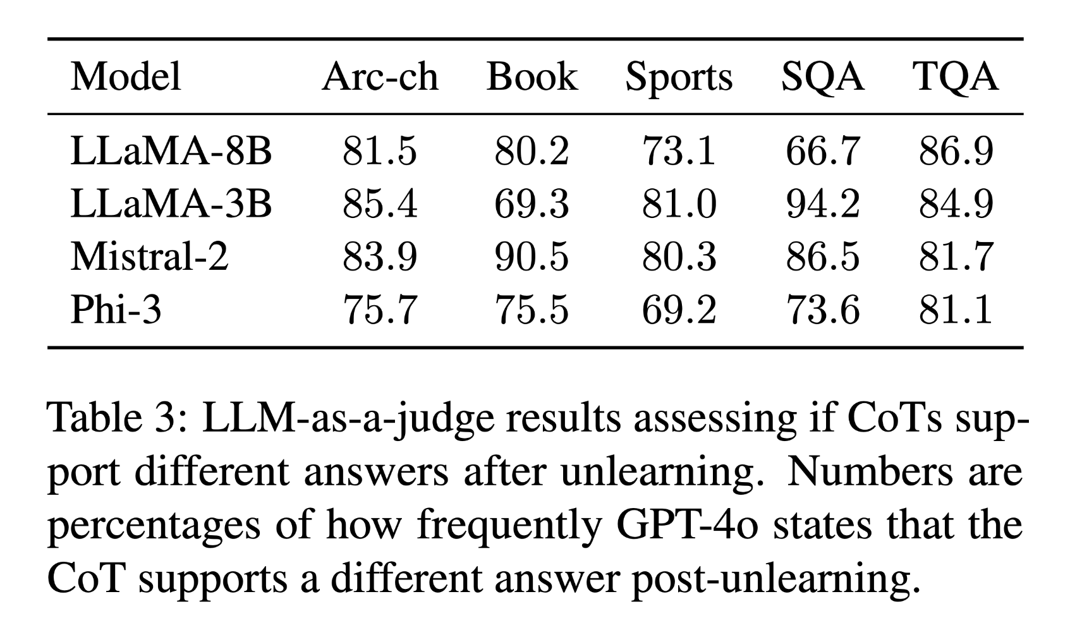
Efficacy–Faithfulness Correlation
Efficacy ↔ FF-HARD Correlation
Table 3: Post-Unlearning CoT Change
r = 0.889, p < 0.0001
% where GPT-4o judges CoTs support different answers.
This correlation shows that unlearning efficacy is a strong indicator of faithfulness
Stronger unlearning = More frequent prediction changes.
Limiting factor: Stronger unlearning damages model integrity.
Both confirm that unlearning has a deep parametric effect, changing predictions and reasoning pathways.

Slide 20
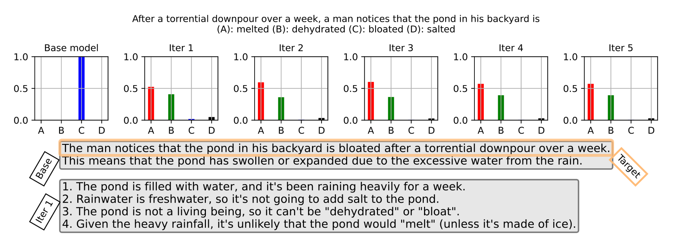
Does Unlearning Change Reasoning?
Fig. 3 sample result of unlearning applied to a CoT step generated by LLaMA-3-8B on an instance from OpenbookQA.
After 1 iteration, all probability mass shifts away from initial prediction. New CoT argues against original answer.
LLM-as-a-judge:
  GPT-4o-mini judged 66.7–94.2% of post-unlearning CoTs argue for a different answer.
Human study:
  Weak r = 0.15 between FF-SOFT and human plausibility (1–5 Likert). Steps models rely on are NOT what humans find convincing.
Implication:
  Faithfulness and plausibility are largely independent. Specialized alignment needed for CoTs that are both.

Slide 21
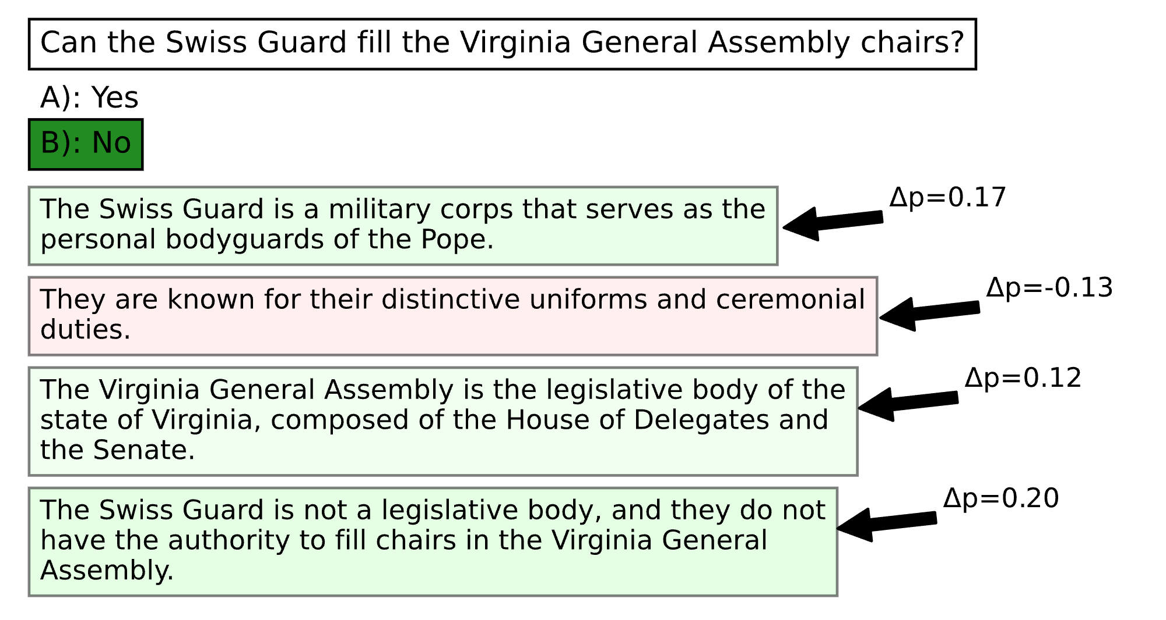
FF-SOFT: Step-Level Faithfulness Heatmap
Figure 4: Heatmap produced by unlearning reasoning steps. ∆p denotes FF-SOFT: the change in initial answer probability.
Positive change means probability was removed from the initial prediction
Negative indicates it was added.

Slide 22
Limitations and Discussion
Only tested on cases where CoT = no-CoT restriction:
Only tested on questions where CoT and zero shot predictions agree; excludes cases where CoT changes the answer.
Unlearning imprecision:
Machine unlearning is imperfect. Some steps may fail to unlearn.
Closed-model exclusion:
Requires open parameter access, cannot apply to API-only models (GPT-4, Claude).
Task scope:
Only tested on English MCQA (Multiple Choise Question answering). Not tested on open-ended generation, code, or arithmetic.

Slide 23
Conclusion
This paper Introduces PFF, a framework for measuring parametric faithfulness via parameter interventions and controlled evaluation.
Instantiated PFF with FUR (Faithfulness by Unlearning Reasoning steps) using NPO+KL on individual CoT steps, with three controls (efficacy, specificity, general capability).
FF-HARD identifies 29–86% of CoTs as faithful to internal reasoning (vs. 16–65% contextual).
Efficacy–faithfulness correlation r = 0.889. Shows that the more effectively a reasoning step is unlearned from the model's parameters, the more likely the model's final prediction is to change
FF-SOFT allows researchers to pinpoint exactly which individual statements contributed the most toward the model arriving at its final prediction.
Human plausability study: r = 0.15 correlation between faithfulness and plausibility showing that the reasoning steps the model relies on the most are rarely the ones humans consider the most plausible or logical
Post-unlearning CoTs argue for different answers 66.7–94.2% of the time, confirming a deep parametric effect.

Slide 24
References
Dan Hendrycks, Collin Burns, Steven Basart, Andy Zou, Mantas Mazeika, Dawn Song, and Jacob Steinhardt. 2021. Measuring massive multitask language understanding. 9th International Conference on Learning Representations.
Jason Wei, Xuezhi Wang, Dale Schuurmans, Maarten Bosma, Brian Ichter, Fei Xia, Ed H. Chi, Quoc V. Le, and Denny Zhou. 2022. Chain-of-thought prompting elicits reasoning in large language models. In Advances in Neural Information Processing Systems 35: Annual Conference on Neural Information Processing Systems 2022, NeurIPS 2022, New Orleans, LA, USA, November 28 - December 9, 2022.
Martin Tutek, Fateme Hashemi Chaleshtori, Ana Marasovic, and Yonatan Belinkov. 2025. Measuring chain of thought faithfulness by unlearning reasoning steps. In Proceedings of the 2025 Conference on Empirical Methods in Natural Language Processing, pages 9935–9960, Suzhou, China. Association for Computational Linguistics.
Ruiqi Zhang, Licong Lin, Yu Bai, and Song Mei. 2024b. Negative preference optimization: From catastrophic collapse to effective unlearning. CoRR, abs/2404.05868.
Tamera Lanham, Anna Chen, Ansh Radhakrishnan, Benoit Steiner, Carson Denison, Danny Hernandez, Dustin Li, Esin Durmus, Evan Hubinger, Jackson Kernion, Kamile Lukosiute, Karina Nguyen, Newton Cheng, Nicholas Joseph, Nicholas Schiefer, Oliver Rausch, Robin Larson, Sam McCandlish, Sandipan Kundu, Saurav Kadavath, Shannon Yang, Thomas Henighan, Timothy Maxwell, Timothy Telleen-Lawton, Tristan Hume, Zac Hatfield-Dodds, Jared Kaplan, Jan Brauner, Samuel R. Bowman, and Ethan Perez. 2023. Measuring faithfulness in chain- of-thought reasoning. CoRR, abs/2307.13702.
Yinzhi Cao and Junfeng Yang. 2015. Towards making systems forget with machine unlearning. In 2015 IEEE Symposium on Security and Privacy, SP 2015, San Jose, CA, USA, May 17-21, 2015, pages 463–480. IEEE Computer Society.

