Slide 1

Recursive Language Models
Authors: Alex L. Zhang, Tim Kraska, Omar Khattab
Presenter: Pritom Kumar Paul
Course: ITCS 6101/8101 – NLP Paper Presentation

Slide 2

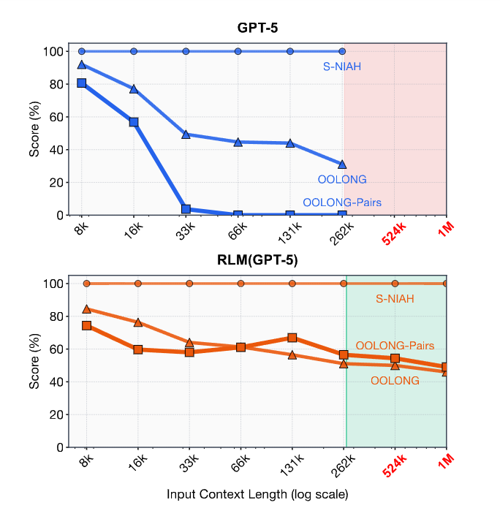
Motivation: Long Context Limitation in LLMs
LLMs have limited context windows (e.g., hundreds of thousands of tokens)
Performance degrades as input length increases (“context rot”)
Many real-world tasks require:
Processing very long documents
Multi-step reasoning across entire input
Existing approaches:
Context truncation
Summarization / compaction
Key issue: Loss of important information
(Figure taken from original paper)

Slide 3
Why This Paper Matters
Context Rot
Computational Scaling
Degradation in model performance as input length increases
Occurs even within the context window
Loss of attention to earlier information
Reduced accuracy on long-context tasks
Tasks requiring processing over many tokens.
Linear (Ω(N)) and pairwise (Ω(N²)) computation
Need to access most or all of the input
Standard LLMs unable to scale computation

Slide 4
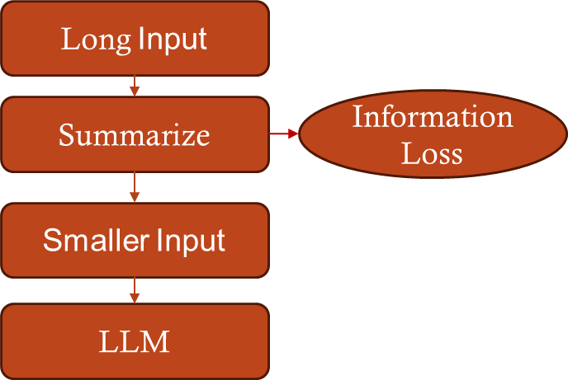
Limitations of Existing Long-Context Methods
Current solutions rely on:
Context compaction (summarization)
Retrieval-based methods
Assumption:
Early information can be safely discarded
Problem:
Fails for information-dense tasks
Examples:
Tasks requiring access to entire input
Multi-step reasoning across all tokens
Proposed Solution (Core idea of this work)
Treat the prompt as an external environment, not inside the context window.
Let the model interact with it programmatically in Read-Eval-Print Loop(REPL) environment.
Enables selective access + recursive reasoning without loading full input.
Figure: Limitations of current methods

Slide 5
Related Work: Long-Context Management
Strategy | How it Works | Key Limitation
Architectural Scaling (Press et al., 2022; Gu et al., 2022; Munkhdalai et al., 2024) | Modify the model architecture to support longer sequences | Expensive and still finite-context
Lossy Compaction (Chen et al., 2023; Wu et al., 2025) | Summarize / truncate old context to make room for new content | Can lose fine-grained information
Memory Systems / Memory Hierarchies (Packer et al., 2024; Chhikara et al., 2025; Zhang et al., 2025) | Store or retrieve selected information through an external memory structure | Still depends on what gets retrieved / retained
RLM (This Work) (Zhang et al., 2026) | Keep full input external and interact with it programmatically | Requires strong reasoning and control
Takeaway
Existing methods still rely on the context window, leading to information loss or scaling limits.
RLM is different: it keeps the full input external and accesses it selectively.

Slide 6
Related Work: Agents vs RLMs
Feature | Standard Agents / Prior Delegation Methods | RLMs
Delegation | Verbal sub-calls or tool requests in natural language (Anthropic, 2025; Schroeder et al., 2025; Sun et al., 2025) | Programmatic calls through code
Scaling | Limited by output length and chat-style delegation (Anthropic, 2025; Sun et al., 2025) | Loops can launch many sub-calls over prompt slices
State / Memory | Stored mainly in chat history or agent trajectory (Guo et al., 2024; Anthropic, 2025) | Stored as external variables in the REPL
Execution Style | One-shot or shallow iterative delegation (Yao et al., 2023; Wang et al., 2024) | Iterative code execution with execution feedback
Takeaway: RLM scales better because recursion happens programmatically through
code and external variables, not just through verbal sub-calls in chat history.

Slide 7
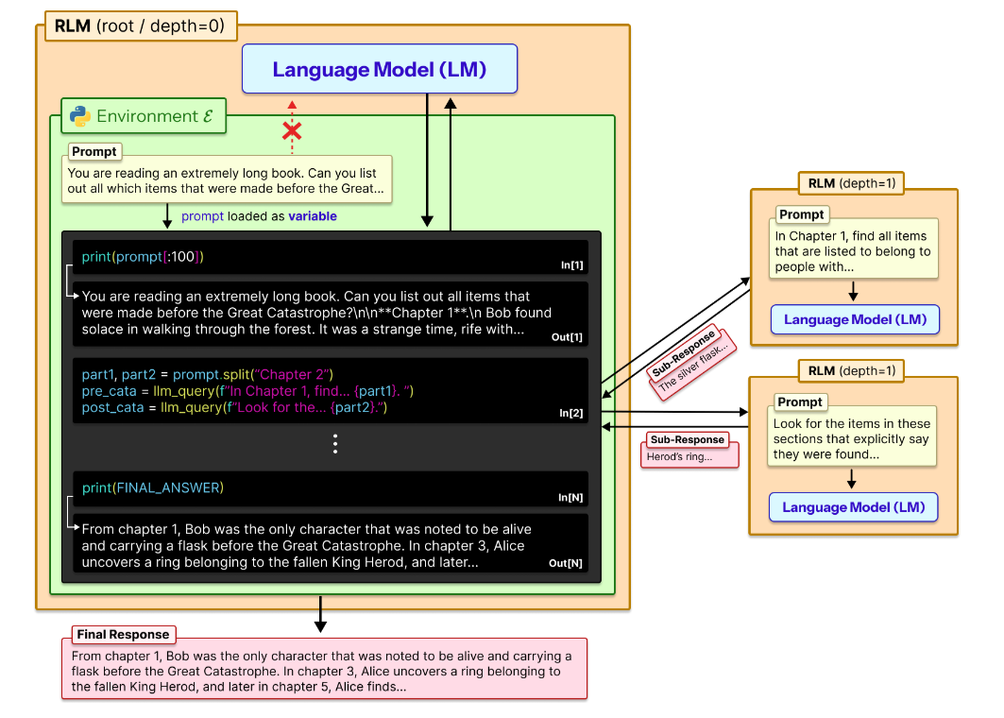
RLM: External Workspace Paradigm
(Figure taken from original paper)

Slide 8
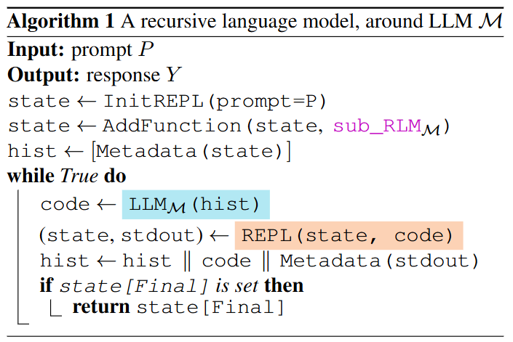
Algorithm 1: Recursive Inference Loop
Init: Prompt → variable P, add sub-call
Input: Metadata only (not full prompt)
Loop:
Generate code
Execute in REPL
Update state
Feedback: Metadata only
Stop: when Final is set
Source: Zhang et al., Recursive Language Models, 2026 (Sec. 2, Alg. 1)
Takeaway: The model never reads the full prompt at once, it iteratively explores it using code and recursion.

Slide 9
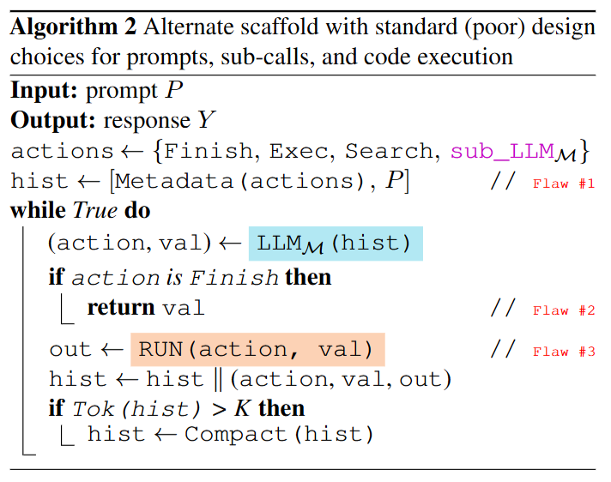
Algorithm 2: Why Standard Methods Fail
Flaw 1: Prompt Stuffing
Full prompt in context
Bounded by K
Flaw 2: Output Limit
Answer generated in one pass
Limited output length
Flaw 3: No Recursion
Verbal sub-calls
Cannot scale tasks
Source: Zhang et al., Recursive Language Models, 2026 (Sec. 2, Alg. 2)
Takeaway: Standard methods fail because they load the prompt into context and generate in one pass, which prevents scaling.

Slide 10
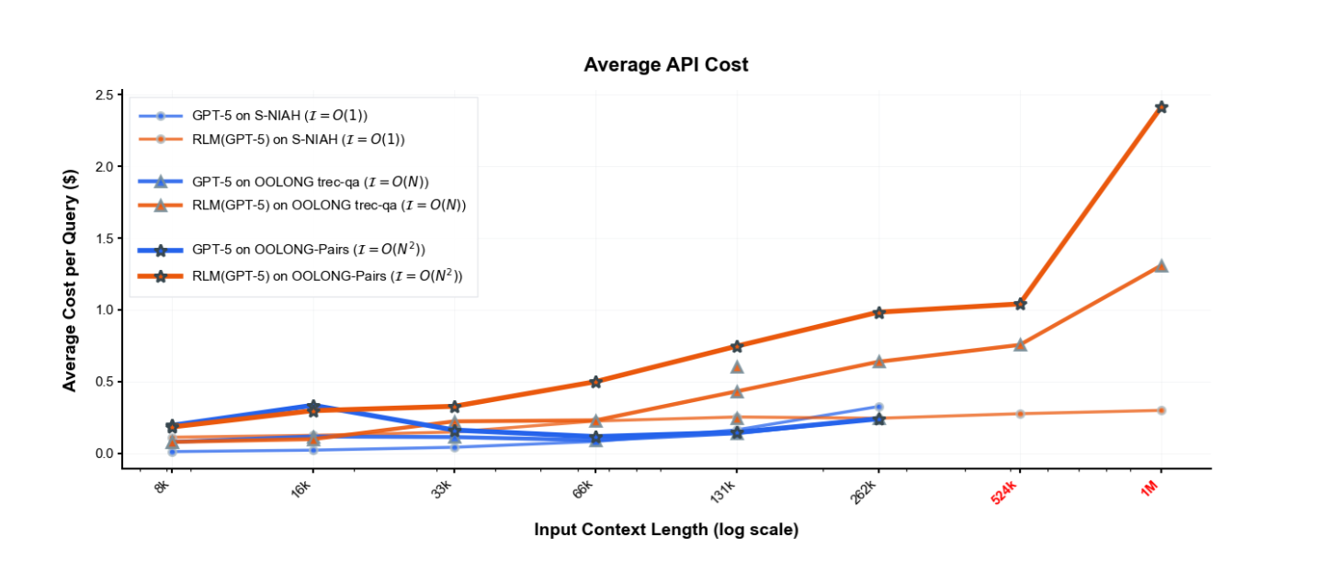
Key Differences
Feature | Standard Scaffolds (Algo 2) | RLMs (Algo 1)
Input Capacity | Prompt inside context → bounded by K | Prompt external → unbounded
Output Capacity | One-shot generation → limited tokens | Built via variables → unbounded
Workload | Manual steps → constant work | Code loops → Ω(N), Ω(N²)
Memory | Context grows → context rot | External vars → clean context
Delegation | Verbal calls (one-by-one) | Programmatic loops (many calls)
(Figure taken from original paper)

Slide 11
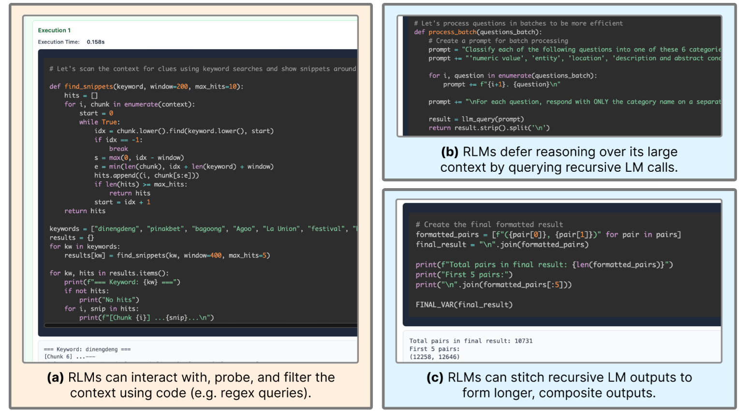
Example: RLM in Action
(Figure taken from original paper)

Slide 12
Tasks for Measuring Computational Scaling
Dataset | Task Type | Complexity | Why this Complexity?
S-NIAH | Needle retrieval | O(1) | Only one target → find a single item regardless of input size
BrowseComp+ | Multi-doc QA | O(1) | Answer depends on a fixed number of documents
OOLONG | Full aggregation | Ω(N) | Must process almost all tokens to compute answer
OOLONG-Pairs | Pairwise reasoning | Ω(N²) | Must compare all pairs of tokens / entries
CodeQA | Code understanding | Mixed | Depends on how many files/functions must be analyzed
Key Idea: Increasing complexity (O(1) → Ω(N) → Ω(N²)) reveals where standard LLMs fail and RLMs continue to scale.

Slide 13
Methods & Baselines
Models Used:
• GPT-5 (main) • Qwen3-Coder-480B-A35B • GPT-5-mini (sub-calls)
Method | Prompt Handling | Recursion? | Key Mechanism / Baseline Logic
CodeAct (+BM25) | Direct input to LM | No | Standard ReAct loop; uses a BM25 retriever for document indexing
CodeAct (+Sub-calls) | Direct input to LM | Yes | An ablation to test if "sub-calls alone" are enough without prompt offloading
Summary Agent | Iterative "Stuffing" | No | Compresses context as it fills; uses GPT-5-nano for compaction to manage costs
RLM (REPL) | Offloaded | Yes | Prompt stored as a variable; Interacts via Python code and llm_query.
RLM (No sub-calls) | Offloaded | No | Ablation: Tests if the external environment helps without the use of recursion
Key Insight: RLM offloads the prompt to an external environment, while most baselines still rely on loading input into the context window

Slide 14
Training a Native Recursive Model (RLM-Qwen3-8B)
Key Insight: Train the “Manager,” Not the Worker
Training Strategy (Simple but Effective)
Root vs. Leaf distinction
Leaf calls = standard LLM queries
Root model = manages decomposition + recursion
Training focuses on: → How to use the REPL + when to call sub-models
Takeaway:
The bottleneck is control logic, not raw reasoning ability.
Teacher model: Qwen3-Coder-480B
Data: ~1,000 filtered trajectories (LongBenchPro)
Distillation approach:
Each RLM step → training sample
Critical step: Programmatic cleanup
Fix errors like FINAL vs FINAL_VAR
Ensures clean tool-use learning
Insight:
They trained behavior, not just outputs

Slide 15
Evaluation Tasks & Metrics
Task | Input | Output | Metric
BrowseComp+ | ~1000 documents + question | Final answer (multi-hop reasoning) | Accuracy (% correct)
OOLONG | Large dataset / long prompt | Aggregated result | Task score / exact match
OOLONG-Pairs | Data requiring pairwise comparisons | Answer from pairwise reasoning | F1 score
CodeQA | Code repository + question | Multiple-choice answer | Accuracy (% correct)

Slide 16
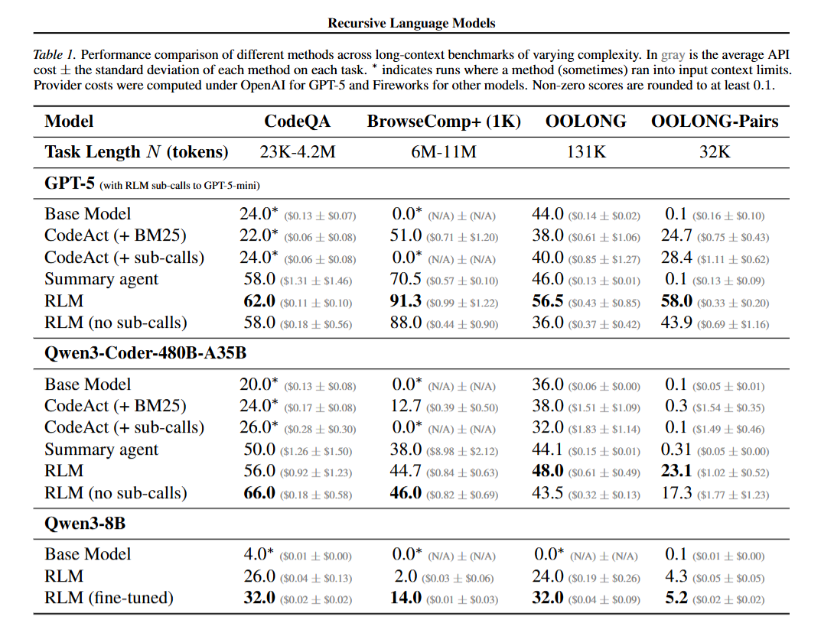
Result Analysis
Scales Beyond Context Limits
Base models → 0% (cannot read input)
RLM → 91.3% (BrowseComp+)
Handles Complex Reasoning
OOLONG-Pairs:
Base → 0.1%
RLM → 58%
More Efficient
CodeQA:
RLM: $0.11
Summary: $1.31
Small Models Improve
8B RLM → 32%
+28% avg gain
Main Result: RLM outperforms base models and common long-context methods on difficult tasks, often with comparable or lower cost.

Slide 17
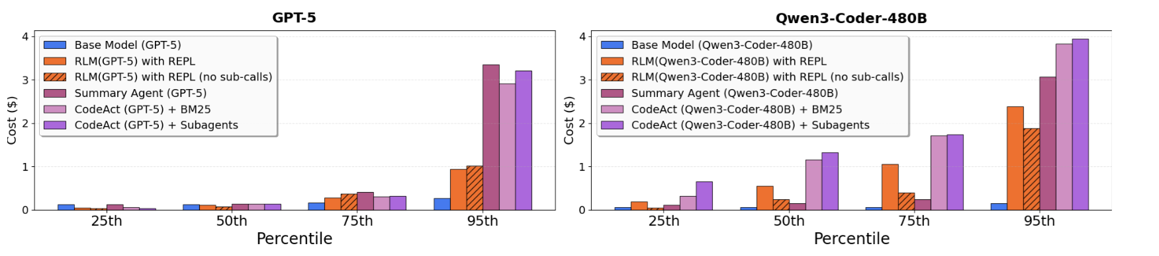
Observations: Scaling, Robustness & Efficiency
Processes inputs far beyond context limits (10M+ tokens), where base models fail.
Outperforms base models and existing methods on complex long-context tasks.
Maintains comparable or lower inference cost.
(Figure taken from original paper)

Slide 18
Observations: Model Behavior & Training
Model Behavior Differences
Impact of Fine-Tuning
RLM performance varies across models due to different exploration strategies.
Models adopt different strategies:
GPT-5 → less sub-calls
Qwen3 → more sub-calls
Effectiveness depends on how well the model navigates and queries the external workspace.
Fine-tuning improves RLM by enabling more efficient decision-making during recursion.
Leads to fewer unnecessary sub-calls and more stable execution.
Results in both higher accuracy and reduced cost.

Slide 19
Strengths & Key Insights
Great Scalability
Complex Reasoning
Handles 10M+ tokens
Far beyond native context limits
Works on Ω(N) and Ω(N²) tasks
Avoids context rot
Efficient Processing
Learnable Framework
Uses selective peeking (code)
Up to 3× cheaper than summarization
More efficient than reading full input
Small models (8B) can be trained
Only ~1,000 samples needed
Can approach larger model performance

Slide 20
Limitations & Practical Challenges
Latency
Model Behavior Issues
Recursive calls are sequential (blocking)
Slower than standard LLM inference
May confuse plan vs final answer
Too many unnecessary sub-calls
Design Constraints
Open Limitations
Requires strong coding ability
Performance depends on:
model capability
prompt design
Limited recursion depth explored
Multi-level recursion still unexplored

Slide 21
Conclusion & Future Directions
Key Contribution
Core Mechanism
Treats prompt as external workspace
Shifts from token-based reading to programmatic interaction.
Code + recursion = scalable reasoning
Enables:
large inputs
complex computation
Main Result
Future Work
Breaks 10M+ token barrier
Better accuracy and cost efficiency
Asynchronous execution (faster runtime)
Deeper recursion strategies
Large-scale native training
General-purpose reasoning systems

Slide 22
References
Zhang, A. L., Kraska, T., & Khattab, O. (2025). Recursive language models. arXiv preprint arXiv:2512.24601.
Anthropic. (2025). Claude code: Subagents — modular AI workflows with isolated agent contexts. https://docs.anthropic.com/en/docs/claude-code/sub-agents
Bai, Y., Tu, S., Zhang, J., Peng, H., Wang, X., Lv, X., Cao, S., Xu, J., Hou, L., Dong, Y., Tang, J., & Li, J. (2025). Longbench v2: Towards deeper understanding and reasoning on realistic long-context multitasks. https://arxiv.org/abs/2412.15204
Bertsch, A., Pratapa, A., Mitamura, T., Neubig, G., & Gormley, M. R. (2025). Oolong: Evaluating long context reasoning and aggregation capabilities. https://arxiv.org/abs/2511.02817
Chen, H., Pasunuru, R., Weston, J., & Celikyilmaz, A. (2023). Walking down the memory maze: Beyond context limit through interactive reading. https://arxiv.org/abs/2310.05029
Chen, Z., Ma, X., Zhuang, S., Nie, P., Zou, K., Liu, A., Green, J., Patel, K., Meng, R., Su, M., Sharify-moghaddam, S., Li, Y., Hong, H., Shi, X., Liu, X., Thakur, N., Zhang, C., Gao, L., Chen, W., & Lin, J. (2025). Browsecomp-plus: A more fair and transparent evaluation benchmark of deep-research agent. https://arxiv.org/abs/2508.06600
DeepSeek-AI. (2025). Deepseek-r1: Incentivizing reasoning capability in llms via reinforcement learning. https://arxiv.org/abs/2501.12948
Goldman, O., Jacovi, A., Slobodkin, A., Maimon, A., Dagan, I., & Tsarfaty, R. (2025). Is it really long context if all you need is retrieval? Towards genuinely difficult long context nlp. https://arxiv.org/abs/2407.00402
Hong, K., Troynikov, A., & Huber, J. (2025). Context rot: How context degradation affects LLM performance. https://research.trychroma.com/context-rot
Hsieh, C.-P., Sun, S., Kriman, S., Acharya, S., Rekesh, D., Jia, F., Zhang, Y., & Ginsburg, B. (2024). Ruler: What’s the Real Context Size of Your Long-Context Language Models? https://arxiv.org/abs/2404.06654
Merrill, W., & Sabharwal, A. (2024). The expressive power of transformers with chain of thought. The Twelfth International Conference on Learning Representations.
OpenAI. (2024). Openai o1 system card. https://arxiv.org/abs/2412.16720
Singh, A., Fry, A., Perelman, A., Tart, A., Ganesh, A., El-Kishky, A., McLaughlin, A., Low, A., Ostrow, A., Ananthram, A., Nathan, A., Luo, A., Helyar, A., Madry, A., Efremov, A., Spyra, A., Baker-Whitcomb, A., Beutel, A., Karpenko, A., Makelov, A., & Kandasam, A. (2025). Openai gpt-5 system card. https://arxiv.org/abs/2601.03267
Sun, W., Lu, M., Ling, Z., Liu, K., Yao, X., Yang, Y., & Chen, J. (2025). Scaling long-horizon llm agent via context-folding. https://arxiv.org/abs/2510.11967
Wang, X., Chen, Y., Yuan, L., Zhang, Y., Li, Y., Peng, H., & Ji, H. (2024). Executable code actions elicit better llm agents. https://arxiv.org/abs/2402.01030
Press, O., Smith, N. A., & Lewis, M. (2021). Train short, test long: Attention with linear biases enables input length extrapolation. arXiv preprint arXiv:2108.12409.
Gu, A., Goel, K., & Ré, C. (2021). Efficiently modeling long sequences with structured state spaces. arXiv preprint arXiv:2111.00396.
Munkhdalai, T., Faruqui, M., & Gopal, S. (2024). Leave no context behind: Efficient infinite context transformers with infini-attention. arXiv preprint arXiv:2404.07143, 101, 15.
Packer, C., Fang, V., Patil, S., Lin, K., Wooders, S., & Gonzalez, J. (2023). MemGPT: towards LLMs as operating systems.
Guo, T., Chen, X., Wang, Y., Chang, R., Pei, S., Chawla, N. V., ... & Zhang, X. (2024). Large language model based multi-agents: A survey of progress and challenges. arXiv preprint arXiv:2402.01680.
Yao, S., Zhao, J., Yu, D., Du, N., Shafran, I., Narasimhan, K. R., & Cao, Y. (2022, October). React: Synergizing reasoning and acting in language models. In The eleventh international conference on learning representations.

Slide 23
Thank You!
Please Feel free to Ask Any Questions

