Slide 1
LLM-enhanced Score Function Evolution for Causal Structure Learning
Zidong Wang, Fei Liu, Qi Feng, Qingfu Zhang, Xiaoguang Gao
IJCAI 2025
Presented by: Justin Smith, Jiaxiang Zhang

Slide 2
Causal Structure Learning (CSL)
Smoking
Tar
Cancer
Causal Structure Learning (CSL) is a fundamental approach for understanding causality.
It aims to uncover causal relationships from observational or interventional data and represent them as Directed Acyclic Graphs (DAGs).
The Challenge
Learning an exact DAG is NP-hard
The number of possible graphs grows exponentially with variables
Exhaustive search is infeasible in real-world settings
Notes:
Causal Structure Learning CSL is a fundamental approach for understanding causality.
Its goal is to uncover cause–effect relationships from data, either observational or experimental, and represent them as a Directed A(e)cyclic Graph, or DAG.
To make this more concrete, consider a simple example:
Suppose we have three variables: Smoking, Tar in lungs, and Lung cancer.
A possible causal structure would be:
Smoking → Tar → Cancer
Here, the DAG tells us not just that these variables are related, but that there is a direction of influence, which is the key difference from correlation.
However, learning this structure is not easy. The main challenge is that learning the exact DAG is NP-hard.
As the number of variables increases, the number of possible graphs grows exponentially.
For example, even with just a small number of variables, there are already many possible ways to connect them into different DAGs.
Because of this, doing an exhaustive search over all possible graphs is infeasible in real-world settings.
So instead, causal structure learning methods focus on finding a good approximation of the true causal graph.

Slide 3
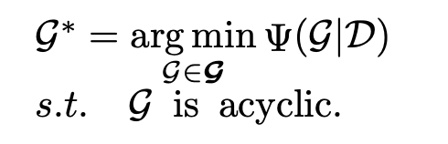
Approaches to observational CSL
2. Score-based methods (focus of this work)
Formulate as an optimization problem
Use a score function to evaluate candidate graphs
Search for the graph that best fits the data
(1) Constraint-based methods
Use statistical independence tests
Example: PC algorithm
Idea:
Find which variables are independent
Build graph structure based on rules
Problem:
Independence tests are unstable
Sensitive to:
  sample size
  dimensionality
Ψ(·) — Score function evaluating fitness
G — Candidate DAG structure
D — Observed dataset
G — Space of possible DAGs
G* — optimal DAGs
Notes:
The first one is constraint-based methods.
These methods rely on statistical independence tests. The idea is to check whether variables are independent or conditionally independent, and then use a set of rules to construct the graph structure. A typical example is the PC algorithm.
but, a key limitation here is that these independence tests can be unstable. Their results are often sensitive to factors like sample size and the dimensionality of the data, which can lead to unreliable structures.
The second approach is score-based methods, which is also the focus of this work.
Here, the problem is formulated as an optimization problem. We define a score function, denoted as Ψ sai, that measures how well a candidate graph fits the observed data.
Then, we search over the space of all possible DAGs, denoted as G, and try to find the optimal graph G* that best explains the dataset D.

Slide 4
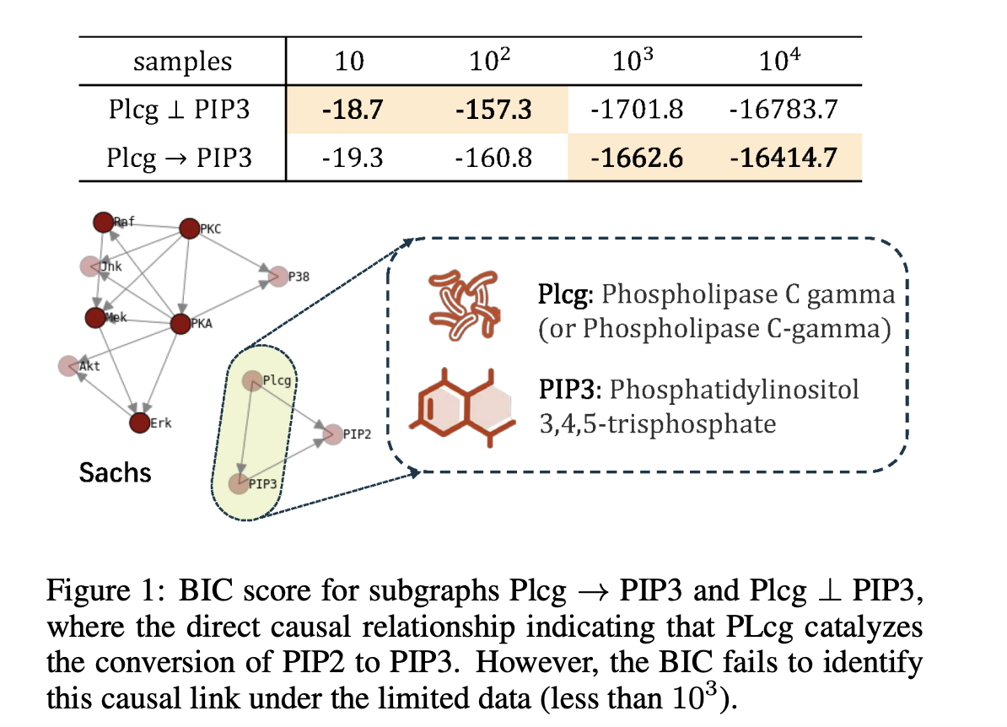
Traditional Score Functions
Traditional score functions (e.g., BIC) assume:
  Large sample size
  Known data distribution
These assumptions rarely hold in practice
→ Leads to suboptimal causal structures
Key Insight
Score functions behave differently under different data conditions
Performance depends on:
  Sample size
  Noise
  Prior assumptions
Specific Issues
Noise → degrades BIC performance
Priors → affect Bayesian scores (BDeu)
Manual design is not scalable
Notes:
Now we look at the limitations of traditional score functions.
Traditional score functions, such as BIC, rely on several strong assumptions. They typically assume a large sample size and a known data distribution.
However, in practice, these assumptions rarely hold. As a result, the learned causal structures can be suboptimal.
This issue is showed in Figure 1. In this example, we compare two possible structures: one where Plcg causes PIP3, and another where they are independent.
In reality, there is a true biological relationship where Plcg → PIP3. However, when the sample size is small, specifically less than 10³, the BIC score behaves differently. Instead of identifying the true causal link, BIC assigns a better score to the simpler independence model.
As a result, it incorrectly selects Plcg ⟂ PIP3, instead of the correct structure Plcg → PIP3.
So even though BIC is theoretically optimal under ideal conditions, this figure shows that it can fail in realistic, limited-data settings.
This leads to an important insight: Score functions behave differently under different data conditions. Their performance depends heavily on factors such as sample size, noise, and prior assumptions. More specifically, we observe several issues:
Noise can negatively affect the performance of BIC, especially in continuous settings.
For Bayesian scores like BDeu, the choice of priors can significantly influence the result.
And importantly, manually designing new score functions for each scenario is not scalable. So this naturally leads to our research question:
Can we improve score functions in an automatic and systematic way?

Slide 5
Traditional Score Functions
Traditional score functions (e.g., BIC) assume:
  Large sample size
  Known data distribution
These assumptions rarely hold in practice
→ Leads to suboptimal causal structures
Key Insight
Score functions behave differently under different data conditions
Performance depends on:
  Sample size
  Noise
  Prior assumptions
Specific Issues
Noise → degrades BIC performance
Priors → affect Bayesian scores (BDeu)
Manual design is not scalable
Can we improve score functions in an automatic and systematic way?
Notes:
And importantly, manually designing new score functions for each scenario is not scalable. So this naturally leads to our research question:
Can we improve score functions in an automatic and systematic way?

Slide 6
Related Work
1. Score-Based Causal Structure Learning
Search over different spaces:
DAG space (G)
  Directly modify edges
Equivalence space (E)
  Search over CPDAGs (equivalent graphs)
Permutation space (O)
  Learn variable ordering, then construct DAG
2. Continuous Optimization Methods
Based on Structural Equation Models (SEM)
Convert DAG learning into continuous optimization
3. LLM for Causal Learning
LLMs used as:
  Causal predictors
(pairwise relationships)
  Domain knowledge sources
Assist with:
  Initialization
  Constraints
  Post-processing
4. LLM for Algorithm Design
Combine LLM + evolutionary search
Automatically generate/improve algorithms
Notes:
After identifying the limitations of traditional score functions, we now look at related work.
First, in score-based causal structure learning, most methods focus on how to search for the optimal graph. These methods operate in different spaces. For example, DAG-based methods directly modify edges, equivalence-based methods search over classes of equivalent graphs, and permutation-based methods learn variable orderings to construct the graph.
Second, there are continuous optimization approaches based on structural equation models to reformulate DAG learning as a continuous optimization problem, which improves scalability.
Third, recent work has explored using large language models for causal learning. In these approaches, LLMs are used either to infer causal relationships directly or to provide useful prior knowledge, such as initialization or structural constraints.
Finally, LLMs have also been applied to automatic algorithm design. These methods combine LLMs with evolutionary strategies to generate and improve algorithms across different domains.
However, despite these advances, most existing work focuses on improving search strategies, while still relying on fixed, manually designed score functions. This highlights a key gap: there is no systematic way to automatically discover better score functions, which directly motivates our approach.

Slide 7
Casual Structure Learning (CSL)
There are two ways to perform CSL:
  Interventional: Interact with the environment to learn causal structure.
  Observational: Use a static dataset to determine causal structure.
Interventional
Interactions make learning easier
Confirmation is possible
Intervention can be expensive
Observational
Static dataset
Does not pay cost of intervention
Cannot confirm causal structure
Notes:
Causal Structure Learning, or CSL, is the task of discovering causal relationships between variables.
There are two main ways to perform CSL: interventional learning and observational learning.
First, observational learning uses a static dataset. This means we only look at data that has already been collected, without actively changing anything in the system. The main advantage is that it does not require the cost of intervention, so it is often easier and cheaper to use. However, the limitation is that observational data alone usually cannot fully confirm the true causal structure.
In contrast, interventional learning involves interacting with the environment. For example, we may deliberately change one variable and observe how the others respond. These interactions often make causal learning easier, and they can provide much stronger evidence for confirming causal relationships. However, interventions can be expensive, difficult, or sometimes even impossible to perform.

Slide 8
LLMs for CSL
LLMs know a lot about the world.
  This is found to be an emergent property of language modeling.
World knowledge Cause and Effect
LLM Graph
Initialization
Post-hoc LLM
Search
Notes:
Now we look at how large language models, or LLMs, can be used for causal structure learning.
LLMs are trained on massive amounts of text, so they capture a significant amount of world knowledge. Interestingly, this includes knowledge about cause-and-effect relationships. This ability is often considered an emergent property of language modeling.
Because of this, we can think of an LLM as a source of prior knowledge. It can help us bridge the gap between raw data and causal graphs.
There are two main ways LLMs are used in CSL.
First is initialization. Here, the LLM is used to generate an initial causal graph based on its knowledge. This graph can then be refined using data-driven methods.
Second is post-hoc usage. In this case, we first learn a graph from data, and then use the LLM to evaluate, refine, or interpret the results.
In both cases, LLMs can also guide the search process, helping us explore better candidate graphs more efficiently.
So overall, LLMs act as a powerful tool to inject world knowledge into causal structure learning

Slide 9
LLMs for CSL
LLMs know a lot about the world.
  This is found to be an emergent property of language modeling.
World knowledge Cause and Effect
LLM Graph
Initialization
Post-door LLM
Search
Notes:
Continuing with LLMs for causal structure learning.
As we mentioned, LLMs contain rich world knowledge, including implicit understanding of cause-and-effect relationships. This makes them a useful bridge between natural language knowledge and causal graphs.
We can think of this process as mapping knowledge inside the LLM into a graph structure that represents causal relationships.
There are three main ways this is used.
First is initialization. The LLM can generate an initial causal graph based on its prior knowledge, which gives us a strong starting point.
Second is post-hoc use. After we learn a graph from data, we can use the LLM to refine it, validate it, or provide explanations for the relationships.
Third is search. LLMs can guide the search process by suggesting better candidate structures, helping us explore the space of possible graphs more efficiently.
So overall, LLMs help connect world knowledge with causal discovery, improving both efficiency and interpretability.

Slide 10
Evolutionary Programming
Initialize a population of models to be tested.
Create new members of the population.
Score the models’ performance.
Keep N members of the population.
Mutation
Changes an existing
member of the
population
Crossover
Combines two members
of a population
Injection
Creates a new member of the population
Ψ
Ψ₁
Ψ₂
Ψ’
Ψ’
Ψ’
Notes:
Now we introduce evolutionary programming, which is used to search for better models.
The idea is to treat each candidate model, in our case each causal graph or score function, as a member of a population.
We start by initializing a population of models to be tested. Then, in each iteration, we generate new candidate models, evaluate their performance using a score function, and keep the top N models for the next generation.
There are three main operations used to create new models.
First, mutation. This means making small changes to an existing model, such as modifying part of a structure or function.
Second, crossover. This combines parts of two existing models to create a new one, allowing us to mix useful components.
Third, injection. This introduces entirely new models into the population, helping maintain diversity and avoid getting stuck in local optima.
Each model is evaluated using a score function, which we denote as Psi. Based on these scores, we select the best-performing models and continue the process.
So overall, evolutionary programming provides a systematic way to explore the search space and gradually improve model quality.

Slide 11
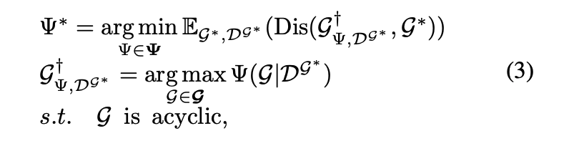
Method: L-SFE Framework
Goal: Automatically learn better score functions
Key idea: Replace manual design with:
  LLM + Evolutionary Search
Core contribution:
  Bi-level optimization framework
Notes:
ow we introduce the L-SFE framework.
The goal of this method is to automatically learn better score functions for causal structure learning.
Traditionally, score functions are manually designed, which can be limiting and may not generalize well across different datasets. The key idea here is to replace manual design with a combination of large language models and evolutionary search.
The LLM is used to generate candidate score functions based on its knowledge, while evolutionary programming is used to iteratively improve them.
The core contribution of this work is a bi-level optimization framework. At the upper level, the method searches for better score functions. At the lower level, each score function is evaluated by how well it helps learn the causal structure from data.
So overall, L-SFE provides a data-driven and automated way to design more effective score functions.

Slide 12
Dataset & Input–Output
Input:
Dataset D={D1​,...,Dm​}
  mmm: samples
  nnn: variables
Each sample: (X1​,...,Xn​)
Types:
  Discrete (multinomial)
  Continuous (Gaussian SEM)
Output:
Directed Acyclic Graph (DAG)
  Nodes: variables
  Edges: causal relationships
Key Process:
Not direct prediction
Instead:
  Define score function Ψ(G∣D)
  Search best graph
Notes:
Now let’s look at the dataset and the input-output setup.
The input to the model is a dataset D, which consists of multiple samples. Each sample contains n variables, written as X1 through Xn. So you can think of it as a table, where each row is one observation, and each column is a variable.
These variables can be of different types. For example, they can be discrete, like categorical or multinomial variables, or continuous, often modeled using Gaussian structural equation models.
The output of the task is a directed acyclic graph, or DAG. In this graph, each node represents a variable, and each directed edge represents a causal relationship between variables.
An important point here is that we are not directly predicting the graph in one step. Instead, we define a score function, denoted as Psi of G given D, which evaluates how well a candidate graph fits the data.
Then, we search over the space of possible graphs to find the one that achieves the best score.
So the overall process is: define a scoring criterion, and then use it to guide the search for the optimal causal structure.

Slide 13

Core Equations
Bi-level optimization framework
Fitness Function for Score Evaluation
Lower level: find best graph using a score function
Upper level: improve the score function itself
Inner loop: learn DAG
Outer loop: learn how to evaluate DAGs
Compare:
  Learned graph vs. True graph
Use:
  Normalized Hamming Distance
Notes:
Now let’s go through the core equations of the framework.
At a high level, this method uses a bi-level optimization setup.
At the upper level, we are trying to learn the best score function, which we denote as Psi star. The goal is to minimize the distance between the graph learned using this score function and the true graph.
At the lower level, given a score function Psi, we search for the best graph G that maximizes the score under the dataset, while ensuring the graph is acyclic.
So intuitively, the inner loop learns the DAG using a fixed score function, and the outer loop improves the score function itself.
On the right side, we define a fitness function to evaluate how good a score function is.
This function measures the difference between the learned graph and the true graph across multiple datasets.
To quantify this difference, we use Normalized Hamming Distance, which counts how many edges are incorrect.
So overall, this framework jointly learns how to generate graphs and how to evaluate them, making the process much more adaptive and data-driven.

Slide 14
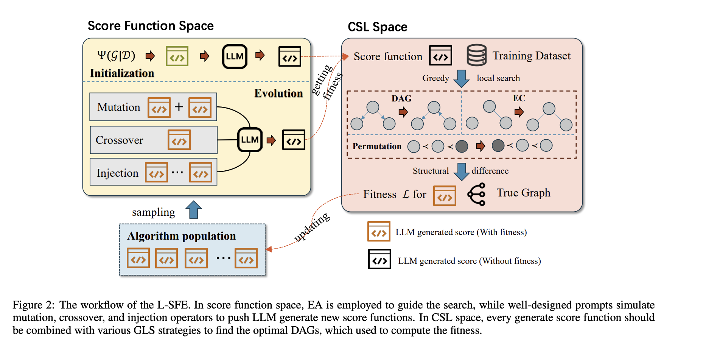
LLMs for Evolution

Slide 15
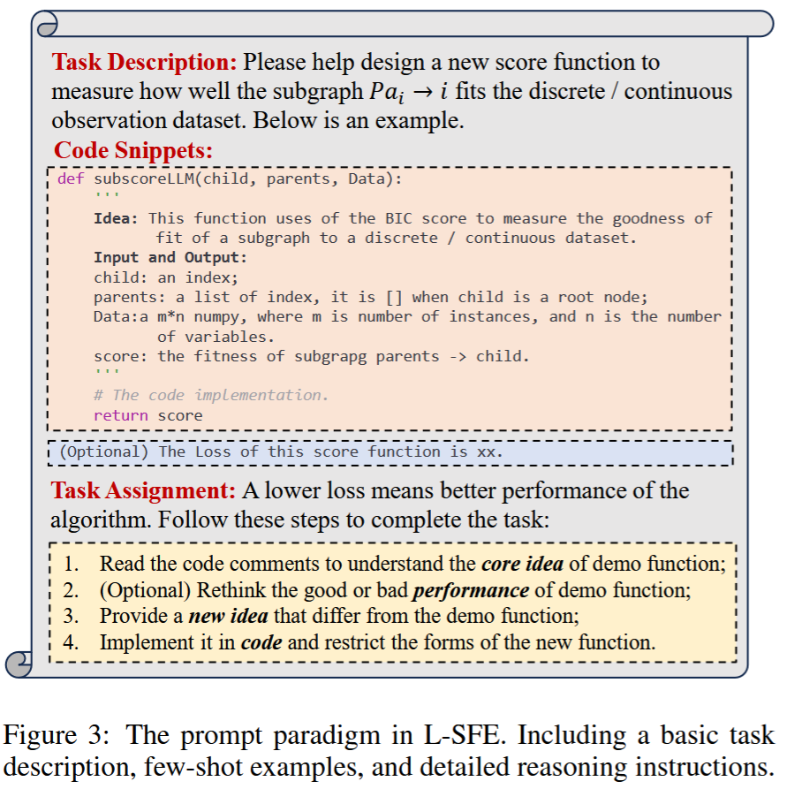
LLMs for Evolution

Slide 16


Evaluation Metrics
Given two graphs, and , the SHD is:
SHD is a measurement of how close two graphs are to one another.
For discrete data, it is the sum of false negatives and false positives.
For weighted edges:

Slide 17
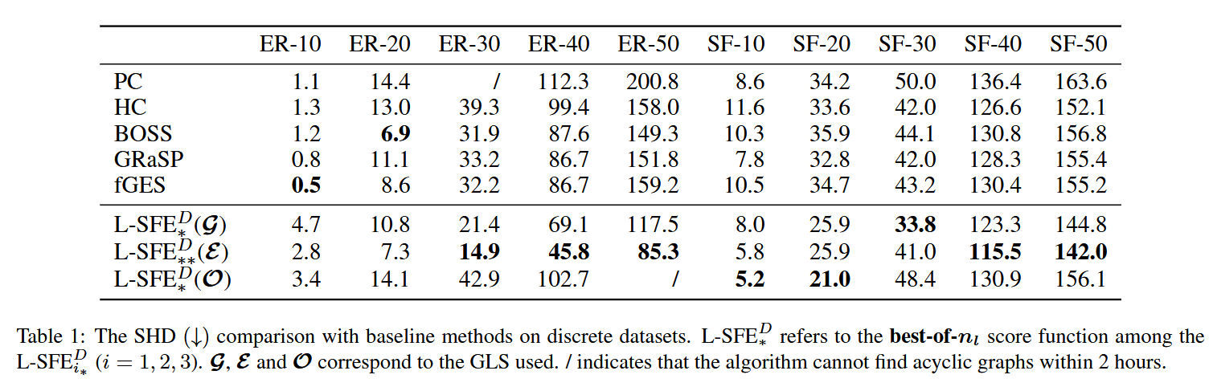
Results

Slide 18
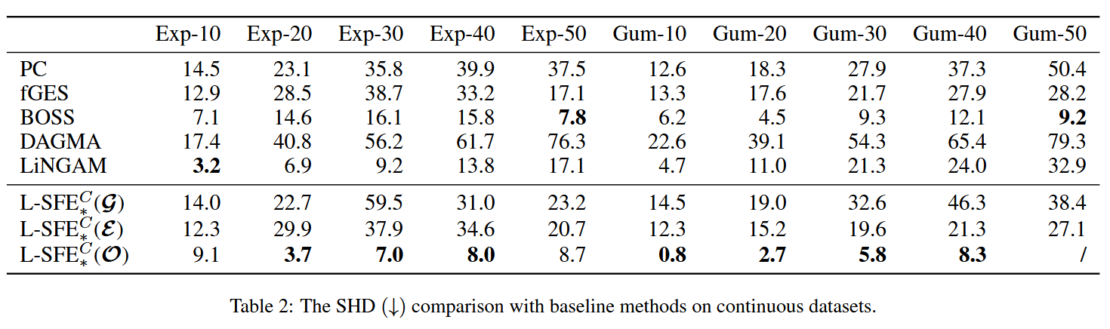
Results

Slide 19
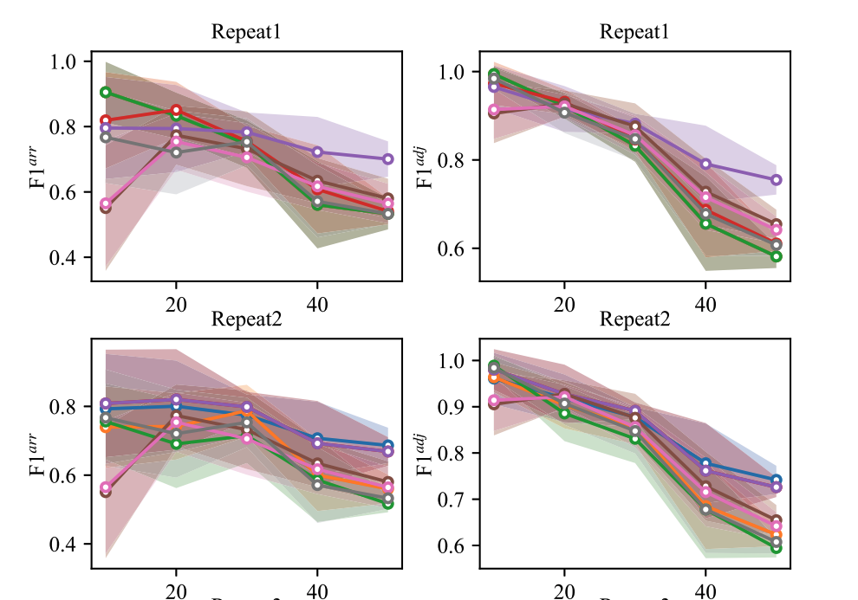
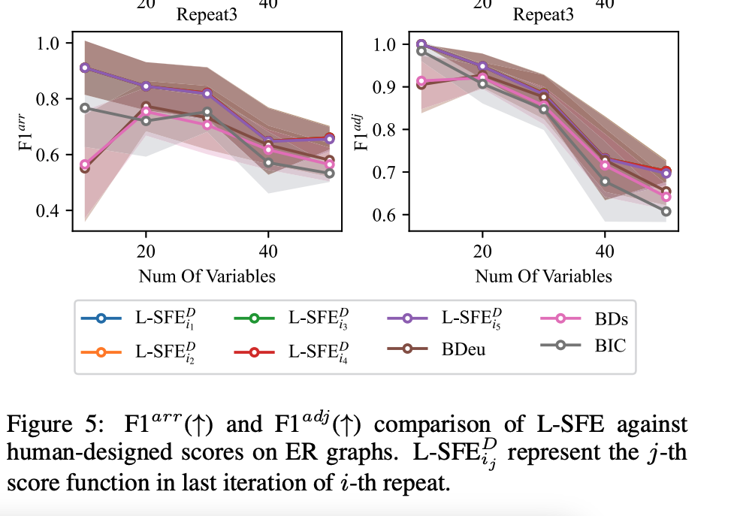
Results

Slide 20
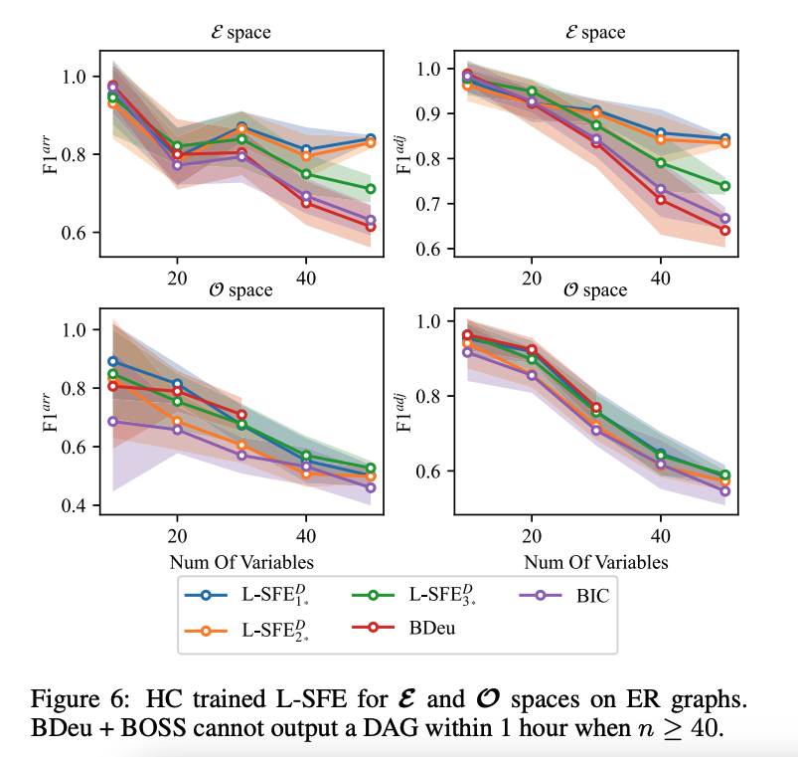
Results

Slide 21
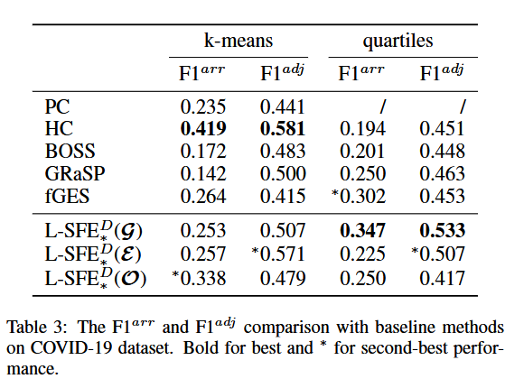
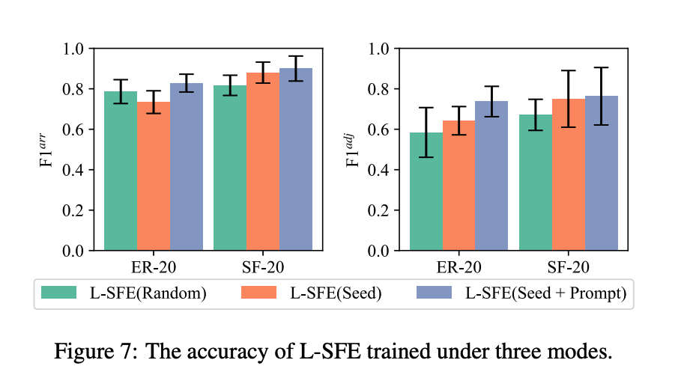
Results

Slide 22
Limitations
LLMs are computationally expensive to run.
  Human-made score functions can outperform the evolution algorithm in some cases.
Only GPT-4o-mini was tested by the authors.
The algorithms all depend on a greedy search algorithm.
  This means that local optima are likely.
Mutation and injection are limited by the LLM’s creativity.
The LLM is not given information about the contents of the nodes.
  This limits the amount of world knowledge that the LLM can display.
The observational data may be biased, creating a biased causal graph.

Slide 23
Conclusion & Future Work
LLMs can enhance evolutionary programming for score functions via:
  Understanding the concepts behind two score functions for crossover.
  Creating novel mutations and injections.
This new score function, L-SFE provides benefits for large-input scenarios.
L-SFE can personalize a score function for use on a given dataset.
LLMs can be guided to produce mutations that minimize the search space.
New search spaces may be more effective for L-SFE.

Slide 24
References
[1] Z. Wang, F. Liu, Q. Feng, Q. Zhang, and X. Gao, "LLM-enhanced score function evolution for causal structure learning," in Proc. 34th Int. Joint Conf. Artif. Intell. (IJCAI-25), Aug. 2025, pp. 9086–9094.
[2] W. Chen, J. Zhang, H. Zhu, B. Xu, Z. Hao, K. Zhang, J. Ye, and R. Cai, "Causal-aware large language models: Enhancing decision-making through learning, adapting and acting," in Proc. 34th Int. Joint Conf. Artif. Intell. (IJCAI-25), Aug. 2025, pp. 4292–4300.

