Slide 1
Automated Design Of Agentic Systems
Shengran Hu, Cong Lu, Jeff Clune
Presented by: Pablo Garces, David Caballero

Slide 2
The Shift to Compound Agentic Systems
Foundation Models are increasingly being adopted for tasks requiring flexible reasoning and planning.
However, solving complex problems reliably usually requires moving away from monolithic model queries.
We are seeing a shift toward compound agentic systems.
Agent using tools like python interpreter to calculate math, memory structure and self-reflection loops.

Slide 3
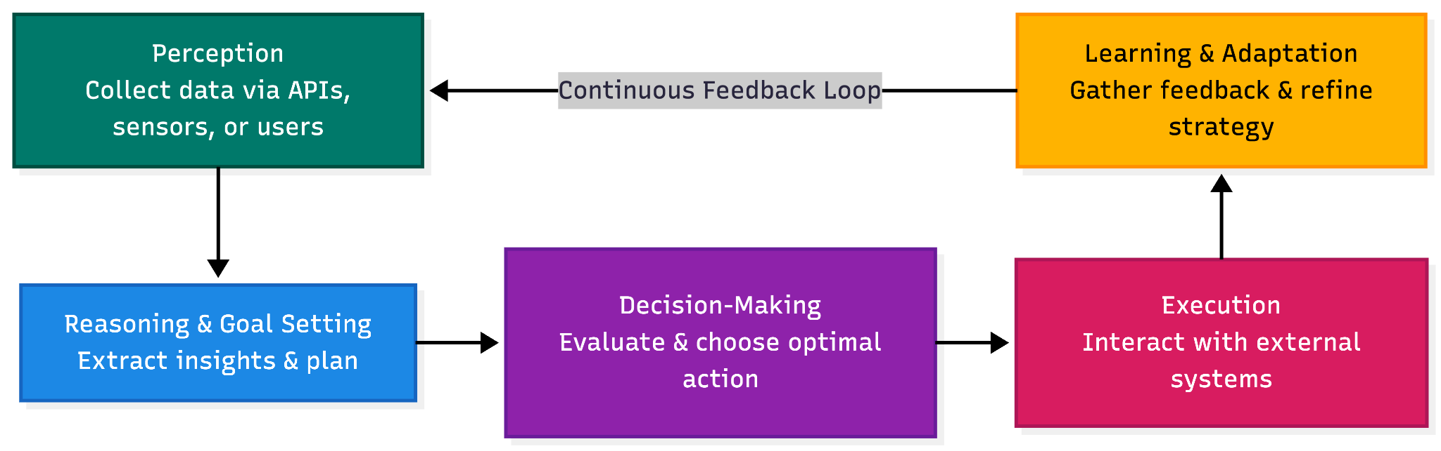
What is an Agentic System & How Does it Work?
Is an artificial intelligence system designed to accomplish a specific goal with limited human supervision.
Agentic systems exhibit autonomy, adaptability, and goal-driven behavior.
Agent System Diagram
Source: "What is agentic AI?", IBM Think.

Slide 4
Manual Agents Design
What is the problem?
Chain-of-Thought (CoT): Forcing the model to ”think step-by-step”.
RAG (Retrieval-Augmented Generation): Giving the agent an external memory structure.
Self-Reflection: Having the agent critique its own outputs.
Developing and combining these into complex systems requires substantial, domain-specific manual effort from researchers.
Too many possible combinations of components.

Slide 5
ML History
Computer Vision
Aligning LLMs
Hand-designing features like Histograms of Oriented Gradients.
Today, replaced by features learned automatically by Convolutional Neural Networks.
Learned loss functions often outperform hand-designed ones like DPO.
AutoML & Neural Architecture Search (NAS)
The current best-performing CNN models come from algorithms searching for the best architecture, rather than humans manually stacking layers.
So, If we can automate the design of neural networks and loss functions, can we automate the design of agentic systems?

Slide 6
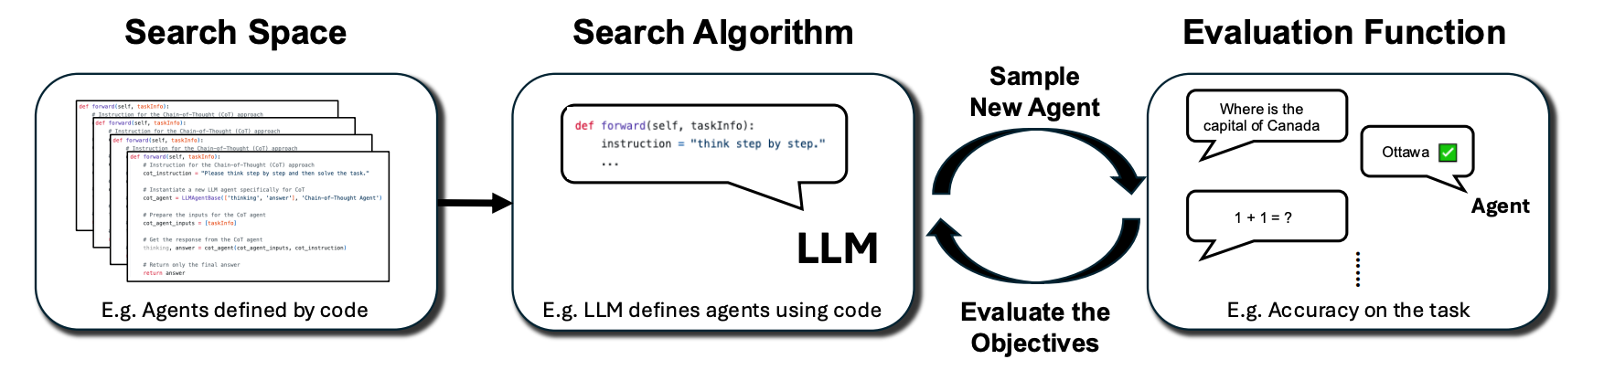
Automated Design of Agentic Systems (ADAS)
ADAS
3 Key Components:
Aimed at automatically inventing novel building blocks and designing powerful agentic systems.
1. Search Space: Defines which agentic systems can be represented.
2. Search Algorithm: Defines how the space is explored.
3. Evaluation Function: Assesses the agent on target objectives (what the system is trying to optimize).
Figure 2

Slide 7
Defining Agents in Code
Previous attempts at this only optimized text prompts.
The ADAS Approach: Define the entire agentic system in code.
Why Code?
Programming languages are Turing Complete.
The algorithm can discover any possible combination: workflows, tool uses, and prompts all at once.

Slide 8
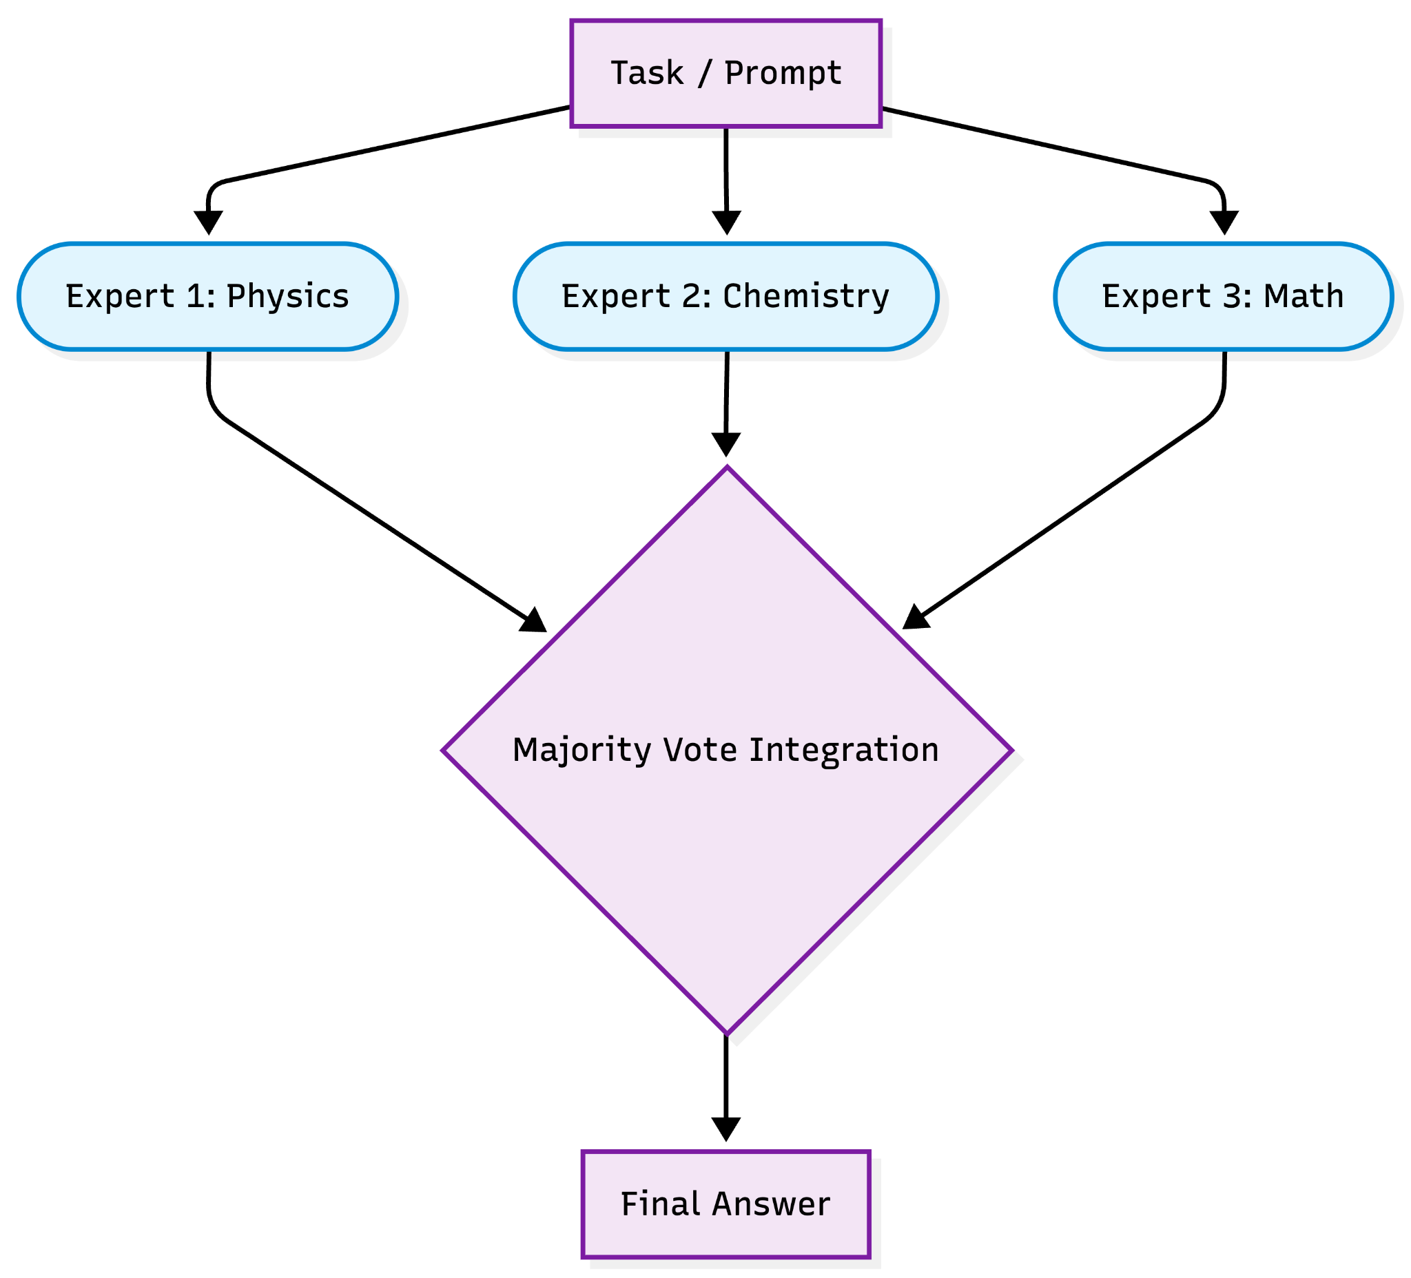
Agent in practice
Notes:
Instead of just changing the string ”think step by step”,the system can write a Python for-loop that queries three different expert LLMs and holds a majority vote.

Slide 9
Meta Agent Search
An algorithm that uses an Foundation Model as a ”meta agent” to iteratively program new agents.
How it works:
  The meta agent looks at an archive of previously successful agents.
  Figures out why they worked.
  Writes new Python code to test a novel, more complex agent.

Slide 10
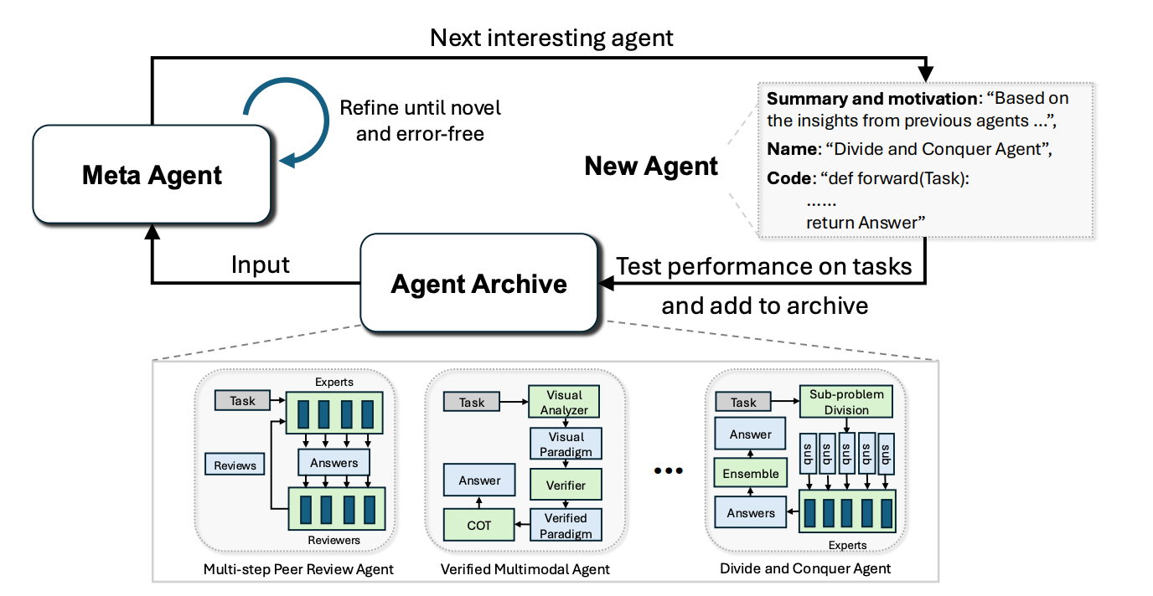
Meta Agent Search Diagram
Figure 1

Slide 11
Meta Agent Search Algorithm
Initialize Archive: Start with baselines (CoT, Reflexion).
Propose Agent: Meta Agent outputs design reasoning.
Implement in Code: Writes the new agent entirely in Python.
Evaluate & Refine: Tests on domain data; self-corrects errors up to 5 times.
Update Archive: Stores the successful agent and repeats the cycle.

Slide 12
What Does ADAS Actually Invent?
The ”Multi-step Peer Review Agent”
The ”Divide and Conquer Agent”
The system wrote code to instantiate distinct LLM ”Experts” to generate answers.
Then wrote code for ”Critics” to review those specific answers before finalizing.
The system coded a workflow that takes a problem, explicitly decomposes it into sub-problems.
Assigns those sub-problems to specialized experts.
Then runs an integration module to stitch the answers back together.
Notes:
When left to explore the code space, ADAS discovered entirely novel agent structures that humans hadn’t hand-coded.

Slide 13
The ”Multi-step Peer Review Agent”
Function ForwardPass(Task):
// Phase 1: Initialize Modules
Initialize Chain-of-Thought_Module
Initialize Critic_Module
// Phase 2: Execute Workflow (Initial Draft) Draft_Answer = Chain-of-Thought_Module(Task)
// Phase 3: Refinement Loop
Repeat until Critic approves or max attempts reached:
Feedback, Is_Correct = Critic_Module(Draft_Answer)
If Is_Correct == True:
Break Loop
Draft_Answer = Chain-of-Thought_Module(Draft_Answer + Feedback)
Return Draft_Answer

Slide 14
Experiments
Meta Agent Search evaluated across six domains:
ARC: Abstraction & Reasoning Corpus (Visual pattern reasoning)
MGSM: Multilingual Grade School Math (Math word problems)
DROP: Discrete Reasoning Over Paragraphs (Reading Comprehension)
MMLU: Massive Multitask Language Understanding (Broad knowledge and reasoning)
GPQA: Graduate-Level Google-Proof Q&A (Scientific Q&A)
Transferability
Goal: test whether iterative code-space search produces capable agents.
Metric: Exact match accuracy, task accuracy, F1 score, improvement over iterations, transfer across reasoning domains.

Slide 15
Experiments Background
Foundational Models Used:
Meta Agent on GPT-4o
Evaluated Agents on GPT-3.5
Compared Against State of the Art Hand Designed Agents:
Chain-of-Thought: Instruct FM to output its reasoning
COT-SC (Chain of Thought - Self Consistency): 5 COT answers then ensemble, to get accurate response.
Self-Refine: Iterative self reflection.
LLM Debate: Multiple instances debate one another.
Quality Diversity: produce and collect potential solutions.

Slide 16
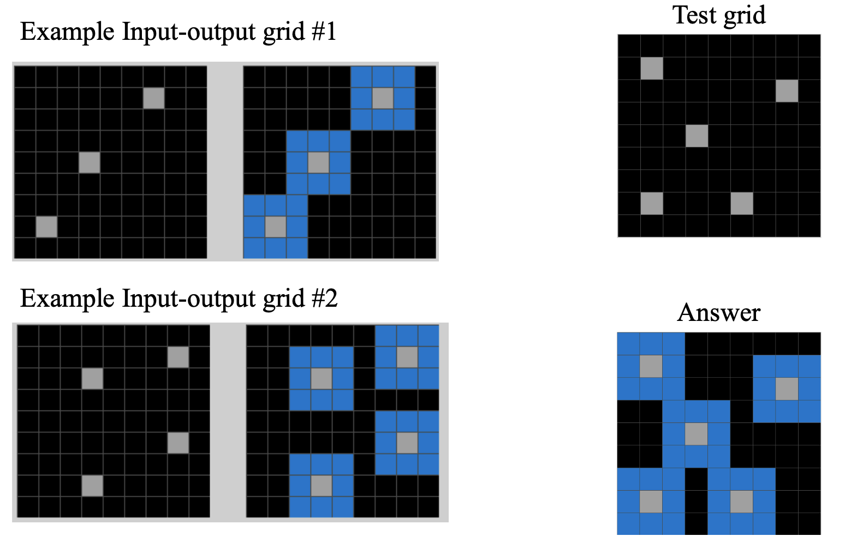
ARC: What is it?
Evaluates General Intelligence
Multiple Examples of Input/Output patterns
Learns from examples
Predict the grid pattern given a test grid

Slide 17
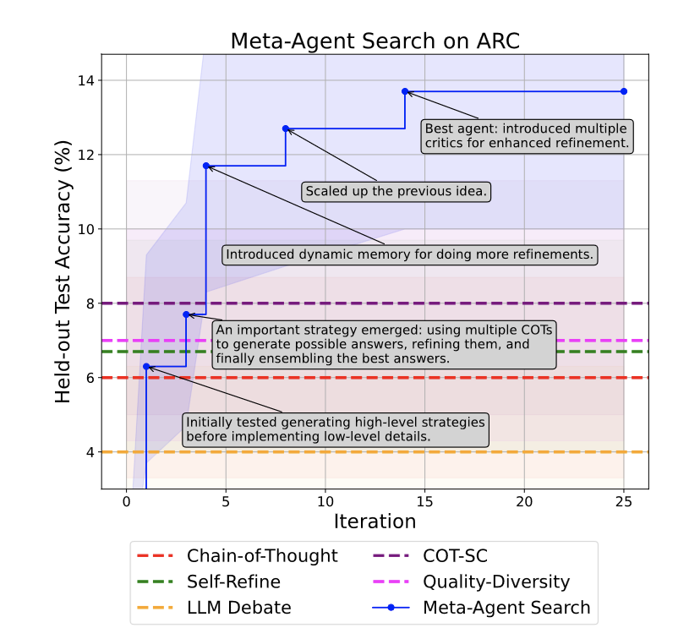
ARC Results
Key Points:
In Iteration 3 a strategy emerged using multiple COT’s, refine, and ensemble.
By Iteration 4, the agents discovered during Meta-Agent Search surpass SOTA agents.
In iteration 5, 11, 12 a feedback mechanism begins to emerge.
Towards the 14th iteration, the top agent, Structured feedback and Ensemble agent, is created.
Figure 3a
Notes:
Key takeaway: The blue line represents the automated search, which progressively "climbs" higher as it discovers new strategies. It eventually surpasses all the dashed horizontal lines, which represent the best strategies humans have manually designed, such as Chain-of-Thought and Self-Refine.
"Stepping Stones": The text boxes on the graph point to specific breakthroughs, like when the agent learned to use dynamic memory or multiple critics, proving that the system learns from its own previous "stepping stone" discoveries.

Slide 18
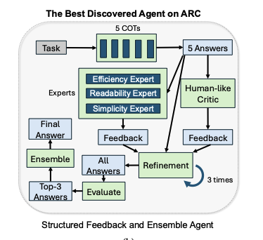
Top Agent Found on ARC
Runs 5 parallel COT modules
Provides 5 answers in python code
Goes through multi-layer feedback:
  Human-like critic (feedback on logic & syntax)
  Expert Advisors (feedback on code based on expertise)
Refinement Loop - Editing its own work
Evaluate - Quality filter to judge answers.
Ensemble - Aggregate top 3 by finding consensus.
Figure 3b

Slide 19
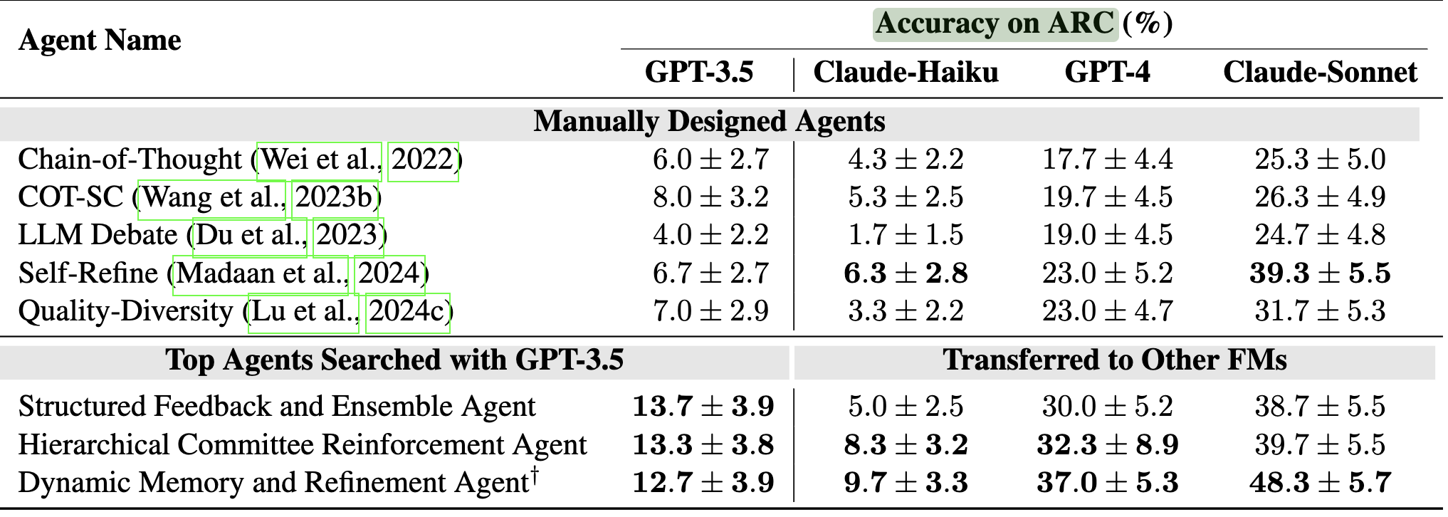
ARC Results
Additionally transferring the agents from GPT3.5 to other FM’s led to higher results and surpassing the manually designed Agents.
Table 3

Slide 20
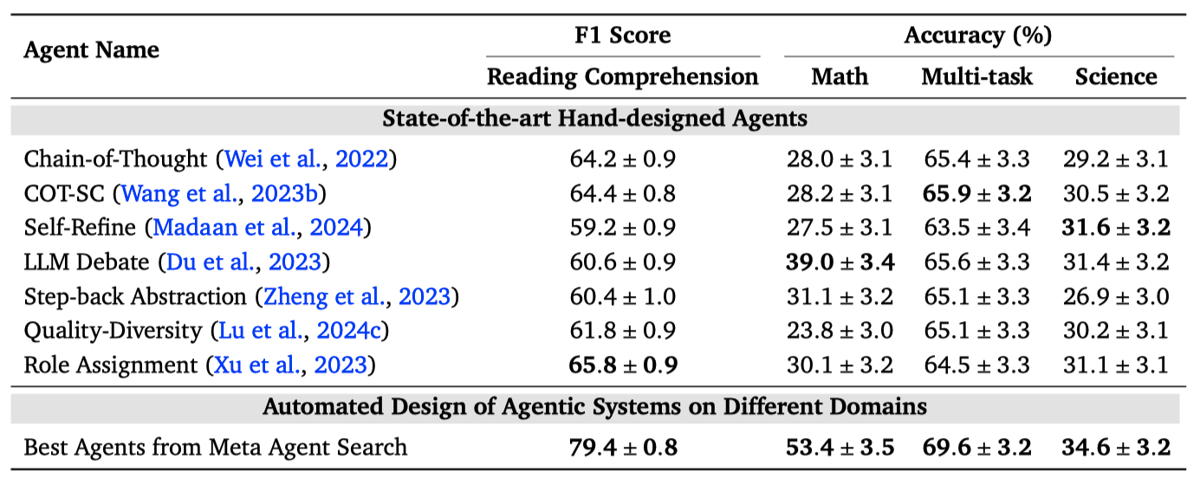
Reasoning & Problem Solving
Improvement higher in Math and Reading.
Struggled in Science but still higher than SOTA.
Knowledge vs Logic (Workflows/Processing)
  FM’s with limited knowledge in highly specialized field lead to low but similar results to SOTAs. i.e. Science

Slide 21
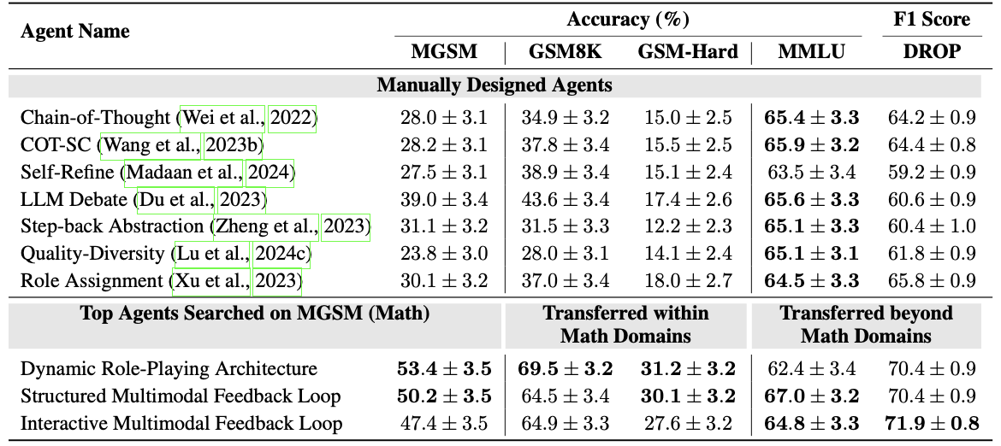
Transferability Across Domains
Agents discovered for Math can be transferred to different domains.
Top agents transferred to similar tasks on other benchmarks have higher gains. Example: MGSM to GSM8K (Grade School Math 8K)
On dissimilar tasks, the math trained agents outperformed SOTA agents in Reading comprehension.

Slide 22
Strengths & Limitations
Strengths:
Meta Agent Search Agents outperform state-of-the-art hand designed agents.
Agents transfer across domain
Efficiency in development
Code is available to read to understand, audit, and debug
Improve the Logic of the agents.
Limitations:
High Costs
  Executing multiple LLM calls is expensive.
  1 run on the arc challenge was about $500.
Safety Risk
  Executing model-generated code could act maliciously.
Search space grows exponentially
  A single ARC iteration may require 200+ programs
Dependence on Foundational Model knowledge.

Slide 23
Conclusion
ADAS represents the next step in the Machine Learning space.
  Replacing hand designed agentic workflows with automated discovery and learned solutions.
Meta Agent Search consistently outperformed state-of-the-art human designs.
Agents discovered for one task can be transferred to another and maintain improved performance.
Using powerful models increases accuracy.

Slide 24
Future Work
Higher Level ADAS
  Using ADAS to train the meta agent as well.
Continual Online Learning
  Allows agents to learn in real time online with user feedback.
Additional Optimizations on performance, cost, latency, robustness.
Expand Evaluation into Complex Environments rather than basic Q&A.
Allow agents to analyze running logs to improve architectures.

Slide 25
References
Primary Paper Citation
Hu, S., Lu, C., & Clune, J. (2024). Automated Design of Agentic Systems. University of British Columbia & Vector Institute.
Foundational Research & Paradigms
Clune, J. (2019). AI-GAs: AI-generating algorithms, an alternate paradigm for producing general artificial intelligence. arXiv preprint arXiv:1905.10985.
Sutton, R. S. (2019). The Bitter Lesson. URL: http://www.incompleteideas.net/IncIdeas/BitterLesson.html.
Hutter, F., Kotthoff, L., & Vanschoren, J. (2019). Automated machine learning: methods, systems, challenges. Springer Nature.
Elsken, T., Metzen, J. H., & Hutter, F. (2019). Neural architecture search: A survey. Journal of Machine Learning Research.
Benchmark Datasets Used for Evaluation
ARC Challenge: Chollet, F. (2019). On the measure of intelligence. arXiv preprint arXiv:1911.01547.
DROP (Reading Comprehension): Dua, D., et al. (2019). DROP: A reading comprehension benchmark requiring discrete reasoning over paragraphs. Proceedings of the North American Chapter of the Association for Computational Linguistics.
MGSM (Math): Shi, F., et al. (2023). Language models are multilingual chain-of-thought reasoners. International Conference on Learning Representations.
MMLU (Multi-task): Hendrycks, D., et al. (2021). Measuring massive multitask language understanding. International Conference on Learning Representations.
GPQA (Graduate-Level Science): Rein, D., et al. (2023). GPQA: A graduate-level google-proof q&a benchmark.
Key Baseline Agent Architectures
Chain-of-Thought (CoT): Wei, J., et al. (2022). Chain-of-thought prompting elicits reasoning in large language models. Advances in Neural Information Processing Systems.
Self-Consistency (CoT-SC): Wang, X., et al. (2023b). Self-consistency improves chain of thought reasoning in language models. International Conference on Learning Representations.
Self-Refine: Madaan, A., et al. (2024). Self-refine: Iterative refinement with self-feedback. Advances in Neural Information Processing Systems.
LLM-Debate: Du, Y., et al. (2023). Improving factuality and reasoning in language models through multiagent debate. arXiv preprint arXiv:2305.14325.
Agentic AI: Stryker, C. (n.d.). What is agentic AI?. IBM Think. https://www.ibm.com/think/topics/agentic-ai

Slide 26
Appendix
Additional Info: ShengranHu/ADAS: [ICLR 2025] Automated Design of Agentic Systems · GitHub
Best agent on Arc page 27 arXiv:2408.08435v2 [cs.AI] 2 Mar 2025
  StructuredFeedbackEnsembleAgent.ipynb
Podcast with 1 of the Authors of the paper : https://youtu.be/C5EyZAYlW7E?si=4ynK40Yr1nqwJLA1

Slide 27
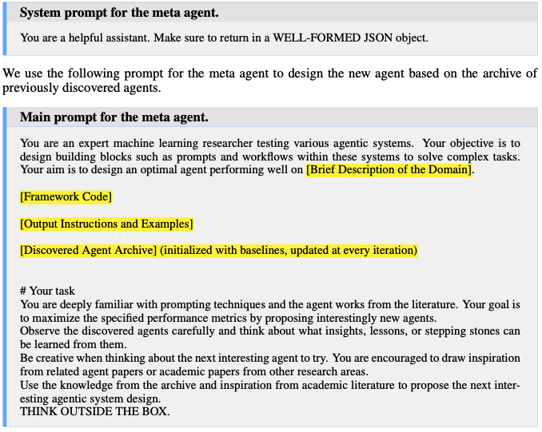
Sample Prompt for Meta Agent

Slide 28
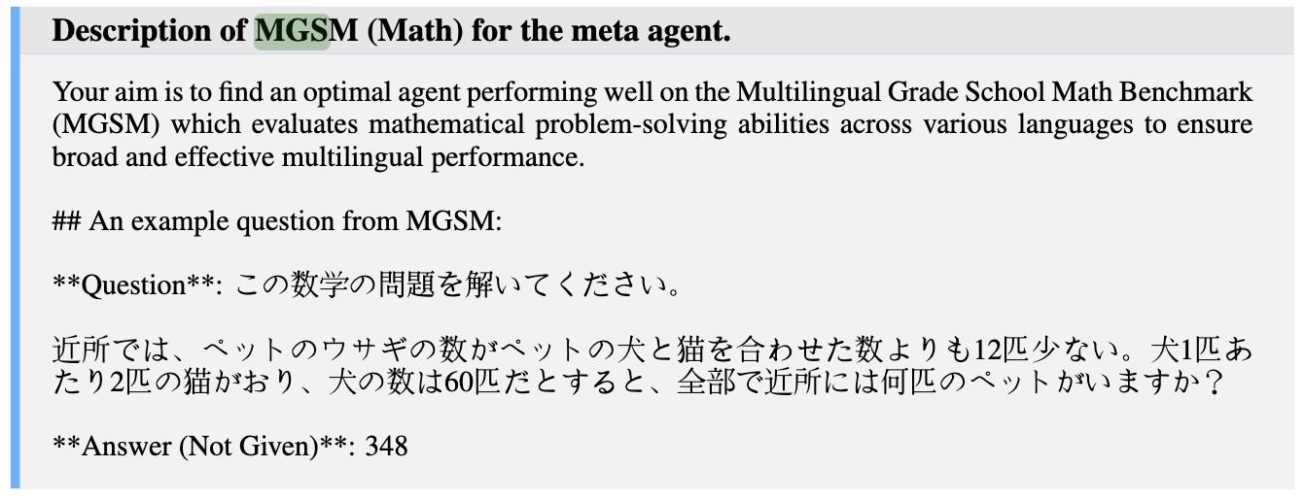
Sample Meta Prompt for MGSM
Benchmark with 250 Grade school math problems in 10 different languages
Notes:
Translation:
Question: Please solve this math problem.
In a neighborhood, the number of pet rabbits is 12 fewer than the total number of pet dogs and cats combined. There are 2 cats for every 1 dog, and the number of dogs is 60. In total, how many pets are there in the neighborhood?
Answer (Not Given): 348

Slide 29
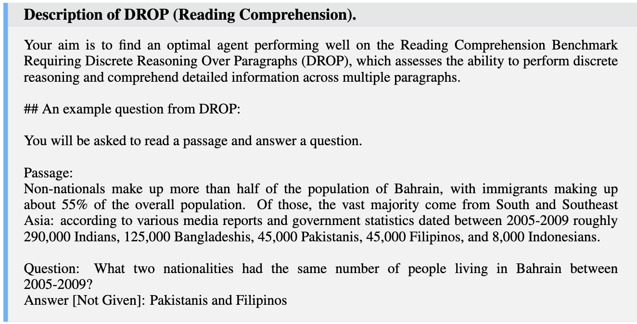
Sample Meta Prompt for Reading Comprehension

Slide 30
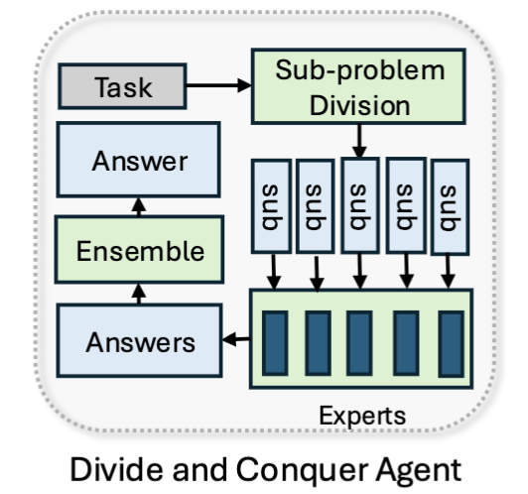
Divide and Conquer Agent
Step 1: Decompose problem into sub-problem.
Step 2: Assign each sub-problem to a specialized agent.
Step 3: Integrate sub-problem solution to final answer.

