Slide 1
Weight-Sparse Transformers
Have Interpretable Circuits
Leo Gao¹, Achyuta Rajaram¹, Jacob Coxon¹, Soham V. Govande¹, Bowen Baker¹, Dan Mossing¹
OpenAI¹
Presented by: Saajan Patel
ITCS 6101/8101 Natural Language Processing

Slide 2
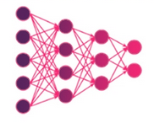
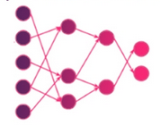
Interpretability
The weights and activations in transformers are not directly interpretable.
Mechanistic interpretability seeks to uncover the algorithms which neural networks implement internally [1].
Dense
Why should we care about interpretability?
To know why models fail
To make interventions
Obstacles to interpretability
vs.
Distributed Representations
Information is spread across many neurons rather than localized.
Abstraction Gap
Existing methods abstract away low-level computations that remain unexplained.
Sparse
Superposition
Neurons representing multiple concepts simultaneously
Figure adapted from [11]
2

Slide 3
Background
Sparse Autoencoders
Sparsity and Sparsity Measure
Sparse Autoencoders (SAEs) encode a dense representation in a sparse latent space.
Makes the representation more interpretable (disentangled)
Activation sparsity: Most neuron outputs are zero or near-zero on any given input; weights stay dense.
Weight sparsity: Most weights themselves are exactly zero; each neuron is wired to only a few others regardless of input.
L₀ norm: the count of nonzero entries in a vector
Node
Individual neuron, attention channel, or residual channel read/write
Edge
A nonzero entry in a weight matrix connecting two nodes
Pruning
Deleting/Removing nodes from the model to reduce size (in this context)
3

Slide 4
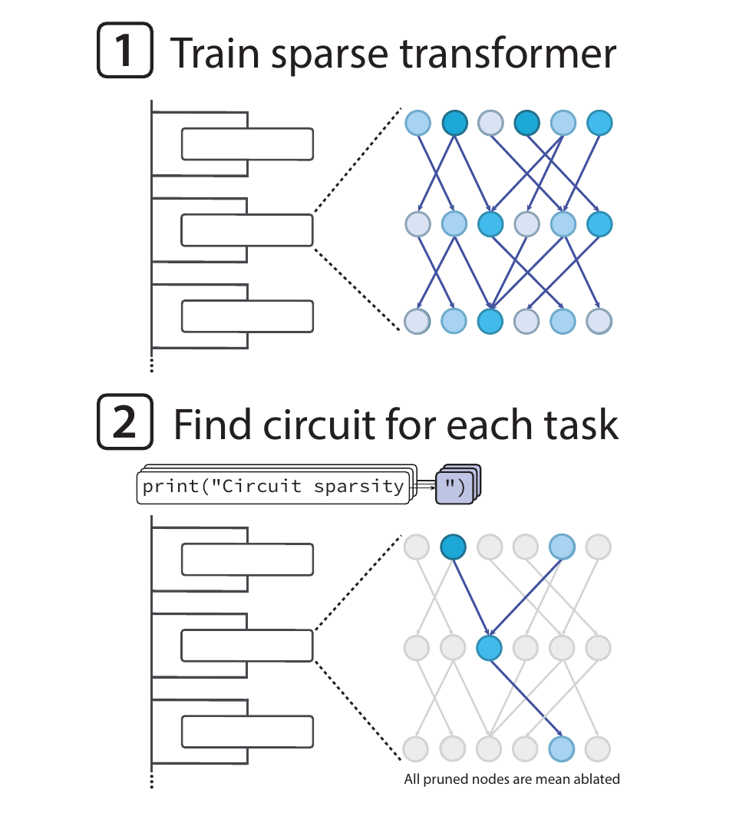
Background: Circuits
What are Circuits in Neural Networks?
A subgraph of the network responsible for a specific behavior. Nodes are neurons/channels; edges are nonzero weights.
Faithfulness: how much an explanation for a model reflects how the model actually works.
A faithful circuit should be sufficient and necessary for a given task.
Visualization of circuit pruning
Figure adapted from Gao et al., 2025 (Figure 1)
4

Slide 5
Prior Work Gaps
Prior Approaches
This Paper's Approach
Sparse Autoencoders (SAEs) find interpretable features but abstract away complex attention computations.
Attribution graphs (Ameisen et al., 2025) yield circuits with noisy global weights — need per-prompt attribution.
Coarse-grained circuits (Conmy et al., 2023) use entire attention heads — too large to interpret fully.
Dense model pruning (Cao et al., 2021) produces circuits too large for human understanding.
Train weight-sparse transformers
where as few as 1 of every 1000 weights are nonzero.
Then prune to isolate minimal circuits
for specific tasks.
5

Slide 6
Main Claim
Training weight-sparse transformers yields circuits up to 16-fold smaller than circuits derived from dense models.
6

Slide 7
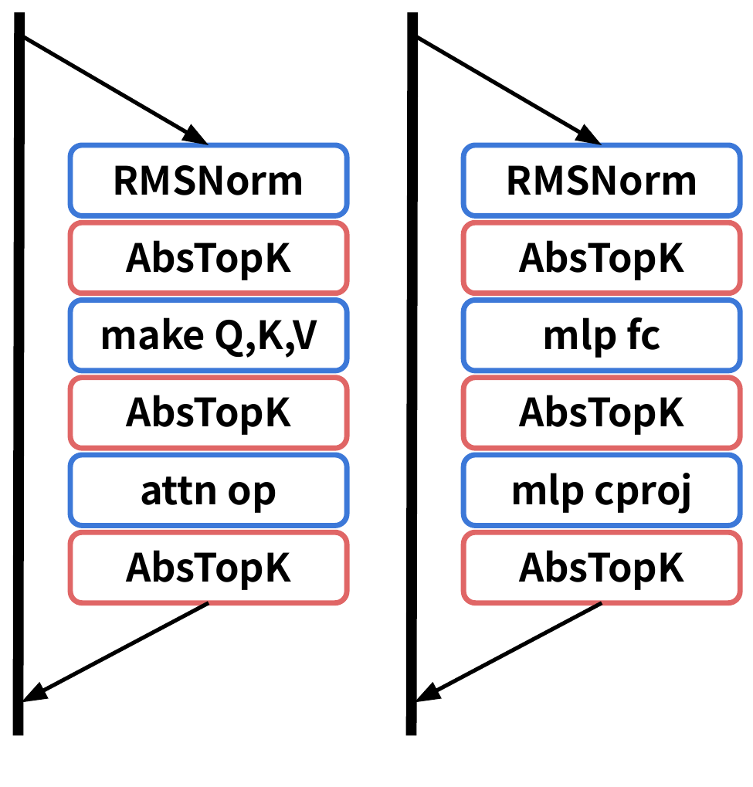
Methods: Pre-Training
Train Weight-Sparse Model
GPT-2 style decoder-only transformer (Radford et al. 2019)
Enforce L₀ constraint: keep top-k magnitude weights per matrix after each optimizer step
Sparsest models: ~1 in 1000 nonzero weights
Enforce activation sparsity via AbsTopK
8 layers, d_{model} = 2048, RMSNorm, Bigram table
Training: 35B tokens of Python code
Placements of AbsTopK in MLP and Attention blocks
Figure adapted from Gao et al., 2025 (Figure 12)
7

Slide 8
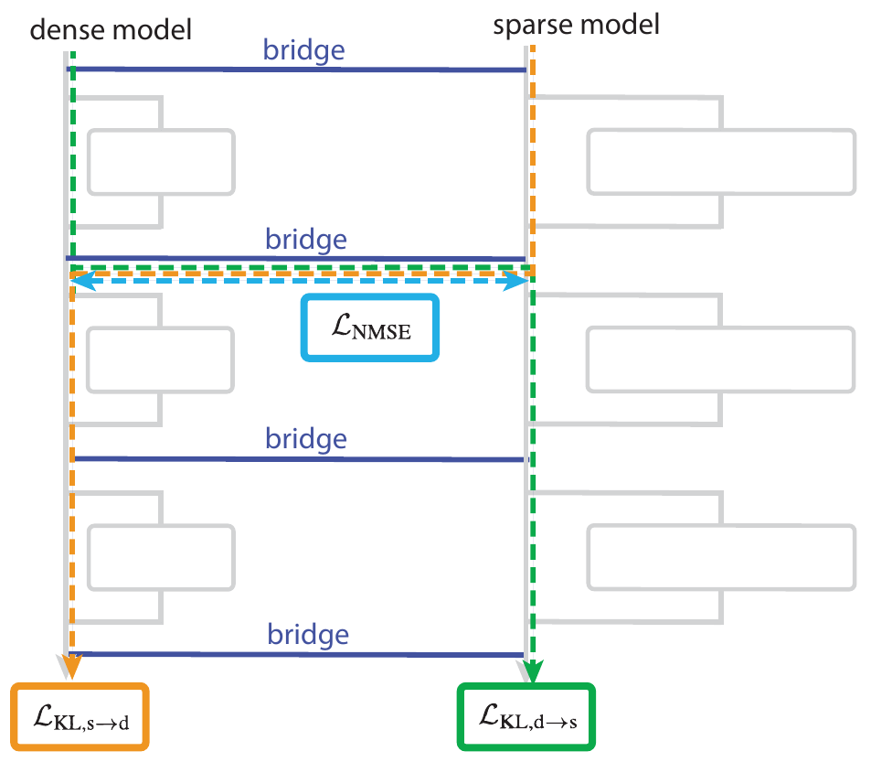



Methods: Bridges
Motivation: Can we translate understanding of circuits in sparse models to dense ones?
Three additional loss terms:
h: residual activations, M: sublayer operations,
f: bridge encoder, g: bridge decoder, y: target, L: # layers
Total loss:
Conversion visualization between Dense and Sparse models
Figure adapted from Gao et al., 2025 (Figure 7)
8

Slide 9
Methods: Tasks
3 example tasks
Find Circuit for each task
Task Name | Description
single_double_quote | Predict ' vs " to close a string
bracket_counting | Predict ] vs ]] based on nesting depth
set_or_string | Track variable type → predict .add vs +=
The experimentation tasks used by the authors are 20 hand-crafted Python binary-classification tasks.
Example for single_double_quote
Input: pair of prompts ran individually
print(“Circuits
print(‘Circuits
Output: Token distribution for full vocab, but for each task, only the two relevant tokens are viewed; the token with higher logit score is chosen.
9

Slide 10


Methods: Circuit Pruning
Mask-Based Pruning
Pruning Process
For each node i, learn a mask parameter τᵢ ∈ [−1, 1]
where σ is the Heaviside step function.
Backprop through σ using a sigmoid-derivative surrogate gradient
Insert boolean masks at all node locations
1
2
Initialize masks with Gaussian noise
3
Optimize masks via AdamW with surrogate gradients
4
After training: bisect for k matching target loss (0.15)
5
Hyperparameter tuning for each individual task configuration
10

Slide 11
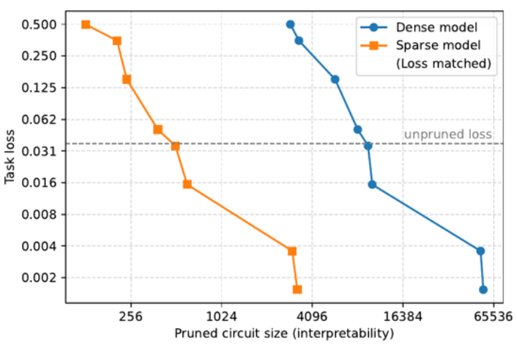
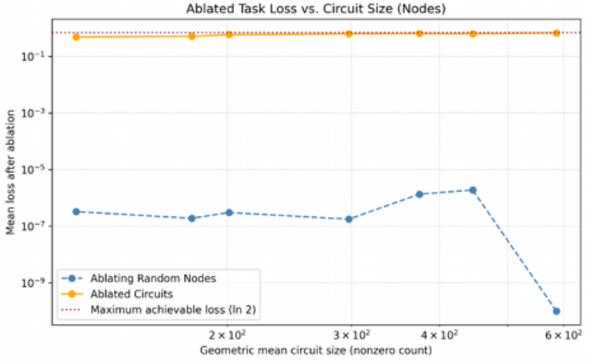
Results: Dense and Sparse Comparison
Performance for sparse and dense models
~16×
smaller circuits
at same task loss
Key Finding:
Sparse models achieve the same task performance at much smaller circuit sizes.
Figures adapted from Gao et al., 2025 (Figures 2, 32)
11

Slide 12
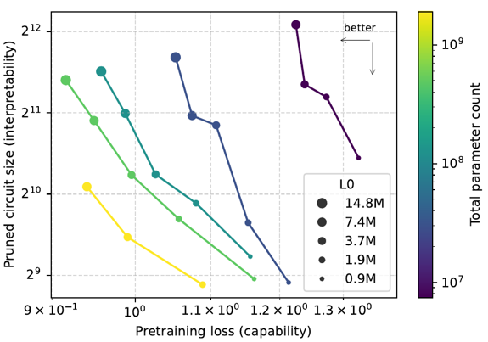
Scaling: Capability vs. Interpretability
Key Scaling Findings
Acknowledgement that decreasing L₀ (sparser) → worse capability, better interpretability, moving along the Pareto frontier.
BUT, scaling up to large, useful models results in better capability AND interpretability.
This refutes the argument that this is a toy-scale interpretability exercise.
Scaling gives more degrees of freedom.
Figure adapted from Gao et al., 2025 (Figure 3)
12

Slide 13
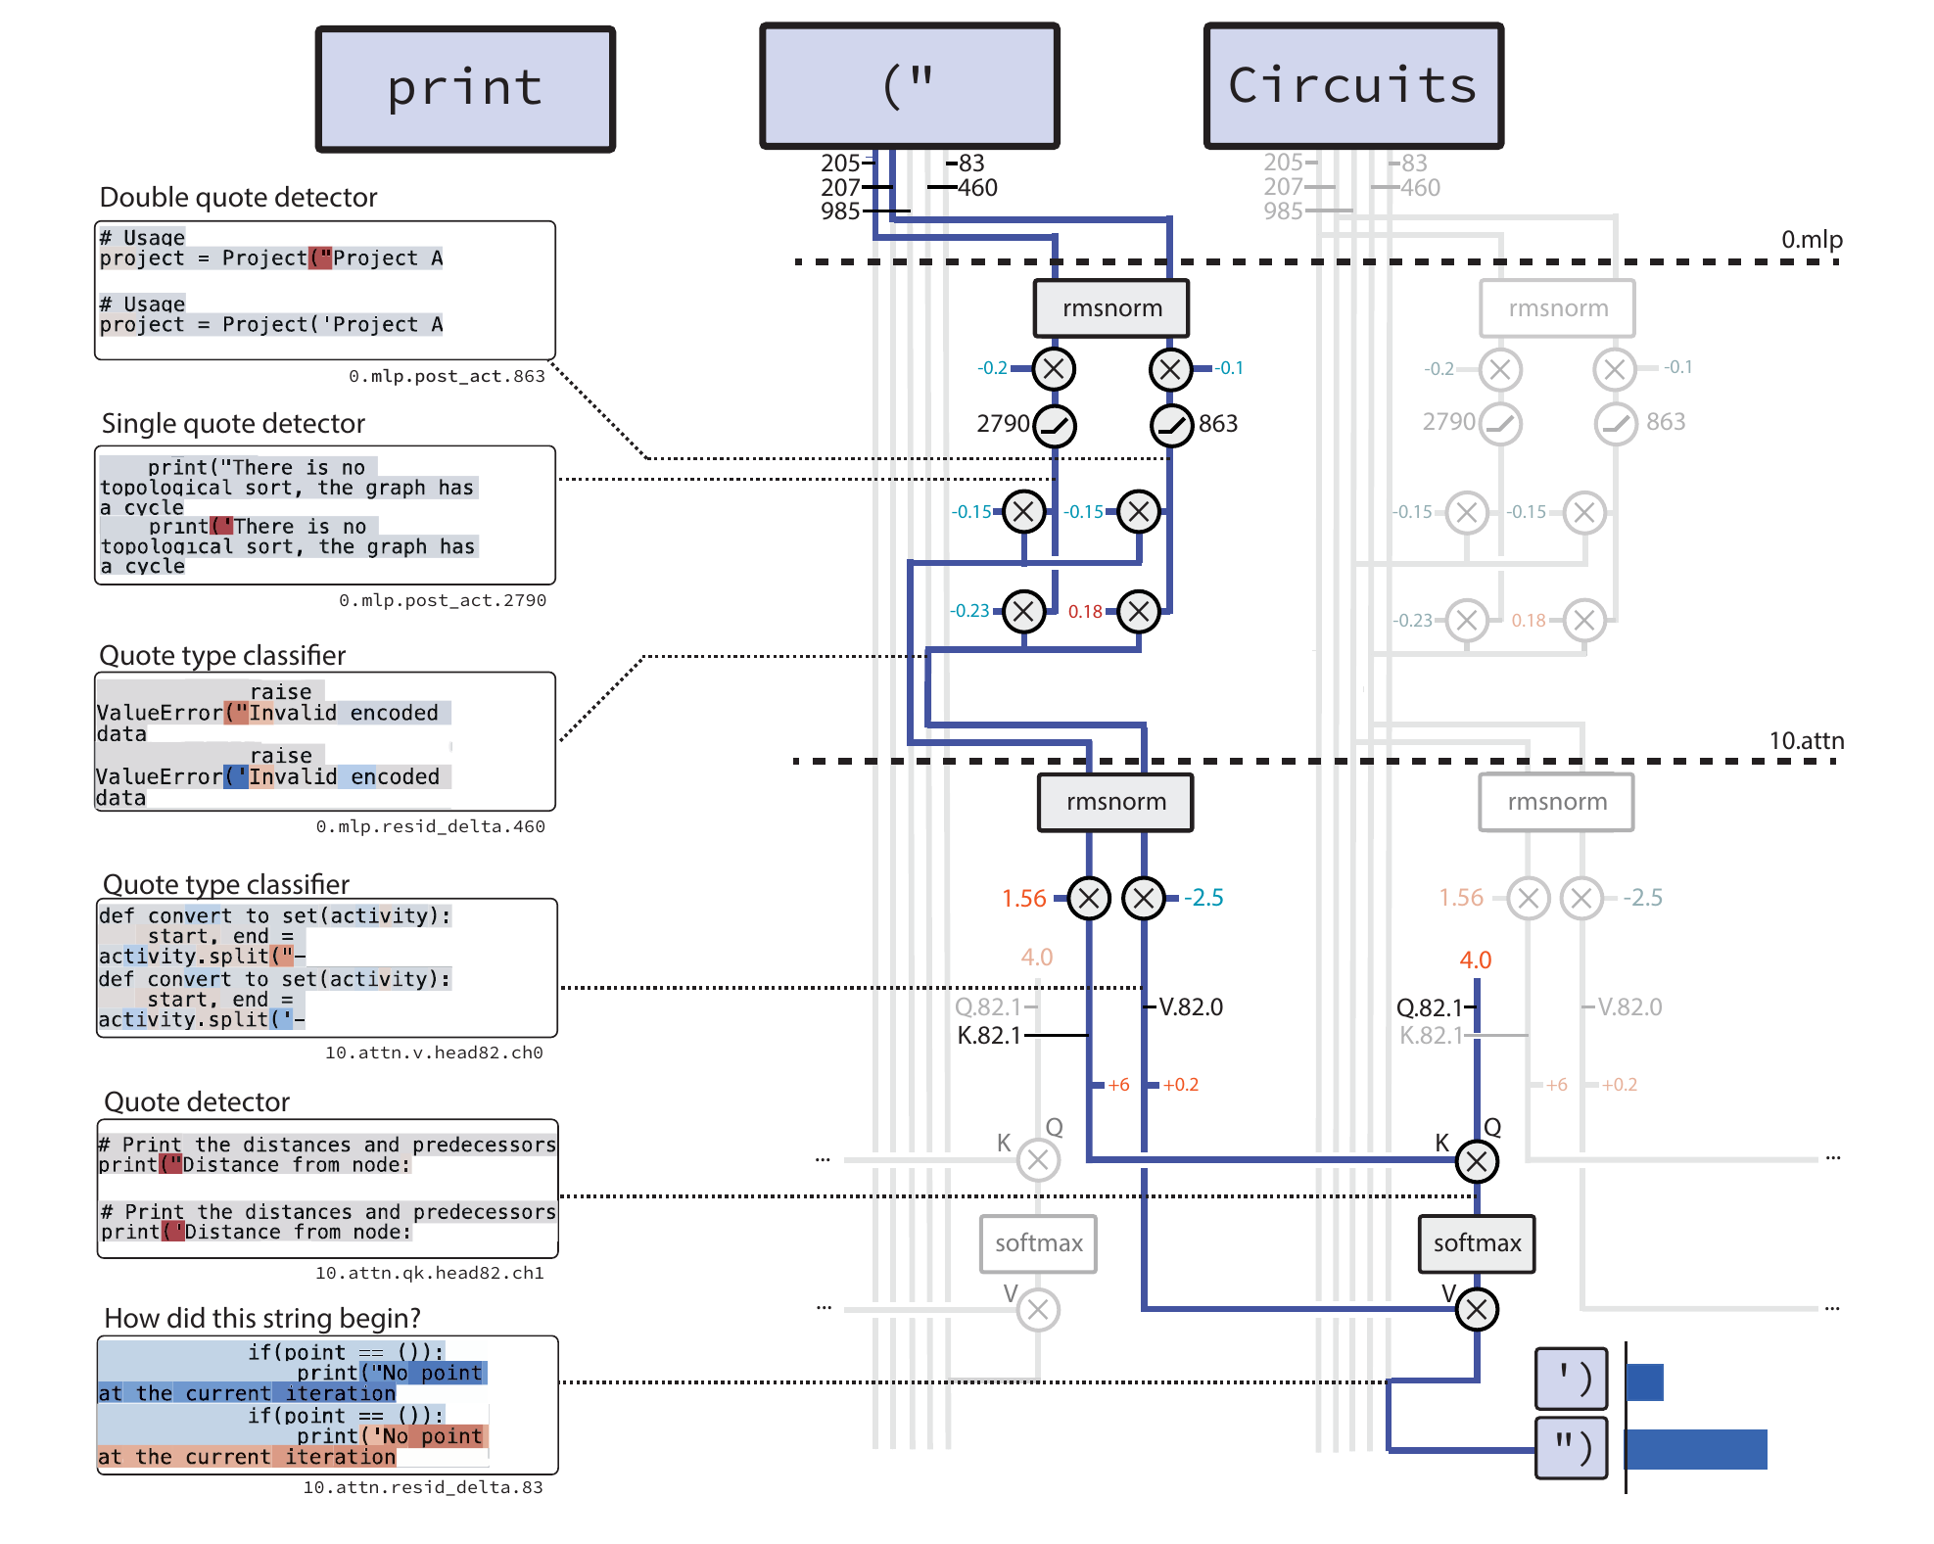
Circuit and Task Example
single_double_quote
Description: Predict whether a string should be closed with ') or ").
Figure adapted from Gao et al., 2025 (Figure 4)
13

Slide 14
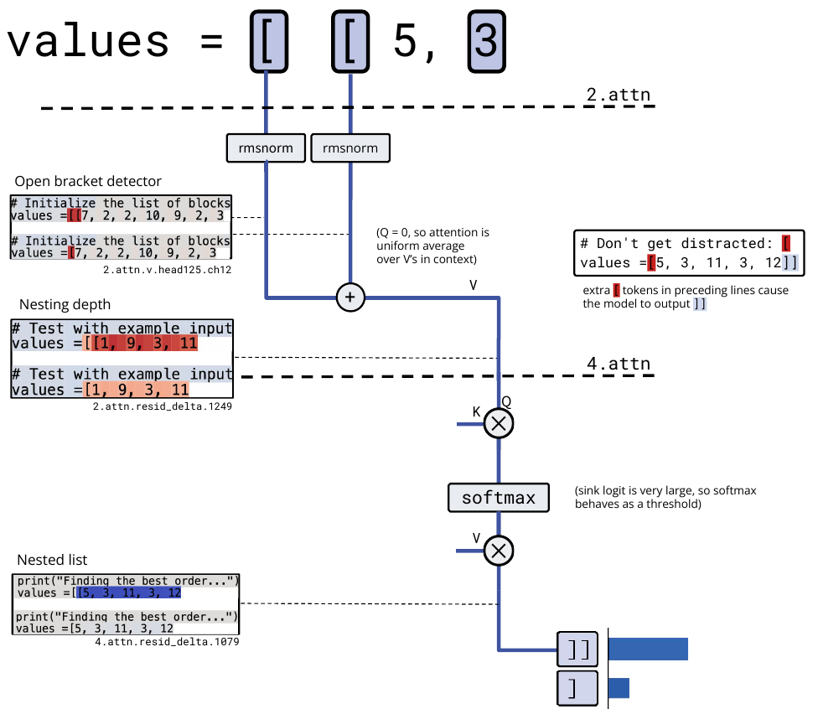
Circuit and Task Example
bracket_counting
Description: Predict ]] or ] depending on the bracket nesting depth.
Figure adapted from Gao et al., 2025 (Figure 5)
14

Slide 15
Ablation Studies & Additional Results
Weight Sparsity → Activation Sparsity
Circuits Are Necessary (Inverse Pruning)
As weight L₀ decreases, residual stream kurtosis increases.
Ablating ONLY the circuit nodes (keeping everything else) → severe performance drop
Ablating random nodes of the same count → negligible effect
Learned Pruning >> Attribution Pruning
Activation Sparsity: Diminishing Returns
Gradient-based learned masks find dramatically smaller circuits at every loss level compared to attribution-based node selection.
Some activation sparsity helps on top of weight sparsity, but too much hurts the capability-interpretability frontier. Weight sparsity is the primary driver.
15

Slide 16
Limitations
Compute Inefficiency (100–1000×)
Sparse models are fundamentally slower to train and deploy than dense models of equal capability.
Only Simple Tasks & Small Models
20 hand-crafted binary Python tasks on models with tens of millions of nonzero params.
Mean Ablation ≠ Full Faithfulness
Mean ablation is weaker than causal scrubbing (Chan et al., 2022). Does not guarantee nodes claimed as irrelevant truly are on ALL inputs.
No Natural Language Models
All experiments use Python code. The simplicity of code syntax may not generalize to the complexities of natural language.
16

Slide 17
Key Takeaways
Weight sparsity (~99.9% zeros) yields circuits that are ~16× smaller than equivalent dense models, which are small enough for humans to fully understand.
1
Scaling model width improves both capability and interpretability simultaneously; L₀ trades off between them.
2
Qualitative investigations reveal intuitive algorithms: quote detectors, bracket counters, variable type trackers.
3
Bridges offer a preliminary path to connecting sparse interpretable circuits with existing dense models.
4
17

Slide 18
References
[1] Gao, L., Rajaram, A., Coxon, J., Govande, S. V., Baker, B., and Mossing, D. Weight-sparse transformers have interpretable circuits. Technical report, OpenAI, 2024. URL https://cdn.openai.com/pdf/41df8f28-d4ef-43e9-aed2-823f9393e470/circuit-sparsity-paper.pdf.
[2] Ameisen, E., Lindsey, J., Pearce, A., Gurnee, W., Turner, N. L., Chen, B., Citro, C., Abrahams, D., Carter, S., Hosmer, B., Marcus, J., Sklar, M., Templeton, A., Bricken, T., McDougall, C., Cunningham, H., Henighan, T., Jermyn, A., Jones, A., Persic, A., Qi, Z., Thompson, T. B., Zimmerman, S., Rivoire, K., Conerly, T., Olah, C., and Batson, J. Circuit tracing: Revealing computational graphs in language models. https://transformer-circuits.pub/2025/attribution-graphs/methods.html, 2025. Accessed July 2025.
[3] Elhage, N., Hume, T., Olsson, C., Schiefer, N., Henighan, T., Kravec, S., Hatfield-Dodds, Z., Lasenby, R., Drain, D., Chen, C., et al. Toy models of superposition. arXiv preprint arXiv:2209.10652, 2022b.
[4] Marks, S., Rager, C., Michaud, E. J., Belinkov, Y., Bau, D., and Mueller, A. Sparse feature circuits: Discovering and editing interpretable causal graphs in language models, 2025. URL https://arxiv.org/abs/2403.19647.
[5] Conmy, A., Mavor-Parker, A. N., Lynch, A., Heimersheim, S., and Garriga-Alonso, A. Towards automated circuit discovery for mechanistic interpretability, 2023. URL https://arxiv.org/abs/2304.14997.
[6] Cao, S., Sanh, V., and Rush, A. M. Low-complexity probing via finding subnetworks, 2021. URL https://arxiv.org/abs/2104.03514.
[7] Chan, L., Garriga-Alonso, A., Goldwosky-Dill, N., Greenblatt, R., Nitishinskaya, J., Radhakrishnan, A., Shlegeris, B., and Thomas, N. Causal scrubbing, a method for rigorously testing interpretability hypotheses. AI Alignment Forum, 2022.
https://www.alignmentforum.org/posts/JvZhhzycHu2Yd57RN/causal-scrubbing-amethod-for-rigorously-testing.
[8] Bricken, T., Templeton, A., Batson, J., Chen, B., Jermyn, A., Conerly, T., Turner, N., Anil, C., Denison, C., Askell, A., Lasenby, R., Wu, Y., Kravec, S., Schiefer, N., Maxwell, T., Joseph, N., Hatfield-Dodds, Z., Tamkin, A., Nguyen, K., McLean, B., Burke, J. E., Hume, T., Carter, S., Henighan, T., and Olah, C. Towards monosemanticity: Decomposing language models with dictionary learning. Transformer Circuits Thread, 2023. https://transformercircuits.pub/2023/monosemantic-features/index.html.
[9] Radford, A., Wu, J., Child, R., Luan, D., Amodei, D., Sutskever, I., et al. Language models are unsupervised multitask learners. OpenAI blog, 1(8):9, 2019.
[10] Wang, K., Variengien, A., Conmy, A., Shlegeris, B., and Steinhardt, J. Interpretability in the wild: a circuit for indirect object identification in gpt-2 small, 2022. URL https://arxiv.org/abs/2211.00593.
[11] Friedrich Miescher Institute, "Building artificial neural networks inspired by the brain," FMI News, Nov. 2, 2020. [Online]. Available: https://www.fmi.ch/news-events/articles/news.html?news=477
18

