Slide 1
Gated Attention for Large Language Models: Non-linearity, Sparsity, and Attention-Sink-Free
Authors: Zihan Qiu, Zekun Wang, Bo Zheng, Zeyu Huang, Kaiyue Wen, Songlin Yang, Rui Men, Le Yu, Fei Huang, Suozhi Huang, Dayiheng Liu, Jingren Zhou, Junyang Lin
Publication venue, Year: NeurIPS, 2025
By: Pradhyumna Kothapalli, Anant Teotia

Slide 2
Why attention matters in LLMs
Attention is the core of modern LLMs
Handles long-range dependencies
Attention determines how tokens interact
Improving attention improves the entire model
Limitations:
Focusing too much or too little on certain tokens
May include noisy or irrelevant information
Attention sink: Tokens earlier receive disproportionately high attention
Goal: make attention more selective and stable.

Slide 3
Why gating matters in LLMs
Many models already use gating mechanisms to control information flow
LSTMs : What information is kept over time
Transformers: gating filters and scales features inside FFNs
MoE: Which expert to use
Since not all information is equally useful, this makes gating a natural way to improve attention.
Gating allows the model to:
Keep most useful features
Suppress the noisy or irrelevant information
Attention selects where to look, while gating decides what to keep

Slide 4
What is still unknown about gating in softmax attention
Gating is widely used to control information flow. However, its role inside softmax attention is not well understood.
Key questions:
Where should gating be applied within attention?
What form of gating is the most effective?
How does gating affect attention behavior and model performance?
Challenge:
Prior work combines gating with other design changes
Makes it difficult to isolate the effect of gating
Core gap: No systematic study of gating within softmax attention.

Slide 5
Problem statement
Objective: Systematically study gating in softmax attention
Approach:
Evaluate gating at different positions
Compare gating designs(type, granularity, sharing)
Analyze the effects on:
Model performance
Training stability
Attention behavior
Key Idea: Isolate the effect of gating from other design changes

Slide 6

Multi-Head Attention
What this does:
Computes the similarity between tokens and assigns attention weights
Outputs a weighted combination of values
Multi-head attention:
Each head focuses on a different aspect of the input (syntax, semantics, long-range dependencies)
Outputs from all heads are combined into a single representation
Can we selectively filter this output?

Slide 7

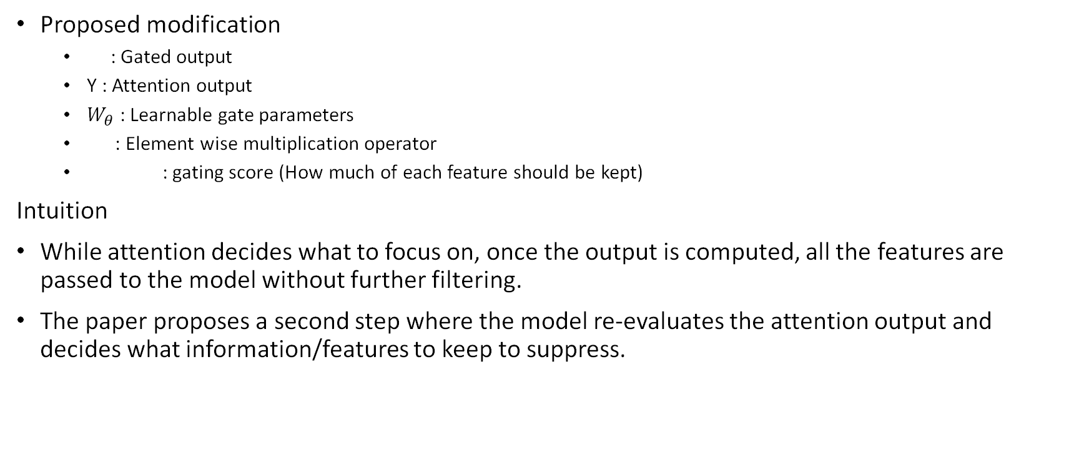
Introducing Gating in Attention
Proposed modification
: Gated output
Y : Attention output
$W_{θ}$ : Learnable gate parameters
: Element wise multiplication operator
: gating score (How much of each feature should be kept)
Intuition
While attention decides what to focus on, once the output is computed, all the features are passed to the model without further filtering.
The paper proposes a second step where the model re-evaluates the attention output and decides what information/features to keep to suppress.

Slide 8
Gating Design Choices in Attention
The paper explores five key aspects of applying gating mechanisms in attention:
Position: Where is gating applied?
Granularity: How fine-grained the gate is
Head Specific or Shared : How are gating scores shared?
Multiplicative or additive: How are gating scores applied to Y?
Activation function: SiLU(unbounded output range so used with additive gating) or sigmoid(Bounded: [0,1])?
Gating can influence where the information is filtered
Different designs can affect the Performance, Stability and Expressiveness differently

Slide 9
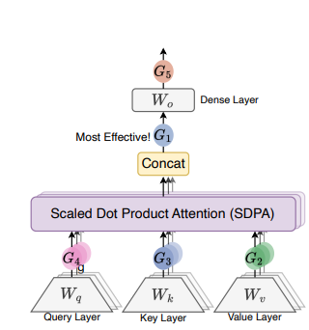
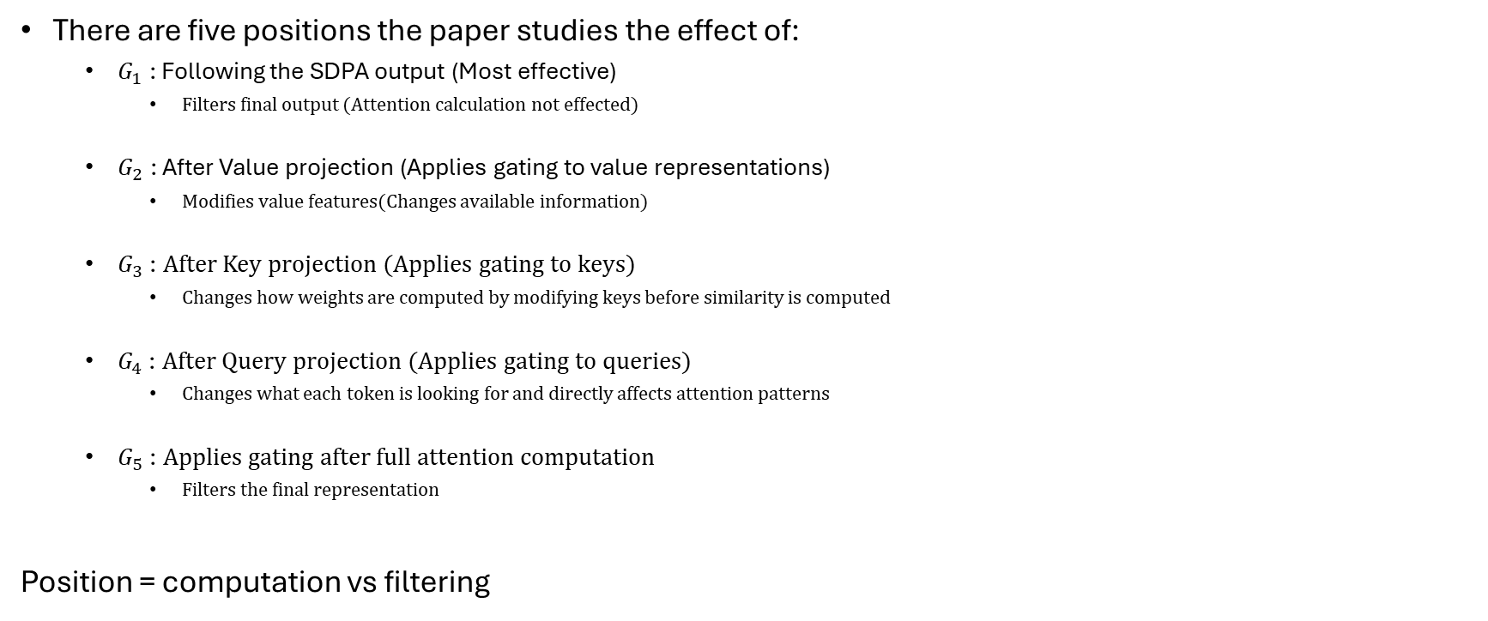
Where should gating be applied?
There are five positions the paper studies the effect of:
$G_{1}$ : Following the SDPA output (Most effective)
Filters final output (Attention calculation not effected)
$G_{2}$ : After Value projection (Applies gating to value representations)
Modifies value features(Changes available information)
$G_{3} \text{:}$ After Key projection (Applies gating to keys)
Changes how weights are computed by modifying keys before similarity is computed
$G_{4} \text{:}$ After Query projection (Applies gating to queries)
Changes what each token is looking for and directly affects attention patterns
$G_{5} \text{:}$ Applies gating after full attention computation
Filters the final representation
Position = computation vs filtering

Slide 10
Granularity and Head Structure
Granularity
Headwise gating: One gate per head (Coarse)
Treats each head as a single unit, Simpler but assumes that all features in a head are equally important
Elementwise gating: One gate per feature (Fine-grained)
This allows for selective filtering within a head and can suppress specific features instead of entire heads
Head structure
Head specific gating: separate gate per head
Different heads learn different patterns, but requires independent control per head
Preserves diversity
Head-shared gating: same gate across heads
Forces all heads to behave similarly and reduces model flexibility, but it is simpler
More fine-grained and independent gating = better control

Slide 11
How should gating modify the attention output?
Multiplicative
Before: [0.8, 0.5, 0.2]
Gate: [1.0, 0.1, 0.0]
After: [0.8, 0.05, 0.0]
Multiplicative gating :
scales features and suppress irrelevant information (≈ 0)
Additive Gating:
Adjusts values (cannot fully remove information)
Activation functions
Sigmoid: Used alongside multiplicative
Outputs between 0 and 1 (controlled filtering)
SiLU: used with additive gating
More flexible but less stable
In this paper: head-specific, multiplicative gating was used using sigmoid
Additive:
Before: [0.8, 0.5, 0.2]
Add: [1.0, 0.1, 0.0]
After: [1.8, 0.6, 0.2]

Slide 12
Experimental setup
Experiments performed on both MoE models(15B total parameters with 2.54 B activated) and dense models(1.7B total parameters)
Training was performed by a corpus of 3.5T tokens in sequence lengths of 4096
Evaluations metrics:
Perplexity(PPL)
Benchmarks:
MMLU: General knowledge
GSM8k: Math reasoning
HumanEval: Coding
Hellaswag: English

Slide 13
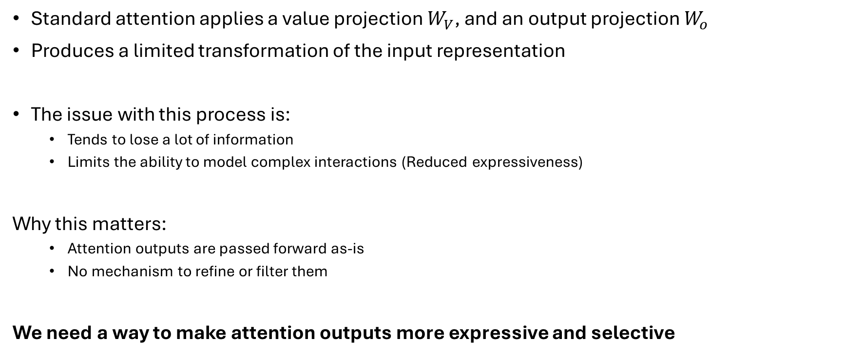
Why should we add gating to Attention?
Standard attention applies a value projection $W_{V}$, and an output projection $W_{o}$
Produces a limited transformation of the input representation
The issue with this process is:
Tends to lose a lot of information
Limits the ability to model complex interactions (Reduced expressiveness)
Why this matters:
Attention outputs are passed forward as-is
No mechanism to refine or filter them
We need a way to make attention outputs more expressive and selective

Slide 14
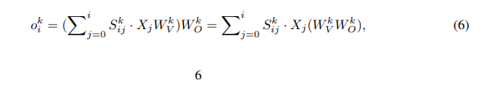

Core contribution: Breaking the low-rank bottleneck
Standard attention has a hidden low-rank bottleneck.
$W_{V}$ and $W_{O}$ compose into one linear map ($W_{V}$ $W_{O}$ ).
This limits expressiveness (especially with GQA / fewer KV heads).
G1 gating inserts non-linearity between $W_{V}$ and $W_{O}$ → more expressive output.
Eq. 6 (paper):

Slide 15
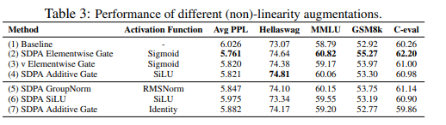
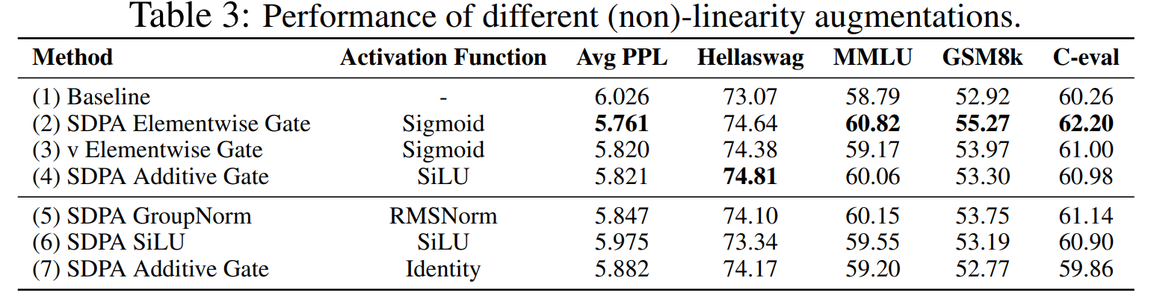

Evidence non-linearity matters
Best perplexity comes from adding non-linearity at G1 (after SDPA).
G5 (after $W_{O}$) gives no gain → too late to break the bottleneck.
Table 3 (paper)

Slide 16
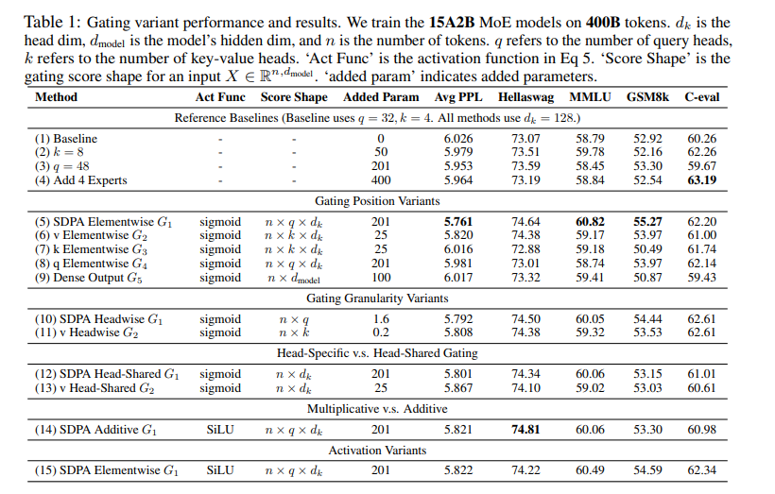
Experiments & Results: MoE scale performance
Takeaway: G1 + elementwise sigmoid gate achieves best PPL and downstream benchmarks.
Head-shared gating underperforms elementwise → fine-grained sparsity matters.

Slide 17
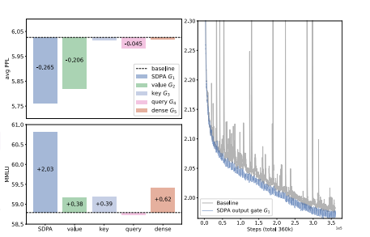
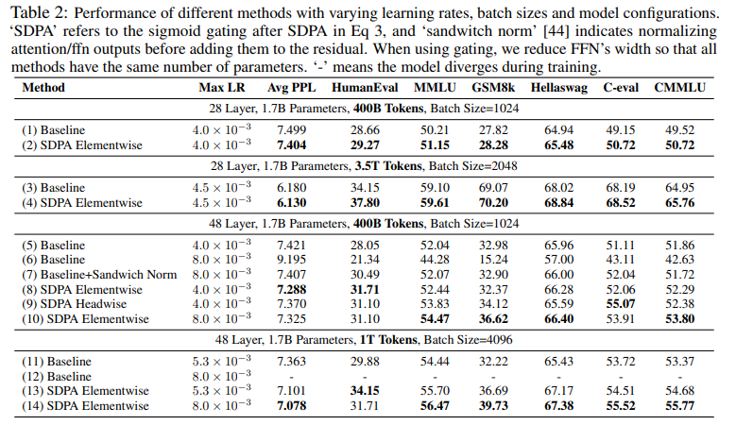
Experiments & Results: Training stability
Baseline diverges at LR = 8×10⁻³; SDPA-Gate remains stable.
Loss curves show fewer spikes with gating (Figure 1).
Complementary to sandwich normalization (Table 2 ablations).

Slide 18
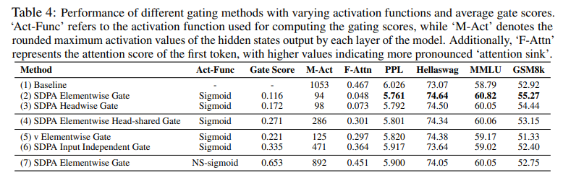
Sparsity removes the attention sink
Gates are very sparse (mean gate score ≈ 0.116).
Massive activations drop (1053 → 94).
First-token attention drops (0.467 → 0.048).
Non-sparse NS-sigmoid loses the benefit → sparsity is key.

Slide 19
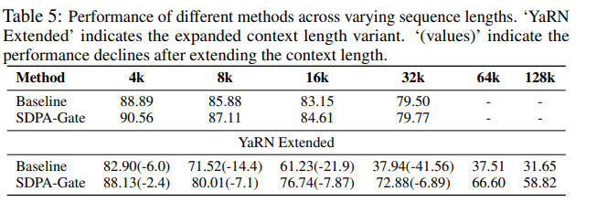
Long-context extension improves with sink-free attention
At 32k: SDPA-Gate loses −2.4 vs baseline −6.0.
At 64k–128k: gated model dominates; baseline often fails.
Takeaway: sink-free attention improves long-context generalization.

Slide 20
Critical Discussion: Strengths & Limitations
Strengths | Limitations
✓ Systematic at scale 30+ variants tested at 15B MoE, 3.5T tokens, not a toy study | ✗ Scale ceiling Only up to 1.7B dense / 15B MoE, unclear if gains hold at 70B+
✓ Clean experimental design Parameter-matched baselines isolate gating from confounds | ✗ No theory No formal explanation of why attention sinks hurt long-context
✓ Actionable Single gate, <2% overhead, clear implementation recipe | ✗ Activation functions Only sigmoid & SiLU tested; tanh, GELU, learnable not explored
✓ Strong analysis Non-linearity + sparsity mechanisms identified via controlled ablations | ✗ Overhead analysis <2% latency claimed; memory and throughput at large batches unstudied
✓ Real-world impact Adopted in Qwen3-Next production models | ✗ Context extension YaRN only, NTK-aware, LongRoPE not tested

Slide 21
Conclusion
Key Takeaways
One sigmoid gate after SDPA (G1) Simple, <2% overhead, consistent gains across scales and tasks
Two key mechanisms Non-linearity breaks low-rank bottleneck; sparsity filters irrelevant context per query
Attention sink eliminated 4.8% vs 46.7% on first token, enables robust long-context generalization
Training stability bonus 11× reduction in massive activations; higher LR tolerance
Production validated Deployed in Alibaba Qwen3-Next LLMs
Open directions: scaling beyond 70B · multi-position gating · gating + KV-cache compression · learnable activation functions

Slide 22
References
Gated Attention for Large Language Models: Non-linearity, Sparsity, and Attention-Sink-Free, Qiu et al., NeurIPS, 2025
[1] Hochreiter & Schmidhuber. Long short-term memory. Neural Computation, 1997.
[2] Srivastava et al. Highway Networks. arXiv:1505.00387, 2015.
[3] Gu & Dao. Mamba: Linear-time sequence modeling. arXiv:2312.00752, 2023.
[5] Jumper et al. AlphaFold2. Nature, 596, 2021.
[7] Sun et al. Massive Activations in LLMs. arXiv:2402.17762, 2024.
[8] Xiao et al. StreamingLLM. arXiv:2309.17453, 2023.
[20] Anonymous. Switch Heads. NeurIPS 2025.
[22] Vaswani et al. Attention Is All You Need. NeurIPS, 2017.
[23] Gu et al. When Attention Sink Emerges. arXiv:2410.10781, 2024.
[25] Shazeer. GLU Variants Improve Transformer. arXiv:2002.05202, 2020.
[44] Ding et al. CogView: Sandwich Normalization. NeurIPS, 2021.
[54] Su et al. RoFormer: RoPE. Neurocomputing, 2024.
[55] Peng et al. YaRN: Context Extension. arXiv:2309.00071, 2023.
[69] Bondarenko et al. Quantizable Transformers. arXiv:2306.12929, 2023.

Slide 23
Critical discussion: Related work
Gating is common (LSTM/GRU; FFN SwiGLU), but not isolated inside softmax attention.
Prior “gated attention” exists, but not systematically across positions.
Attention-sink work studies sink behavior + mitigations.
This paper: 5 positions + mechanisms (non-linearity, sparsity, sink removal).

