Slide 1
OS Fingerprinting through Memory De-duplication Technique in Virtual Machines
Rodney Owens and Weichao Wang Department of SIS
UNC Charlotte

Slide 2
Organization
Motivation
Our Approach from 500 Miles Away
Details of the Approach

Slide 3
Motivation (IE: who should care)
Organizations using “Infrastructure as a Service.”
Attacker can “guess and check” Operating System.
Anyone directly using a virtual machine in which an untrusted third party may be allowed to manipulate another virtual machine on the same host.

Slide 4
Approach from 500 miles away
Overview of the Attack
Run virtual machine on same host as target.
Guess at an OS.
Allow memory de-duplication to compare and merge the memory files.
Fingerprint the OS based on the access delay.
Defense
Guest can load other OS signatures.
Disable de-duplication

Slide 5
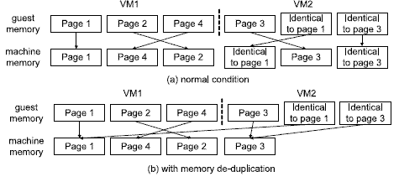
What is Memory De-duplication?
Details Loc.
Memory de-duplication is when memory pages that have the same contents are only stored in memory once
Of particular advantage for a hypervisor hosting several virtual machines that may have the same contents, more memory can be allocated than is available.

Slide 6
So memory is shared between programs/VMs?
 | Details Loc.
Only data that “coincidentally” shares an exactly matching memory page (typically 4KB) is shared.
Programs/VMs are not informed when they have a shared memory page.

Slide 7
How does it work?
 |  | Details Loc.
Hypervisor/kernel scans for memory pages that are identical during free clock cycles.
If found, make pointers for each virtual memory page to point to a single physical memory page
If page is written to in the future, make a copy of the memory page for that individual to write to. “Copy-on-write”

Slide 8
Won’t Address Space Load Randomization prevent pages from de-duplicating?
 |  |  | Details Loc.
No, with ASLR, memory pages are loaded in random locations.
The contents are not changed.
The location of the memory pages does not matter, only that they have exactly matching contents.

Slide 9
But the delay is too small to measure!
 |  |  |  | Details Loc.
Not if you guess several memory pages at once.
Guess at thousands of memory pages at the same time, the delay will accumulate into the milliseconds, which is measureable.

Slide 10
How do you accurately measure ms?
 |  |  |  |  | Details Loc.
In a good hypervisor, the APIC timer is virtualized to measure time in the milliseconds accurately.
Write your program in assembly and use the timeGetTime directive provided by masm32.

Slide 11
How to build an OS signature.
 |  |  |  |  |  | Details Loc.
Load VM with desired OS
Take memory dump
Repeat at least 3 times, more is better
Protects from unknown variables, disk caching
Split each into 4KB memory pages
Repeat with next OS
Memory pages present in all samples of one OS, but none of the others, are combined into an “OS signature.”
These signatures are what is written to memory; its re-write time is measured after de-duplication for a longer delay than other signatures.

Slide 12
What OS’s did we build signatures for?
 |  |  |  |  |  |  | Details Loc.
Windows | 2000 | XP SP1 | XP SP2 | XP SP3 | 2003 | Vista 32 bit | Vista 64 bit | 7 32 | 7 64 | 2008 32 | 2008 64
Signature Size (pages) | 4239 | 4090 | 3325 | 3582 | 3695 | 5503 | 20053 | 9753 | 23977 | 5638 | 16240
Linux | Signature Size (pages)
Fedora
7 | 4572
8 | 5274
Ubuntu
10 | 8179
11 | 5547

Slide 13
What OS is the attacker left to run?
 |  |  |  |  |  |  |  | Details Loc.
Windows 95!
Very low memory demands
Uses PE executable binaries
Easy to append signatures to.
timeGetTime has a 1ms resolution.

Slide 14
Attack Experiment Results
 |  |  |  |  |  |  |  |  | Details Loc.
Done with CPU and Memory demands at different levels:
Low – left idle
Medium:
CPU - encryption algorithms are left running
Memory – QA+Win32 memory test
High –
Prime95 stress test

Slide 15
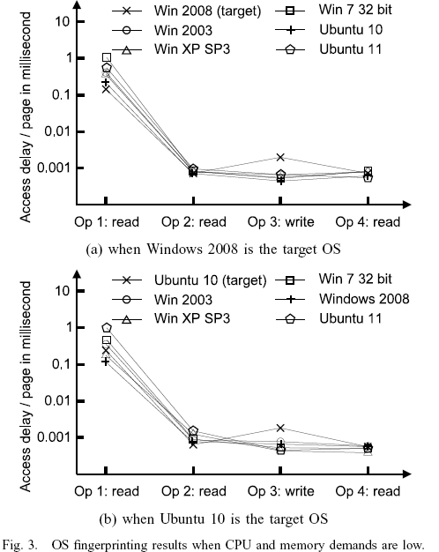
Low CPU/Memory Demand
 |  |  |  |  |  |  |  |  |  | Details Loc.

Slide 16
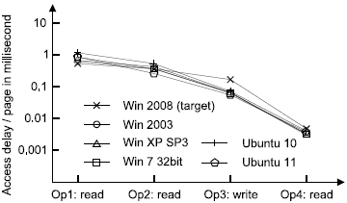
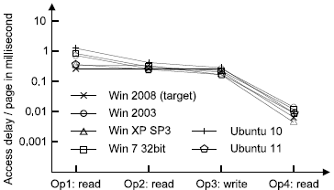
Medium CPU Demand
Medium CPU & Memory Demand
Medium Memory Demand
Extreme CPU & Memory Demand

Slide 17
Possible Defense
Load other OS signatures in your VM.
Security through obfuscation wastes memory and is not 100%.
Change Hypervisor to not de-duplicate OS signature files.
Requires a change in the Hypervisor.

Slide 18
Related Work
P. Auffret, “Sinfp, unification of active and passive operating system fingerprinting,” Jour. Comp. Virology, vol. 6, no. 3, pp. 197–205, 2010.
Fyodor, “Remote os detection via tcp/ip stack fingerprinting,” http://www.insecure.org/nmap/nmap-fingerprinting-article.html, Tech. Rep.,1999.
L. G. Greenwald and T. J. Thomas, “Toward undetected operating system fingerprinting,” in Proceedings of the first USENIX workshopon Offensive Technologies, 2007, pp. 6:1–6:10.
D. Richardson, S. Gribble, and T. Kohno, “The limits of automatic os fingerprint generation,” in ACM workshop on Artificial intelligence and security (AISec), 2010, pp. 24–34.
G. Taleck, “Ambiguity resolution via passive os fingerprinting,” in International Symposium on Recent Advances in Intrusion Detection (RAID), 2003, pp. 192–206.
A. Verma, P. Ahuja, and A. Neogi, “Power-aware dynamic placement of hpc applications,” in Proceedings of the annual international conference on Supercomputing, 2008, pp. 175–184.
A. Aviram, S. Hu, B. Ford, and R. Gummadi, “Determinating timing channels in compute clouds,” in Proceedings of ACM workshop on Cloud computing security workshop, 2010, pp. 103–108.
T. Ristenpart, E. Tromer, H. Shacham, and S. Savage, “Hey, you, get off of my cloud: exploring information leakage in third-party compute clouds,” in Proc. of ACM Conference on Computer and Communications Security (CCS), 2009.
K. Okamura and Y. Oyama, “Load-based covert channels between xen virtual machines,” in Proceedings of the ACM Symposium on Applied Computing, 2010, pp. 173–180.
D. Gupta, S. Lee, M. Vrable, S. Savage, A. Snoeren, G. Varghese, G. Voelker, and A. Vahdat, “Difference engine: harnessing memory redundancy in virtual machines,” Commun. ACM, vol. 53, no. 10, pp. 85–93, 2010.
X. Zhang, Z. Huo, J. Ma, and D. Meng, “Exploiting data deduplication to accelerate live virtual machine migration,” in IEEE International Conference on Cluster Computing, 2010, pp. 88–96.
A. Arcangeli, I. Eidus, and C. Wright, “Increasing memory density by using ksm,” in Linux Symposium, 2009, pp. 19–28.
K. Suzaki, K. Iijima, T. Yagi, and C. Artho, “Memory deduplication as a threat to the guest os,” in Proceedings of the Fourth European Workshop on System Security, 2011, pp. 1:1–1:6.
H. Raj, R. Nathuji, A. Singh, and P. England, “Resource management for isolation enhanced cloud services,” in ACM Cloud Computing Security Workshop, 2009, pp. 77–84.
Y. Zhang, A. Juels, A. Oprea, and M. K. Reiter, “Homealone: Coresidency detection in the cloud via side-channel analysis,” in Proceedings of the IEEE Symposium on Security and Privacy (Oakland), 2011, pp. 313–328.

Slide 19
Questions?

