Slide 1
Self-Healing Control Flow Protection in Sensor Applications

Slide 2
Motivation
Sensors usually have very tight resources and use very simple OS and application software
Data/System memory are not separated
System/User tasks are not isolated
No recovery scheme: crash and reboot
Cannot embed complicated protection methods into the system
Still need to protect the memory/OS image

Slide 3
Approach from 500 miles away
Divide the program into blocks and generate control flow graph
Assign a different label to each program block. When transitions among blocks happen, examine the labels to make sure such transitions are legal
If not, remove the task and take back the resources to clean it up

Slide 4
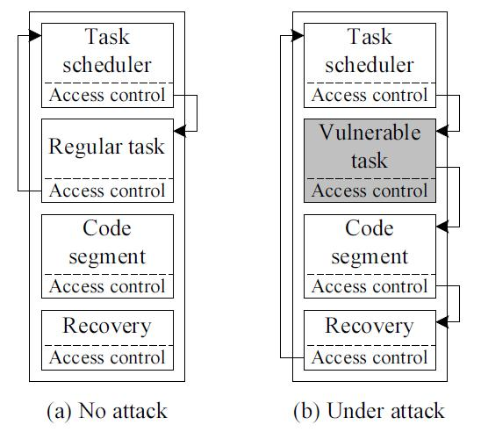
Overview of the program structure

Slide 5
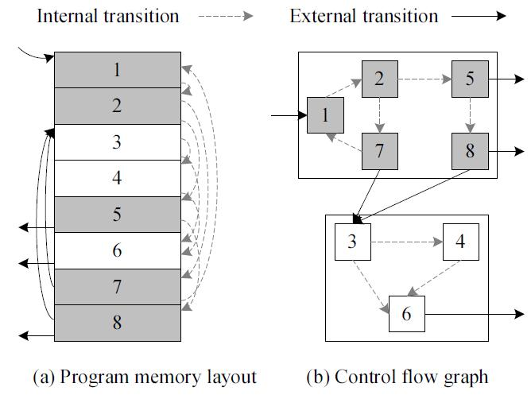
Details of the design
Divide programs into blocks
Every function is a Control Node
Can detect only illegal transitions among functions

Slide 6
How to detect illegal transitions
Each CN is assigned with a label value
When we enter the function, Rx = label
When we leave the function, we check again whether or not the label ?= Rx
If attackers have control the program and jump into another function, the label will have a different value

Slide 7
New problem: how to protect the label value
At the compilation time, inject randomness so that every sensor has different access control code segments
The labels are in write-protected program memory
What is the label anyway:
A 8-bit or 16-bit random number

Slide 8
How to recovery
Sensor OS can handle only one task at a time
Therefore, just kill that task and get back all the resources will be fine
Not as simple as this when we consider the memory management scheme

Slide 9
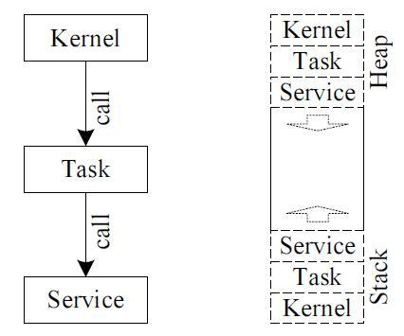
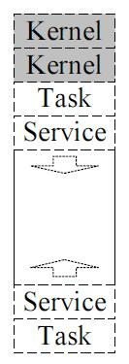

Slide 10
Now we have separated kernel memory and task memory
During recovery
Release the task related memory
Release the I/O resources
Remove the current task from the task queue
Fetch the next task

Slide 11
Discussion
Where do we put the label
Rx can be in registers or memory space
But where do we put the label of each function?

