Slide 1
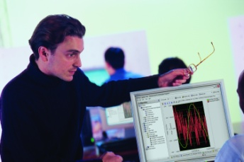
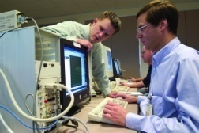
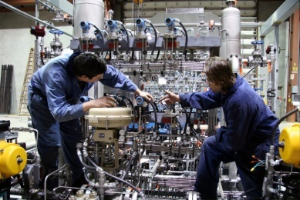
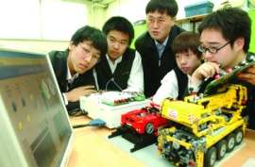
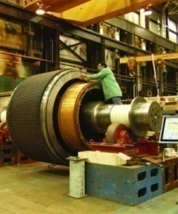
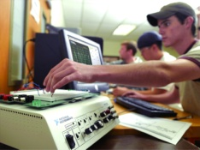
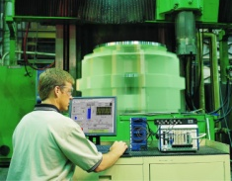
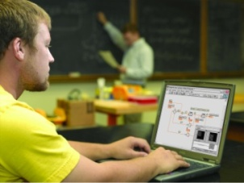
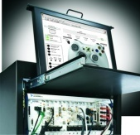
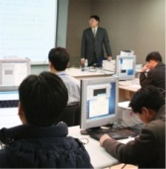
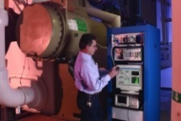

Slide 2
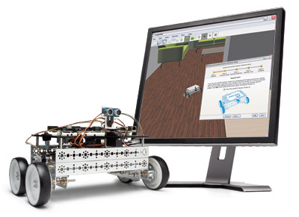
What You’ll Do Today
Learn LabVIEW fundamentals
Interface to an ultrasonic position sensor
Aim the sensor with a servo motor
Program an FPGA to blink an LED

Slide 3
National Instruments at a Glance
Leaders in Computer-Based Measurement and Automation
Long-term Track Record of Growth and Profitability
Record Revenue: $821M in 2008
Fortune “100 Best Companies to Work For” ten years in a row
More than 4,900 employees; operations in 40+ countries
Founded in 1976 with focus on Instrument Control
LabVIEW 1.0 released in 1986
NI HQ
Net Revenue in Millions

Slide 4
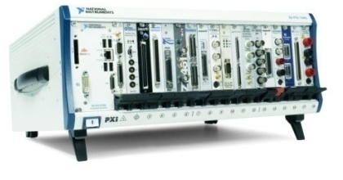
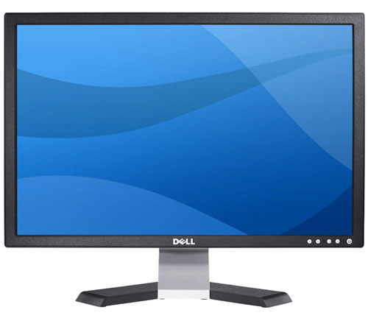
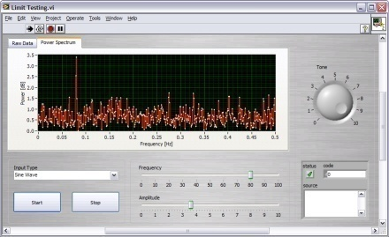
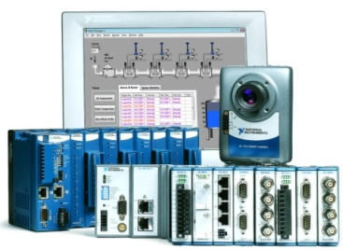
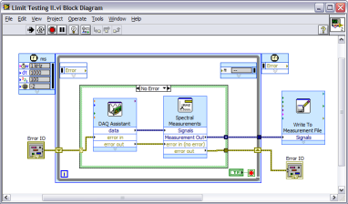
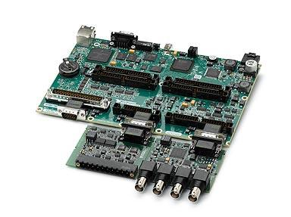
Design, Control, Test with LabVIEW
Measurements
Industrial
Modular I/O
Embedded
Software-defined behavior

Slide 5
What is LabVIEW?

Slide 6
LabVIEW is a Programming Language
Graphical Programming
Data types
Structures (i.e. loops, case, event handling)
Standard functions (i.e. File I/O)
Reuse external code
Compiles to machine code
Automatic multithreading

Slide 7
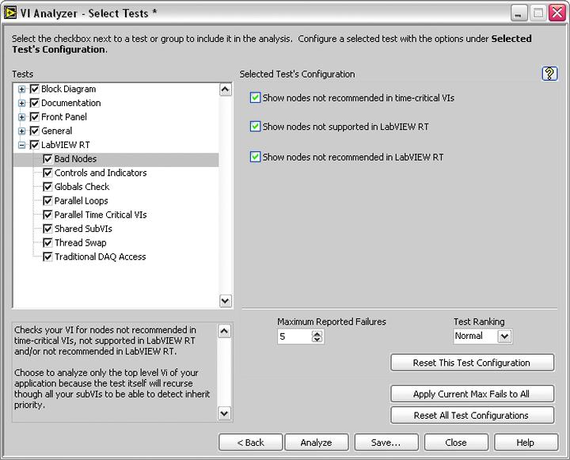
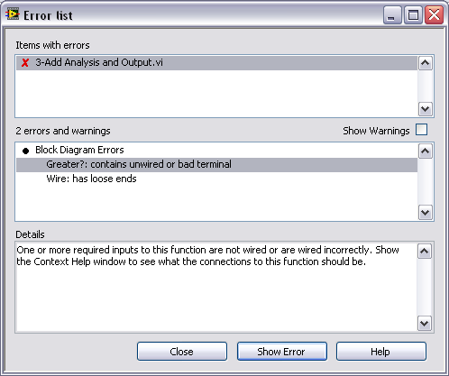
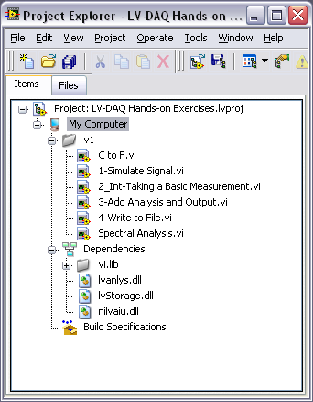
LabVIEW is a Development Environment
Debugging tools
Assistants
Configurable functions
I/O Finder
Easy UI Development
Software Engineering Tools
Performance Tools

Slide 8
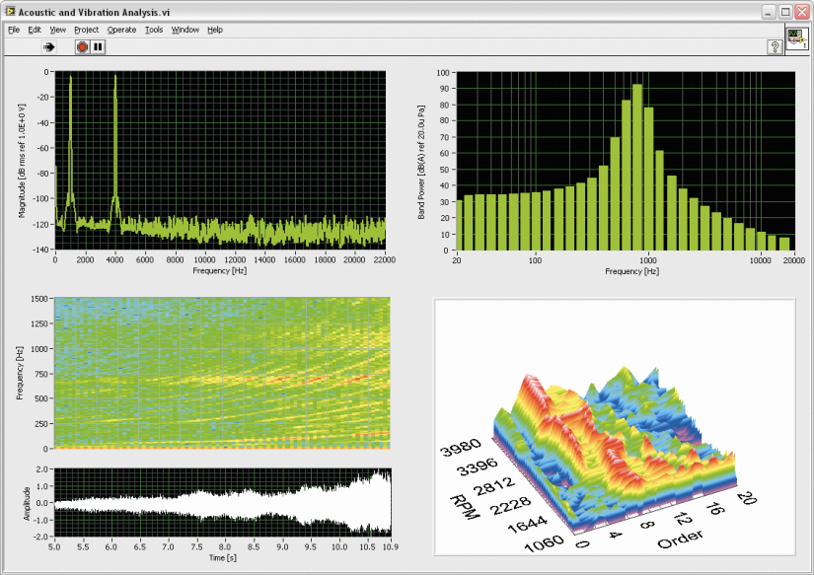
LabVIEW Includes Built-in IP Libraries
In-line and off-line analysis and control
Signal processing
Analysis and filtering
Complex math
PID/Advanced control
Vision
Motion
…

Slide 9
LabVIEW Provides Proven Middleware
Application Software
Graphical or Text programming
Program HMI, real-time processor and FPGA with one tool flow
Signal processing, control, communications libraries in LabVIEW
Complete C and VHDL support
Driver API
Complete Easy to Use I/O API Libraries:
Built-in APIs for analog, digital, motion, etc
APIs for DMA transfer
APIs for Serial, CAN, TCP and file I/O
Validated Low-level Drivers:
Device drivers for all analog and digital I/O
Device drivers for RS232, TCP/IP, UDP, etc
Drivers for System Services such as Interrupt Control , Power Management , External Bus Interface Unit Control , Deferred Callback , DMA Management
“It just works”
Device Drivers
Board Support Package (BSP)
Ready to Run Out of the Box:
VxWorks RTOS with prebuilt BSP
Built-in boot loader, flash and download utilities/drivers
USB, Ethernet and other low-level software stacks
CompactRIO,
or
Single-Board RIO
Freescale MPC5200 Processor
FPGA (Xilinx 3E)
NI custom high performance bus interface ASIC
Connectivity for custom design or C Series I/O

Slide 10
Today’s System: NI Robotics Starter Kit
NI Single-Board RIO-based controller
LabVIEW Robotics, LabVIEW Real-Time and LabVIEW FPGA software modules
Ultrasonic sensor, encoders, motors, battery, and charger included

Slide 11
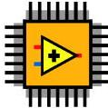
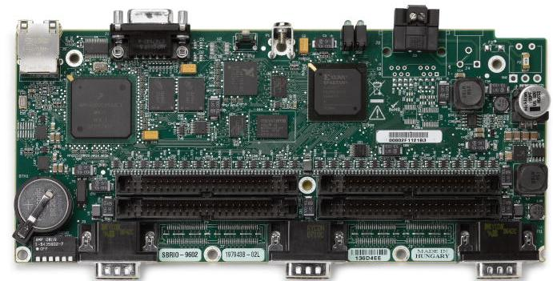
NI Single-Board RIO Platform
Digital I/O
Analog I/O
Real-Time Processor
FPGA
C Series I/O

Slide 12
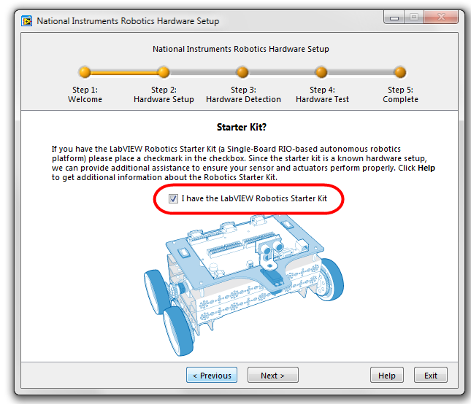
Exercise 1: Test and Configure the Robotics Starter Kit

Slide 13
LabVIEW Fundamentals

Slide 14
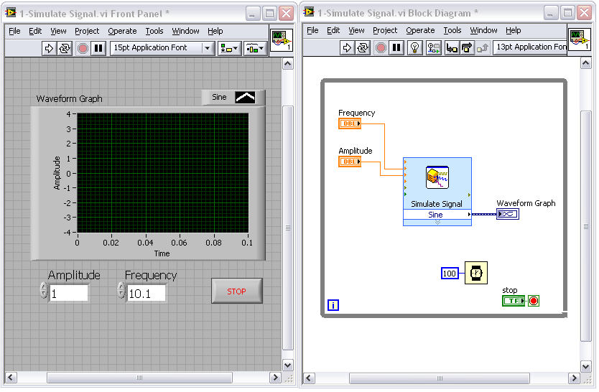
The LabVIEW Environment
“VI” = program or function
“Front Panel” = user interface
“Block Diagram” = code

Slide 15
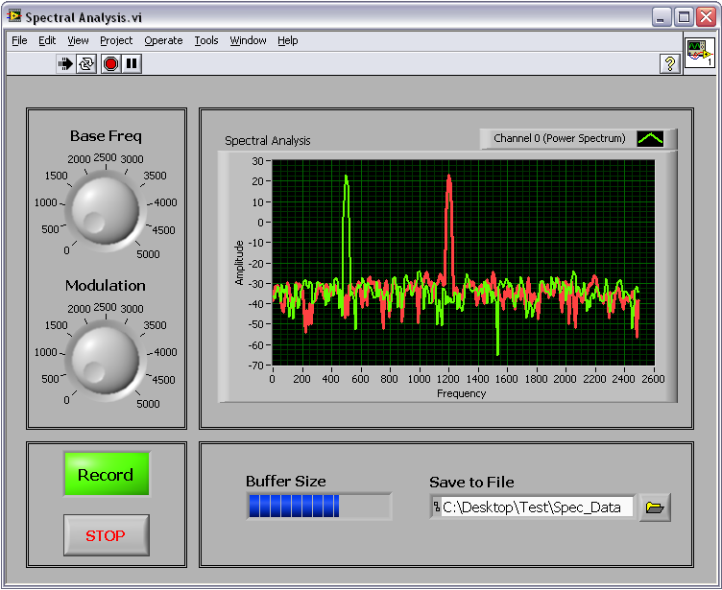
Controls & Indicators
Front Panel
Knobs/Dials
Graphs/Charts
Buttons
Digital Displays
Sliders
Thermometers
Customize and create your own

Slide 16
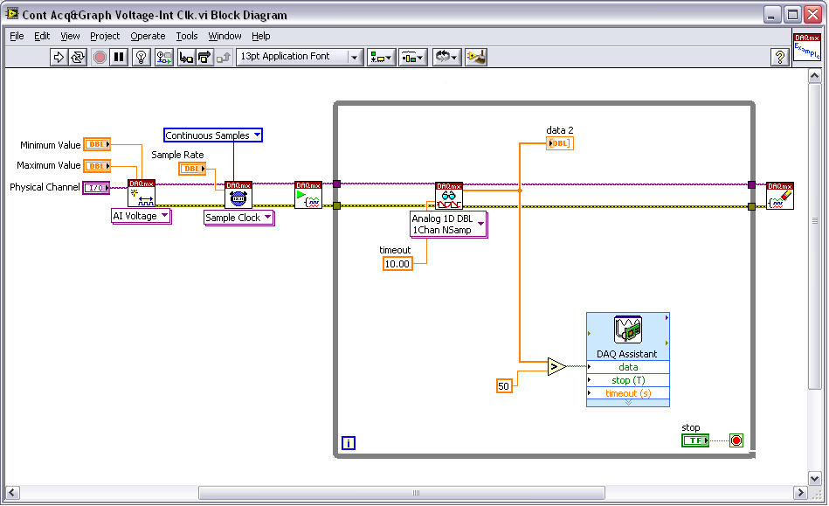
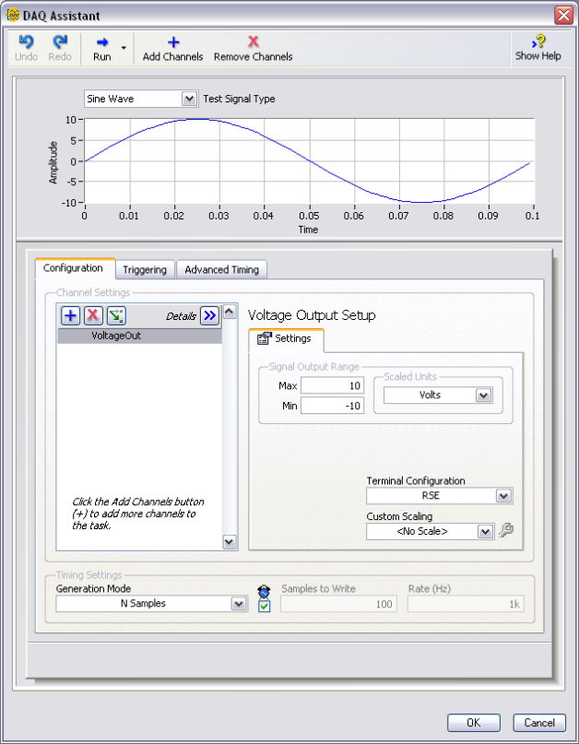
Functions and VIs
Block Diagram
Configuration Based
Express VI
Standard VIs

Slide 17
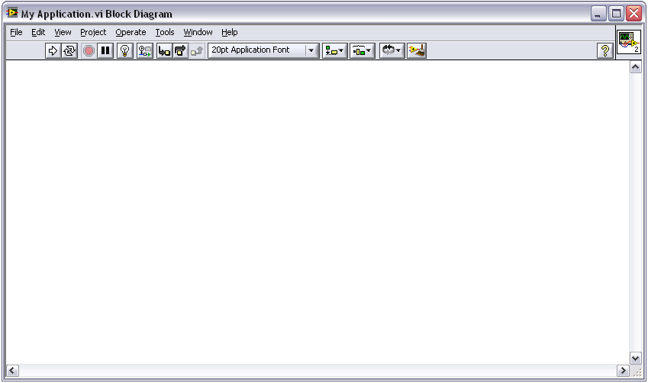
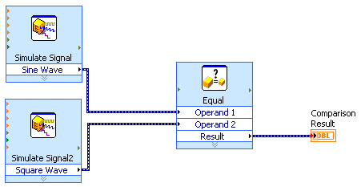
Dataflow Programming
Block Diagram
1
2
3
1
Both Simulate Signal Express VIs execute simultaneously
2
Comparison waits until all inputs are present, then executes
3
Once executed, output from comparison continues through code

Slide 18
Wires and Data Types
Block Diagram
Transfer data between block diagram objects through wires
Wires are different colors, styles, and thicknesses, depending on their data types
A broken wire appears as a dashed black line with a red X in the middle
DBL Numeric Integer Numeric String
Scalar
1D Array
2D Array

Slide 19
Execution Control Structures
Block Diagram
While Loop
For Loop
Run until stop condition met
Run N times
Allow same piece of code to run multiple times
Exit conditions different for each

Slide 20
Timed Loop Structure
Multirate
Dynamic
Priority Configurable
Period = 100 ms, Acquire = 50 ms, Loop idle = 50 ms
LabVIEW executes lower priority tasks during idle time.

Slide 21
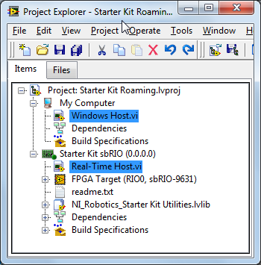
LabVIEW Project
Run VIs on multiple targets
My Computer
Single-Board RIO Real-Time Processor
Single-Board RIO FPGA

Slide 22
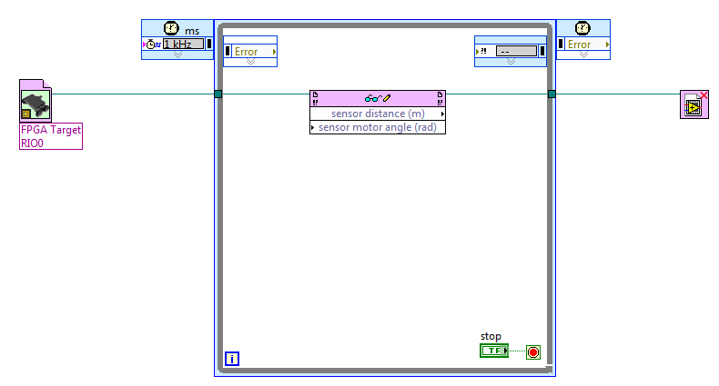
Interfacing with the FPGA
Download and run FPGA VI on the Single-Board RIO
Read and write data to the FPGA VI
Terminate communication with the FPGA VI

Slide 23
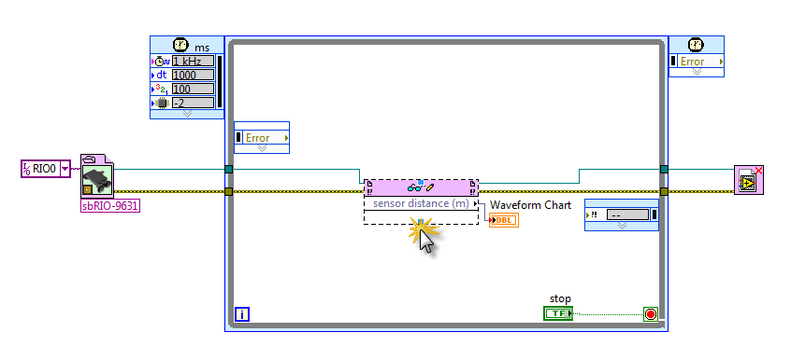
Exercise 2: Introduction to the LabVIEW Development Environment

Slide 24
Built-in Programming Assistance
Highlight Execution
Block Diagram Cleanup
Context Help

Slide 25
Analysis and Signal Processing

Slide 26
LabVIEW Signal Processing, Analysis and Math
Signal Processing & Analysis
Waveform Generation
Waveform Conditioning
Waveform Monitoring
Waveform Measurements
Signal Generation
Signal Operations
Windows
Digital Filters
Spectral Analysis
Transforms
Point-by-Point
Mathematics
Numeric
Elementary and Special Functions
BLAS/LAPAC-based Linear Algebra
Curve Fitting
Interpolation / Extrapolation
Probability and Statistics
Optimization
Ordinary Differential Equations
Geometry
Polynomial
Formula Parsing
1D & 2D Evaluation
Calculus

Slide 27
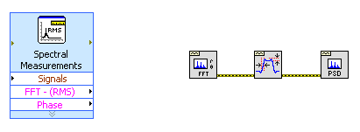
Using Analysis Functions
Programmatic,
Low-Level VIs
Configuration Based
Express VIs
Text-based
MathScript Node

Slide 28
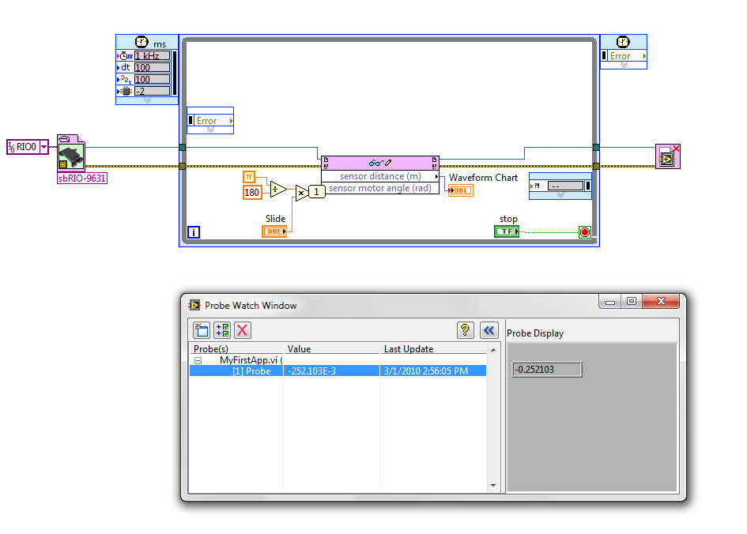
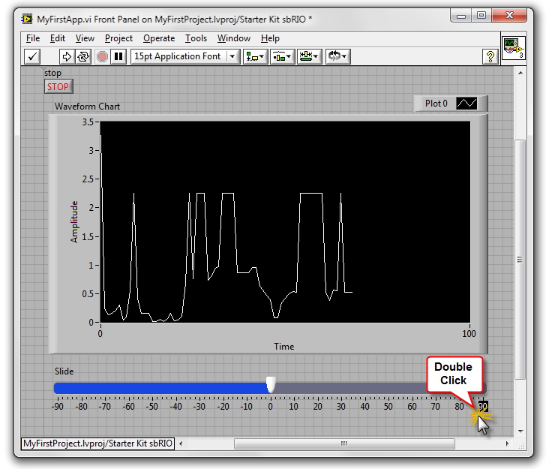
Exercise 3: Math and Debugging in LabVIEW

Slide 29
FPGA Programming

Slide 30
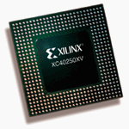
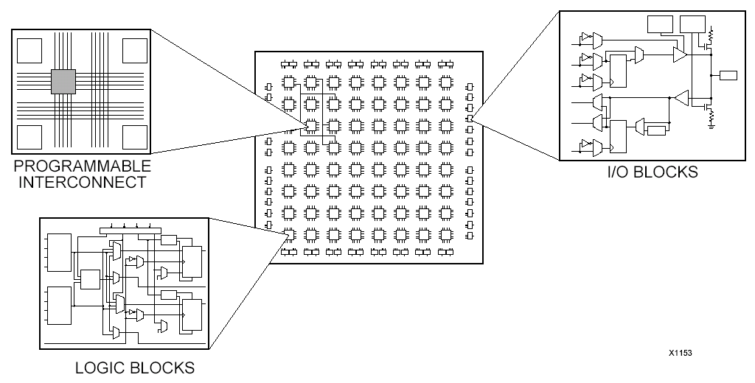
What is an FPGA?
What it is
Field-programmable gate array
A silicon chip with unconnected gates
User can define and re-define functionality
How it works
Define behavior in software
Compile and download to the hardware
Hardware implementation of code

Slide 31
Importance of FPGA in Systems
High Reliability – Designs become a custom circuit
High Determinism – Runs algorithms at deterministic rates down to 25 ns (faster in many cases)
True Parallelism – Enables parallel tasks and pipelining
Reconfigurable – Create new and alter existing task-specific personalities

Slide 32
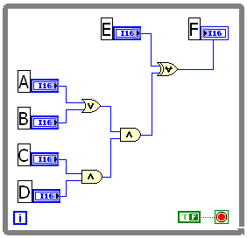
Simplified FPGA Example
Implementing Logic on FPGA: F = {(A+B)CD} ⊕ E
E
F
LabVIEW FPGA Code
AB
CD

Slide 33
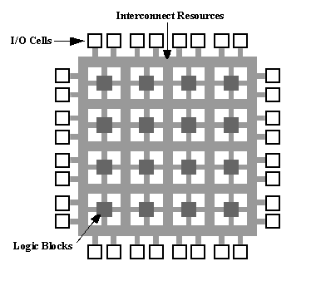
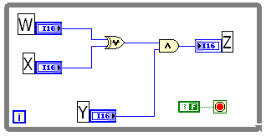
Simplified FPGA Example
E
F
AB
CD
Z
W X
Y

Slide 34
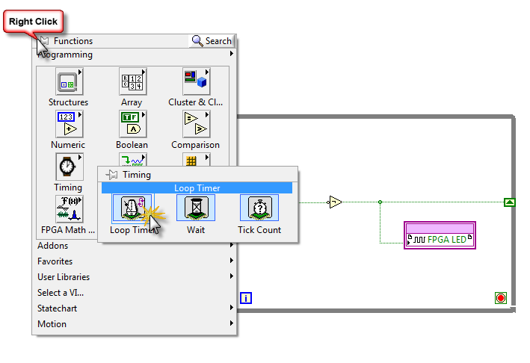
Exercise 4: Your First LabVIEW FPGA Application

Slide 35
Putting It All Together

Slide 36
Overview of Our Simple Mobile Robot
Sense
Think
Analyze Vector Field Histogram
Act
Steer motors away from obstacles
Sweep ultrasonic sensor
Build Vector Field Histogram

Slide 37
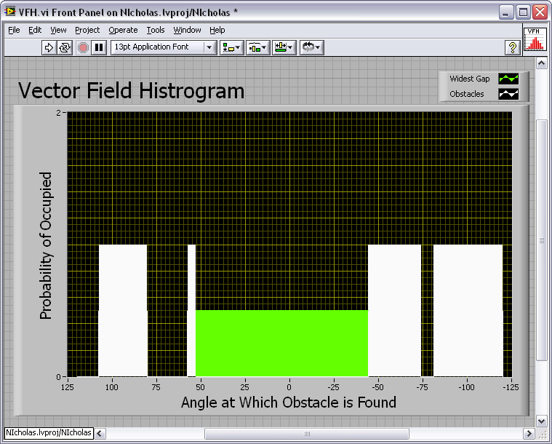
Vector Field Histogram
Builds a map of viewable area of a sensor
Determines the largest area that is not occupied
Checks for a “panic” threshold
robot

Slide 38
Instructor Demo: Explore Roaming Code
Explore final application
Acquire, analyze and display temperature signal

Slide 39
Next Steps

Slide 40
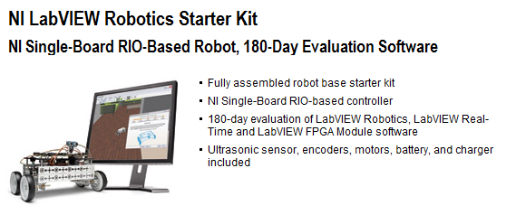
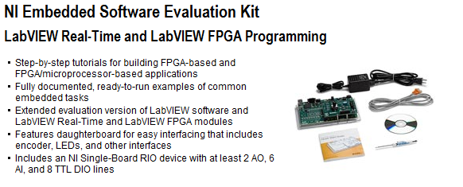
Order Your Evaluation Kit
$1,999
$999
and up

Slide 41
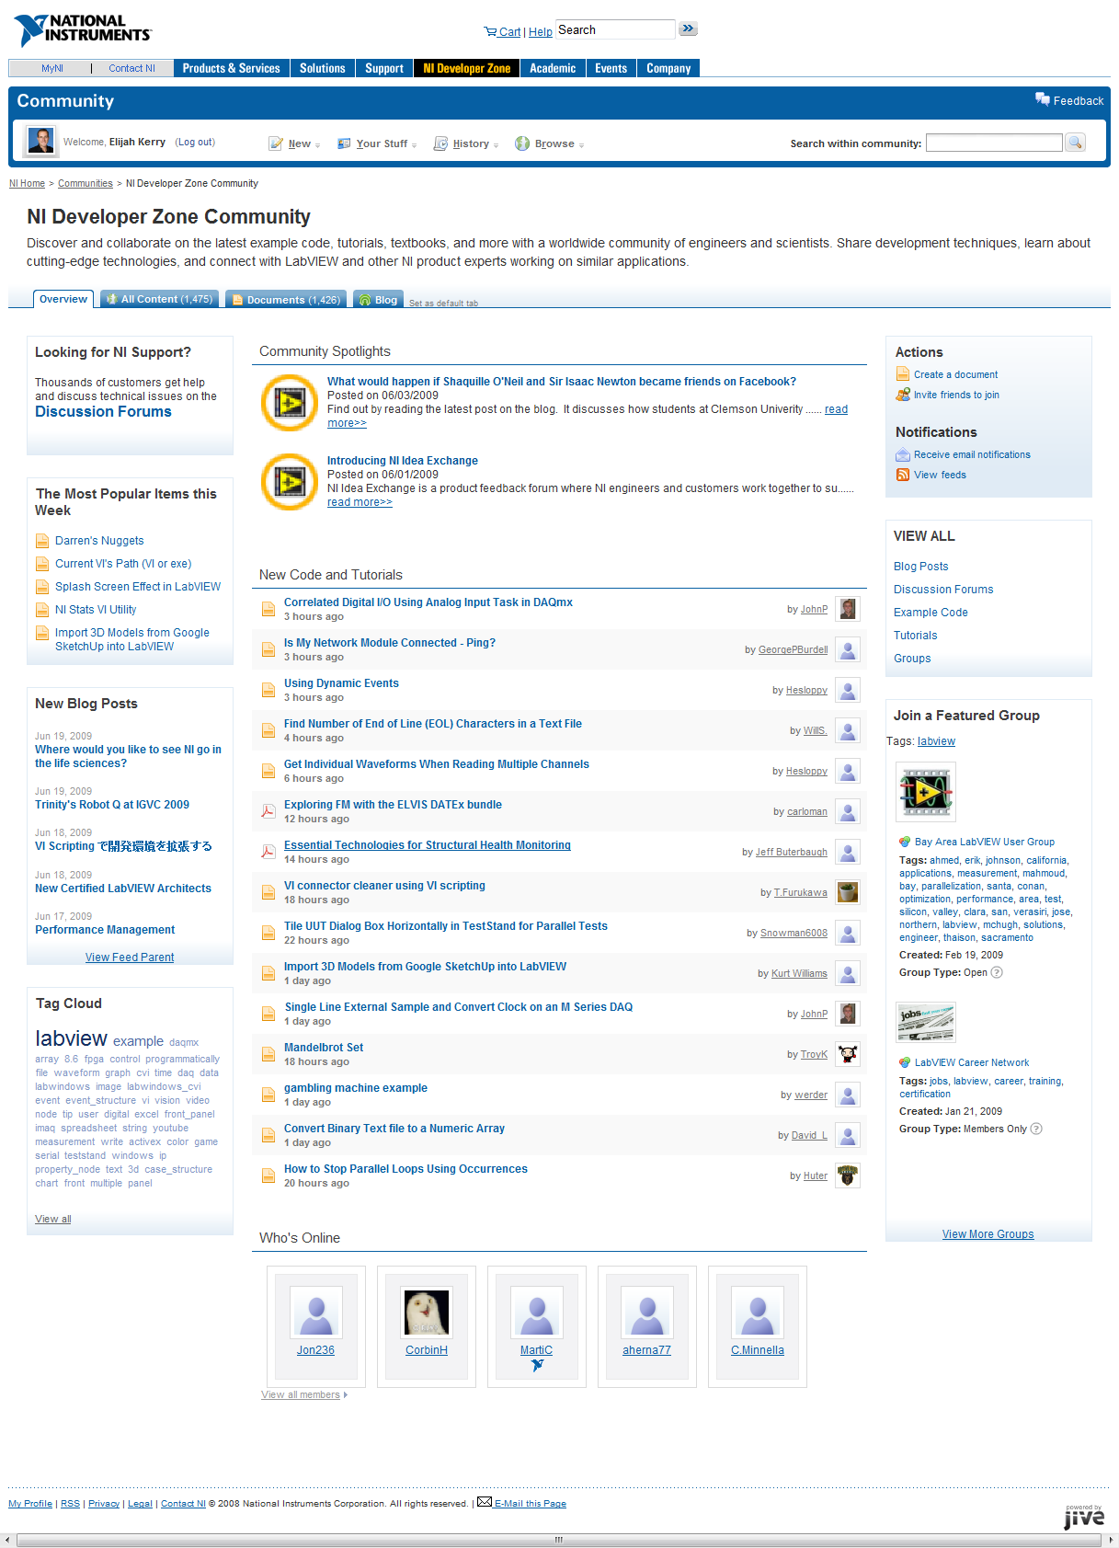
Worldwide LabVIEW User Community
Over 100,000 members on award-winning NI Discussion Forums
NI and LabVIEW user-contributed examples, tutorials and blogs
More than 100 LabVIEW User Groups
Third-party community web sites in over 15 languages
Hundreds of third-party add-on tools on the LabVIEW Tools Network

Slide 42
Software Maintenance and Support
Membership in a National Instruments software maintenance and support program allows you to:
Receive software updates and maintenance releases automatically
Enjoy direct access to technical support from NI applications engineers
Access special online software training modules that highlight features, application uses, and development best practices
Visit ni.com/services to learn more

Slide 43
Training and Certification
Together, the National Instruments training and certification programs deliver the fastest, most certain route to increased proficiency and productivity using NI software and hardware.
NI Training: Build Your Knowledge NI training helps you build the skills to more efficiently develop robust, maintainable applications. We provide several training options including classroom, self-paced, online, or on-site training at your facility. | NI Certification: Validate Your Expertise NI certification confirms your technical growth and skill. This professional certification is ideal for differentiating yourself from the competition and making your own informed hiring and outsourcing decisions.
Visit ni.com/training to learn more

Slide 44
LabVIEW Modules and Toolkits

Slide 45
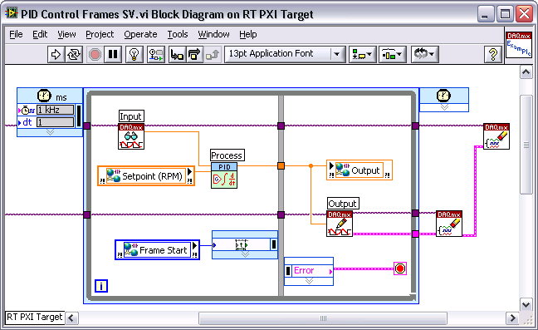
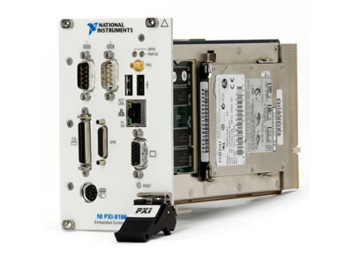
LabVIEW Real-Time Module
Rapidly develop deterministic applications with graphical programming
Easily architect distributed control and monitoring systems
Eliminate time spent integrating diverse I/O

Slide 46
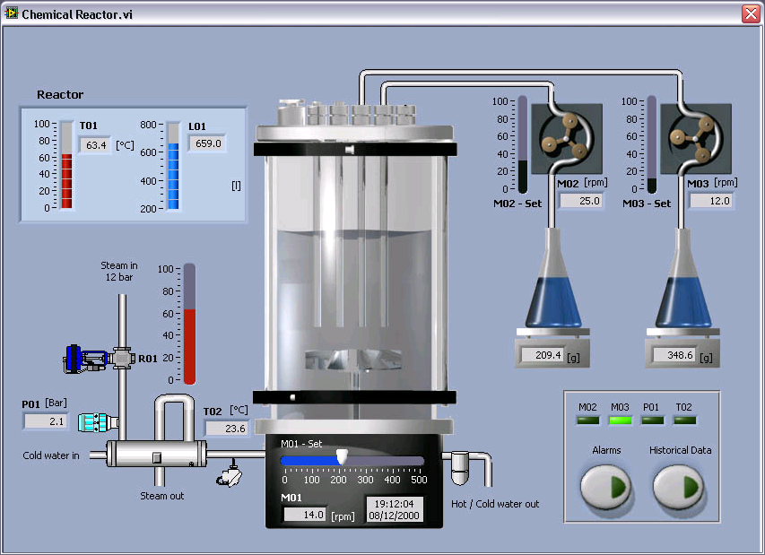
LabVIEW Datalogging and Supervisory Control Module
Graphical development for distributed monitoring and control systems
Trend real-time and historical data
Log data from any networked I/O to a historical database
Monitor and log alarms and events
Network LabVIEW Real-Time targets and OPC devices
Add security to LabVIEW user interfaces

Slide 47
LabVIEW FPGA Module
Define custom FPGA I/O without VHDL programming
Achieve hardware deterministic response within 25ns
Execute tasks with true parallelism
R Series Intelligent DAQ
NI CompactRIO

Slide 48
LabVIEW Touch Panel Module
NI TPC-2006
Create custom human-machine interface (HMI) applications for the NI TPC-2006 and other Windows CE devices

Slide 49
LabVIEW Statechart Module
Statecharts provide high-level abstraction for state based applications
Simple semantics represent complex systems
Self-documenting design
Integrate statecharts into existing LabVIEW applications
Generate code for desktop, Real-time, FPGA, and embedded targets

Slide 50
LabVIEW Mobile Module
Wireless communication with shared variable
Portable low-cost USB DAQ

Slide 51
NI Vision Development Module
LabVIEW programming libraries for machine vision and image processing
Includes Vision Assistant
Prototypes and benchmarks applications
Generates complete code for LabVIEW, Visual Basic, and C
Hundreds of tools to:
Enhance images
Check for presence
Locate features
Identify parts
Measure objects

Slide 52
Motion Control with LabVIEW
NI Motion Assistant
Interactive environment with 3D visualization
Ready-to-run LabVIEW or C code creation
Easy trapezoidal or S-curve velocity profile implementation
Teach pendant for easy prototyping
NI SoftMotion Controller for CANopen and IEEE 1394
Use LabVIEW and NI Motion Assistant to program distributed motion control applications
Compatible with intelligent CANopen drives from Copley and IEEE 1394 drives from ORMEC
NI SoftMotion Development Module
Develop custom motion controllers in LabVIEW Real-Time or LabVIEW FPGA
Use trajectory generation, spline interpolation, position, velocity control, and encoder implementation VIs

Slide 53
LabVIEW Sound and Vibration Toolkit
10 Express VIs
Fractional Octave Analysis with Weighting
Vibration Level with Single or Double Integration
Sound Level with A-, B-, C-Weighting
Power Spectrum
Zoom Power Spectrum
Frequency Response
Peak Search
Power in Band
Limit Testing

Slide 54
LabVIEW Order Analysis Toolkit
Gabor order tracking algorithm analyzes signals from rotating machinery
Resampling order analysis for online condition monitoring
Flexible order energy selection in the joint time-frequency domain
Plot order versus time or RPM
Order extraction tools separate order-specific signal components
Digital and analog tachometer signal processing

Slide 55
PID Control Toolkit
PID Control
Autotuning
Gain scheduling
Fuzzy Logic
Control strategies
Decision making

Slide 56
Report Generation Toolkit for Microsoft Office
Programmatically create and edit reports in Microsoft Word and Excel
Populate report templates
Manage report layout, format, and appearance
E-mail reports and run macros
Express VI included

Slide 57
LabVIEW Advanced Signal Processing Toolkit
Time-Frequency Analysis
Time-Series Analysis
Wavelet and filter bank design
Applications
Automotive
Biomedical
Seismology
Radar/Sonar

Slide 58
Database Connectivity Toolkit
Insert, select data from OLE DB, ODBC databases
Microsoft Access, SQL Server, Oracle, etc.
Create, drop tables
Save records in XML format
Execute SQL queries
Immediate, parameterized
Execute stored procedures
Accept, reject multiple operations (transactions)

