Slide 1
ECGR4161/5196 – Lecture 6 – June 9, 2011
YouTube Videos:
http://www.youtube.com/watch?v=7hag6Zgj78o&feature=player_embedded
Micro Robotics
Worlds smallest robot - Version 1 - "tank"
Worlds smallest robot - Version 2 - " BristleBot"
Worlds smallest robot - Version 3 - " picoBot“

Slide 2
ECGR4161/5196 – Lecture 6 – June 9, 2011
Tutorials
http://dkc1.digikey.com/us/en/tod/Microchip/StepperMotorControl/StepperMotorControl.html
http://dkc1.digikey.com/us/en/tod/CUI/MotionControlKit/MotionControlKit.html
http://dkc1.digikey.com/us/en/tod/STMicroelectronics/StepperFundamentals/Stepper_Fundamentals.html

Slide 3
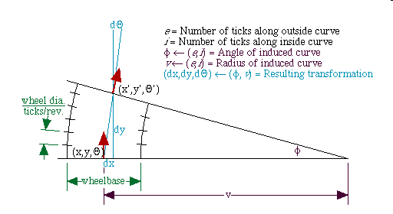
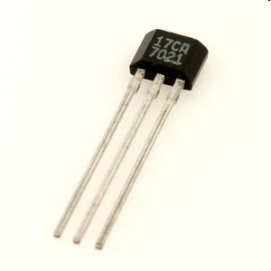
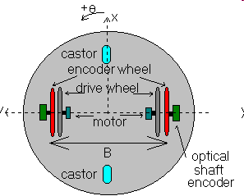
Melexis 90217 Hall-Effect Gear Tooth Sensor
4mm
The main application for the Melexis 90217 is to act as an encoder or pulse generator for ‘practical scale’ ferrous gears or encoders
This functionality can be exploited in a wide variety of applications such as:
  Speed Encoding (bi-directional)
  Position Encoding
  Motor control (position/speed)
The chief advantages of this sensor:
  Low-cost ($5-8)
  Rugged and robust (non-contact)
  Simple installation (any ferrous gear or vaned structure can become an encoder)
  Built-in, self adjusting ADC
Applicability: Robot odometry, or manipulator feedback
Odometry is the major topic of Lab 2

Slide 4
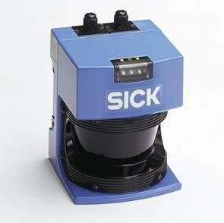
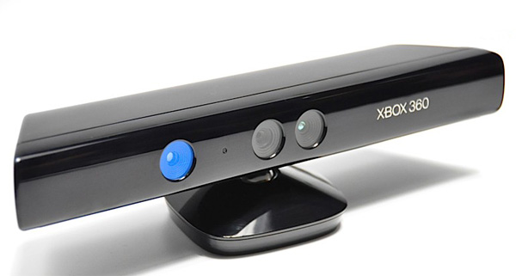
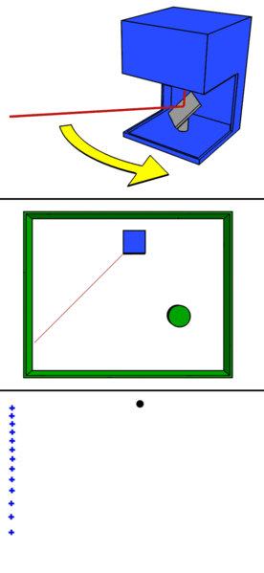
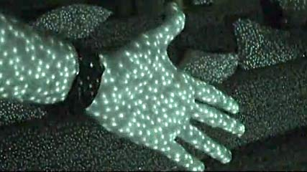
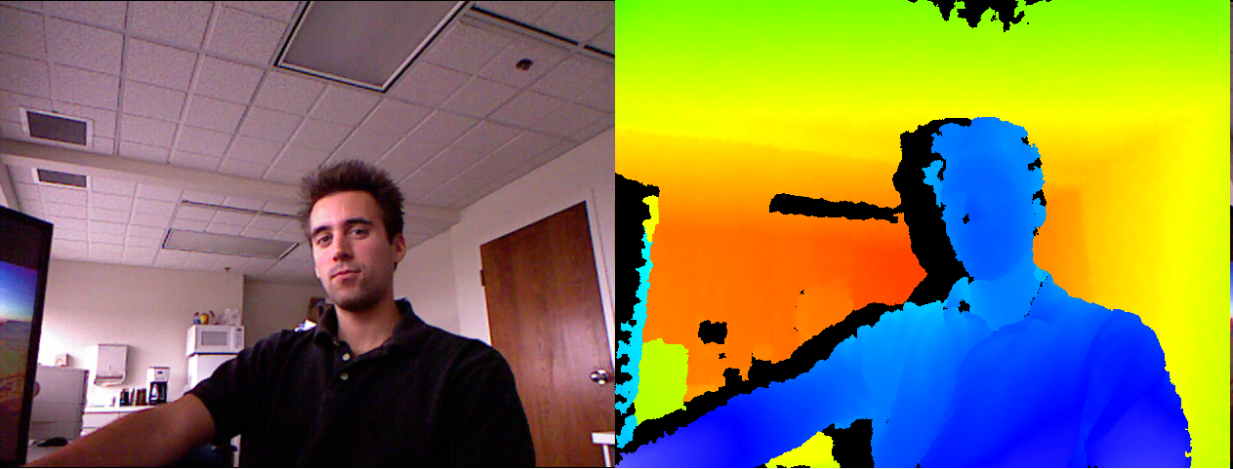
Microsoft Xbox Kinect
Traditional LIDARS
-Uses “time of flight”
-Long Range
-Limited FOV
-EXPENSIVE
Xbox Kinect
-Uses “displacement”
-Short Range
-same FOV as a camera
-$150

Slide 5
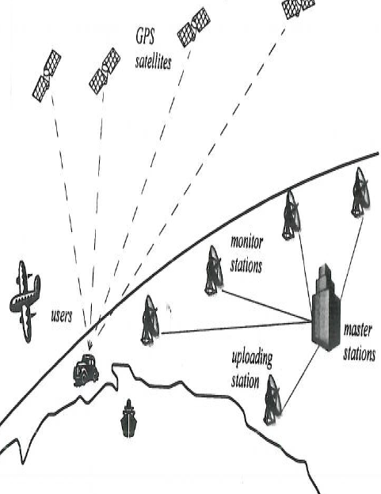
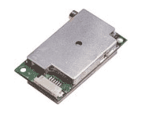
GPS (global positioning system) Sensors
ROBOT GPS receivers are passive but exteroceptive sensors. They provide an estimate of the robot’s location. GPS receiver does not work indoors, to avoid this obstacle new strategies were used with GPS sensors, the pseudo range and the Differential GPS (which make use of a static 2nd receiver at a known location)
Figure 1 GPS 15™ sensor from [1] Figure 2 from [2]
References:
1. http://www.megagps.com/gps15xw.aspx
2. Chapters 4 and 5 of the introduction to Autonomous Mobile Robots
Notes:
We classify Sensors for mobile robots in two categories: 1. Proprioceptive sensors (measure values internal to the robot such as motor speed, wheel load, robot arm joint angle and battery voltage) and
2. Exteroceptive sensors ( gather information from the robot environment such as location, distance measurement) therefore exteroceptive sensors are interpreted by the robot in order to get meaningful
data. ( info from ref 2)

Slide 6
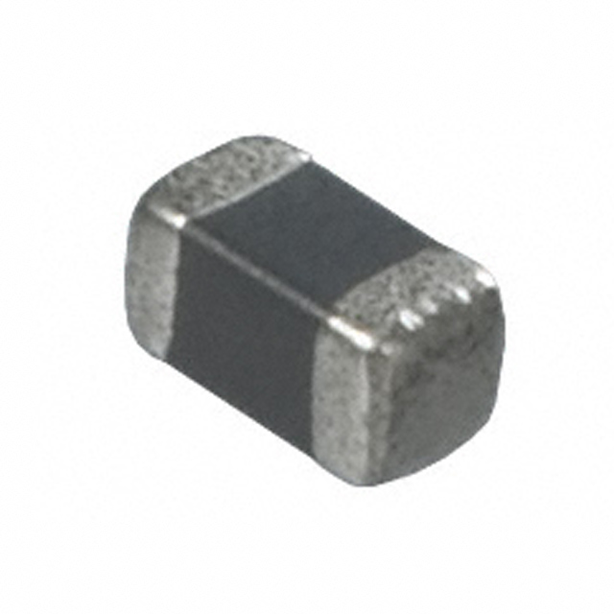
Thermistor – Temp Sensor
Part Number - NCP15XW152J03RC
Resistance varies with
temperature
Used in overcurrent protection
circuits, overtemperature
protection, and heat
regulation circuitry
2 basic types – NTC, PTC
Part Number Code | Specification
NC | NTC Type
P | Plated Termination Series
15 | 1.00 x 0.50 mm (0402)
XW | Beta 3950 - 3999K
152 | 1.5 kOhm
J | 5 % Tolerance
3 | Standard Type
RC | 2mm Pitch Packaging
References:
http://search.digikey.com/scripts/DkSearch/dksus.dll?Detail&name=490-2421-1-ND
http://en.wikipedia.org/wiki/Thermistor

Slide 7
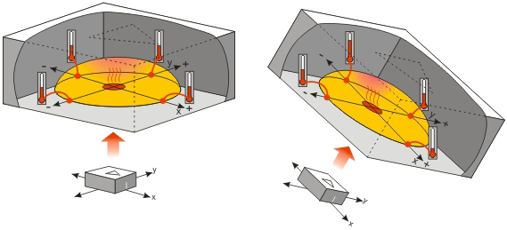
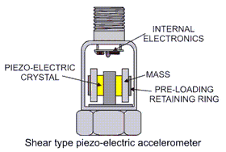
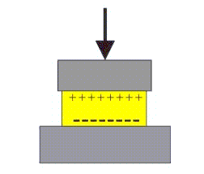
Accelerometer – Heated Gas Pocket, Piezoelectric
Acceleration
Tilt and tilt angle
Incline
Rotation
Vibration
Collision
Gravity
Heated Gas Pocket
Compression Piezoelectric accelerometer
http://www.mastec.co.nz/Dataforth/PDFs/How%20does%20a%20piezo%20accel%20work.pdf
http://www.parallax.com/dl/docs/prod/compshop/SICMemsicTut.pdf

Slide 8
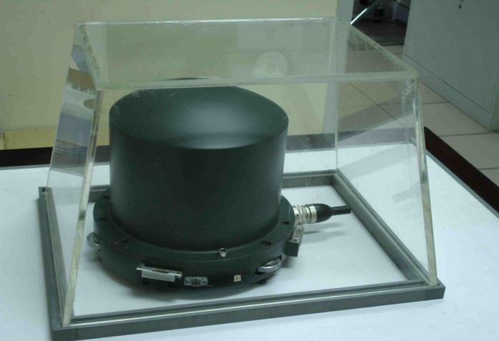
Broadband Seismometer (BBVS-60)
Seismometers are instruments that measure motions of the ground, including those of seismic waves generated by earthquakes, volcanic eruptions, and other seismic source
Built-in 3 Components
Electronic feedback
Dynamic range: 140 dB
Broadband:50Hz～120s
Measure Range：±4g
Remote mass monitoring\
Remote mass centering
Low power consumption
Low noise
broadband, wide dynamic range, low noise, high sensitivity seismometer. It’s transmission function is very stable and suitable for broadband seismic observations.

Slide 9
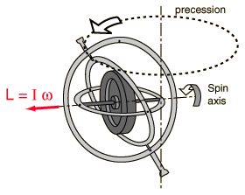
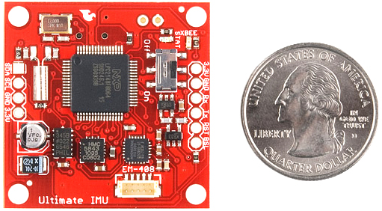
Gyroscope
The effect of all this is that, once you spin a gyroscope, its axle wants to keep pointing in the same direction. If you mount the gyroscope in a set of gimbals so that it can continue pointing in the same direction, it will. This is the basis of the gyro-compass.[2]
If several gyroscopes are mounted within a platform and then mounted within a set of gimbals this can be known as an inertial navigation system(INS)
"Gyroscope." Test Page for Apache Installation. Web. 09 June 2011. <http://hyperphysics.phy-astr.gsu.edu/hbase/gyr.html>.
"HowStuffWorks "How Gyroscopes Work"" HowStuffWorks "Science" Web. 09 June 2011. http://science.howstuffworks.com/gyroscope3.htm
"SFE Ultimate IMU Triple Axis Accelerometer, Gyro and Magnetometer - RobotShop." RobotShop | Robot Store | Robots | Robot Parts | Robot Kits | Robot Toys. Web. 09 June 2011. <http://www.robotshop.com/ca/sfe-ultimate-imu-triple-axis-accelerometer-gyro-magnetometer.html>

Slide 10
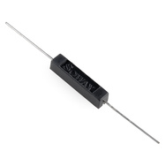
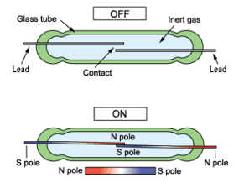
The Reed Switch
The basic reed switch contains two ferrous conductors encapsulated in glass and sometimes plastic with one conductor held over the other by a very small distance.
When a magnetic field is applied, the conductors (reeds) are pulled together and close the switch. This is an excellent non-contact switch that can be used in any application requiring non-contact momentary switching.
Some common uses are speedometers and door/window alarms
An example product is the (RS-01C) manufactored by Soway and found at SparkFun.com http://www.sparkfun.com/products/10601
This is a plastic insulated Reed Switch that is capable of handling loads of up to 1A @ 180VDC or 130VAC
Can be mounted directly to a PCB
Soway RS-01C Reed Switch
http://www.sparkfun.com/products/10601
Reed Switch Operation
http://www.hy1688.com.tw/SWITCH/REED%20SWITCH/SWITCH/O-OKI.htm
Sources:
SparkFun - http://www.sparkfun.com/products/10601
Hamlin Sensors - http://www.hamlin.com/technical-detail-reed-switch.cfm

Slide 11

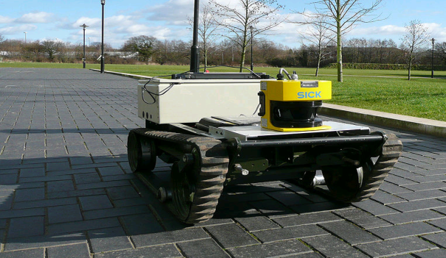
LIDAR (Light Detection and Ranging)
  Uses optical remote sensing technology to measure the distance to an object by illuminating it with light (often pulses from a laser)
  Used ultraviolet, near infrared light.
  Measures distance, speed, rotation,
  chemical composition and concentration.
  Major components: Laser, scanner,
  photo detector and receiver electronics,
  position and navigation systems.
http://www.pages.drexel.edu/~kws23/tutorials/sick/sick.html
http://www.lidar.com/
http://en.wikipedia.org/wiki/LIDAR

Slide 12
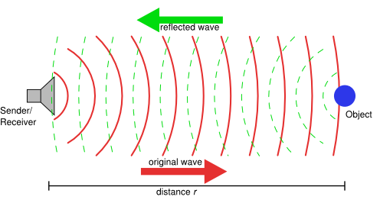
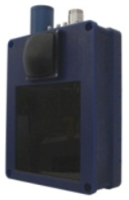
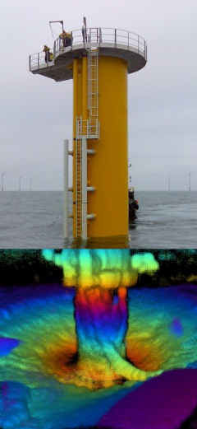
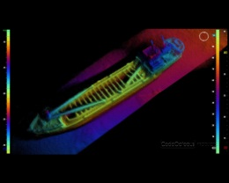
Echoscope 3D Sonar
Information
Produces 16000 beams
simultaneously, producing 3D
Images of stationary or moving
objects.
Data density 100x greater than
traditional echo sounders
Capability of viewing the
same data from multiple
angles.
Applications
Underwater Construction
Bridge and Dam Inspection
Search and Recovery
Obstacle Avoidance
Specifications
Max Range: 150 feet
Min Range: 3 feet
Frequency: 375 kHz
Range Resolution : 3cm
Jeffrey Skelnik ECGR 5196
http://www.codaoctopus.com/echoscope-3d-sonar/ http://www.youtube.com/watch?v=LUx9r2wSuIE
http://en.wikipedia.org/wiki/Sonar
Notes:
http://www.youtube.com/watch?v=LUx9r2wSuIE

Slide 13
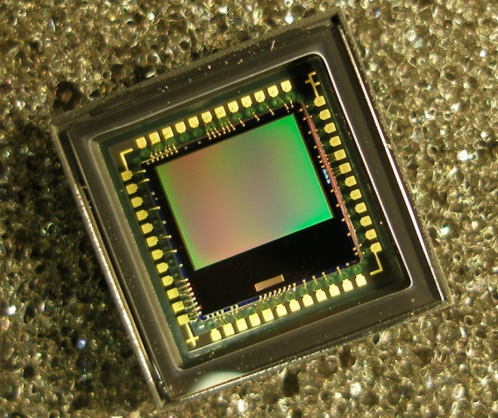
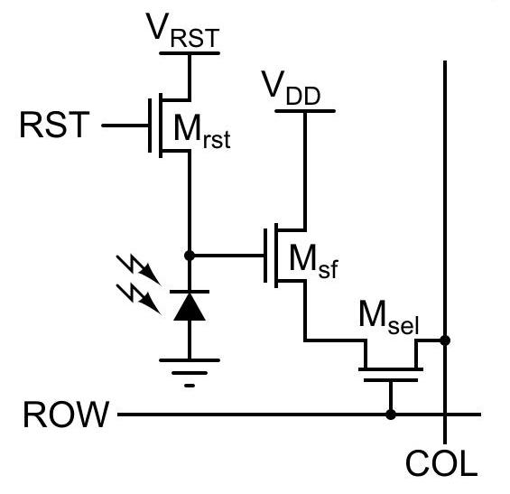
CMOS Active Pixel Sensor
Increasingly used in robotics
  Environmental analysis
  Navigation
  Object ID/Tracking
Pixels built from transistors and a photodiode
  One to reset image after each acquisition
  One to amplify the signal
  One to select the row of pixels
"Robotics Fundamentals Series: CCDs and CMOS Image Sensors - Developer Zone - National Instruments."
NI Developer Zone. National Instruments Corp. Web. 09 June 2011.
<http://zone.ni.com/devzone/cda/tut/p/id/8178>.
Brandon McLean, ECGR 4161, June 2011

