Slide 1
ECGR4161/5196 – July 26, 2011
Read Chapter 5
Exam 2 contents:
Labs 0, 1, 2, 3, 4, 6
Homework 1, 2, 3, 4, 5
Book Chapters 1, 2, 3, 4, 5
All class notes

Slide 2
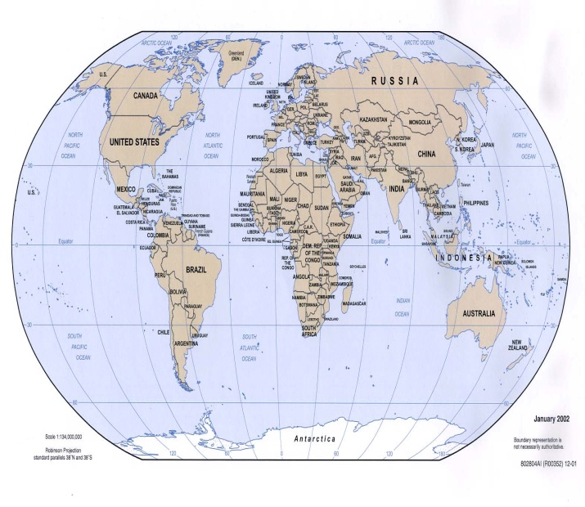
Challenges in Map Representation
3 Fundamentals of Map Representation
Map precision must match precision of robot’s precision to achieve goals
Map precision and object representation must match sensor data precision
Map complexity has a direct impact on computational complexity
Major Issues with Map Representation
Memory constraints on large and precise map representations
How do you define objects and nodes in a map? (Indoor vs. Outdoor)
What is the object? (Sensor shortcomings, vision research state of the art, etc.)
Real world is dynamic (humans, nature, transient objects, etc.)
Sensor fusion problem yet to be solved
References:
Siegwart, Roland. Autonomous Mobile Robots. Cambridge, Massachusetts. The MIT Press, 2011, 284-296.

Slide 3
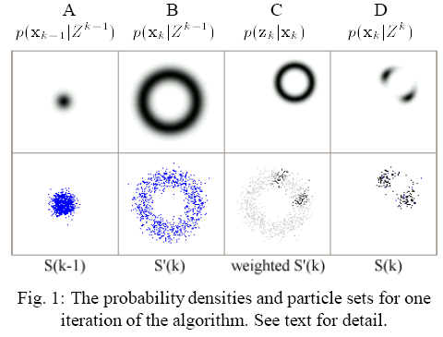


Monte Carlo Localization for Mobile Robots
Probabilistic approach to localization problems
Global position estimation– ability to determine the robot’s position in a previously learned map given no other info than the robot is somewhere on the map
Local tracking is keeping track of that position over time
The position measurements up to time k
The 3D state vector
Predicts current position using motion only (given by integration)
Is some type of known control input
Likelihood the robot is at location given was observed
Posterior density over (Bayes Theorem)
A: Uncertainty – represented by cloud of particles
B: Robot moved 1 meter. Robot is somewhere within 1 meter radius
C: Observing landmark .5 meters away in top-right corner
D: Re-sampling from the weighted set – starting point for next iteration
Jeffrey Skelnik
jbskelni@uncc.edu
http://www.ri.cmu.edu/pub_files/pub1/dellaert_frank_1999_2/dellaert_frank_1999_2.pdf

Slide 4
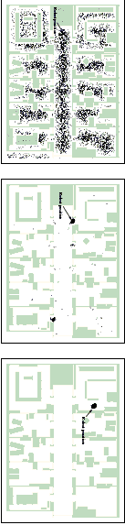
Monte Carlo Localization (Particle Filtering)
Based on a collection of samples (also known as particles)
  Each sample consists of a possible location along with the probability (importance weights) that the robot is at that location
  More samples More accuracy at the expense of computational time
Algorithm:
1- inputs: Distance u_{t}, sensor reading z_{t}., sampleset S_{t} = { (x_{t}^{(i)}, w_{t}^{(i)}) | i = 1,...,n}
2- for i = 1 to n do // First update the current set of samples
  x_{t} = updateDist(x_{t}, u_{t}) // Compute new location
  w_{t}^{(i)} = prob( z_{t} | x_{t}^{(i)} ) // Compute new probability
3- S_{t+1} = null // Then resample to get the next generation of samples
4- for i = 1 to n do
  Sample an index j from the distribution given by the weights in S_{t}
  Add (x_{t}^{(j)}, w_{t}^{(j)}) to S_{t+1} // Add sample j to the set of new samples
5- return S_{t+1}
http://www.youtube.com/watch?v=dItTmkR4hsQ&feature=player_embedded#at=12
http://www.mcs.alma.edu/LMICSE/LabMaterials/AI/MonteCarloLoc/MonteCarlo.htm
http://www.cs.washington.edu/ai/Mobile_Robotics//mcl/

Slide 5
Localization: Using Visual Cues and Vanishing Points
Base image compared with best fit lines
Flaws within the system…
No two images are ever the same
Needs a preexisting definition of “land marks” to search for
Reflections brought out by surfaces
Saurer, Olivier, Marc Pollefeys, and Friedrich Fraundorfer. Visual Localization Using Global Visual Features and Vanishing Points. Computer Vision and Geometry Group. Web. 25th July 2011. <http://www.clef2010.org/resources/proceedings/clef2010labs_submission_89.pdf>.

Slide 6
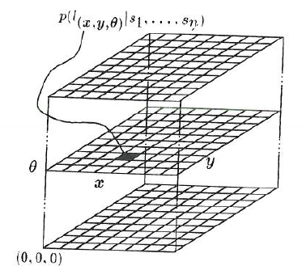
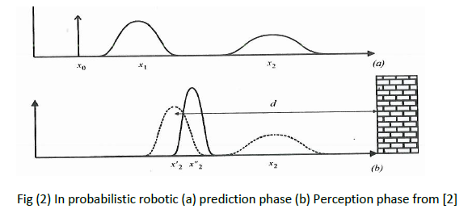
Markov Localization a probabilistic algorithm
Equation (1) Markov Localization algorithm from [1]
Fig(1) 3D array used in Markov Localization [2]
References: 1. http://www.cs.washington.edu/homes/fox/diss/diss.html
2. Chapters 5 of the introduction to Autonomous Mobile Robots
Notes:
Markov Localization provides a general probabilistic technique to find the global position of an autonomous mobile robot based on observations and actions.
Equation 1 describes the belief of being at location l at time t, from ref [1] which is a Ph.D. Thesis for Dieter Fox from the University of Bonn, Germany on this subject.

Slide 7
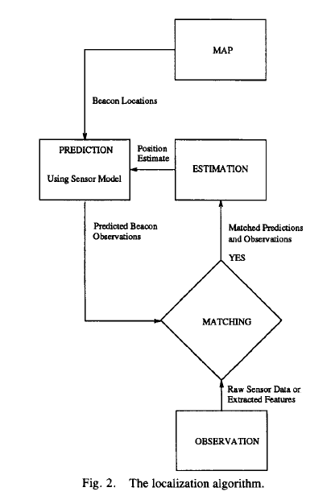
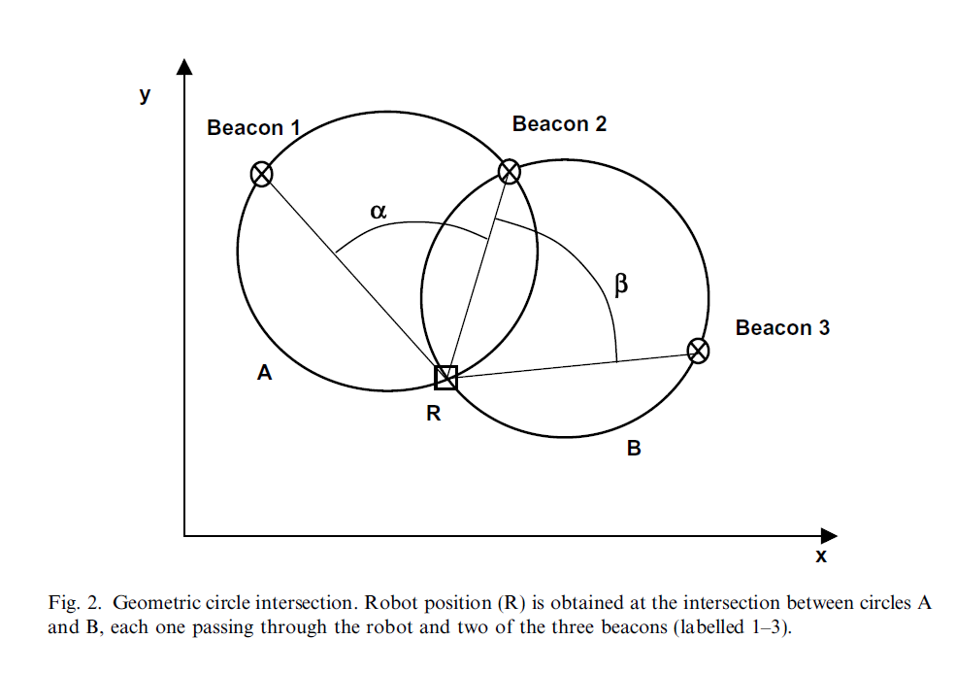
Local Positioning - Passive Sonar Beacons
  Local Positioning Systems use intentionally placed local (as opposed to global) ‘beacons’ to identify a reference within a space
  Reference Systems have the chief advantage of resolving error (incremental errors do not accumulate as in proprioceptive ‘dead reckoning’)
  Simple triangulation provides absolute localization data
  Passive references are the simplest to employ
  Sonar is just one example lasers, light, or radio also work
  Not effective in unprepared locales
Video:
Light-Reflector Passive Beacons
Refs:
Microcontroller Based System for 2D Localization; Casanova, Quijada, Garcia-Bermejo, Gonzalez
Mobile Robot Localization by Tracking Geometric Beacons; Durant-Whyte

Slide 8
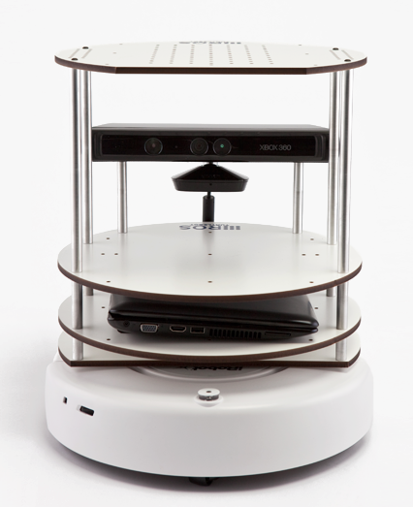
Turtle Bot Localization Using Kinect and I-Robot Base.
The Turtle Bot utilizes a few sensors to determine its position based on a previously formed map or model of the area.
It has a single axis gyro, edge sensors, Kinect sensor with IR sensors and a camera, and encoders to determine position, speed, and obstacles.
It can be programmed to just avoid obstacles, identify object shapes, or stay within map/model boundaries.
Reference (image and info) : http://www.willowgarage.com/turtlebot

Slide 9
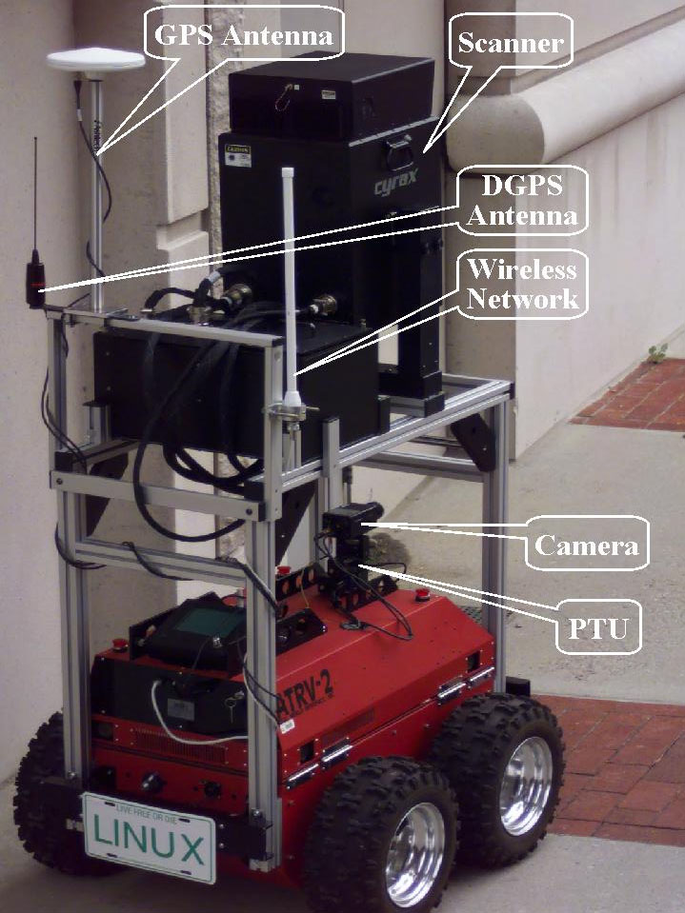
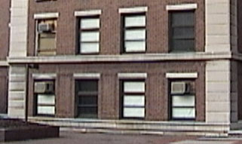
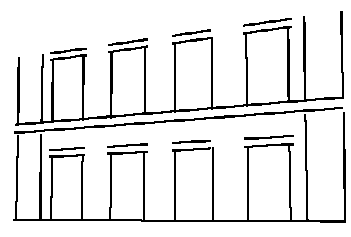
Localization Methods for a Mobile Robot in Urban Environment
Outdoor urban environments. pose unique set of challenges Different from both indoor and outdoor open environment.
Open space localization :-
Odometry- minute errors accumulate over time, The error can not be bounded without the use of sensor such as GPS.
Digital Compass- helps to find orientation
The GPS receiver allows the position uncertainty from accumulating beyond acceptable limits.
Visual Localization :- On-demand updates, only when the open-space configuration fails.
On demand allows more time for image processing operations which increases the robustness of the overall system.
Reference:- ieeexplore.ieee.org/iel5/8860/29531/01339385.pdf

Slide 10

Monte Carlo Localization for Mobile Robots
key advantages:
represent multi-modal distributions and thus can globally localize a robot and drastically reduces the amount of memory required
Prediction Phase: Update Phase:
use a motion model to predict the current position of the robot in the form of a predictive PDF p(x_{k}|Z^{k-1})
Current state x_{k} is dependent on the previous state x_{k-1} & known control input u_{k-1}.
the motion model is specified as a conditional density p(x_{k}|x_{k-1}, u_{k-1})
predictive density over x_{k} is then obtained by integration:
p(x_{k}|Z^{k-1}) = ∫p(x_{k}|x_{k-1},u_{k-1}) p(x_{k-1}|Z^{k-1}) dx_{k-1}
use a measurement model (MM) to incorporate information from the sensors to obtain the posterior PDF p(x_{k}|Z^{k})
assume that the measurement z_{k} is conditionally independent of Z^{k-1} given x_{k}, and that the MM is given in terms of a likelihood p(z_{k}|x_{k})
The posterior density over x_{k} is obtained using Bayes theorem:
[1] Frank Dellaert, Dieter Fox, Wolfram Burgard, and Sebastian Thrun, "Monte Carlo Localization for Mobile Robots," IEEE International Conference on Robotics and Automation (ICRA99), May, 1999.

Slide 11
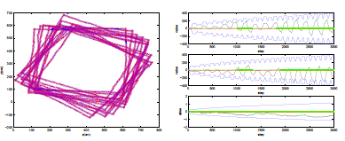
Kalman Filters
Definition:
A Kalman Filter (KF) is a state estimator that works on a prediction-correction basis. It depends on the reference coordinate system (x, y, φ) [1].
(a) True and Estimated trajectory of square driving robot with measurements
(b) Posterior estimation error (solid black), 95% confidence interval (solid blue), run with and without measurements (solid green and solid red, respectively)
Figure 1: Position Tracking with Corrections
Principle:
The KF is used as a control for a dynamic system and for state estimation. It provides the information that cannot directly be measured by estimating the values of the variables from indirect and noisy measurements [1]
Sources:
[1] Robot Localization and Kalman Filters (http://www.negenborn.net/kal_loc/thesis.pdf)

