Slide 1
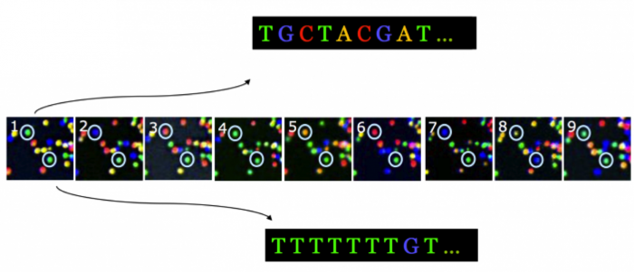

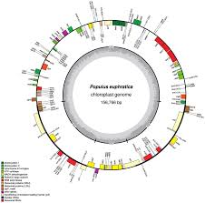
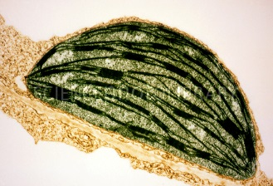
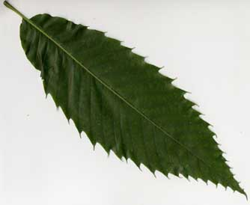
B3- Olympic High School Bioinformatics
Dr. Jennifer Weller
May 2016
Sequence Analysis
Notes:
How do you go from the organism (the American Chestnut tree) to a sample you can collect (the leaf), to the part of the leaf of interest (the chloroplast) to the chloroplast DNA (from sequencing) to putting the sequence together in order (a map) and labeling the parts (annotation) so you can pick out one particular region that you want to barcode?
Part of this involves the wet-lab process that we do in the Summer Science camp, where we use wet-lab tools to purify the DNA sample and carry out the sequencing.
Part of it is a computational process – it still requires tools and knowing how to use them. One of the things you can do is complete the circle to go back to the lab with better (more focused) assays.

Slide 2
Topics
Encoding Information about content
Encoding information about quality
Comparing sequences
Visualizing multiple sequence comparisons

Slide 3
Encoding Information
Symbols or characters represent information – a set of symbols can represent more information
  Note: a linear sequence of characters is called a string.
  The information is encoded – you can’t decipher the meaning unless you have the key
  The key is a set of consistent rules.
  You can transform between encodings.
    ‘My name is Dr. Weller’ → ‘Je m’appelle Dr. Weller’

Slide 4
Encoding Molecular Information
Challenge – what is the rule set?
  Ordered strings (Sequences) of nucleotides represent RNA or DNA – long strings without punctuation.
  Sequences of amino acids give proteins
What kind of characters should we use?
  US-ASCII advantage: it is a standard the American Standard Code for Information Exchange).
Notes:
ASCII is a character-encoding scheme to represent text in computers, communication equipment etc. It was the most common encoding used on the WWW until 2007, when another encoding scheme called UTF-8 was adopted (but it incorporates ASCII). It encodes 128 specified characters into 7-bit integers. Of these 33 are control characters used to control processing of text and spaces. The space has its own character as it has a ‘presence’ by its absence.

Slide 5
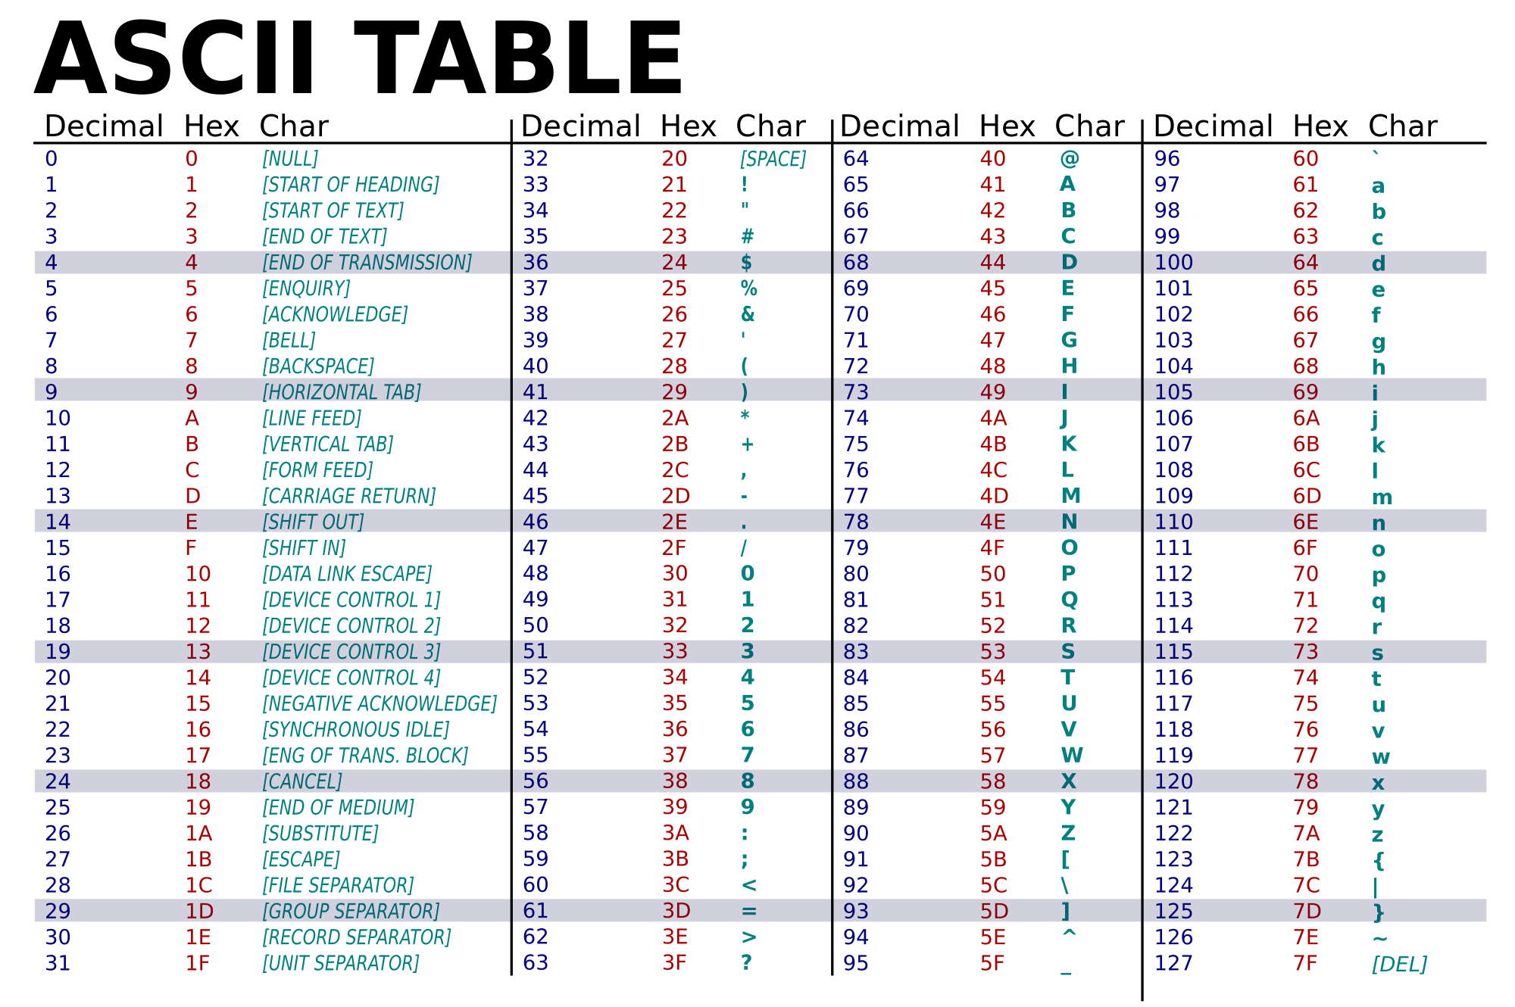
What is 4D792062726F776E20646F672E in text? What is ATG ACC AAA in HEX?
Notes:
This is HEX code since it contains letters. The text is “My brown dog.”
Converting the other: 4154472041434320414141
Excel contains functions that let you convert text strings to one of the encoding systems, between systems, and back again. It is very length-limited, so will not serve as a good tool for general bioinformatics work, but it makes a reasonable thing to play with.

Slide 6
How much information can you capture?
Natural language has very complicated rules both with respect to sounds and to grammar
  Phonetic alphabets convey 2 layers of information
  Pictograms convey one layer of information
Computers cannot reason as well as the human brain, so the grammar has to be kept much simpler.
  The alphabet has only two characters, 0 and 1.
Notes:
Another way to say this, is how complicated can you make this?

Slide 7
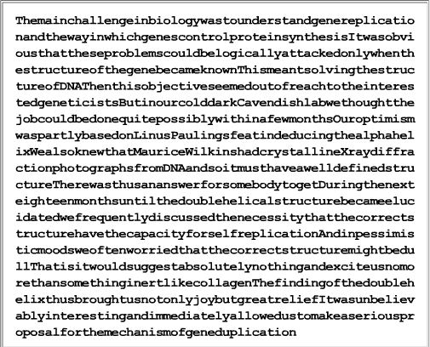
Notes:
ASCII text encoding of English language.
There are 26 characters, and small and capital letters. Does this encode information – something meaningful? The alphabet is an encoding for language.
Does the content mean anything? That is, there are English words embedded but they could just be a word salad.
One thing this tells you is that the space encodes something helpful (just like zero does in math).
The capital letters were left in, which does help break up sentences, although proper nouns confuse this somewhat. Getting rid of the spaces compresses the information – it takes up less space so you save on storage. This is only useful if you have rules for regenerating the original uncompressed version.
Note – this is from the DNA Subway Red Line Background Information slides, which note that the content is taken from the text of Dr. James Watson’s Nobel Prize speech in Dec of 1962.

Slide 8
Ways to Analyze Character Strings
What are some ways to analyze a string of characters?
  Presence/absence
  Relative abundance (Frequency)
  Co-Frequency Patterns (which ones are always together)
  Presence of patterns already known (‘words’)

Slide 9
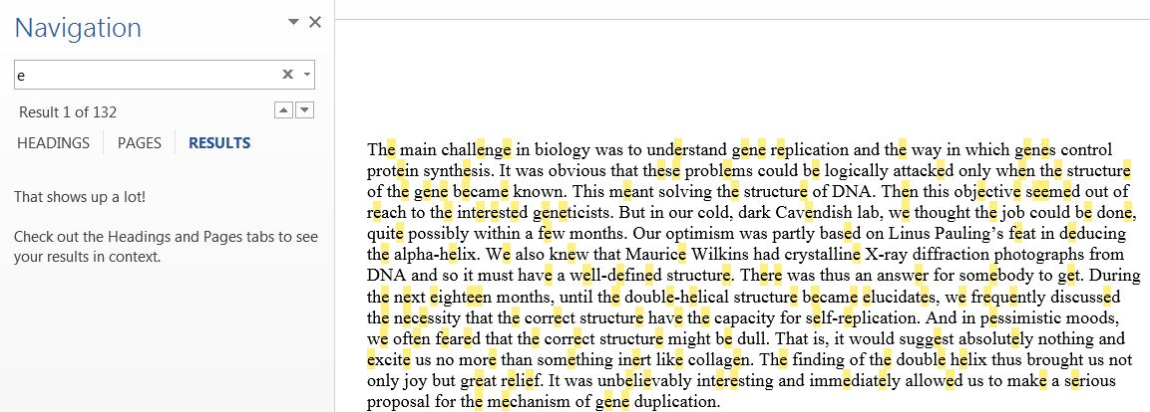
Carry out a frequency count for some letters:
If you open the file in Word, you can use the Find function, enter an ‘e’, for example and then the icon – you will see highlights and a count.
Notes:
E is 132, r is 51, y is 18, j is 3.

Slide 10
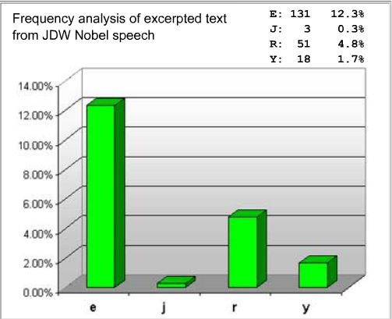
Frequency Analysis
Using Excel or a similar program, you enter the count, calculate the frequency, summarize with a graph.

Slide 11
Letter Frequency this file
Notes:
Is this going to be characteristic of all English documents?

Slide 12
What controls might you need?
Random letters
  Does length matter? What if I have a length of 4?
  What do you expect from a truly random selection of 26 letters over 1066 choices?
Text written in English
  Does the ‘flavor’ of English matter (note that Brits spell flavor as ‘flavour’ and analyze as ‘analyse’)
  Does the type of document matter?
How typical is our document of English-language texts?
Notes:
You would expect to see each letter 41 times and a frequency of ~4%.
The length matters because if you aren’t at least as long as the thing you are comparing to then some letters don’t show up at all – this is a false negative.
If you are selecting randomly with replacement you can make sure your string is long enough to approximate the true proportion or sample multiple times.

Slide 13
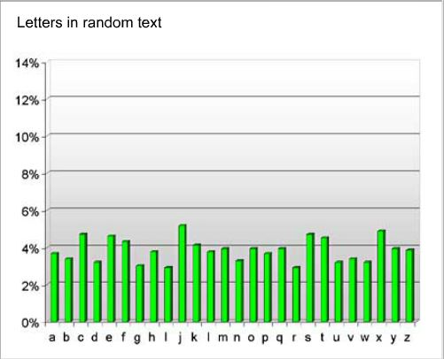
Random Text
Notes:
We imposed a rule that we would select randomly, with replacement, so the frequencies are approximately equal. That is, no language rules were included.

Slide 14
From Wikipedia – Frequency
What can you conclude about letter characters used in English words?
How useful is this analysis?
Notes:
Some letters are used much more frequently than others (vowels for example, and the consonants N, S, T).
Single-character analysis is not that useful, other than to tell you if the text is ‘typical’ of letter usage in English.

Slide 15
Computational Symbols
At the machine level, a switch is either on or off. To encode that state, you can represent on as ‘1’ and off as ‘0’ .
01010101010101010101
Does this have a pattern?
Is there a rule?
What would you predict comes next?
What does frequency analysis yield?
Notes:
You could use other characters in the encoding, but this is convenient for representing computation using binary operations.
If you think this is enough sample, the rules are
Zero is followed by 1
One is followed by 0
You would predict the next symbol will be a zero, followed by a 1, etc.
50% of the characters are 0 and 50% are 1.
That is, there is a 50% chance that the next symbol will be a 1 instead of a 0, but your intuition is saying that is not true – why?
You are really picking up on a 2-sy

Slide 16
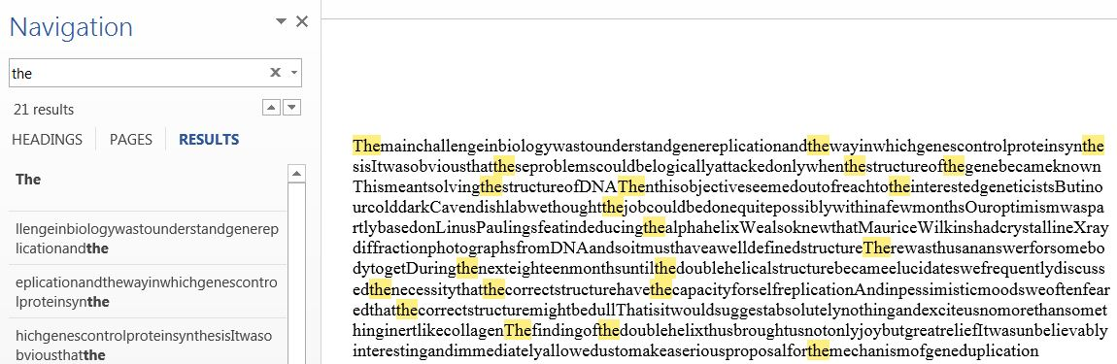
Pattern analysis
What types of patterns might you look for in English text?
Notes:
Find words, for example - for short words this is harder than for longer words, especially if you have removed the white space and punctuation.

Slide 17
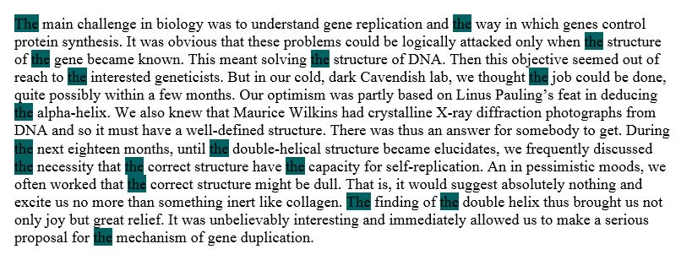
Including more rules
Given white space, we can use another rule, ‘restrict to whole words’.
Notes:
Now we find only ‘the’ and not words containing those letters in that order.

Slide 18
Pairwise combinations
Since we have just 2 symbols, there are only 4 ways to combine them, assuming order matters.
01010101010101010101
Characters | Count | Frequency
00 | 0 | 0
01 | 10 | 53
10 | 9 | 47
11 | 0 | 0
25
25
25
25
Notes:
So, if pairs of characters are looked at, the divergence of the true frequency from the random expectation means that the pattern is not random.

Slide 19
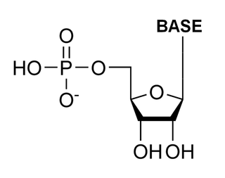
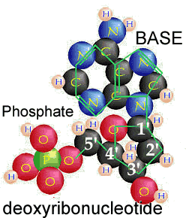
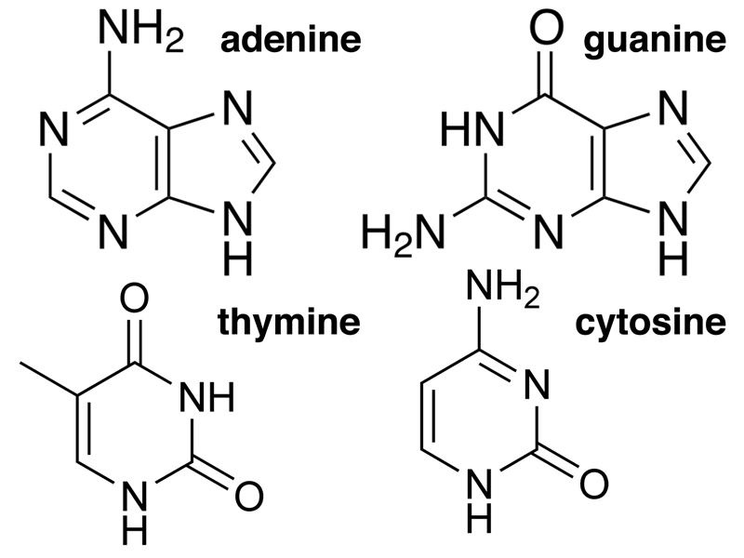
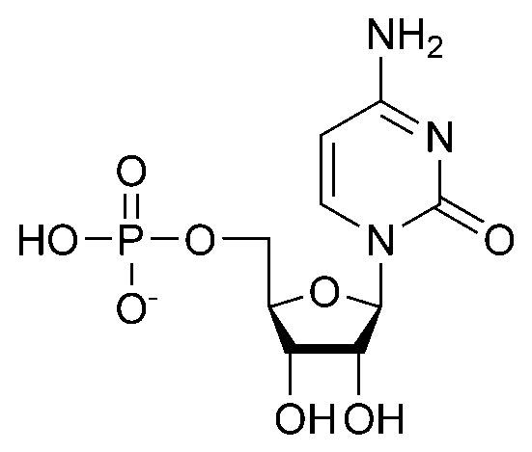
Go back to encoding the nts
(DNA)
dA dG
dT dC
A G
T C
Notes:
These are all abstractions – symbols for a set of related organic molecules. We capture the part that discriminates among them – the shorthand should carry with it the reminder in your head of all the other parts when then become important.

Slide 20
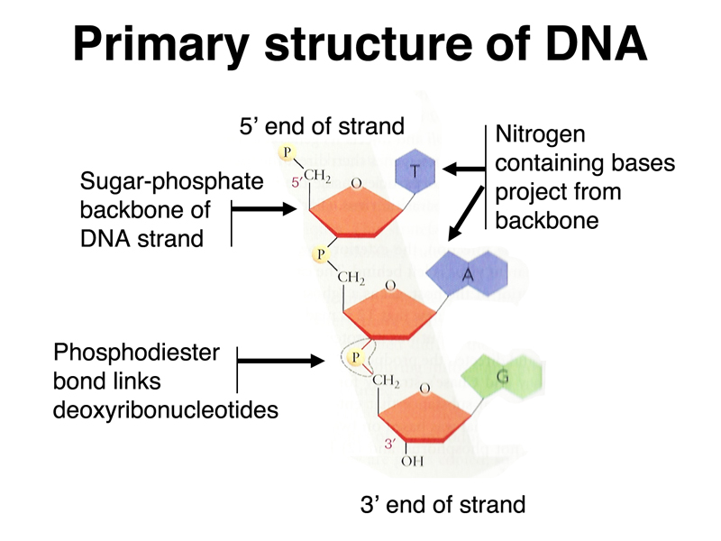
DNA Rules
Notes:
There is a directionality to a DNA strand because the monomers are not symmetric and the way they connect means the phosphate is directed out and the bases in.

Slide 21
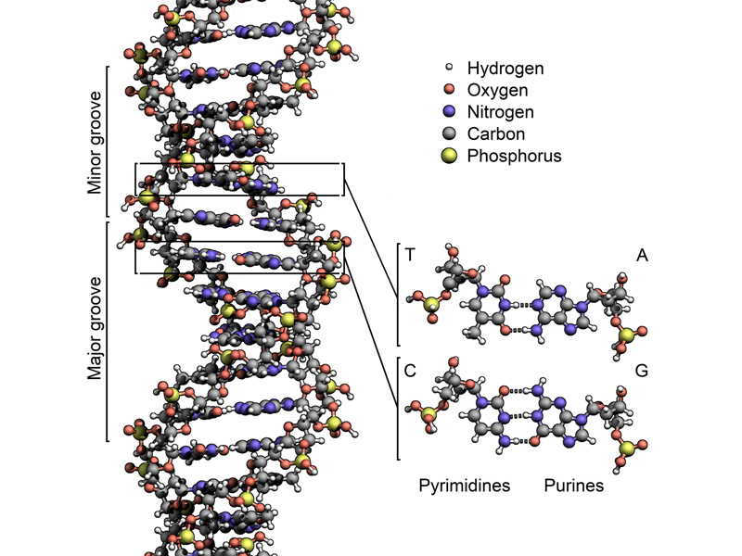
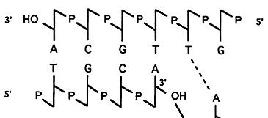

TGCA
Notes:
DNA in chromosomes is double-stranded, the strands can be separated with heat (non-covalent). The strands when H-bonded run in ante-parallel directions. The bases are complementary on the two strands, a to T and G to C.
That means that if you know the nts on one strand you can figure out the nts on the other strand, and the direction.

Slide 22
Other encodings
What other encoding could you think of to show the differences in the nucleotides?
What do you think is important for an encoding scheme?
What type of molecule is this?
  ACGCAACCGAAAGCCGCCAGAGCC
What type of molecule is this?
  ACGCUACCAAAGCUACCAUGCGCC
Notes:
You could 4 different shapes. You could assign a numeral.
Where humans will manipulate the information as well as computers it is a good idea to keep it unambiguous and easy to recognize.

