Slide 1
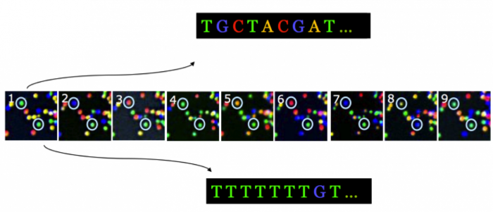
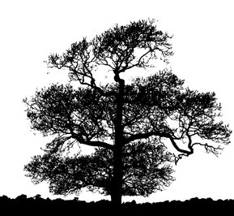
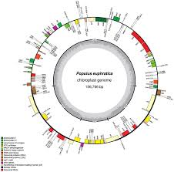
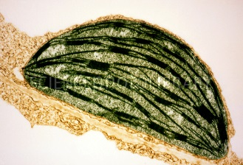
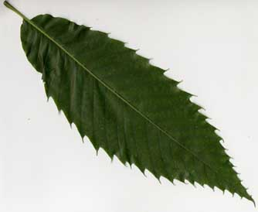
B3- Olympic High School Bioinformatics
Dr. Jennifer Weller
May 2016
Sequence Analysis
Notes:
How do you go from the organism (the American Chestnut tree) to a sample you can collect (the leaf), to the part of the leaf of interest (the chloroplast) to the chloroplast DNA (from sequencing) to putting the sequence together in order (a map) and labeling the parts (annotation) so you can pick out one particular region that you want to barcode?
Part of this involves the wet-lab process that we do in the Summer Science camp, where we use wet-lab tools to purify the DNA sample and carry out the sequencing.
Part of it is a computational process – it still requires tools and knowing how to use them. One of the things you can do is complete the circle to go back to the lab with better (more focused) assays.

Slide 2
Topics
Finding patterns & comparing sequences
Visualizing multiple sequence comparisons

Slide 3
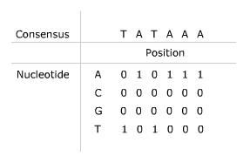
Finding a pattern in DNA
DNA sequence does not come with Capital letters, periods and spaces to help identify ‘words’ or patterns of interest.
A matrix is set up to scan across the DNA string, with the DNA string set up as the columns.

Slide 4
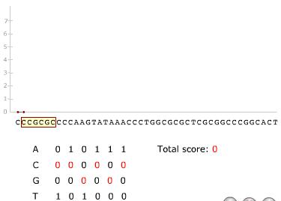
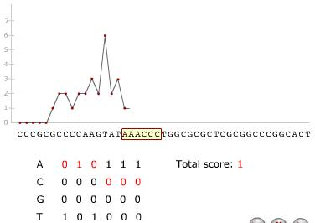
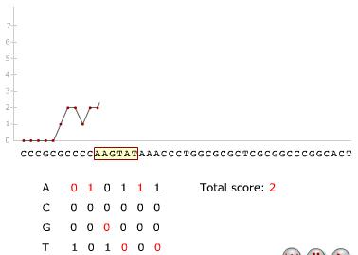
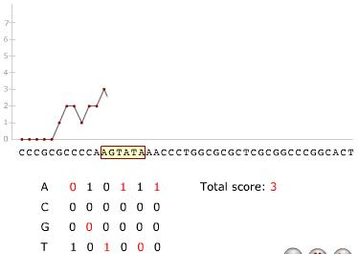
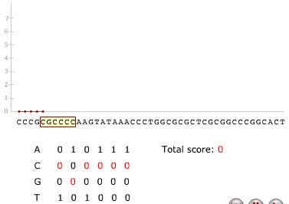
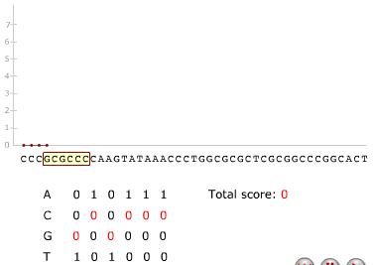
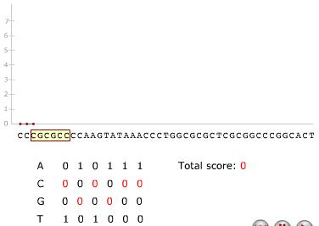
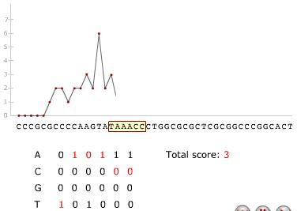
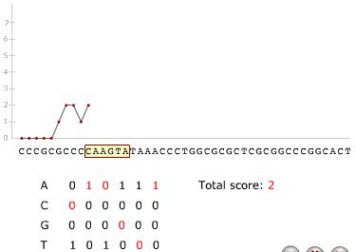
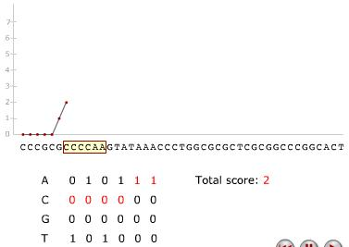
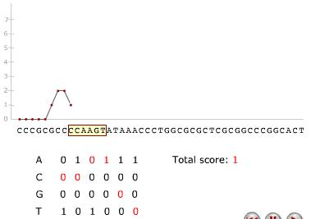
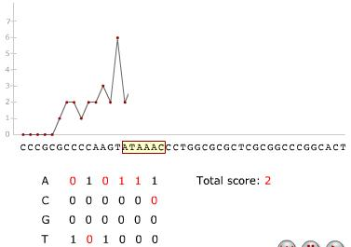
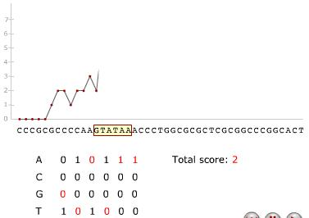
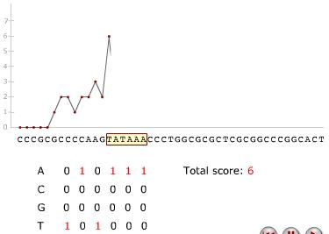
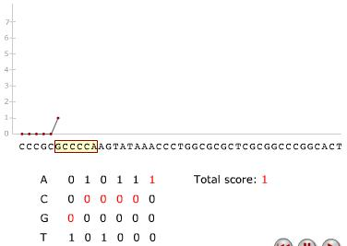
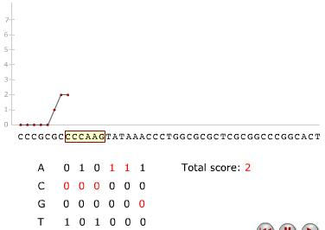
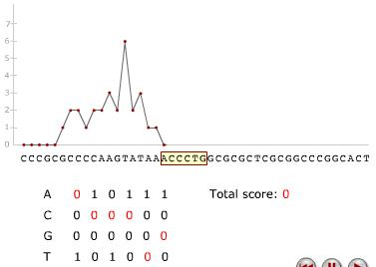
T A T A A A
Notes:
You only get a score when one of the ‘1s’ is in the desired position.

Slide 5
Comparing sequences
We can find a pattern by using a sliding window, as we did above, but we needed prior knowledge – the pattern of interest.
Data-driven approach: we can compare sequences and look for common patterns – if a pattern is present in many organisms, or many places in one organism, it may have some functional importance.
  The sequences should be in register (aligned) with each other or they will look more different than they are:
TCAAAGATTAAGCCATGCATGTCAAAGTACAAGCCCCATTAAGGTGAAACCGCGAATGGCT
GACCTCAAAGATAAAGCCAAGCATGTCAATGTACAAGGCCCATTTAGGTGAAACCGGGAATGG
TCAAAGATTAAGCCATGCATGTCAAAGTACAAGCCCCATTAAGGTGAAACCGCGAATGGCT
GACCTCAAAGATAAAGCCAAGCATGTCAATGTACAAGGCCCATTTAGGTGAAACCGGGAATGG
Notes:
If the sequence is a coding sequence (makes a protein) you can check whether the nucleotide change creates an amino acid change, and check whether the amino acid change looks like it will change the function of the protein in some way. Some changes that don’t change the amino acid in the protein have still been shown to affect the turn-over or regulation of the RNA: the so-called ‘silent’ or synonymous mutations are not necessarily without effect.
I could transform this encoding to the protein encoding if I know the register – where the start of the protein is, and whether there are introns (interruptions) in this gene.

Slide 6
Multiple Sequence Alignment
With two sequences to compare you can slide them along (inserting gaps as necessary) to get the best possible alignment.
With multiple sequences there you have to
  Pick one as the reference
  Align the rest of the sequences
  Nice extras: provide visual cues showing similarities and differences
The DNA Subway Blue line has the MUSCLE program integrated in it. http://www.ebi.ac.uk/Tools/msa/muscle/

Slide 7
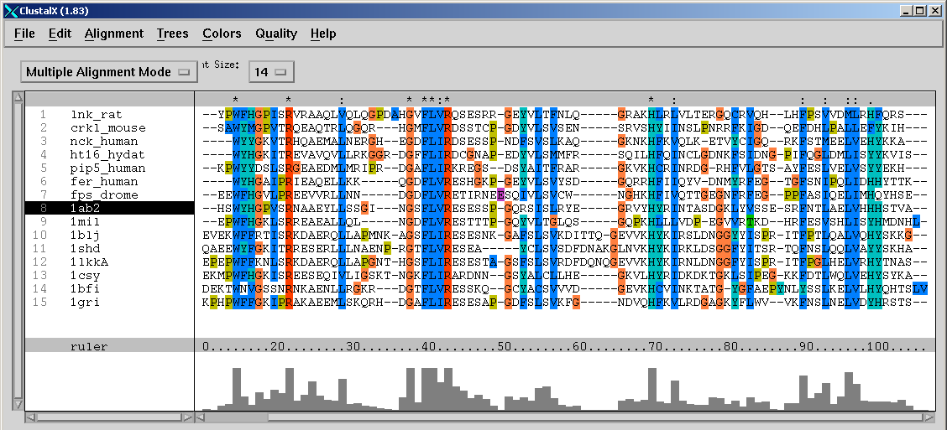
Annotating the MSA
A representation of a set of sequences, in which equivalent residues (e.g. functional or structural) are aligned in columns
Conserved residues
Conservation profile
Secondary structure

Slide 8
Scoring the comparison
You can count the similarities (or differences) between each pair of sequences, and keep track of them in a table (called a matrix in this case).
Below is a comparison of the hemoglobin a and b chains in a number of organisms with scores derived by: (1-(#identical residues/# compared residues) - you can multiply by 100 to get percent.
Each sequence compared to itself is 0 difference (shown as -).
Hbb_human
1
-
.17 -
.59 .60 -
.59 .59 .13 -
.77 .77 .75 .75 -
.81 .82 .73 .74 .80 -
.87 .86 .86 .88 .93 .90 -
Hbb_horse
2
Hba_human
3
Hba_horse
4
Myg_phyca
5
Glb5_petma
6
Lgb2_lupla
7
1
2
3
4
5
6
7

Slide 9
Analogy and Homology
When organisms share a trait due to common ancestry, it is called a homologous trait.
  Vertebrate animals have skeletons because the ancestor of all vertebrates had a skeleton and passed on that trait.
  The trait can be morphological, such as the bones in the front limb, or molecular, such as the RNA that organizes ribosomes.
When organisms share a trait for reasons other than relatedness it is called an analogous trait. Functions may occur as adaptations to a common environmental challenges, giving rise to analogous traits (convergent evolution).
  The ‘eye’ and ‘wings’ have arisen independently a number of times.

Slide 10
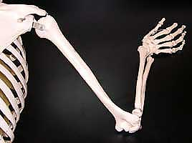
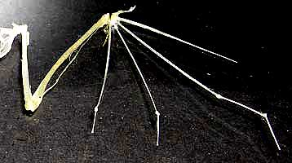
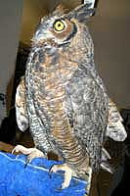
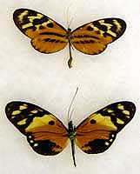
http://www.nku.edu/~whitsonma/Bio120LSite/Bio120LReviews/Bio120LHomologyRev.html

Slide 11
Visualization - Sequence Variation and Homology
Trees are a common way to represent the distance between two elements
You can define different rules for using the distance matrix that determines the branching of the tree.

Slide 12
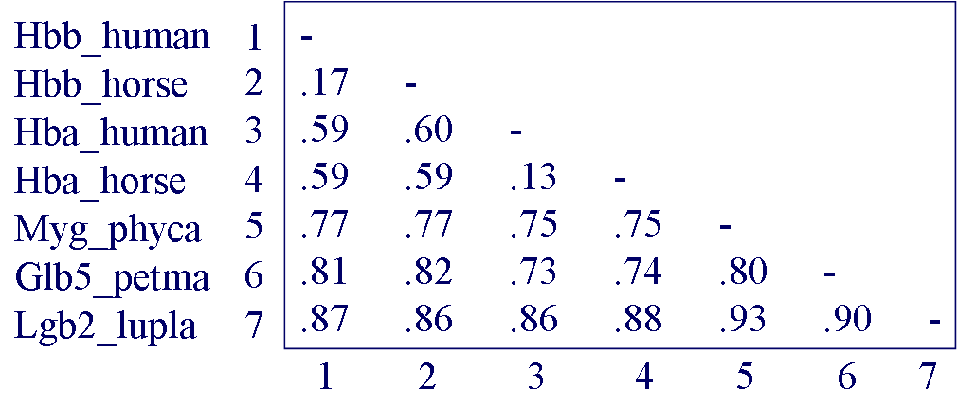
Progressive multiple alignment
Sequential branching / Guide tree construction
Sequential branching
Guide tree
Hba_human
Hbb_human
Hba_horse
Hbb_horse
Hbb_horse
Hba_human
Hbb_human
Hba_horse
Glb5_petma
Myg_phyca
Myg_phyca
Glb5_petma
Lgb2_lupla
Lgb2_lupla
- Join the 2 closest sequences
- Recalculate distances and join the 2 closest sequences or nodes
- Step 3 is repeated until all sequences are joined

Slide 13
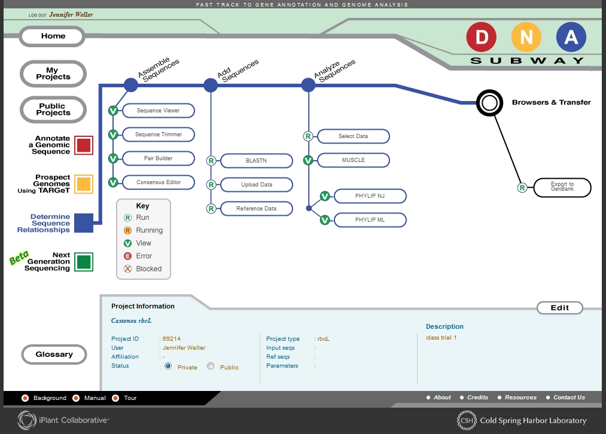
Lab: Using the Blue Line for sequence comparisons
Log into the Blue Line
We are going to use the chloroplast gene coding for a protein used in the photon-to- sugar conversion pathway called Ribulose bis-phosphate carboxylase or RubisCO - the protein has two subunits, we will be looking at the gene for the large subunit (rbcL) for our comparisons.
Select CSH HS Oct 2010 for an example of such a gene sequence.
Name the project (your initials, CP1 for example)

Slide 14
Add more sequences from a database
You can use one of the sequences as a search string against a database of sequences like GenBank – this lets you add sequences from other species than those you sampled yourself.

Slide 15
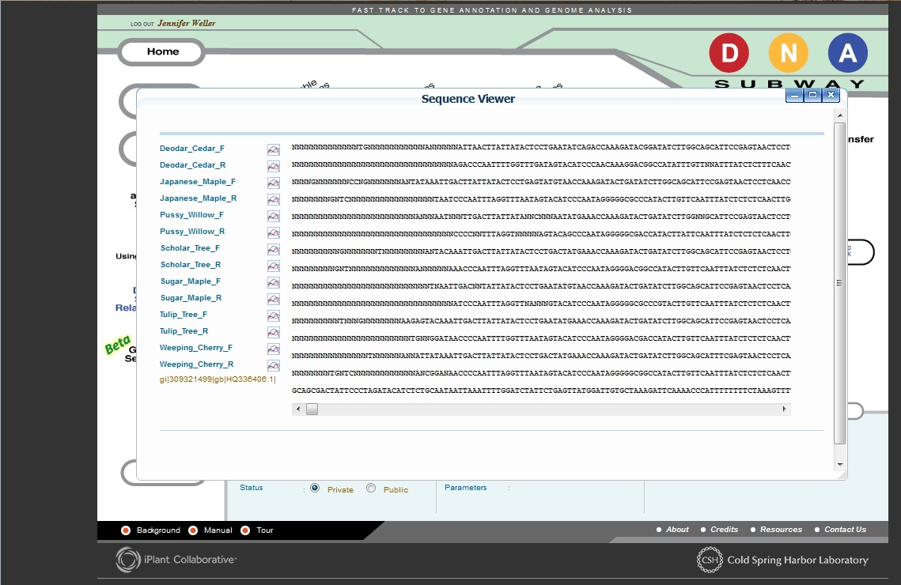

Slide 16
Sequence data can be imported and inspected
Why would you want to eliminate poor quality base calls?
By pairing forward and reverse reads you can
  Get better quality assurance on base calls that overlap
  Get longer reads where forward and reverse do not overlap
Why do you want sequences you are comparing to be the same length? Should the consensus be perfect? What does it mean if it is an exact match?
  Build a agreed-upon sequence – a consensus – a region of the same length and mostly the same sequence

Slide 17
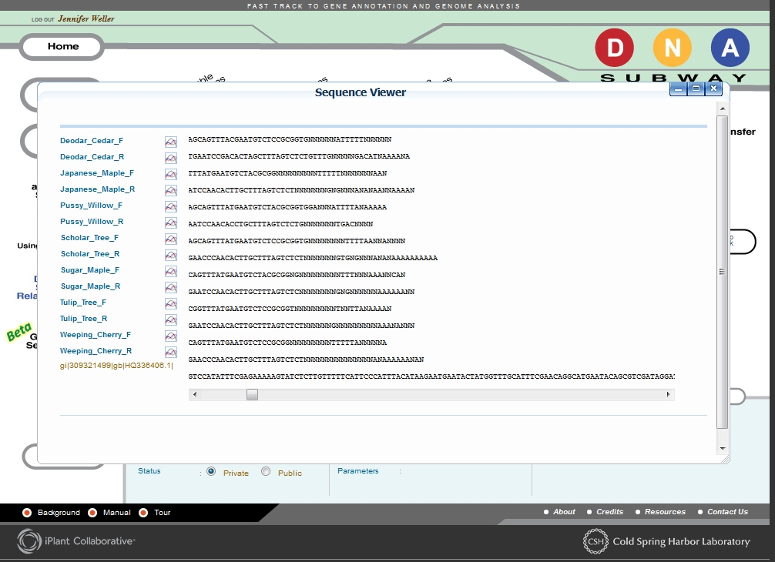

Slide 18
Screen shots for saving data

Slide 19
Quality scores
If the information is available, a quality score cut-off can be imposed – low-quality bases will be greyed out.
  These can be trimmed
  If there are paired reads that overlap and they disagree at one position, if one is below the quality cut-off score then the other call will be used in the consensus sequence for that sample.

Slide 20
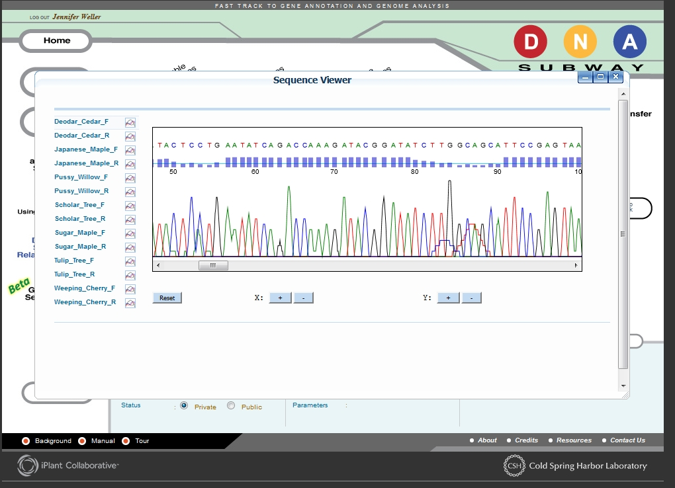

Slide 21
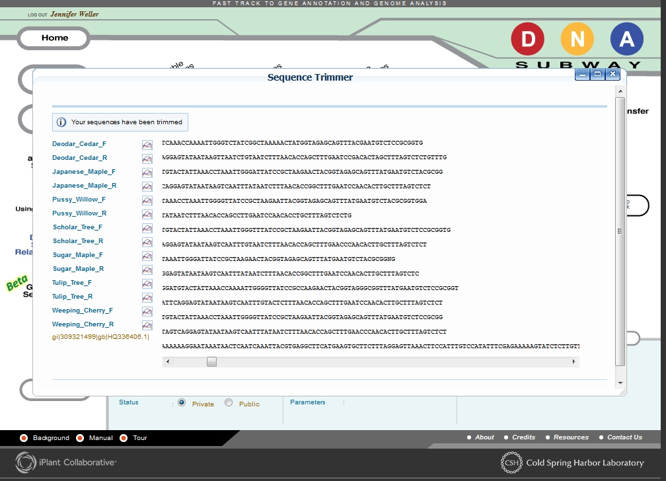

Slide 22
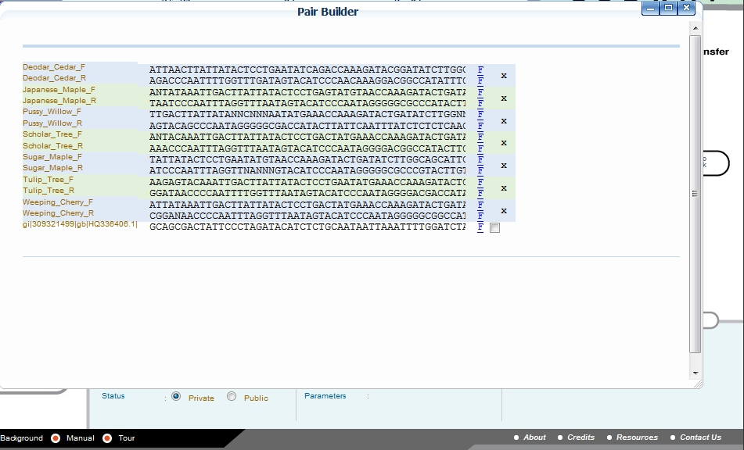

Slide 23
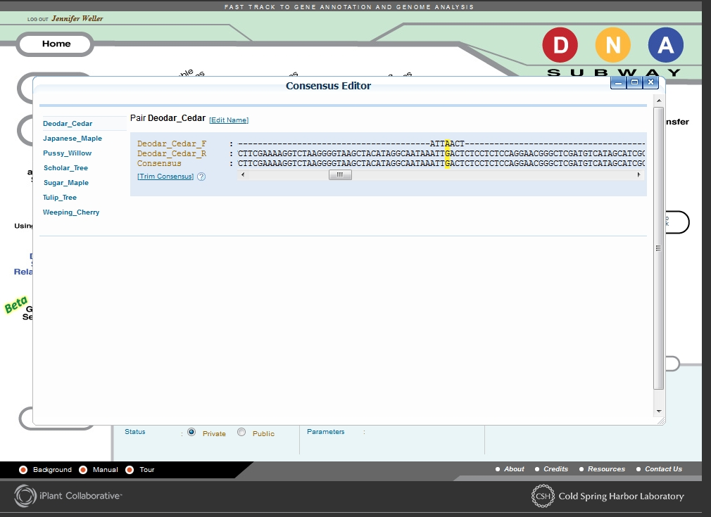

Slide 24
Multiple Alignments - MUSCLE

Slide 25
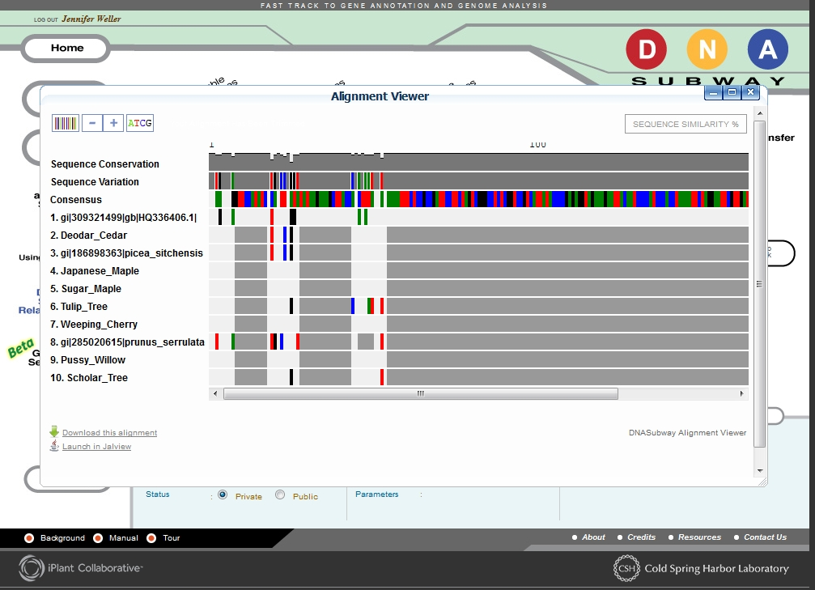

Slide 26
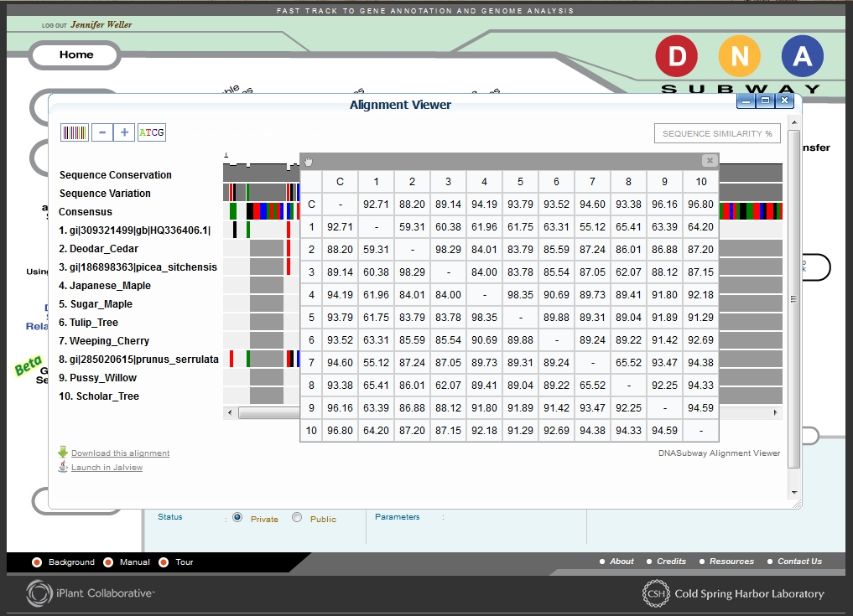

Slide 27
Visualizing the comparisons
Phylip – Neighbor Joining
Phylip – Maximum Likelihood

Slide 28
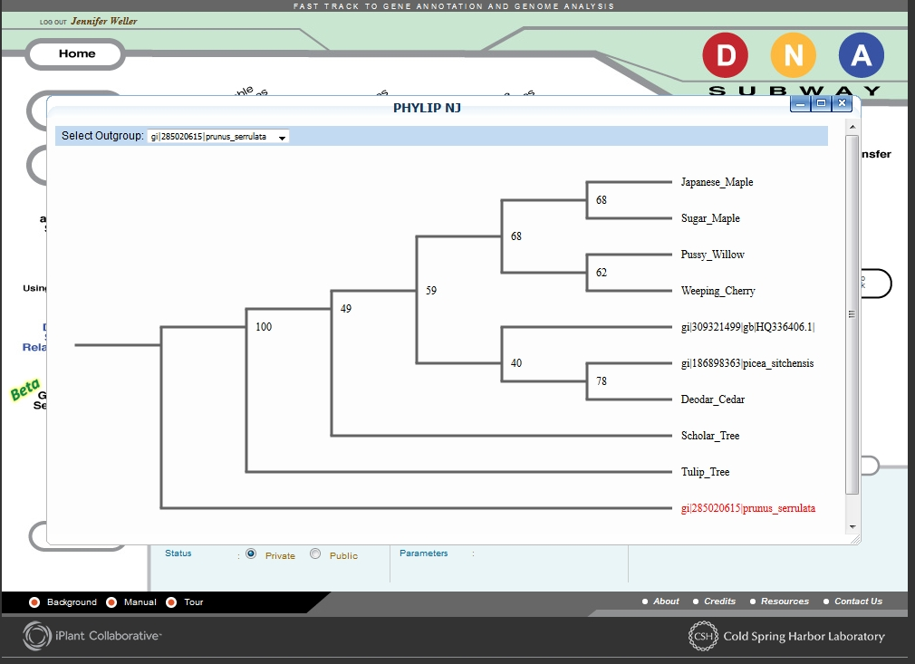

Slide 29
