Slide 1
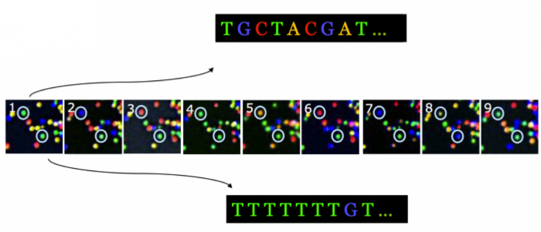
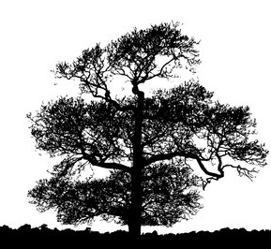
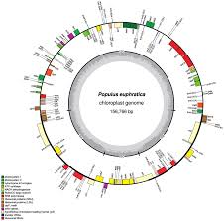
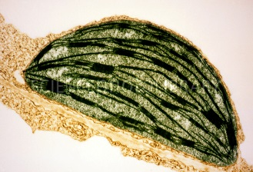
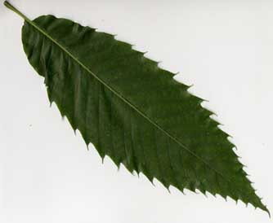
B3- Olympic High School Bioinformatics
Dr. Jennifer Weller
May 2016
Sequencing Technologies
Notes:
How do you go from the organism (the American Chestnut tree) to a sample you can collect (the leaf), to the part of the leaf of interest (the chloroplast) to the chloroplast DNA (from sequencing) to putting the sequence together in order (a map) and labeling the parts (annotation) so you can pick out one particular region that you want to barcode?
Part of this involves the wet-lab process that we do in the Summer Science camp, where we use wet-lab tools to purify the DNA sample and carry out the sequencing.
Part of it is a computational process – it still requires tools and knowing how to use them. One of the things you can do is complete the circle to go back to the lab with better (more focused) assays.

Slide 2
Topics
Signal Detection
errors, base calls and quality scores
Sequence Assembly
Overlaps, ordering, redundancy

Slide 3
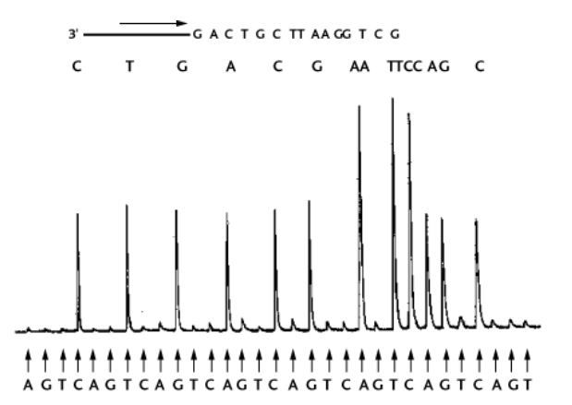
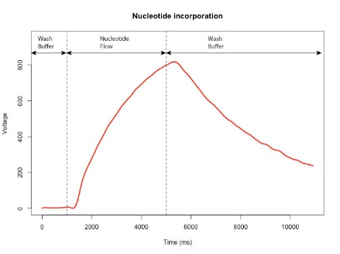
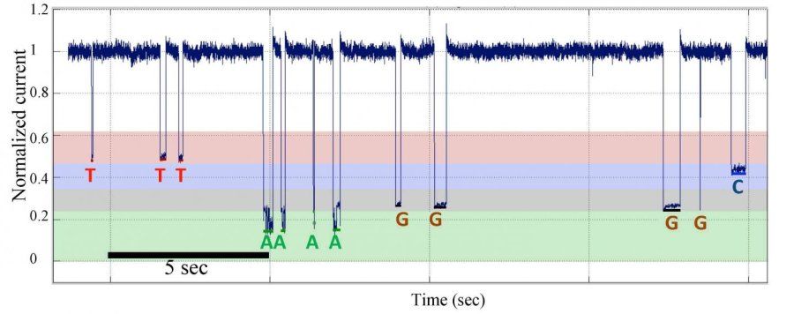
Signal Quality
Types of signals
Types of errors
Quality Scores

Slide 4
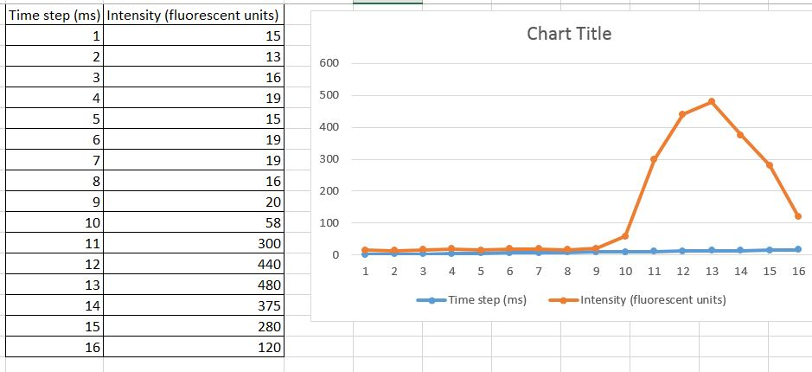
Primary and interpreted signal
The primary signal is what the instrument measures
For example, with the fluorescent-dye capillary electrophoresis system the dye passes the detector in a cloud, which is converted to a nicer visual form by signal processing software.

Slide 5
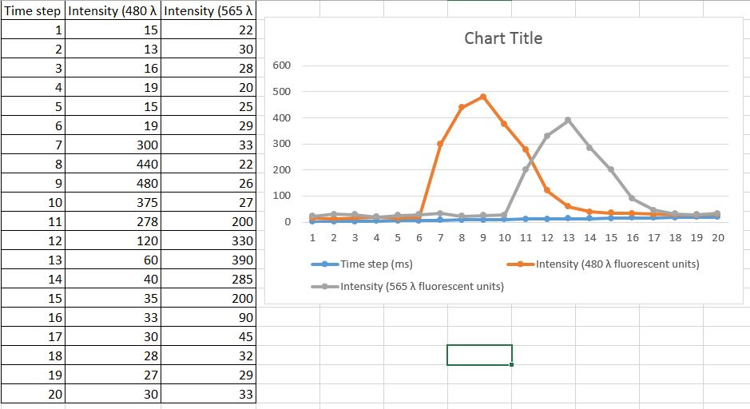
Bands are not equally/completely spaced
Detector
Detector
Detector
Detector
Detector
Detector
Detector
Detector
Detector
Detector
Detector
Detector
Detector
Detector
Detector
Detector
Detector

Slide 6
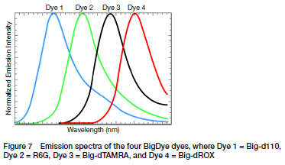
Detector selects wavelength band
The dyes produce photons at wavelengths that overlap – depending on where the detector is set, the signal might be quite specific, but not very sensitive.
The dyes overlap – all wavelengths in the set are tracked: the software mathematically filters fluorescence signal from dyes when there is overlap.

Slide 7
Signal Processing: Basecalling
Each base is labeled with its own dye.
There is a background level of fluorescence – you set a level so that only a peak greater than that level is a ‘real’ band.
There should be some minimal separation between peaks to be sure the order is correct.
The dyes change the behavior of the fragments, so one type of chemistry behaves a little different from another – you use training sets for this
What makes a good training set?
The software will assign ONE base to each peak (A, C, G, T, or N if it really can’t tell).

Slide 8
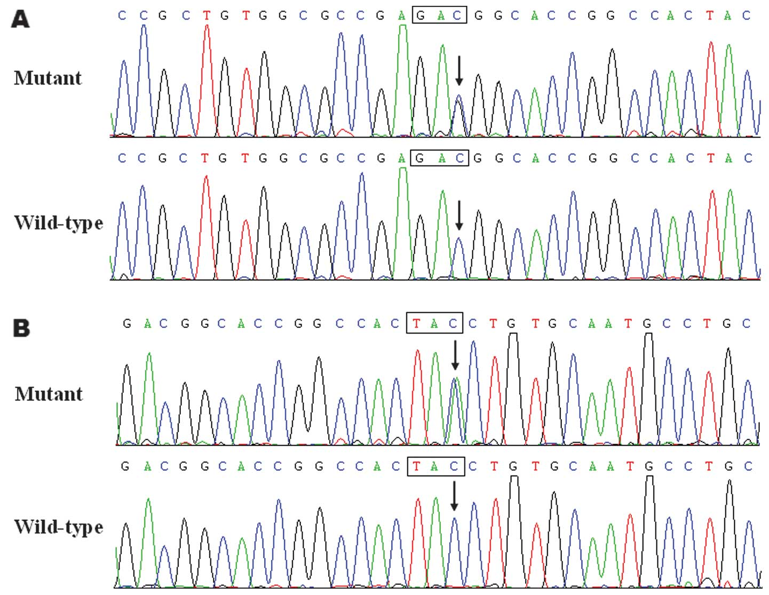

Slide 9
Data Processing: Quality scores
When sequence data was first collected only the base calls were submitted.
Bad science: trying to interpret as a mutation a call that was a mistake.
Phil Green at the University of Washington first came up with the idea of assigning a quality score to predict the probability of a basecall error.
His algorithm is called Phred – you often hear people talk about ‘Phred scores’ even when they did not use that algorithm.
FinchTV is an electropherogram viewer/editor that implements Phred – if there is time we will try it out.
File extensions are .abi or .sff for sequence files and .phd for phred calls.
Different algorithms use different assessment methods. Using the same raw data, Phred may assign a score of 20 while KB assigns a score of 15.
A QV of 20 predicts an error rate of 1%.

Slide 10
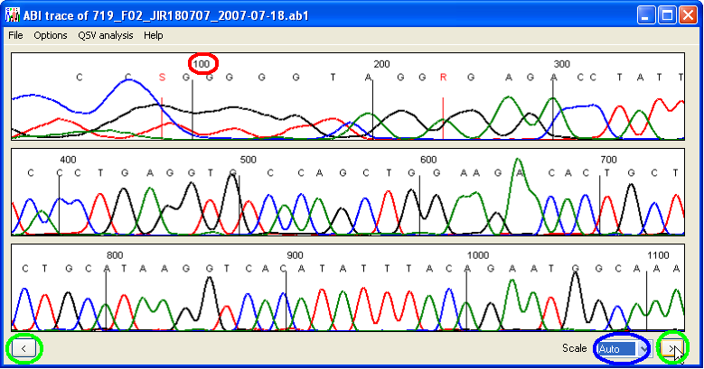
What are some things you notice about these peaks?
Is there a characteristic peak height and width for each color?
Is there a characteristic separation between peaks at the top?
Is there a characteristic separation at the bottom?
Do some of the characteristics depend on the neighbors?
Use a training set of known sequences, run them many times, look at the frequency of incorrect base calls, turn that into the probability that a given call is correct - basically a weight.

Slide 11
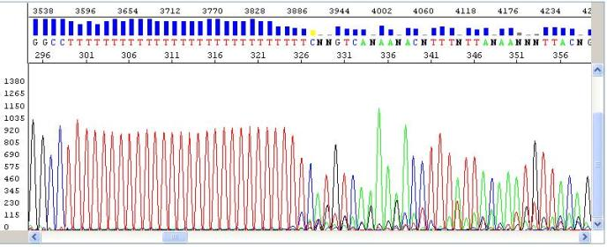
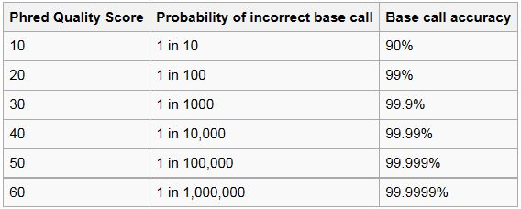
Q = -10logP

Slide 12
Using Quality Scores
If you have 5 sequences of the ‘same’ gene but there is a sequence difference at several positions in two of the reads, do you conclude you have found a variant, or is there an error?
If you have sequenced across a gene that is 5000bp long, using 12 overlapping sequences, which sequence are you less likely to use when assembling the virtual sequence (the contig)?

Slide 13
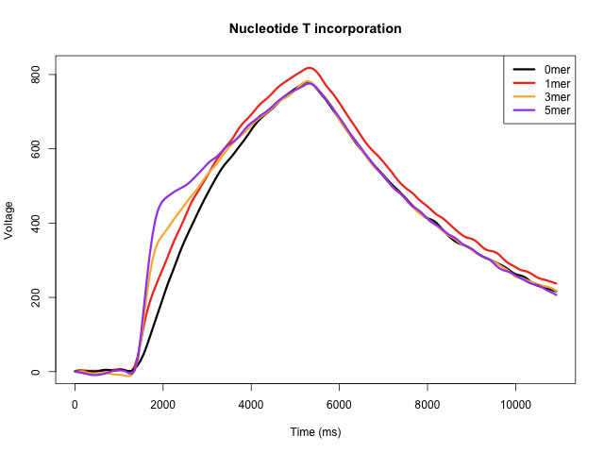
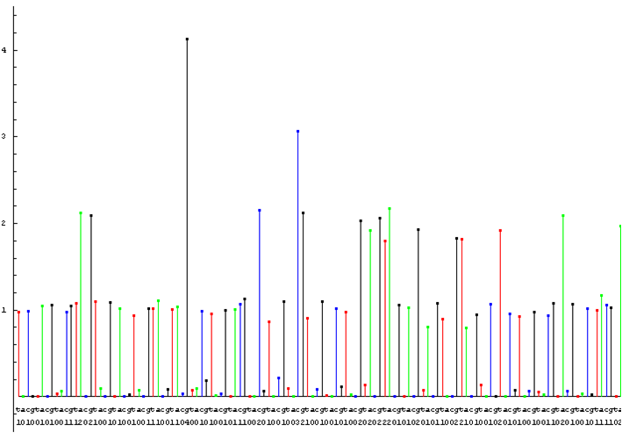
What about the NGS platforms?
Ion Torrent: Shape of voltage response, whether there is background, how close the response it to a unit level, whether there is response for only one type of base in each set of flows.

Slide 14
Pacific Biosciences – this has a very high base call error rate (15%)
Illumina: the image has to be carefully registered, the dyes can overlap, etc.

Slide 15
Why don’t we have sequence viewer/editors for NGS platforms?
It is possible to access the raw files, but each run has hundreds of thousands of reads. Keeping track of the subset you have looked at and the changes made will require a lot of bookkeeping and Data Science skills.
The image files are extremely large and there is a huge stack of them – you will need some Data Science skills.
Therefore biologists don’t tend to interact with the raw data and edit it – they take the sequence data with quality scores and focus on the downstream operations.
Note: research does go on to improve our understanding of what affects the signal, the processing and therefore the data quality!
Note: because the signal properties are so different, the quality scores for different platforms may not mean quite the same thing – combining data from different platforms may mean some filtering has to be done in addition to using the Q values.

Slide 16
FastQ files for encoding Base call + Q value
With electropherogram data, the phred scores were stored in a separate (.phd) file. This is very inconvenient – what if they get separated? What if you use the wrong one?
A single file prevents this, but you could do this in several ways.
AAA then 202520, or A20A25A20.
Generally you will see 4 lines/read
@ with an identifier and a description that is optional
The base calls as letters (AGTC or N)
‘+’ (if paired-end there will be a matched ‘-’ for the other strand)
The base call+ quality values, encoded as single ASCI characters (starting at code 33 and adding the Q value so Q20 is ASCII character 53, which is 5).

Slide 18
ASCII characters. simplified

Slide 19
NCBI fastQ
The file is now being loaded with more information – but it is intended to help identify the exact sequence and sample.
So what are the quality scores here? I= 40, 9 = 24, G=38, C = 34
@db identifier
Instrument ID
:Lane:tile:Xcoor:Ycoord

Slide 20
QC Lab
The Human Genome Project did not allow data that did not achieve a Phred Score of at least 30 for each base to be included in the final data set. What fastQ characters would you filter for to know what files to exclude?
The amount of usable sequence in a read has to be at least 75 nucleotides, and they have to all be of Q30 or higher. If you trim off the ends of the sequences in the file (which is mostly where low values occur) which of the sequences is now usable for the project?

Slide 21
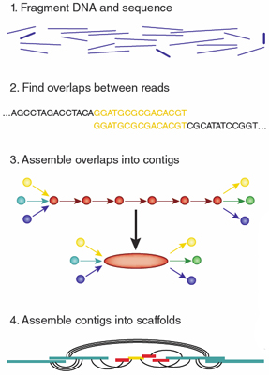
The Fragment Assembly Problem
Sequencing platforms produce high-quality sequence for only 200-500nt lengths.
Genes and genomes are much longer (a bacterial gene is ~3000nt on average, a genome might be 3million bp)
The DNA is broken into pieces you can sequence by one of 2 strategies
Sequence walking: using restriction enzymes and cloning vectors
Shotgun sequencing: shearing randomly
The pieces have to be put back together
Method 1: other data provides the order
Method 2: The pieces contain overlaps.

Slide 22
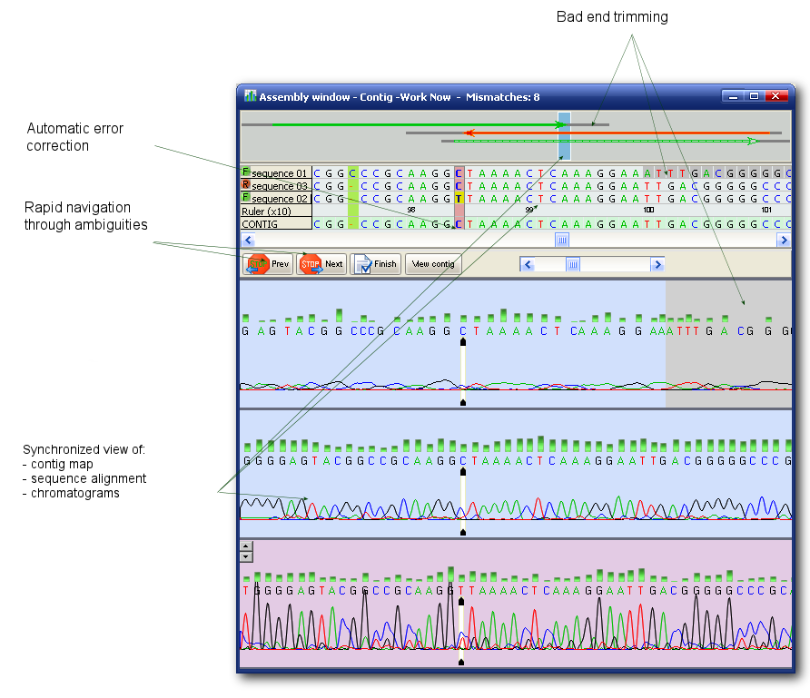
Assembly Rules
How much overlap (the k-mer where k is the overlap length) should you require?
Are there ways you could estimate this length for a known genome?
Should the quality score matter?
Should you trim the sequence?
Should you filter out sequences with low-quality bases in the middle?
Is it useful to keep track of how many times a nucleotide has been incorporated (through individual reads) in the longer contig?

Slide 23
Randomness, size filtering and X-fold coverage
We have a 42-bp sequence. In one experiment we only had 2 copies, in one we had 4 copies and in one we had 6 copies.
Random fragmentation was performed.
Fragments 8bp and smaller were discarded, there was no upper limit (that is all fragments longer than 8bp were kept).
Perform and record your strategy for re-assembling the original sequence.
Notes:
CATCACG CTTGTCG ATTTACT TGCATCG CATCACT TATTGCC

Slide 24
Quality Scores and 5X coverage
To the previous rules, add that bases used in the actual assembly (the overlaps) must have a quality score of at least Q30, unless there are two fragments with the same base call in that position and neither has a quality score lower than Q25.

Slide 25
Why we like longer reads, even at low quality
The long sequence can only be used to order shorter contigs when 80% of the nucleotides are in the same order OR when all of the nucleotides in the overlap have a Q30 or better.

Slide 26
Algorithms and Software for the FAP
There are competitions for algorithms, using datasets that include specific types of problems
There are approaches to managing the computer memory problems – how to handle millions of fragments efficiently.
So → not a solved problem
Some examples of software are given here, with reviews and recommendations, http://omictools.com/genome-assembly-category although some links are no longer active.

