Slide 1
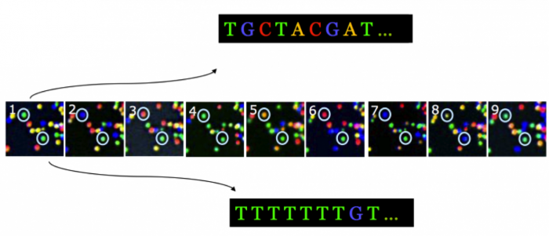

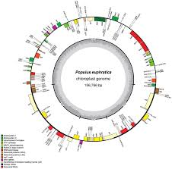
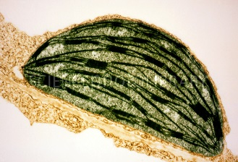
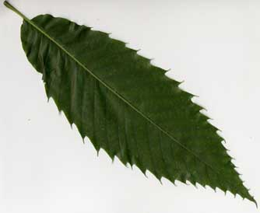
B3- Olympic High School Bioinformatics
Dr. Jennifer Weller
May 2016
Sequencing Technologies
Notes:
How do you go from the organism (the American Chestnut tree) to a sample you can collect (the leaf), to the part of the leaf of interest (the chloroplast) to the chloroplast DNA (from sequencing) to putting the sequence together in order (a map) and labeling the parts (annotation) so you can pick out one particular region that you want to barcode?
Part of this involves the wet-lab process that we do in the Summer Science camp, where we use wet-lab tools to purify the DNA sample and carry out the sequencing.
Part of it is a computational process – it still requires tools and knowing how to use them. One of the things you can do is complete the circle to go back to the lab with better (more focused) assays.

Slide 2
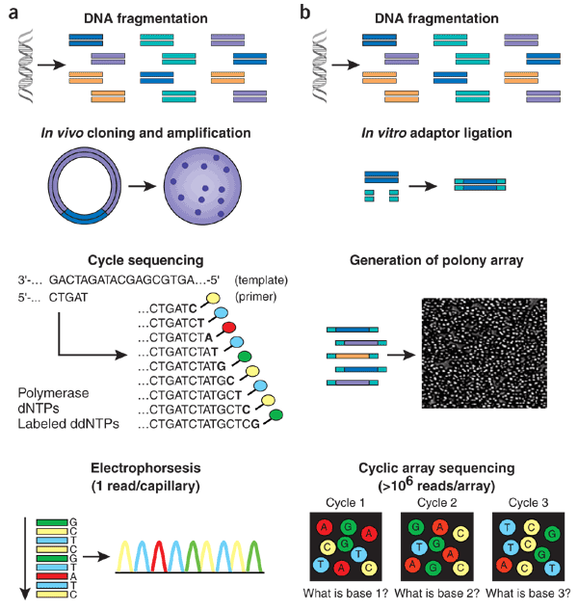
Topics
Fundamentals of ‘Sequencing by Synthesis’
Sequencing Technologies or ‘Platforms’
  Sanger/Capillary sequencing
  High-throughput or Next- Generation Sequencing Technologies
Part 2: Signal recognition, errors, base calls and quality scores with Assembly

Slide 3
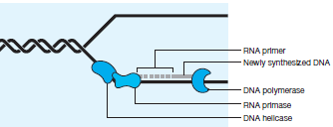
Synthesis = Organic chemistry OR DNA replication
Cells make new copies of DNA using replication proteins
  1 short bit of complementary primer (short piece of nucleic acid, usually RNA)
  Building blocks = deoxyribonucleotide subunits (dNTPs.)
  3 enzymes: DNA helicase, DNA polymerase, RNA primase
    DNA helicase unwinds the 2 strands – they become templates.
    RNA primase introduces the primer at the junction
    DNA polymerase then binds to primer-template and starts adding nucleotides to the 3′-hydroxyl end of the primer so the new strand grows in the 5’ → 3’ direction.

Slide 4
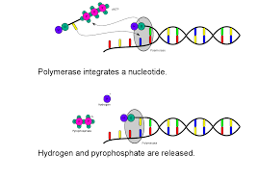
In vitro biosynthesis
How can you separate the strands?
  The H-bonds can be broken using heat or base while the covalent backbone stays intact.
What can you do to provide the primer?
  Organic chemists learned how to synthesize dNTPs and use them to make short pieces with a known sequence
What can you do to provide the polymerase?
  Purify the protein from a source that has a lot, like E coli
  Clone a gene, put it into E coli or yeast, purify the protein
The polymerase moves REALLY fast.
Notes:
A template is single stranded, the sample is double stranded – how can you do this? Clone helicase or use another approach.
This makes one copy – what can you do to detect the steps (2000nt per minute may be added)

Slide 5
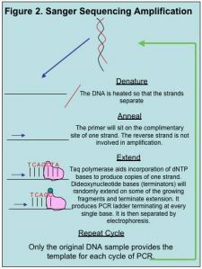
Sequencing by Synthesis – Generation Zero
Clever Chemist Wins Nobel Prize: Fred Sanger
We need to
  Slow the polymerase down
  Include something you can detect.
Strategy: include some synthetic modified nucleotides that have a defect: no more nucleotides can be added = stop means you have slowed down a lot).
Label the phosphate group with radioactive P³², which will cause film to darken.

Slide 6
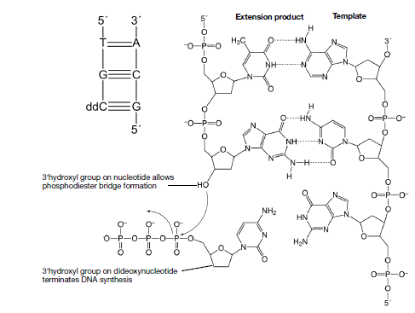
Notes:
DNA polymerase can incorporate 2′, 3′-dideoxynucleotides, synthetic analogs with a 3’-H that cannot form phosphodiester bond.

Slide 7

Add a ratio of about 1 ddNTP* per 10 dNTP so most of the DNA strands keep growing. Run 4 reactions side by side.
  The end product is a one-sided nested set of complementary fragments.
Separate the products by length using gel electrophoresis.
Put a piece of film on top of the gel to expose it.

Slide 8
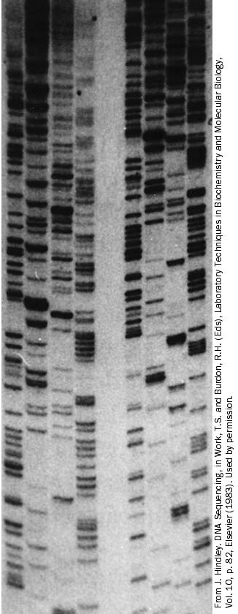
Fragment separation
Shortest fragments are at the bottom, closest to the primer
The order is preserved, but complementary to the template fragment – you are copying it using sequencing by synthesis.
Bands get closer together towards the top of the gel – this is very hard to ‘read’.

Slide 9
Gen 1: better chemistry, auto-detection and software!
It would be nice to get rid of the P³². What else do we have sensitive detectors for?
It would be nice to have automatic, real-time signal detection.
This is Generation 1 in Sequencing by Synthesis
  Use fluorescent dyes and a fluorescent signal detector built into the electrophoresis platform.
  Photon emission data is stored as a function of time and wavelength
  Software processes the signal and interprets it.

Slide 10
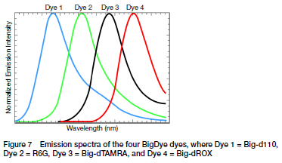
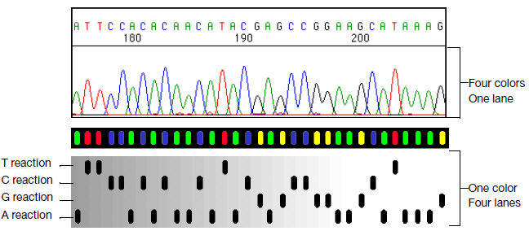
Fluorescent Dyes and Data Output

Slide 11
Sequencing by Synthesis Gen2 – High Throughput or Next-Generation Sequencing
Wish-list: no more electrophoresis and much higher numbers of sequences per run of the instrument.
Illumina strategy – use fluorescent-dye labeled dNTPs, block extension in a reversible way and use much better optical systems
To get the more reads: use a flat clear surface (flow cell) with short oligonucleotides covalently attached to it at an even density.
The change in chemistry: each dNTP has its own color, but the block at the 3’ –OH can be removed. After each polymerase step the extra dNTPs are washed away, an image is captured, then the block is removed so each strand can be extended again.
Signal detection: A flow cell is imaged (4 times, once to capture each color) after each flow of dNTPs
  The flow cell is imaged in 100 tiles each time in 4 colors.
  37 cycles gives 118, 400 images
  Resolution: one pixel is 0.14um² with 9 pixels per cluster
Notes:
You end up with about 10 million sites per flow cell, each with about 1000 copies of the template.

Slide 12
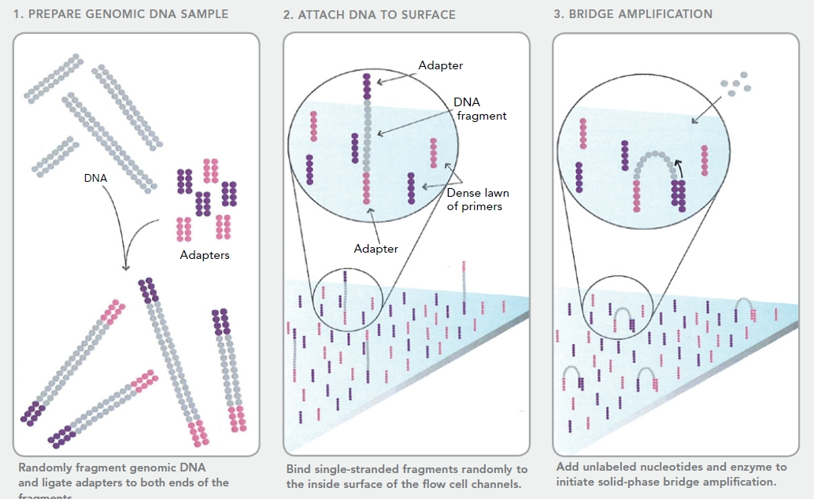
Illumina - MiSeq and HiSeq

Slide 13
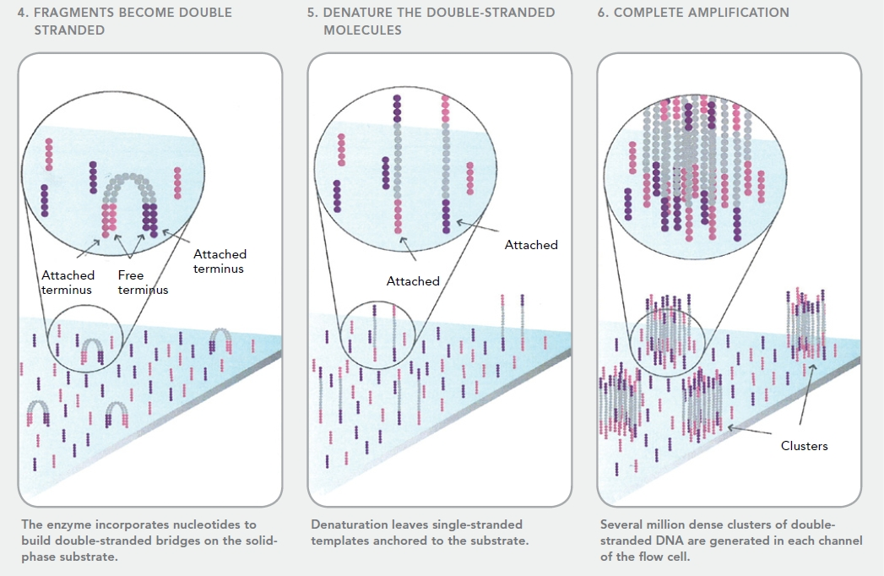
PCR colony = Polony creation
Notes:
Clusters are sometimes called polonies, or polymerase-generated colonies
Note that you would end up with both strands that could be sequenced – you cleave off the strand of choice (based on a restriction site in each adaptor) before starting the sequencing

Slide 14
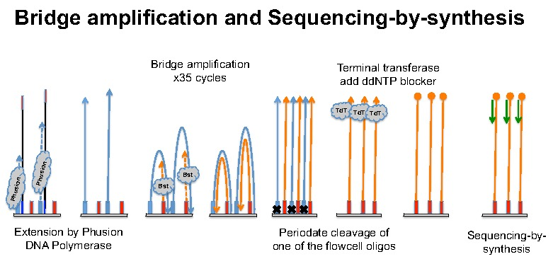
Single-stranded DNA anneals to one of the flowcell oligos (primer) → synthesize copy.
The new strand flops over and finds the complement on its other end on the surface (primer) → synthesize copy.
New strands are very close together (the length of the DNA template) → colony
Add sequencing primer and dye-labeled 3’ blocked dNTPS.

Slide 15
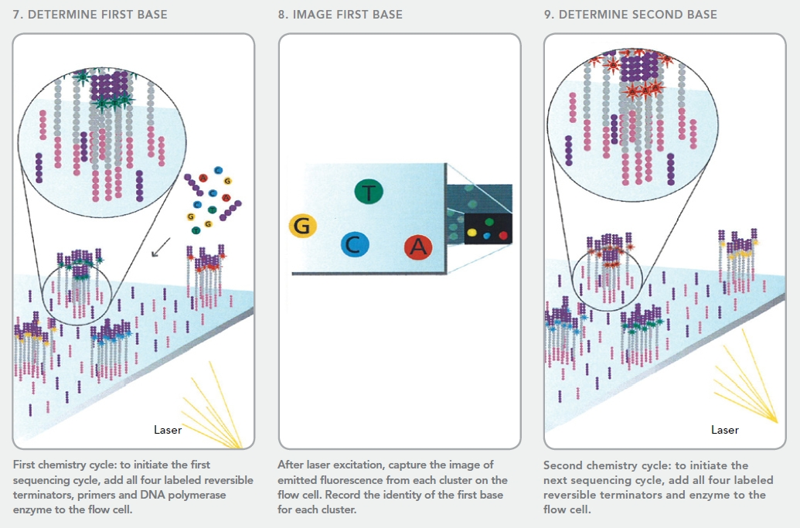
Reagent Cycling and Data Capture

Slide 16
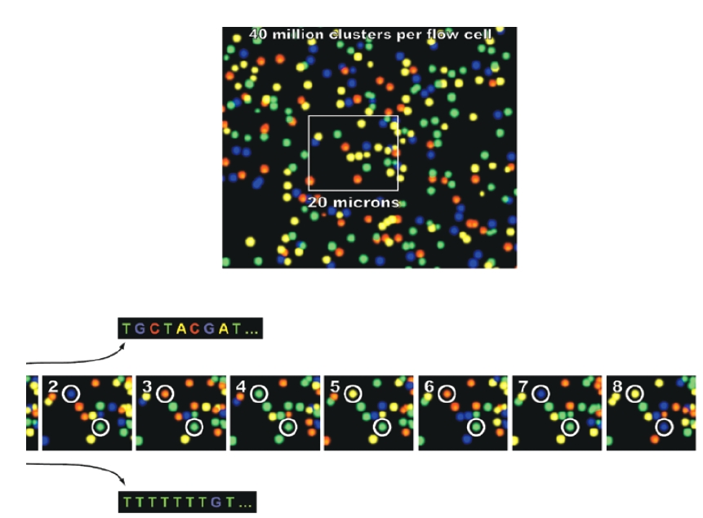
Examples of images
Location is the basis for building sequence

Slide 17
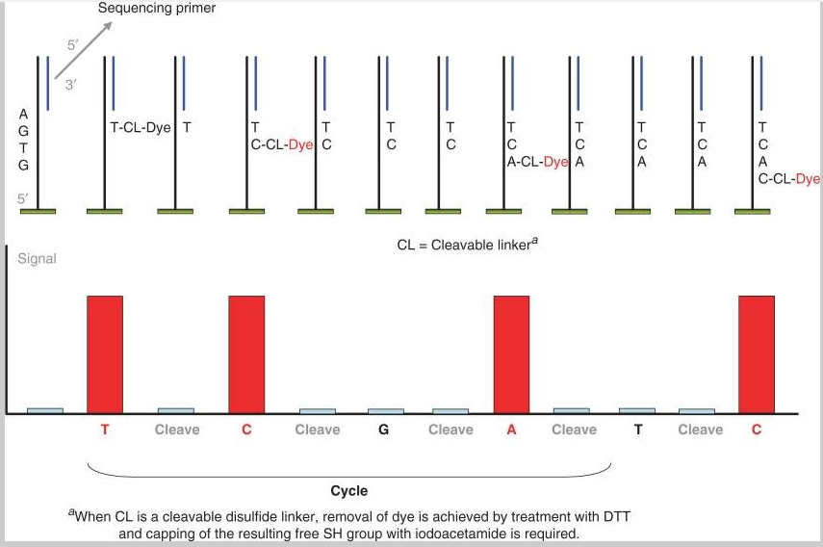
Data Read-out = Flowgram

Slide 18
What other sequencing options do we have?
Notes:
This makes one copy – what can you do to detect the steps (2000nt per minute may be added)

Slide 19
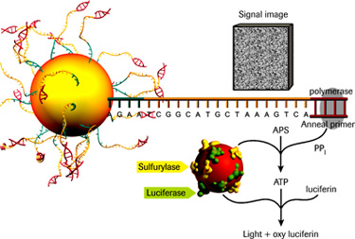
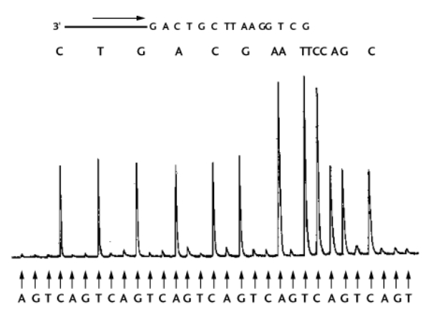
454: pyrosequencing
http://www.454.com/products-solutions/how-it-works/index.asp
Notes:
Adaptors have biotin so streptavidin can be used for purification
The pyrophosphate molecule released when the nucleotide is added to the chain is used for energy by a bacterial pyrophosphatase – it makes ATP which is then used by luciferase to make light.
Generates ~20Mb of sequence per run
200,000 reads per run
5.5 hours per run
$6-8k per run
Prep takes longer than a day

Slide 20
What other sequencing options do we have?
Notes:
This makes one copy – what can you do to detect the steps (2000nt per minute may be added)

Slide 21
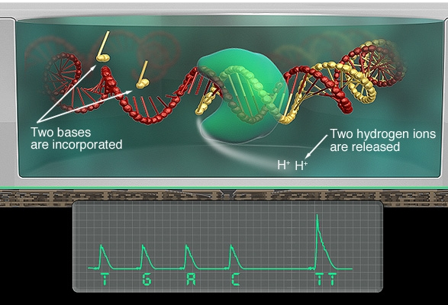
Ion Torrent Platform

Slide 22
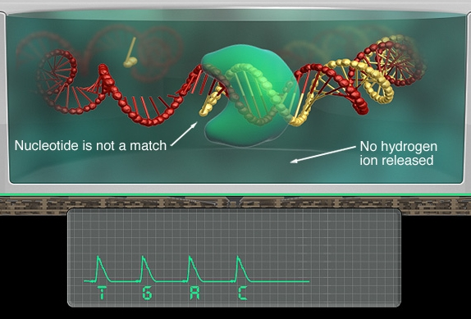
Ion Torrent Platform

Slide 23
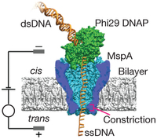
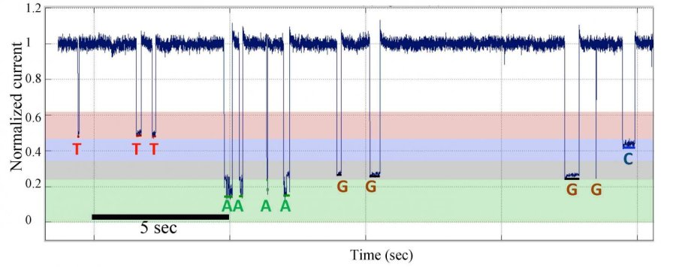
Third-Generation Sequencing is NOT sequencing by synthesis.
Note: there was one second-generation platform that used a different enzyme (DNA ligase) to add nucleotides to a template.
Single-molecule detection systems, threading DNA through a nanopore.

Slide 24
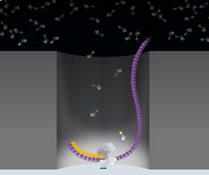
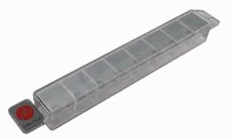
Pacific Biosciences Single Molecule Sequencing
Goal: No PCR amplification, longer reads
A DNA polymerase is tethered at the bottom of well – it binds to a circularized template.
As nucleotides are added the event is detected and the DNA molecule is advanced one base.

Slide 25
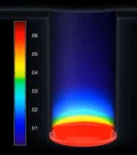
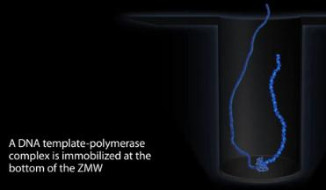
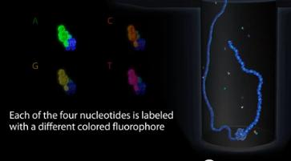
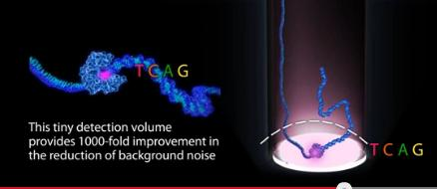
Pacific Biosciences Single Molecule Sequencing

Slide 26
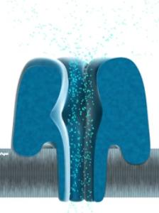
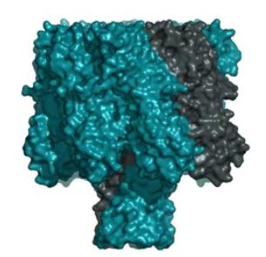
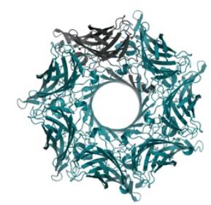
Oxford Nanopore – single-molecule sequencing
In this case the DNA passes through a nano-scale pore made of protein.
Notes:
Nanopore is in a synthetic membrane with high resistance. Current only go through the aperture – this changes the resistance.
An intact polymer is – the DNA enzyme complex attaches to the nanopore – the enzyme feeds the DNA through at a controlled rate. Both strands can be sequenced if a structure is placed

Slide 27
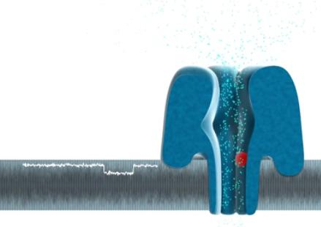
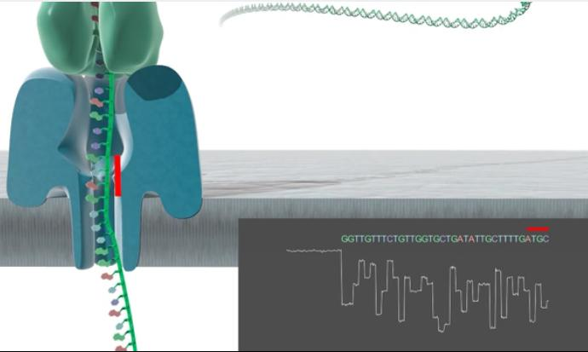
Oxford Nanopore – single-molecule sequencing
Current flows only through the aperture of the Nanopore
Notes:
Nanopore is in a synthetic membrane with high resistance. Current only go through the aperture – this changes the resistance.
An intact polymer is – the DNA enzyme complex attaches to the nanopore – the enzyme feedsthe DNA through at a controlled rate. Both strands can be sequenced if a structure is placed

Slide 28
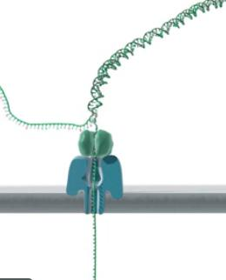
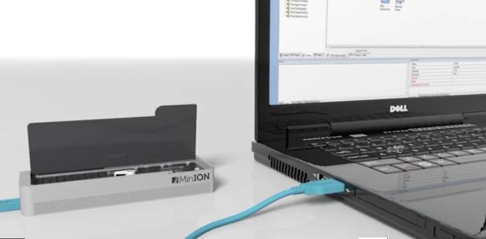
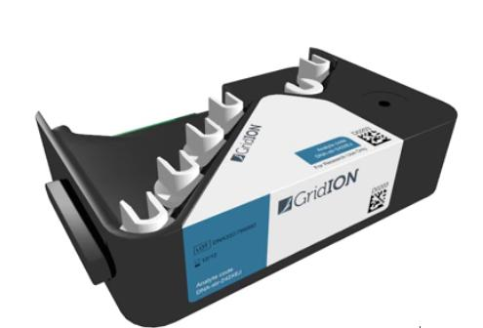
Oxford Nanopore – single-molecule sequencing
Both strands can be sequenced if a hairpin is included at one end.
Notes:
Nanopore is in a synthetic membrane with high resistance. Current only go through the aperture – this changes the resistance.
An intact polymer is – the DNA enzyme complex attaches to the nanopore – the enzyme feedsthe DNA through at a controlled rate. Both strands can be sequenced if a structure is placed

