Slide 1
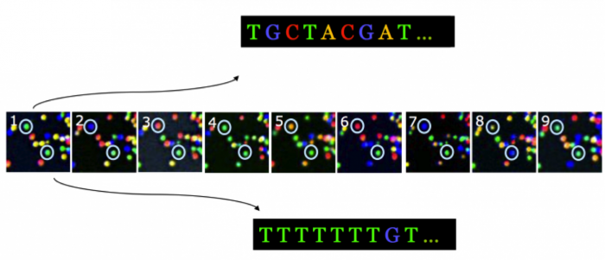

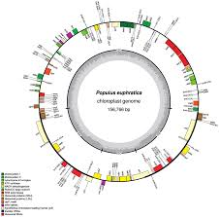
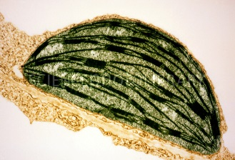
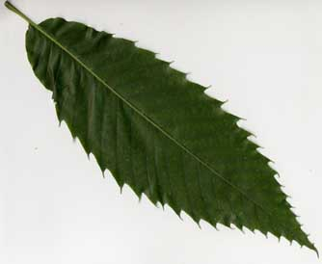
B3- Olympic High School Bioinformatics
Dr. Jennifer Weller
May 2016
Notes:
How do you go from the organism (the American Chestnut tree) to a sample you can collect (the leaf), to the part of the leaf of interest (the chloroplast) to the chloroplast DNA (from sequencing) to putting the sequence together in order (a map) and labeling the parts (annotation) so you can pick out one particular region that you want to barcode?
Part of this involves the wet-lab process that we do in the Summer Science camp, where we use wet-lab tools to purify the DNA sample and carry out the sequencing.
Part of it is a computational process – it still requires tools and knowing how to use them. One of the things you can do is complete the circle to go back to the lab with better (more focused) assays.

Slide 2
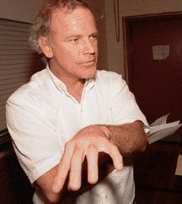
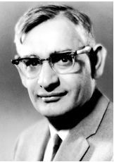
Polymerase Chain Reaction
Paper 1988
Nobel: 1993
C.Mullis
Paper 1971
Nobel: 1968
H. Khorana
How do you get enough target DNA to sequence it?
  Purify DNA and sequence all of it using NGS methods
  Use the Polymerase Chain Reaction to make copies of the regions of interest
Current NGS platforms depend on PCR
  Library production (replaces cloning)
  Putting copies on beads or surface colonies
Notes:
Tens of thousands of specific sequences and millions to billions of bases in any genome (besides viruses)
Pull out and manipulate the 3000 nucleotides of interest
Extremophiles, then genetic engineering
1988, Saiki, Mullis et al. in Science
using a polymerase purified from an organism characterized by Brock from Yellowstone N.P.

Slide 3
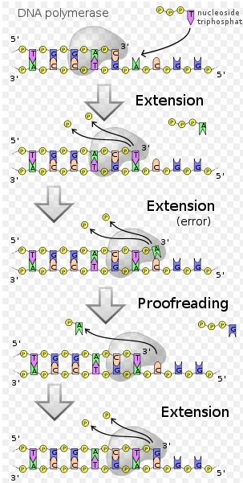
Polymerase basics
Initiation step
XNA-dependent XNA Polymerases
  X can be either DNA or RNA
  The template is single stranded
  A copy-complement of each strand is made in the 5’ to 3’ direction (only add to 3’ –OH)
  The pol. binding site must be ds, so a primer is needed
    A small oligonucleotide sits on the template → It becomes the 5’ end of new strand
Extension step: add dNTPs making the complement of the template

Slide 4
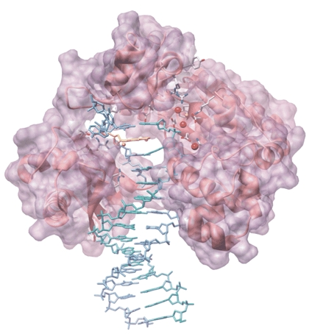
Thermo-cycling
Thermo:
  Thermo→ melt duplex DNA so the strands separate (templates)
  Cool the reaction quickly so the strands don’t re-form the duplex
  Stop at a temperature ~25C below the Tm
    Include some Mg++
Cycling: include buffer + salt, primers, nucleotides and a DNA polymerase
  Primers complement the region to be copied. They are at higher conc. than the template
  Start at a lower temperature to bind the primer and polymerase to the template
  Increase the temperature for the polymerase to work efficiently
  Raise to the melting temperature to separate the new strands.

Slide 5
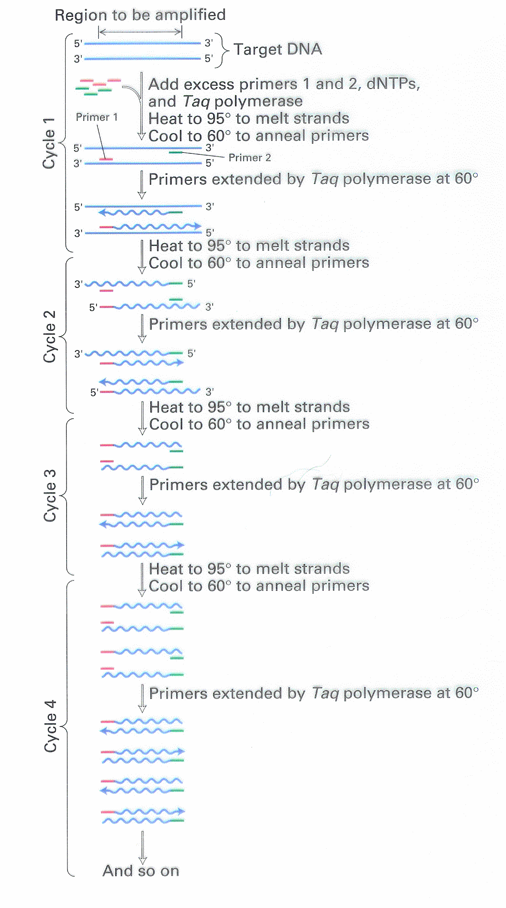

Slide 6
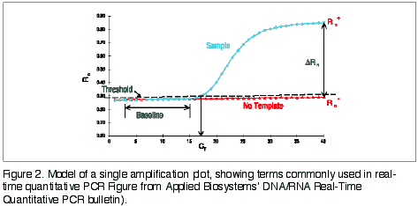
PCR yields
As product increases, primer and dNTPs are used up.
  The reaction saturates and no more product is made
  The amount of product depends on the amount of input template and the number of amplification cycles

Slide 7
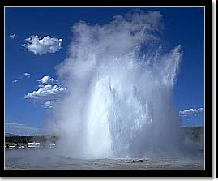
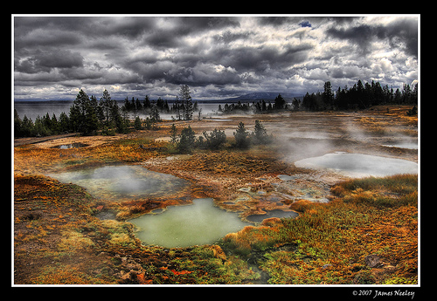
Taq – Moving from Khorana PCR to Mullis PCR
Thermus aquaticus : Great Fountain in the West Thumb Geyser Basin
  photos at Flickr, Russ Finley, James Neeley
The heat-stable polymerase:
  First one was from the microorganism Thermus aquaticus
  This allows the cycling part of the process to be a one-tube, one-step set-up procedure.
Notes:
(isolated
The organism and its enzymes are stable at close to 100C, so it survives the repeated rounds of heating.
from a hot spring mat in Yellowstone Park by Brock)

Slide 8
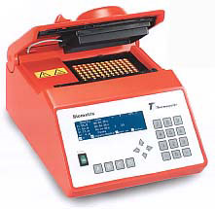
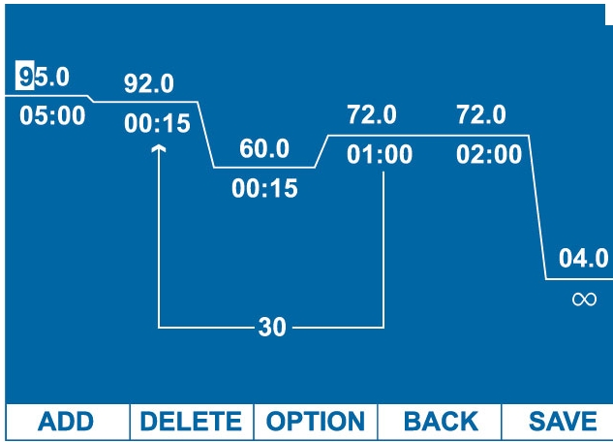
Thermocycler engineering – moving from Khorana PCR to Mullis PCR .
  A carefully engineered heating/cooling block
    Drilled holes enclose sample tubes; insulated lid for evaporation.
    Controlled rates of heating or cooling and holding temperature give reproducible results.
http://sentrabd.com/_borders/T1b.jpg

Slide 9
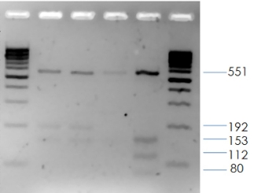
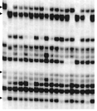
Classifying PCR Experiments
    Type I: target amplification of a known region of nucleic acid
      Sequence is known, primers are as specific as possible to the target region
      Either RNA or DNA may be the target (PCR vs RT-PCR)
      A quantitative and real-time assay may be performed
    Type II: to randomly amplify fragments given known primer(s) but unknown complement(s).
      A genome-wide fingerprinting approach
      Polymorphism rather than identity is sought

Slide 10
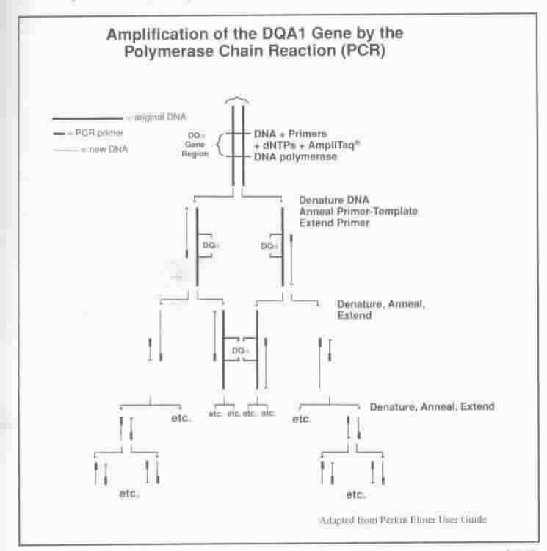
Type I: Gene-specific PCR Assay

Slide 11
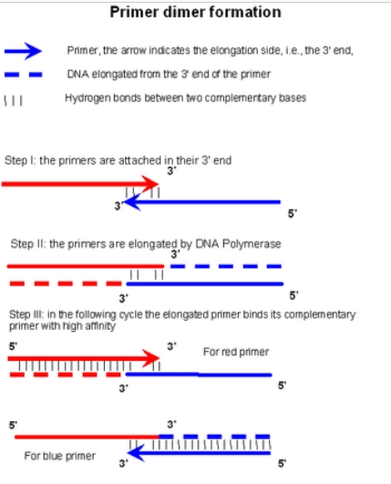
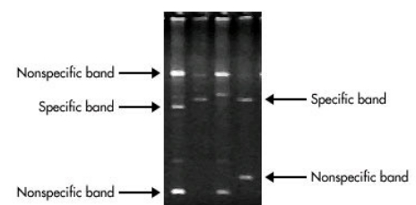
Single-locus PCR
Quality control:
Do you get only one product?
  Why would you not get one product?
Is the correct product made?
Is the yield in the expected range?
Wikipedia

Slide 12
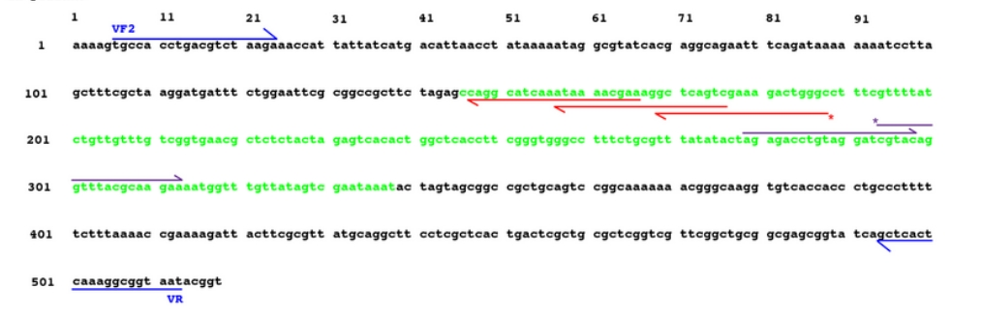
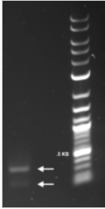

PCR QC
Did the primers amplify an unintended locus?
  Check 1: Is the length correct?
  If the length is correct: sequence or restrict the product

Slide 13
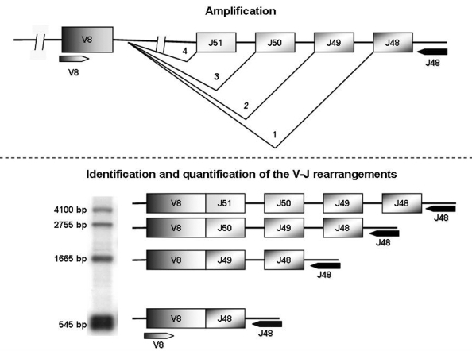
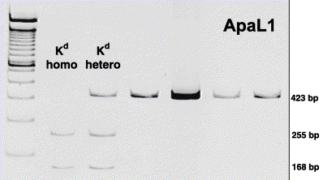
Product validation
Length ≠ Correct product.
  Why?
    Two alleles are naturally present, one longer/shorter than the reference
    A gene family is present
    There is a common motif in your primer
Notes:
Clone and sequence both fragments
Use a restriction endonuclease
Gel purify and sequence both fragments.

Slide 14
PCR and Next Generation Sequencing
PCR is used at 2 steps in NGS sample preparation:
Step 1: Specific genes /regions are amplified to ‘purify’ them from the rest of the genome (such as bar code regions)
  Specific PCR products are made
    The sequencing primer sites are added to the gene-specific primers (fusion amplicons)
    An extra bit of sequence gives a sample label (index), pool samples
  Randomly sheared pieces of DNA have known sequences added to the ends so PCR works
    The known ends include sequencing primers/indices
Step 2: use PCR to make more of the final targets so there is enough to get a good sequencing signal
  Ion Torrent libraries
  454 Libraries
  Illumina libraries

Slide 15
PCR assay design for a specific region
There must be a primer at each end of the desired region that is
  Unique to a single site in the genome,
  Primers are matched in forming stable duplexes within 2-3° of each other, aim for 55-72C.
    In practice this means they are usually 18-25nt long, but they don’t have to have the same length
  Primers should not have internal structure or bind to each other
In setting up the reaction, add enoughprimer and dNTPs for the amount of product you want – both are incorporated into the product
  Note: you won’t get more than 1ug/ml

Slide 16
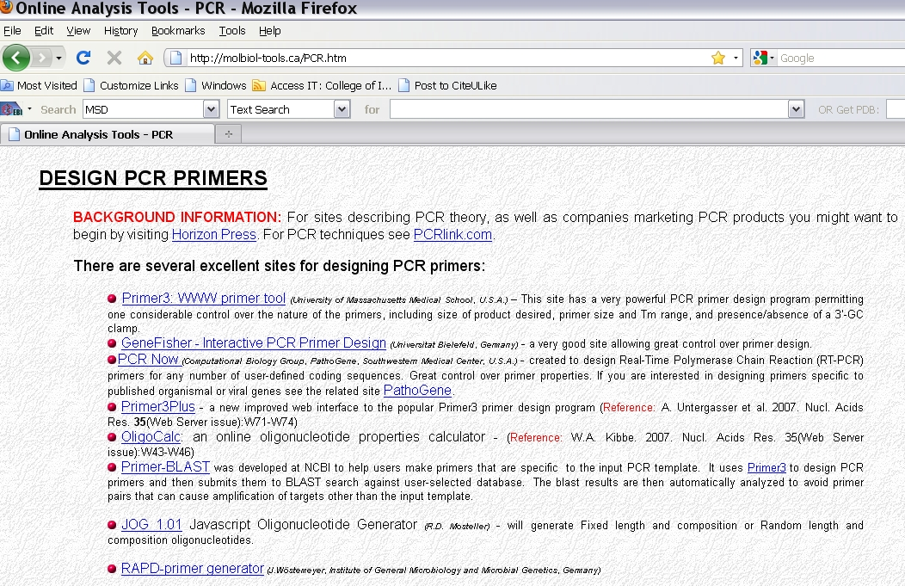

Slide 17
Primer3 Input
Filter out:
  Avoid sequence of low quality (‘N’s or Q-scores below 20)
  Trim sequences added to the ends to allow polymerase to bind, or sample indexing
  Remove simple repeats (e.g. ATATATATA).
  Avoid primers that partially match a different gene
Source Sequence
  The template sequence you want: the basis of the design
Sequence Id
  A label you provide, that identifies the output.

Slide 18
Primer 3 terms
Targets = Included Region – a region on the source that must be in the PCR product – the bar code region is only part of the rbcL gene.
  You can provide a (start, length) pair if several parts of a gene are OK, but not all of it.
    start is the count # of the first base of your input target string
    length is the final product length (units = nt).
Excluded Regions -A region that primer oligos may not overlap.
  You can also specify these with (start, length) pairs
  This is one way to leave out simple sequence repeats, for example

Slide 19
Primer 3 parameters
Product Size Range
  A list of product size ranges you are willing to accept
    E.g. 150-250 100-300 301-400
    You don’t get some of each: the first range is tried first, then the second and so on.
    It is possible to end up with nothing that matches all of your other criteria and you have to reset these.
Product Size
  Minimum, Optimum, and Maximum product lengths
  Primer3 will not generate primers with products shorter than Min or longer than Max
  It will attempt to pick primers producing products close to the Optimum length.

Slide 20
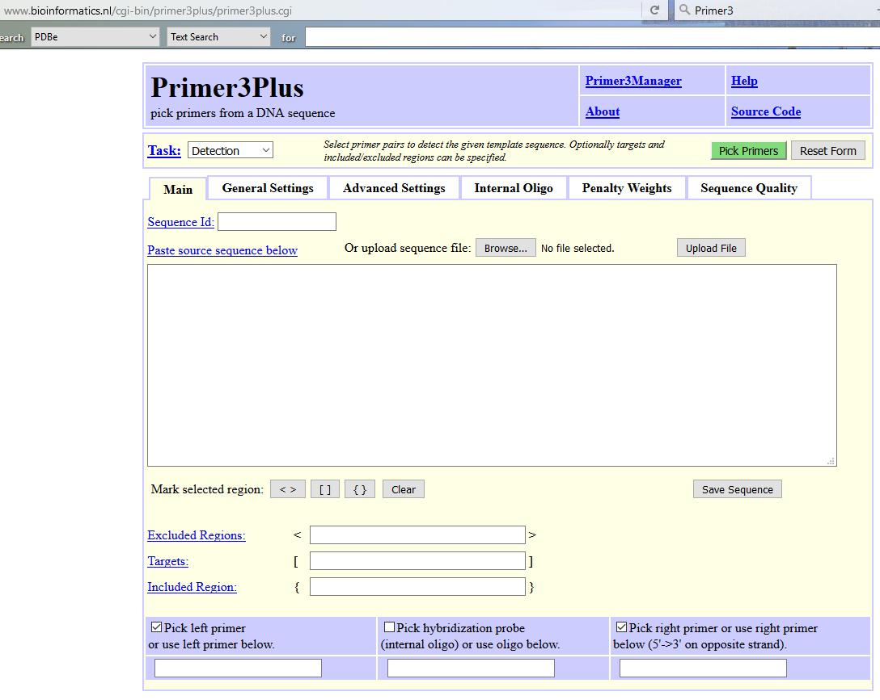
Example Primer design
To click along: http://www.bioinformatics.nl/cgi-bin/primer3plus/primer3plus.cgi and upload the file SARS_M_PCR.fasta

Slide 21
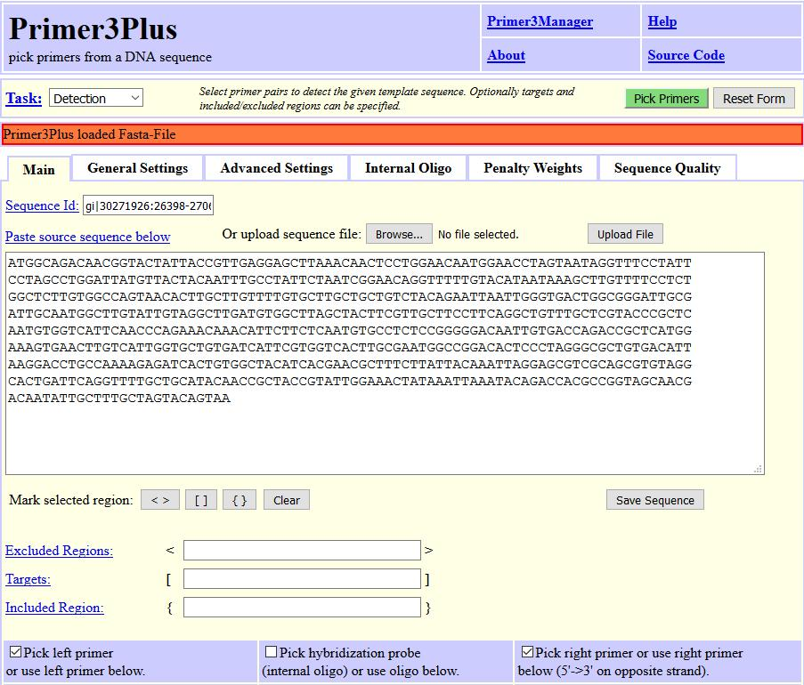

Slide 22
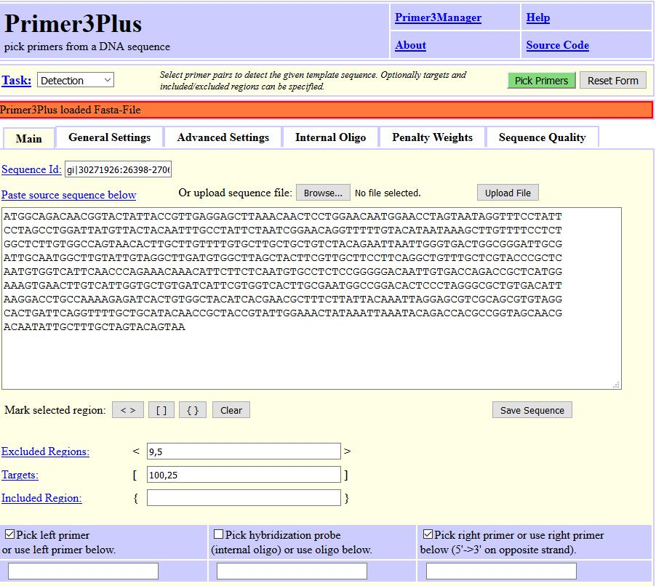
Primers may not include the nt from 9 to 14
Primers must surround the 25 bases from position 100 to 124
You could exclude low-quality or non-target sequence, 20, 400 would be start picking primers from position 20 through the next 400.

Slide 23
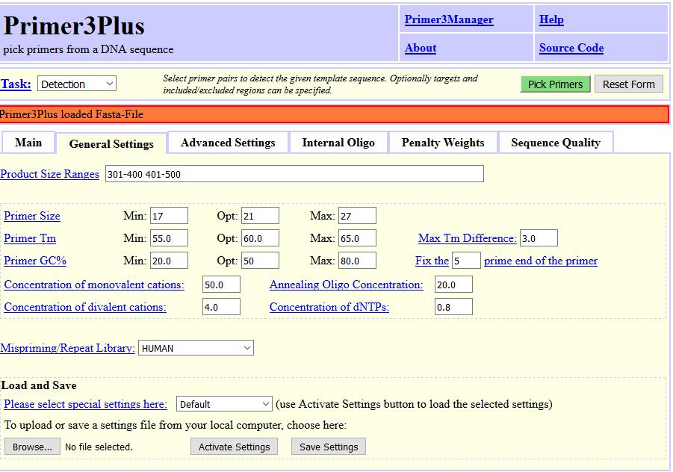

Slide 24
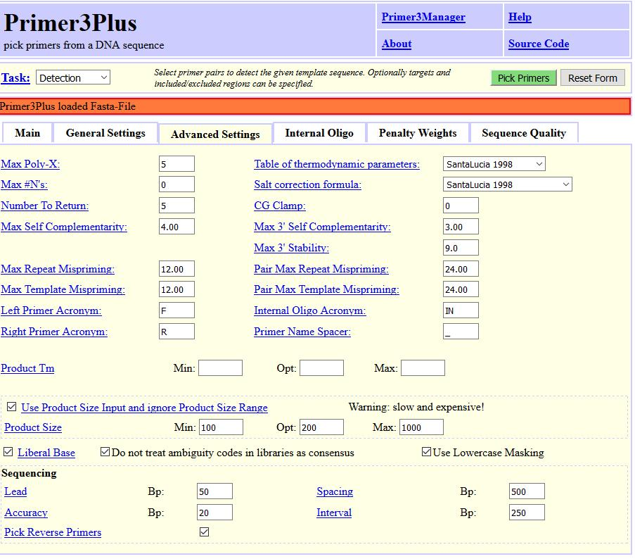

Slide 25

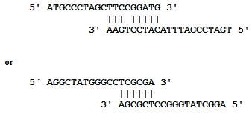

Self-Complementarity and Primer Complementarity Examples

Slide 26
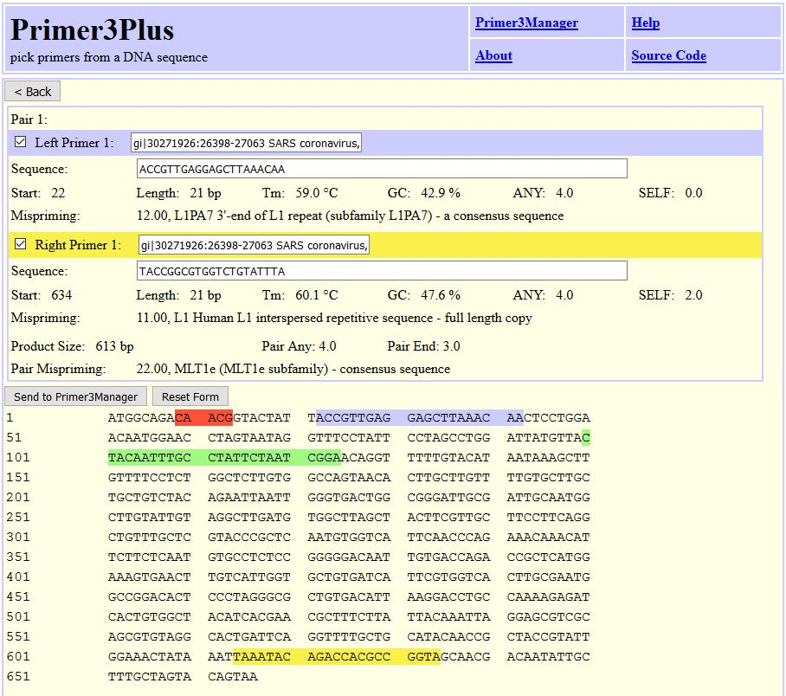

Slide 27
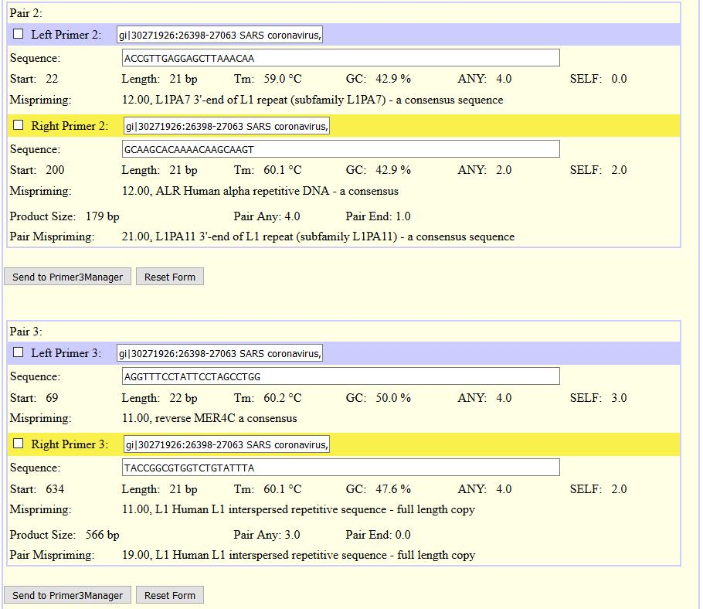

Slide 28
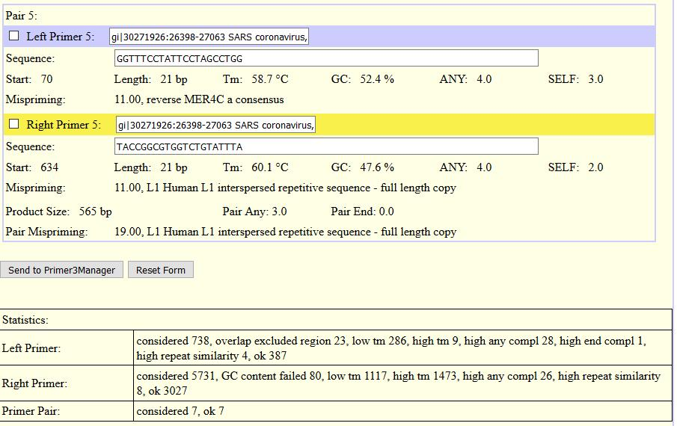

Slide 29
