Slide 1
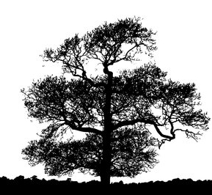
B3- Olympic High School Science Camp
Dr. Jennifer Weller
Summer 2013

Slide 2
Bioethics
What is ethics?
What is the difference between professional and personal ethics?
When might they be in conflict?
How do you learn to think about making ethical decisions?

Slide 3
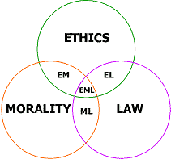
Definition of Ethics
“Ethics is the study of ethical behavior, that which is right vs. wrong.
Morality might be considered the distinction between good and evil – often implies intent rather than outcome alone.
Professional ethical behavior: ‘what are the written (and unwritten) rules of the profession’?
How does this differ from personal ethics?
From http://en.wikipedia.org/wiki/Ethics
Notes:
What are right and wrong? Good and evil? This doesn’t help you a lot.
Professional ethics are a kind of contract you get certain privileges as a member of a particular profession and in return you are required to follow the rules of that profession.
You agree to follow the rules in return for privileges. You don't have the right to ignore those rules that you don't agree with (besides which, people who think they are outside the rules usually end up deceiving themselves into serious trouble).
Professional ethics may expect you to do something contrary to your personal moral views, for example a lawyer who takes on defending a murderer is expected by professional ethics to do a good job even if s/he thinks the murderer deserved to be convicted. (Lawyers don't have to take a case, but somebody has to take the job of defending the murderer.). A pharmacist who disagrees with abortion measures the dose for RU84.

Slide 4
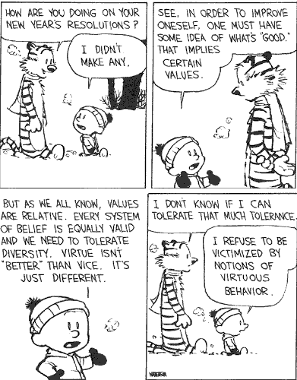
Ethical Relativism
No rules of behavior are universal for all cultures and circumstances.
But many cultures have converged on common principles.
Justice, the right to truth, compassion, respect, responsibility.
Limitations on who counts differs a lot.
Notes:
Morality of action must be determined by considering the action relative to time and culture in which it takes place.
Descriptive relativism notes that there are differences among cultures’ ethical practices and standards without saying anything about their justification.
Prescriptive relativism goes further and claims that people ought not to apply the standards of one culture to evaluating the behavior of another culture. This is usually called “cultural relativism.”
Humans tend to construct ideals that include concepts such as fairness, individual dignity, the right to the truth, compassion.
Universal vote meaning men only, white men only, white property-owning me only, etc.
Trustworthiness (truthfulness, sincerity, candor, loyalty, promise keeping, honesty)
Respect (autonomy, courtesy)
Responsibility (diligence, continuous improvement, self-restraint)
Justice (fairness, impartiality, equity)
Caring (kindness, compassion)

Slide 5
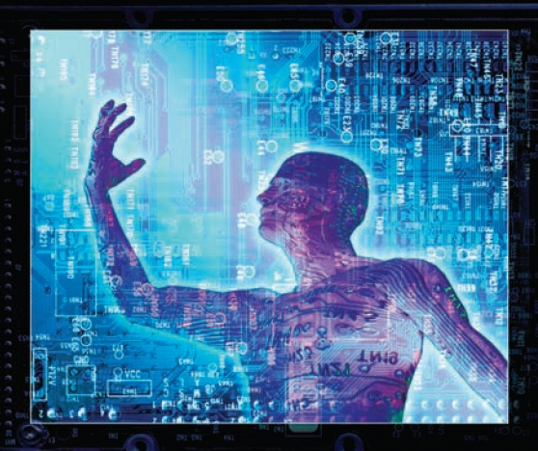
Why study ethics in a biotechnology setting?
Obtaining funding: formal training is required before granting agencies allocate money (e.g. NIH).
Consequences of lapses to profession
Scandals: the negative attention leads to condemning all of a group for the actions of one member.
Conflicts of Interest: as Universities emphasize ‘entrepreneurial activities’ out of research activities you increase the benefit for cheating.
Privacy: biomedical data has usually been considered personal and private when your MD has you tested.
Notes:
Biotechnology is used in fertility clinics – what type of selection is good? How much do we really know? Do we just cure disease, or conditions we consider defects? What is a defect? Sickle-cell anemia and Cystic fibrosis.
Biotechnology is going to be used to develop personalized medicine – we think of cancer drugs, but what about performance enhancing drugs?
Genomics produces whole-genome sequences and whole-expression panels – everything that can be known at the molecular level a given time. How might you use this? How might you MIS-use this? What are people’s expectations?
Bioinformatics adds knowledge to the genomic sequence. What specific gene do you have? With whom do you share it? What other patterns exist? How might you MIS-use this?

Slide 6
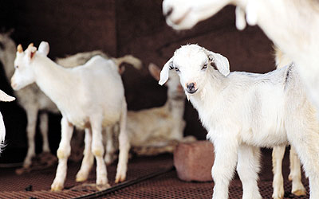
What are the consequences of our research?
Biotechnology allows animals to be used to improve human health
Treat disease, make organs, change nutrition of food
What happens to food safety? Animal welfare? Environmental diversity and safety?
Notes:
Biotech firms are developing transgenic animals to: provide organs for human transplantation, provide proteins for pharmaceutical and industrial production, limit environmental harm from agricultural practices, and improve production traits such as disease resistance.
there is extensive discussion about the appropriateness of changing an animal�s genetic makeup. It is unclear if consumers are prepared for the arrival of food products from cloned and transgenic animals. Although transgenic and cloning technologies could be accepted as just another technique food producers can use to improve the quality of food, consumer research suggests that public sentiment about animal and plant biotechnology is very different.

Slide 7
Professional Ethics
Do scientists have the same amount of responsibility to protect society or do they have extra responsibility because they have expert knowledge?
A consequence of having special knowledge is the Whistle Blower idea.
Is this an obligation?
Do we protect them? What if they were wrong?

Slide 8
Ethics: by Example or by Decree
Learning about ethics
Teachers, mentors, leaders should actively demonstrate ethical behavior.
Clearly state the rules for ethical conduct and their rationale, and limits. – Why?
Ethical issues arise from ignorance of standards, conflicting directions or fuzzy boundaries between principles.
Ignorance: release of data that allows someone else to invade another’s privacy
‘Do no harm’ versus maintaining a life that is full of pain
Admittance to schools based on merit alone versus overcoming years of deliberate inequality
Notes:
Providing explicit rules of ethical conduct and the reasons for their existence and the limits of their application ensures uniformity and universality.
A consideration of cases may provide one with the tools for making ethical decisions in ambiguous cases
You may intend no mis-use of data but by violating a standard you may make it possible for someone else to mis-use data.

Slide 9
Applying ethical theory
Do we judge intentions or actions?
How do you ascertain motivations?
Could bad consequences have been foreseen?
What if there are conflicting ethical obligations?
For example: what if scientists publish fraudulent data?
Reproducing results takes much longer
Credibility becomes low, so funding is much less
Technological and theoretical progress become very slow
Development of cures for diseases is overtaken by the rate at which they occur
Life enriching technologies emerge more slowly

Slide 10
Professional Codes of Ethics
A beginning discussion of the topic can be found at:
http://www.casanet.org/program-management/volunteer-manage/ethics-today.htm
Many professional groups have codes of ethics.
you may have to discriminate between individual ethics and the ethics, standards and policies of an organization or profession.
You may be asked to agree to that code as part of a licensing procedure or to join a society. The code should have:
Values: core beliefs that guide actions
Ethics: a particular code of values
Collective Standards: particular methods of practice
Code of Ethics: formal rules which govern behavior of a group
Policies: guidelines for behavior in particular situations
Notes:
Professionals should uphold a recognized code of ethics relating to the field of activity. All share some statements about the importance of
Maintaining a balanced approach
Avoiding conflicts of interest (including the perception of such conflicts)
Avoiding bias and the perceptions of bias
Resisting the degradation of ones work in the face of political and financial pressure.
There was recently a request in Congress to investigate allegations by the scientist involved in providing reports that the administration deliberately changed the wording of those reports to change the interpretation of the data:
see CNN at http://www.cnn.com/2007/POLITICS/01/30/congress.climate.ap/index.html?eref=rss_topstories

Slide 11
Bad Science vs Misconduct
Misconduct means actively unethical behavior.
Deliberate carelessness, misleading statements so you can’t identify and correct inaccurate results.
Why would someone do this?
‘Bad science’ usually does not mean unethical behavior.
Faulty assumptions and poor logic, methodological mistakes etc.

Slide 12
Fraud
Fraud is a specific legal term, so it is not usually used about unethical scientific behavior.
Fraud requires proof of all of the following conditions:
False representation has occurred
The presenter knew that the representation was false
A belief in the false data was promoted
Others did in fact believe the misrepresentation
Damage resulted from the misrepresentation

Slide 13
Scientific Misconduct (DHHS and NSF)
The general categories are simple and obvious. You should not
Fabricate: make up results completely
Falsify: tamper with results (careful selection of part of the data)
Plagiarize: present another’s words or ideas as your own.
Other serious deviations from accepted practices include
It is the responsibility of the individual and of certification groups of professionals to know what the accepted practices in their area of expertise are.
“ignorance of the law is no excuse”

Slide 14
Deviations from ethical standards
Misappropriation:
Plagiarism: using someone else’s ideas or words without giving them credit (or getting their permission)
Revealing information that is not your own so that others receive an unfair advantage.
Interference:
Take, hide or damage the research-related property of someone else.
Apparatus, materials, writings, data, software

Slide 15
Misrepresentation
Omit fact(s) so that when you analyze the subset you come up with a false result.
Global warming reports are a great example of this
Misrepresentation can get slippery:
In publications scientists are supposed to summarize data and results, so selection does occur – it has to be done properly but not everyone agrees about what is proper.
A new theory might be proposed that does not have a solid factual basis yet, but is valuable for suggesting new experiments.

Slide 16
Good Scientific Practice
You must be able to have contrasting hypotheses with tests you can perform (although you might need to build the equipment first)
Intelligent Design has been discredited by all knowledgeable scientists because of this requirement
You should suggest multiple ways to interpret data (some might conflict – more experiments would have to be done).
Explain any errors in recording devices or methods that might have affected the outcome.
Make all material, data and methods available to other scientists

